Slide 1

Unit-2 Exception Handling & Transaction Management
Database Management System – II (DBMS-II)
#2101CS302
Prof. Naimish R. Vadodariya
Computer Engineering Department
naimish.vadodariya@darshan.ac.in
8866215253

Slide 2

Looping
Outline
Exception Handling
Introduction
Types of Exceptions
THROW
RAISERROR
Transaction Management
Introduction
Modes of Transaction
Save Points in Transaction
Marked Transaction

Slide 3
Exception Handling
Section - 1

Slide 4
Introduction : Error/Exception Handling
An error condition during a program execution is called an exception and the mechanism for resolving such an exception is known as exception handling.
SQL Server provides TRY, CATCH blocks for exception handling.
We can put all T-SQL statements into a TRY BLOCK and the code for exception handling can be put into a CATCH block.
We can also generate user-defined errors using a THROW block.
Error handling in SQL Server gives us control over the Transact-SQL code.
For example, when things go wrong, we get a chance to do something about it and possibly make it right again.
In exception handling all T-SQL statements are put into a try block. If all statements execute without any error then everything is OK else control will go to the catch block.

Slide 5
Types of SQL Server Exceptions
SQL Server contains the following two types of exceptions:
System Defined
User Defined
System Defined Exception
In a System Defined Exception the exceptions (errors) are generated by the system.
User Defined Exception
This type of exception is user generated, not system generated.

Slide 6
System Defined Exception – Example | Divide by zero error
System Defined Exception
1
2
3
4
5
6
7
8
9
Declare @val1 int;
Declare @val2 int;
BEGIN TRY
Set @val1=8;
Set @val2=@val1/0; /* Error Occur Here */
END TRY
BEGIN CATCH
Print 'Error Occur that is:' + Error_Message()
END CATCH
O/P:
Error Occur that is: Divide by zero error encountered.

Slide 7
Handling Errors using TRY…CATCH
Here’s how the syntax looks like.
BEGIN TRY
--code to try
END TRY
BEGIN CATCH
--code to run if an error occurs is generated in try
END CATCH
Anything between the BEGIN TRY and END TRY is the code that we want to monitor for an error.
So, if an error would have happened inside this TRY statement, the control would have immediately get transferred to the CATCH statement and then it would have started executing code line by line.
Now, inside the CATCH statement, we can try to fix the error, report the error or even log the error, so we know when it happened, who did it by logging the username, all the useful stuff.

Slide 8
Nested TRY Block
BEGIN TRY
--- Statements that may cause exceptions
END TRY
BEGIN CATCH
-- Statements to handle exception
BEGIN TRY
--- Nested TRY block
END TRY
BEGIN CATCH
--- Nested CATCH block
END CATCH
END CATCH

Slide 9
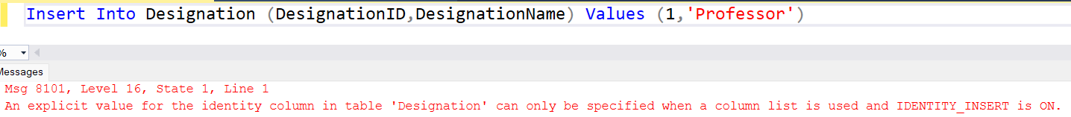
Error Functions in SQL
Error | Details
ERROR_NUMBER() | Returns the internal number of the error
ERROR_SEVERITY() | Returns the information about anything from informational errors to errors user of DBA can fix, etc. 13 - Indicates transaction deadlock errors. 14 - Indicates security-related errors, such as permission denied. 15 - Indicates syntax errors in the Transact-SQL command. 16 - Indicates general errors that can be corrected by the user.
ERROR_STATE() | Returns the information about the source
ERROR_LINE() | Returns the line number at which an error happened on
ERROR_MESSAGE() | Returns the most essential information and that is the message text of the error
ERROR_PROCEDURE() | Returns the name of the stored procedure or function

Slide 10
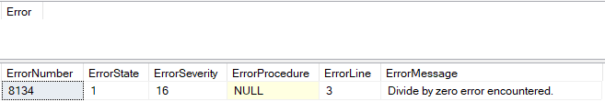
Example: Error Functions
Divide by Zero Exception
1
2
3
4
5
6
7
8
9
10
11
12
13
14
BEGIN TRY
-- Generate a divide-by-zero error
SELECT
1 / 0 AS Error;
END TRY
BEGIN CATCH
SELECT
ERROR_NUMBER() AS ErrorNumber,
ERROR_STATE() AS ErrorState,
ERROR_SEVERITY() AS ErrorSeverity,
ERROR_PROCEDURE() AS ErrorProcedure,
ERROR_LINE() AS ErrorLine,
ERROR_MESSAGE() AS ErrorMessage;
END CATCH;

Slide 11
Procedure with TRY…CATCH Example
Divide by Zero Exception in Stored Procedure
1
2
3
4
5
6
7
8
9
10
11
12
13
14
15
16
17
18
19
CREATE PROC PR_divide
@a decimal,
@b decimal,
@c decimal output
AS
BEGIN
BEGIN TRY
SET @c = @a / @b;
END TRY
BEGIN CATCH
SELECT
ERROR_NUMBER() AS ErrorNumber
,ERROR_SEVERITY() AS ErrorSeverity
,ERROR_STATE() AS ErrorState
,ERROR_PROCEDURE() AS ErrorProcedure
,ERROR_LINE() AS ErrorLine
,ERROR_MESSAGE() AS ErrorMessage;
END CATCH
END;
--Executing a procedure PR_divide
DECLARE @r decimal;
EXEC PR_divide 10, 2, @r output;
PRINT @r;
--Output
5
--Executing a procedure PR_divide
DECLARE @r decimal;
EXEC PR_divide 10, 0, @r output;
PRINT @r;

Slide 12
Stored Procedure – Exception Example
Handling Exception in Stored Procedure
1
2
3
4
5
6
7
8
9
10
11
CREATE PROCEDURE Sample_Proc
AS
BEGIN
BEGIN TRY
SELECT Salary + FirstName From Person Where WorkerID=101
END TRY
BEGIN CATCH
SELECT ERROR_PROCEDURE() AS ProcName;
SELECT ERROR_MESSAGE() AS Message;
END CATCH;
END
Execute Procedure : Exec Sample_Proc
O/P:
Sample_Proc | Error converting data type varchar to numeric.

Slide 13
Throw & RaiseError()
Section - 2

Slide 14
Throw
The THROW statement raises an exception and transfers execution to a CATCH block of a TRY...CATCH.
The following illustrates the syntax of the THROW statement:
Syntax
1
THROW error_number, message, state;
Parameters | Description
error_number | The error_number is an integer that represents the exception. The error_number must be greater than 50,000 and less than or equal to 2,147,483,647.
message | The message is a string of type NVARCHAR(2048) that describes the exception.
state | The state is a INT with the value between 0 and 255. The state indicates the state associated with the message.

Slide 15
Throw Cont..
If you don’t specify any parameter for the THROW statement, you must place the THROW statement inside a CATCH block:
THROW
1
2
3
4
5
6
7
BEGIN TRY
--statements that may cause an errors
END TRY
BEGIN CATCH
--statement to handle errors
THROW;
END CATCH

Slide 16
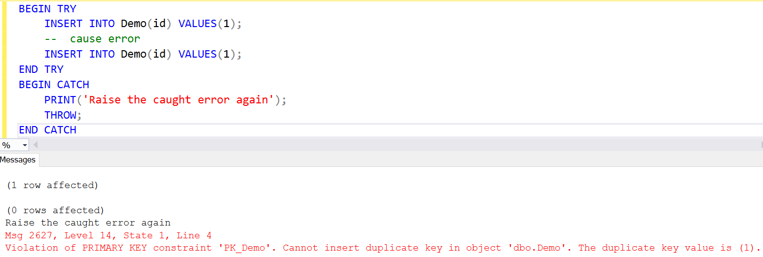
Using THROW statement to raise an Exception

Slide 17
Throw Example
Example of THROW
Output
1
2
3
4
5
6
7
8
9
10
11
12
13
14
15
16
17
18
19
20
21
CREATE PROCEDURE spDivideBy2
@No1 INT,
@No2 INT
AS
BEGIN
DECLARE @Result INT
SET @Result = 0
BEGIN TRY
IF @No2 = 1
THROW 50001,'DIVISOR CANNOT BE ONE', 1
ELSE
SET @Result = @No1 / @No2
PRINT 'THE RESULT IS: '+CAST(@Result AS VARCHAR)
END TRY
BEGIN CATCH
PRINT ERROR_NUMBER()
PRINT ERROR_MESSAGE()
PRINT ERROR_SEVERITY()
PRINT ERROR_STATE()
END CATCH
END
--Exec spDivideBy2 10,1
50001
DIVISOR CANNOT BE ONE
16 (The severity of the exception is always set to 16)
1
Error Number
Error Message
Error State
--Exec spDivideBy2 10,2
THE RESULT IS: 5

Slide 18
Throw Example
Example of THROW
Output
1
2
3
4
5
6
7
8
9
10
11
12
13
14
15
16
17
18
19
20
21
CREATE PROCEDURE spDivideBy2
@No1 INT,
@No2 INT
AS
BEGIN
DECLARE @Result INT
SET @Result = 0
BEGIN TRY
IF @No2 = 1
THROW 48000,'DIVISOR CANNOT BE ONE', 1
ELSE
SET @Result = @No1 / @No2
PRINT 'THE RESULT IS: '+CAST(@Result AS VARCHAR)
END TRY
BEGIN CATCH
PRINT ERROR_NUMBER()
PRINT ERROR_MESSAGE()
PRINT ERROR_SEVERITY()
PRINT ERROR_STATE()
END CATCH
END
--Exec spDivideBy2 10,1
35100
Error number 48000 in the THROW statement is outside the valid range. Specify an error number in the valid range of 50000 to 2147483647.
16
10
--Exec spDivideBy2 10,2
THE RESULT IS: 5

Slide 19
User Defined Exception – Example [Odd/Even Number]
User Defined Exception
1
2
3
4
5
6
7
8
9
10
11
12
13
14
15
16
Declare @val1 int;
Declare @val2 int;
BEGIN TRY
Set @val1=8;
Set @val2=@val1%2;
IF @val2=1
PRINT 'Error Occur'
ELSE
BEGIN
PRINT 'Error Not Occur';
Throw 60000,'Number Is Even',5
END
END TRY
BEGIN CATCH
Print 'Error Occur that is : ' + Error_Message()
END CATCH
O/P: (For Value 8)
Error Not Occur
Error Occur that is : Number Is Even
O/P: (For Value 3)
Error Occur

Slide 20
User Defined Exception – Example [Odd/Even Number]
User Defined Exception
1
2
3
4
5
6
7
8
9
10
11
12
13
14
15
16
Declare @val1 int;
Declare @val2 int;
BEGIN TRY
Set @val1=8;
Set @val2=@val1%2;
IF @val2=1
PRINT 'Error Occur'
ELSE
BEGIN
PRINT 'Error Not Occur';
Throw;
END
END TRY
BEGIN CATCH
Print 'Error Occur that is : ' + Error_Message()
END CATCH
Msg 10704, Level 15, State 1, Line 11
To rethrow an error, a THROW statement must be used inside a CATCH block. Insert the THROW statement inside a CATCH block, or add error parameters to the THROW statement.

Slide 21
Using THROW statement to raise an System Exception

Slide 22

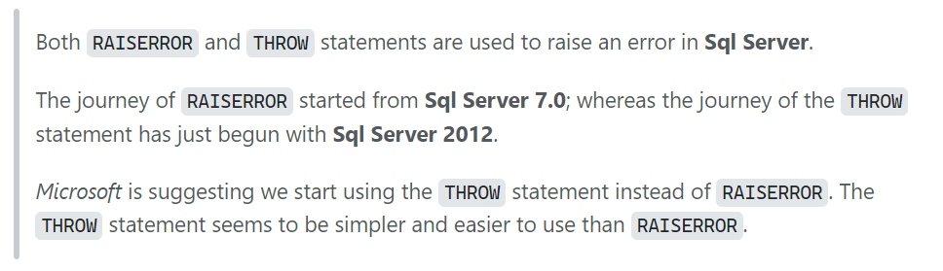
Information!!!

Slide 23
RAISERROR()
We use the RAISERROR inside a TRY block to cause execution to jump to the associated CATCH block.
Inside the CATCH block, we use the RAISERROR to return the error information that invoked the CATCH block.
Syntax
1
RAISERROR(Error Message, Severity, state);
RAISEERROR()
1
2
3
4
5
6
7
8
9
BEGIN TRY
RAISERROR('Error occurred in the TRY block.', 16, 1);
END TRY
BEGIN CATCH
SELECT
ERROR_MESSAGE(),
ERROR_SEVERITY(),
ERROR_STATE();
END CATCH;

Slide 24
RAISERROR() Example
RAISERROR
1
2
3
4
5
6
7
8
9
10
11
12
13
14
15
16
17
18
19
CREATE PROCEDURE spDivideBy1(@No1 INT, @No2 INT)
AS
BEGIN
DECLARE @Result INT
SET @Result = 0
BEGIN TRY
IF @No2 = 1
RAISERROR ('DIVISOR CANNOT BE ONE', 16, 1)
ELSE
SET @Result = @No1 / @No2
PRINT 'THE RESULT IS: '+CAST(@Result AS VARCHAR)
END TRY
BEGIN CATCH
PRINT ERROR_NUMBER()
PRINT ERROR_MESSAGE()
PRINT ERROR_SEVERITY()
PRINT ERROR_STATE()
END CATCH
END
--Exec spDivideBy1 10,1
50000
DIVISOR CANNOT BE ONE
16
1
--Exec spDivideBy1 10,2
THE RESULT IS: 5

Slide 25
Transaction Management
Section - 3

Slide 26
Example - Transaction
Suppose, we want to withdraw money from the ATM, the ATM application will achieve this operation in three steps.
As a first step, the application will check the balance of the account, and then it will deduct the money from the source account.
Along with these two processes, it will keep the log of this money withdrawing activity.
ATM Transaction Begins
ATM Transaction Reads the Balance of the account
ATM Transaction Updates the Balance of the account
Write modified data to the database
Rollback the data modification
Success
ATM Transaction Writes the withdraw operation into log table
Fail

Slide 27
Example - Transaction
Example of transaction:
Want to transfer Rs. 50 from Account-A to Account-B
Works as a single logical unit
read (A)
A = A – 50
write (A)
read (B)
B = B + 50
write (B)
Transaction
Operations

Slide 28
ACID properties of transaction
Section – 3.1

Slide 29
ACID properties of transaction
Atomicity (Either transaction execute 0% or 100%)
Consistency (Database must remain in a consistent state after any transaction)
Isolation [Separation] (Intermediate transaction results must be hidden from other concurrently executed transactions)
Durability (Once a transaction completed successfully, the changes it has made into the database should be permanent)

Slide 30
ACID properties of transaction (Atomicity)
This property states that a transaction must be treated as an atomic unit, that is, either all of its operations are executed or none.
Either transaction execute 0% or 100%.
For example, consider a transaction to transfer Rs. 50 from account A to account B.
In this transaction, if Rs. 50 is deducted from account A then it must be added to account B.
read (A)
A = A – 50
write (A)
read (B)
B = B + 50
write (B)
0%
FAIL
100%

Slide 31
ACID properties of transaction (Consistency)
The database must remain in a consistent state after any transaction.
If the database was in a consistent state before the execution of a transaction, it must remain consistent after the execution of the transaction as well.
In our example, total of A and B must remain same before and after the execution of transaction.
A=500, B=500
A+B=1000
read (A)
A = A – 50
write (A)
read (B)
B = B + 50
write (B)
A=450, B=550
A+B=1000

Slide 32



ACID properties of transaction (Isolation)
Changes occurring in a particular transaction will not be visible to any other transaction until it has been committed.
Intermediate transaction results must be hidden from other concurrently executed transactions.
In our example once our transaction starts from first step (step 1) its result should not be access by any other transaction until last step (step 6) is completed.
Start
Transaction
read (A)
A = A – 50
write (A)
read (B)
B = B + 50
write (B)

Slide 33
ACID properties of transaction (Durability)
After a transaction completes successfully, the changes it has made to the database persist (permanent), even if there are system failures.
Once our transaction completed up to last step (step 6) its result must be stored permanently. It should not be removed if system fails.
A=500, B=500
read (A)
A = A – 50
write (A)
read (B)
B = B + 50
write (B)
A=450, B=550
These values must be stored permanently in the database

Slide 34
Transaction State OR State Transition Diagram
Section – 3.2

Slide 35
Transaction State Diagram OR State Transition Diagram
When a transaction executes its final operation, it is said to be in a partially committed state.
read (A)
A = A – 50
write (A)
read (B)
B = B + 50
write (B)
Commit
The transaction enters in this state after successful completion of the transaction.
We cannot abort or rollback a committed transaction.
Aborted
Active
Partial
Committed
Committed
Active
Failed
FAIL
Active
End
Partial Committed
Committed
Failed
Aborted
This is the initial state.
The transaction stays in this state while it is executing.
Discover that normal execution can no longer proceed.
Once a transaction cannot be completed, any changes that it made must be undone rolling it back.
The state after the transaction has been rolled back and the database has been restored to its state prior to the start of the transaction.

Slide 36
Transaction State Diagram OR State Transition Diagram
Active
This is the initial state.
The transaction stays in this state while it is executing.
Partial Committed
When a transaction executes its final operation/ instruction, it is said to be in a partially committed state.
Failed
Discover that normal execution can no longer proceed.
Once a transaction cannot be completed, any changes that it made must be undone rolling it back.
Committed
The transaction enters in this state after successful completion of the transaction (after committing transaction).
We cannot abort or rollback a committed transaction.
Aborted
The state after the transaction has been rolled back and the database has been restored to its state prior to the start of the transaction.

Slide 37
Introduction : Transactions
Section – 3.3

Slide 38
Introduction : Transaction
A transaction is a single unit of work.
A transaction is the logical work unit that performs a single activity or multiple activities in a database.
Transactions may consist of a single read, write, delete, or update operations or a combination of these.
If a transaction is successful, all of the data modifications made during the transaction are committed and become a permanent part of the database.
If a transaction encounters errors and must be canceled or rolled back, then all of the data modifications are erased.
The main idea of transactions is that when each of the statements returns an error, the entire modifications rollback to provide data integrity.
On the other hand, if all statements are completed successfully the data modifications will become permanent on the database.

Slide 39
Transaction Steps
Begins the Transaction
Process database Commands
Check for Errors
Yes
Rollback the Transaction
No
Commit the Transaction

Slide 40
Modes of Transactions
Section – 3.4

Slide 41
Modes of Transaction
SQL Server operates in the following transaction modes:
Autocommit transaction
Each individual statement is a transaction.
Autocommit mode is the default transaction mode for the SQL Server.
In this mode, each T-SQL statement is evaluated as a transaction and they are committed or rolled back according to their results.
Implicit transaction
A new transaction for every DML statement is implicitly started when the prior transaction completes, but each transaction is explicitly completed with a COMMIT or ROLLBACK statement.
Explicit transaction
Each transaction is explicitly started with the BEGIN TRANSACTION statement and explicitly ended with a COMMIT or ROLLBACK statement.
It provides to define a transaction exactly with the starting and ending points of the transaction.

Slide 42
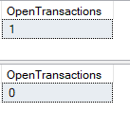
1. Implicit Transaction
In order to define an implicit transaction, we need to enable the IMPLICIT_TRANSACTIONS option.
The following query illustrates an example of an implicit transaction.
@@TRANCOUNT function returns the number of BEGIN TRANSACTION statements in the current session and we can use this function to count the open local transaction numbers
Implicit Transaction
1
2
3
4
5
6
7
8
9
SET IMPLICIT_TRANSACTIONS ON
UPDATE Person SET Lastname = 'Patel', Firstname ='Naimish’
WHERE WorkerID = 101
SELECT
@@TRANCOUNT AS OpenTransactions
COMMIT TRAN
SELECT
@@TRANCOUNT AS OpenTransactions
The COMMIT TRANSACTION statement applies the data changes to the database and the changed data will become permanent.

Slide 43
2. Explicit Transaction
In order to define an explicit transaction, we start to use the BEGIN TRANSACTION command because this statement identifies the starting point of the explicit transaction.
It has the following syntax:
BEGIN TRANSACTION [ {transaction_name | @tran_name_variable }
[WITH MARK ['description’]]]
transaction_name option is used to assign a specific name to transactions
@trans_var option is a user-defined variable that is used to hold the transaction name
WITH MARK option enable to mark a particular transaction in the log file.

Slide 44
2. Explicit Transaction Cont..
After defining an explicit transaction through the BEGIN TRANSACTION command, the related resources acquired a lock depending on the isolation level of the transaction.
For this reason as possible to use the shortest transaction will help to reduce lock issues.
The following statement starts a transaction and then it will change the name of a particular row in the Person table.
As we stated in the previous section COMMIT TRAN statement applies the data changes to the database and the changed data will become permanent. Now let’s complete the open transaction with a COMMIT TRAN statement.
Explicit Transaction
1
2
3
4
5
6
7
BEGIN TRAN
UPDATE Person
SET Lastname = 'Patel', Firstname= 'Naimish'
WHERE WorkerID = 101
SELECT @@TRANCOUNT AS OpenTransactions
COMMIT TRAN
SELECT @@TRANCOUNT AS OpenTransactions

Slide 45
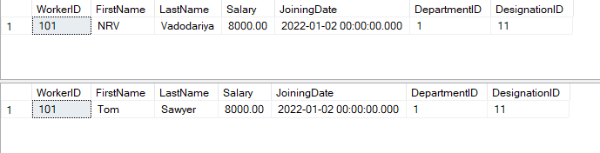
2. Explicit Transaction Cont..
On the other hand, the ROLLBACK TRANSACTION statement helps in undoing all data modifications that are applied by the transaction.
In the following example, we will change a particular row but this data modification will not persist.
Explicit Transaction with Rollback
1
2
3
4
5
6
7
BEGIN TRAN
UPDATE Person SET Lastname = 'Vadodariya',
Firstname = 'NRV’
WHERE WorkerID=101
SELECT * FROM Person WHERE WorkerID=101
ROLLBACK TRAN
SELECT * FROM Person WHERE WorkerID=101

Slide 46
Save Points in Transactions
Section – 3.5

Slide 47
Why Save Points?
SQL Server save points are used to roll back transactions to a specified point.
In the other words, this lets you roll back part of the transaction instead of the entire transaction.
So, if we are rolling back transactions to a specific savepoint, only statements after the savepoint and before the rollback command will be rolled back.
To define a save point in a transaction we use the SAVE TRANSACTION syntax and then we give a name to the save point.

Slide 48
Save Points in Transaction
Savepoints can be useful when it is necessary to roll back part of a SQL Server transaction.
To set a savepoint within a transaction, the SAVE TRANSACTION <savepoint_name> command is used, SAVE TRAN <savepoint_name> syntax is also acceptable.
The <savepoint_name> can be an identifier with a maximum of 32 characters.
It can also be a user-defined variable with a char, varchar, nchar, nnvarchar data type and must contain a name conforming to the rules of identifiers.

Slide 49
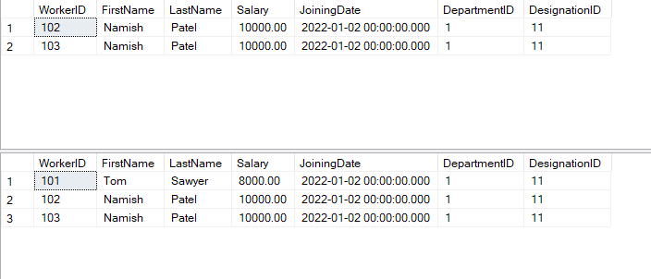
Save Points in Transaction Cont..
Save Point
1
2
3
4
5
6
7
8
BEGIN TRAN
INSERT INTO Person VALUES(103,'Namish','Patel',10000,'2022-01-02',1,11)
SAVE TRANSACTION InsertStatement
DELETE Person WHERE WorkerID=101
SELECT * FROM Person
ROLLBACK TRANSACTION InsertStatement
COMMIT
SELECT * FROM Person

Slide 50
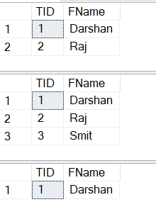
Save Points in Transaction [Without Rollback Tran Name]
Save Point without Rollback Tran Name
1
2
3
4
5
6
7
8
9
BEGIN TRANSACTION
INSERT INTO TestTable(TID,FName) VALUES (2, 'Raj')
SELECT * FROM TestTable
SAVE TRANSACTION FirstInsert
INSERT INTO TestTable(TID,FName) VALUES (3, 'Smit')
SELECT * FROM TestTable
ROLLBACK TRANSACTION
COMMIT
SELECT * FROM TestTable

Slide 51

Save Points in Transaction Cont..
Save Point
1
2
3
4
5
6
7
8
9
10
11
12
BEGIN TRANSACTION
INSERT INTO TestTable(TID,FName) VALUES (1, 'Darshan')
-- This will create a savepoint after the first INSERT
SAVE TRANSACTION FirstInsert
INSERT INTO TestTable(TID,FName) VALUES (2, 'Raj')
-- This will rollback to the savepoint right after the first INSERT was done
ROLLBACK TRANSACTION FirstInsert
-- This will commit the transaction leaving just the first INSERT
COMMIT
SELECT * FROM TestTable

Slide 52

Save Point Name using a Variable
Save Point Name Using a Variable
1
2
3
4
5
6
7
8
9
10
11
12
13
14
15
DECLARE @svpSecondInsert NVARCHAR(50) = 'SecondInsert'
BEGIN TRANSACTION
INSERT INTO TestTable(TID, FName) VALUES (1, 'Darshan')
-- This will create a savepoint after the first INSERT
SAVE TRANSACTION FirstInsert
INSERT INTO TestTable(TID, FName) VALUES (2, 'Raj')
-------------------------------------------------------------
-- This will create a savepoint after the second INSERT
SAVE TRANSACTION @svpSecondInsert
INSERT INTO TestTable(TID, FName) VALUES (3, 'Smit')
-- Can also use ROLLBACK TRANSACTION SecondInsert
ROLLBACK TRANSACTION @svpSecondInsert
-------------------------------------------------------------
COMMIT
SELECT * FROM TestTable

Slide 53
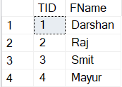
Save Points with Same Name
Save Point with Same Name
1
2
3
4
5
6
7
8
9
10
11
12
13
BEGIN TRAN
INSERT INTO TestTable(TID, FName) VALUES (1, 'Darshan')
SAVE TRANSACTION DataInsert
INSERT INTO TestTable(TID, FName) VALUES (2, 'Raj')
SAVE TRANSACTION DataInsert
INSERT INTO TestTable(TID, FName) VALUES (3, 'Smit')
SAVE TRANSACTION DataInsert
INSERT INTO TestTable(TID, FName) VALUES (4, 'Mayur')
COMMIT
SELECT * FROM TestTable

Slide 54
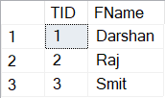
Save Points with Same Name Cont..
Save Point with Same Name
1
2
3
4
5
6
7
8
9
10
11
12
13
14
BEGIN TRAN
INSERT INTO TestTable(TID, FName) VALUES (1, 'Darshan')
SAVE TRANSACTION DataInsert
INSERT INTO TestTable(TID, FName) VALUES (2, 'Raj')
SAVE TRANSACTION DataInsert
INSERT INTO TestTable(TID, FName) VALUES (3, 'Smit')
SAVE TRANSACTION DataInsert
INSERT INTO TestTable(TID, FName) VALUES (4, 'Mayur')
ROLLBACK TRANSACTION DataInsert
COMMIT
SELECT * FROM TestTable

Slide 55
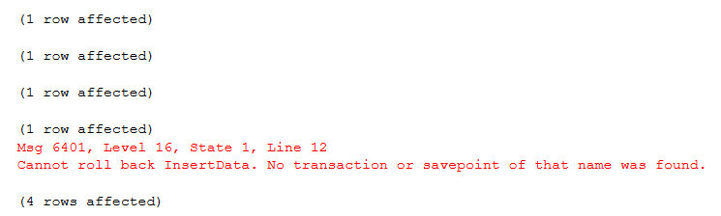
Save Point with Mismatch Name in Roll Back
Save Point with Same Name
1
2
3
4
5
6
7
8
9
10
11
12
13
14
BEGIN TRAN
INSERT INTO TestTable(TID, FName) VALUES (1, 'Darshan')
SAVE TRANSACTION DataInsert
INSERT INTO TestTable(TID, FName) VALUES (2, 'Raj')
SAVE TRANSACTION DataInsert
INSERT INTO TestTable(TID, FName) VALUES (3, 'Smit')
SAVE TRANSACTION DataInsert
INSERT INTO TestTable(TID, FName) VALUES (4, 'Mayur')
ROLLBACK TRANSACTION InsertData
COMMIT
SELECT * FROM TestTable

Slide 56
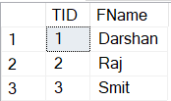
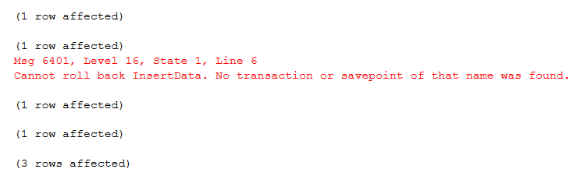
Save Point with Mismatch Name in Roll Back Cont..
Save Point with Same Name
1
2
3
4
5
6
7
8
9
10
11
12
13
14
15
BEGIN TRAN
INSERT INTO TestTable(TID, FName) VALUES (1, 'Darshan')
SAVE TRANSACTION DataInsert
INSERT INTO TestTable(TID, FName) VALUES (2, 'Raj')
ROLLBACK TRANSACTION InsertData
SAVE TRANSACTION DataInsert
INSERT INTO TestTable(TID, FName) VALUES (3, 'Smit')
SAVE TRANSACTION InsertData
INSERT INTO TestTable(TID, FName) VALUES (4, 'Mayur')
ROLLBACK TRANSACTION InsertData
COMMIT
SELECT * FROM TestTable

Slide 57
Auto Rollback Transaction
Generally, the transactions include more than one query.
So, if one of the SQL statements returns an error all modifications are erased or reversed, and the remaining statements are not executed.
This process is called Auto Rollback Transaction in SQL.
Auto Rollback Transaction
1
2
3
4
5
BEGIN TRANSACTION
INSERT INTO TestTable(TID,FName) VALUES ('Darshan', 'University')
UPDATE TestTable Set FName = 'DU' Where TID = 1
COMMIT
SELECT * FROM TestTable

Slide 58
Marked Transaction
A feature of SQL Server is the ability to assign a name and a description to a transaction.
The name of the transaction is recorded in the transaction log, and the transaction is called a marked transaction.
The syntax is BEGIN TRANSACTION TransactionName WITH MARK 'TransactionDescription' (the description is optional).
Marked transactions for all databases on the instance are also recorded in the dbo.logmarkhistory table in the MSDB database.
Why Marked Transactions?
One of the reasons to use marked transactions is to be able to restore a set of related databases.
Simplify recovery and minimize potential data loss when deploying database schema or data changes, i.e. during a release.

Slide 59
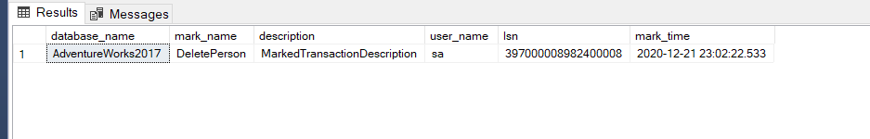
Marked Transaction Cont..
The logmarkhistory table stores details about each marked transactions that have been committed and it is placed in the msdb database.
Marked Transaction
1
2
3
4
BEGIN TRAN DeletePerson WITH MARK 'MarkedTransactionDescription’
DELETE Person WHERE PersonID BETWEEN 3 AND 4
COMMIT TRAN DeletePerson
SELECT * FROM dbo.logmarkhistory

Slide 60

Database Management System - II (DBMS-II)
2101CS302
Prof. Naimish R. Vadodariya
Computer Science & Engineering Department
Naimish.vadodariya@darshan.ac.in
8866215253

