Slide 1

Unit-5 Advanced MongoDB Concepts
Database Management System – II (DBMS-II)
#2101CS302
Prof. Firoz A. Sherasiya
Computer Science and Engineering Department
firoz.sherasiya@darshan.ac.in
9879879861

Slide 2

Looping
Outline
Aggregation
Indexes
Regex
Schema Validation
Embedded Documents
Transactions
Time series
BASE Theorem
CAP Theorem
Backup and Recovery
Create user & add role in MongoDB
Replication and Sharding
Cursor

Slide 3
Aggregation
Section - 1

Slide 4
Aggregation [RDBMS: aggregate]
Aggregation operations group values from multiple documents together, and can perform a variety of operations on the grouped data to return a single result.
In SQL count(*) and with group by is an equivalent of MongoDB aggregation.
For the aggregation in MongoDB, you should use aggregate() method.
One of the most common use cases of aggregation is to calculate aggregate values for groups of documents.
Aggregation is a way of processing a large number of documents in a collection by means of passing them through different stages.
The stages make up what is known as a pipeline.
The stages in a pipeline can filter, sort, group, reshape and modify documents that pass through the pipeline.

Slide 5
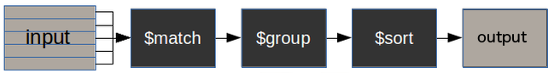
How does the MongoDB aggregation pipeline work?
collectionName – is the name of a collection,
pipeline – is an array that contains the aggregation stages
options – optional parameters for the aggregation
$match stage – filters those documents we need to work with, those that fit our needs
$group stage – does the aggregation job
$sort stage – sorts the resulting documents the way we require (ascending or descending)
Syntax
pipeline
db.collectionName.aggregate(pipeline, options)
[
{ $match : { … } },
{ $group : { … } },
{ $sort : { … } }
]

Slide 6
Aggregation example [RDBMS: aggregate]
Count number of employee in emp collection.
Count department wise number of employees in a emp collection.
Display distinct values from the Dept field.
emp
Example
{_id : 1, FirstName : "Neha", Dept : “CE”,
Salary: 10000},
{_id : 2, FirstName : "Milan", Dept : “IT”,
Salary: 15000 },
{_id : 3, FirstName : "Sohan", Dept : “CE”,
Salary: 12000 },
{_id : 4, FirstName : "Nehal", Dept : “CE”,
Salary: 14000},
{_id : 5, FirstName : "Mitesh", Dept : “IT”,
Salary: 17000},
{_id : 6, FirstName : “Ashok", Dept : “EC”,
Salary: 19000}
db.emp.find().count()
Example
db.emp.aggregate([
{$group:{_id:"$Dept", qty:{$sum:1}}} ])
Example
db.emp.aggregate([
{"$group":{_id:"$Dept"}} ])

Slide 7
Aggregation example [RDBMS: aggregate]
Count number of employees in CE department from emp collection.
Count department wise number of employees in a emp collection and display departments having more than one employee.
emp
{_id : 1, FirstName : "Neha", Dept : “CE”,
Salary: 10000},
{_id : 2, FirstName : "Milan", Dept : “IT”,
Salary: 15000 },
{_id : 3, FirstName : "Sohan", Dept : “CE”,
Salary: 12000 },
{_id : 4, FirstName : "Nehal", Dept : “CE”,
Salary: 14000},
{_id : 5, FirstName : "Mitesh", Dept : “IT”,
Salary: 17000},
{_id : 6, FirstName : “Ashok", Dept : “EC”,
Salary: 19000}
Example
db.emp.aggregate([
{$match: { Dept: "CE" } },
{$group:{_id:"$Dept", count: {$sum: 1}}} ])
Example
db.emp.aggregate([
{"$group":{_id:"$Dept", qty:{$sum:1}}},
{$match: { qty: {$gt: 1} } }])

Slide 8
Aggregation example [RDBMS: aggregate]
Count department wise number of employees in a emp collection and sort the output on number of employee in ascending order.
emp
{_id : 1, FirstName : "Neha", Dept : “CE”,
Salary: 10000},
{_id : 2, FirstName : "Milan", Dept : “IT”,
Salary: 15000 },
{_id : 3, FirstName : "Sohan", Dept : “CE”,
Salary: 12000 },
{_id : 4, FirstName : "Nehal", Dept : “CE”,
Salary: 14000},
{_id : 5, FirstName : "Mitesh", Dept : “IT”,
Salary: 17000},
{_id : 6, FirstName : “Ashok", Dept : “EC”,
Salary: 19000}
Example
db.emp.aggregate([
{"$group":{_id:"$Dept", qty:{$sum:1}}},
{$sort: { qty : 1}} ])

Slide 9
Indexes
Section - 2

Slide 10
Indexes [RDBMS: index]
Indexes support the efficient resolution of queries.
Without indexes, MongoDB must scan every document of a collection to select those documents that match the query statement.
This scan is highly inefficient and require MongoDB to process a large volume of data.
Indexes are special data structures, that store a small portion of the data set in an easy-to-traverse form.
The index stores the value of a specific field or set of fields, ordered by the value of the field as specified in the index.
Here key is the name of the field on which you want to create index and 1 is for ascending order.
To create index in descending order you need to use -1.
Syntax
db.collectionName.createIndex({KEY:1})

Slide 11
Indexes [RDBMS: index]
Create an index on “FirstName” on emp collection.
Retrieves all the indexes in the collection emp.
Drop an index created on “FirstName” from emp collection.
emp
Example
{_id : 1, FirstName : "Neha", Dept : “CE”,
Joiningdate: 2023-07-10T05:31:14.168Z},
{_id : 2, FirstName : "Milan", Dept : “IT”,
Joiningdate: 2023-07-10T05:31:14.168Z },
{_id : 3, FirstName : "Sohan", Dept : “CE”,
Joiningdate: 2023-07-10T05:31:14.168Z },
{_id : 4, FirstName : "Nehal", Dept : “CE”,
Joiningdate: 2023-07-10T05:31:14.168Z},
{_id : 5, FirstName : "Mitesh", Dept : “IT”,
Joiningdate: 2023-07-10T05:31:14.168Z },
{_id : 6, FirstName : “Ashok", Dept : “EC”,
Joiningdate: 2023-07-10T05:31:14.168Z }
db.emp.createIndex({FirstName: 1})
Example
db.emp.getIndexes()
Example
db.emp.dropIndex({FirstName: 1})

Slide 12
Regex
Section - 3

Slide 13
Regex [RDBMS: like]
MongoDB provides the functionality to search a pattern in a string during a query by writing a regular expression.
A regular expression is a generalized way to match patterns with sequences of characters.
In MongoDB, we can do pattern matching in two different ways:
With $regex operator
Without $regex operator

Slide 14
$regex [RDBMS: like]
This operator is used to search for the given string in the specified collection.
In MongoDB, the following <options> are available for use with regular expression:
i: To match both lower case and upper case pattern in the string.
m: To include ^ and $ in the pattern in the match i.e. to specifically search for ^ and $ inside the string. Without this option, these anchors match at the beginning or end of the string.
x: To ignore all white space characters in the $regex pattern.
s: To allow the dot character “.” to match all characters including newline characters.
Syntax
db.collectionName.find({field_name: { $regex: /pattern/, $options: '<options>' } })

Slide 15
$regex [RDBMS: like]
Displaying details of employee who are having the word developer in their position field.
Displaying details of employee who are a software engineer with case insensitive by using i <options>.
Displaying details of the employee whose name starts with ‘B’.
emp
{
name: "Tony",
position: "Backend developer"
}
{
name: "Bruce",
position: "frontend developer"
}
{
name: "Nick",
position: "HR Manager“
}
{
name: “Jimmy",
position: “backend developer"
}
Example
db.emp.find({position : {$regex : "developer"}})
Example
db.emp.find({position:{$regex:"software",$options:"i"}})
Example
db.emp.find({name:{$regex:"^B"}})

Slide 16
$regex [RDBMS: like]
Displaying details of the employee whose name ends with ‘e’.
Displaying details of the employee whose name starts with ‘B’ and ends with ‘e’.
Displaying details of the employee whose name have ‘r’ is second character.
emp
{
name: "Tony",
position: "Backend developer"
}
{
name: "Bruce",
position: "frontend developer"
}
{
name: "Nick",
position: "HR Manager“
}
{
name: “Jimmy",
position: “backend developer"
}
Example
db.emp.find({name : {$regex : “e$"}})
Example
db.emp.find({$and:[ {name:{$regex: "^B" }}, {name:{$regex: “e$"}}]})
Example
db.emp.find({ name: { $regex: "^.r" } })

Slide 17
$regex [RDBMS: like]
Displaying details of the employee whose name consist of c character at any place.
Displaying details of the employee whose name does not starts with B.
emp
{
name: "Tony",
position: "Backend developer"
}
{
name: "Bruce",
position: "frontend developer"
}
{
name: "Nick",
position: "HR Manager“
}
{
name: “Jimmy",
position: “backend developer"
}
Example
db.emp.find({name : {$regex : “c"}})
Example
db.emp.find({name: {$not: {$regex:"^B"}}})

Slide 18
Schema validation
Section - 4

Slide 19
Schema validation [RDBMS: validation]
Syntax
Example
We can assign a JSON Schema validator when we create a collection.
In the above syntax “collection_name” is the name of the collection to which you want to assign the validator document and the validator option assigns a specified JSON Schema document as the collection’s validator.
Applying a JSON Schema validator from the start like this means every document you add to the collection must satisfy the requirements set by the validator.
db.createCollection(
"collection_name", {
validator: {
$jsonSchema: {JSON_Schema_document}
}
})
db.createCollection("emp", {
validator: {
$jsonSchema: {
bsonType: "object",
required: [ "eid", "ename" ],
properties: {
eid: {bsonType: "int"},
ename: {bsonType: "string"},
city: {bsonType: "string"}
}}}})

Slide 20
Schema validation [RDBMS: validation]
Syntax
Example
The JSON schema document you pass to the validator attribute should outline every validation rule you want to apply to the collection.
The root part of the JSON Schema document (the fields before properties, which in this case are bsonType, description, and required) describes the database document itself.
The bsonType property describes the data type that the validation engine will expect to find.
In MongoDB, every document is an object.
db.createCollection(
"collection_name", {
validator: {
$jsonSchema: {JSON_Schema_document}
}
})
db.createCollection("emp", {
validator: {
$jsonSchema: {
bsonType: "object",
required: [ "eid", "ename" ],
properties: {
eid: {bsonType: "int"},
ename: {bsonType: "string"},
city: {bsonType: "string"}
}}}})

Slide 21
Embedded or Nested Document
Section - 5

Slide 22
Embedded or Nested Document
Embedded document or nested documents are those types of documents which contain a document inside another document.
Or in other words, when a collection has a document, this document contains another document, another document contains another sub-document, and so on, then such types of documents are known as embedded/nested documents.
Notes –
In MongoDB, you can only nest document up to 100 levels.
The overall document size must not exceed 16 MB.

Slide 23
Creating Embedded Documents
In MongoDB, we can easily embed a document inside another document.
As we know that in the mongo shell, documents are represented using curly braces ( {} ) and inside these curly braces we have field-value pairs.
Now inside these fields, we can embed another document using curly braces {} and this document may contain field-value pairs or another sub-document.
Query on Embedded/Nested Documents
Syntax
Example
{
....
field: {field1: value1, field2: value2}
....
}
db.student.insertOne({
Name: {Fname:'Raj’, Lname:'Mehta’},
City:'Rajkot'})
Example
db.student.find({"Name.Fname": ‘Raj'})

Slide 24
Transaction
Section - 6

Slide 25
Transaction
A transaction is a sequence of database operations that will only succeed if every operation within the transaction has been executed correctly.
In MongoDB, an operation on a single document is atomic.
Because you can use embedded documents and arrays to capture relationships between data in a single document structure instead of normalizing across multiple documents and collections, this single-document atomicity obviates the need for multi-document transactions for many practical use cases.
For situations that require atomicity of reads and writes to multiple documents (in a single or multiple collections), MongoDB supports multi-document transactions.

Slide 26
Time series
Section - 7

Slide 27
Time series
Time series data are measurements taken at time intervals from one or more sources.
Time series data is any data that is collected over time and is uniquely identified by one or more unchanging parameters. The unchanging parameters that identify your time series data is generally your data source's metadata.
Time series data is generated everywhere from social media to stock tickers to IoT devices.
Analyzing time series data enables organizations to detect, prevent, and predict events ahead of their competition. But where should the ever-increasing volume of time series data be stored? And how can it be analyzed?
Time series data is generally composed of these components:
Time when the data point was recorded.
Metadata (sometimes referred to as source), which is a label or tag that uniquely identifies a series and rarely changes.
Measurements (sometimes referred to as metrics or values), which are the data points tracked at increments in time. Generally these are key-value pairs that change over time.

Slide 28
BASE Theorem
Section - 8

Slide 29
BASE Theorem
BASE stands for Basically Available, Soft State, and Eventual Consistency.
Basically Available
This property refers to the fact that the database system should always be available to respond to user requests even in the event of failure.
Rather than enforcing immediate consistency, BASE-modelled NoSQL databases will ensure availability of data by spreading and replicating it across the nodes of the database cluster.
Soft State
This property refers to the fact that the state of the database can change over time, even without any explicit user intervention.
This can happen due to the effects of background processes, updates to data, and other factors.
The database should be designed to handle this change gracefully, and ensure that it does not lead to data corruption or loss.
Eventual Consistency
The fact that BASE does not obligates immediate consistency but it does not mean that it never achieves it.
The system will eventually become consistent once it stops receiving input.

Slide 30
BASE Theorem
Where BASE Databases can be used?
BASE databases are used in modern, highly-available, and scalable systems that handle large amounts of data.
Examples of such systems include online shopping websites, social media platforms, and cloud-based services.

Slide 31
CAP Theorem
Section - 9

Slide 32
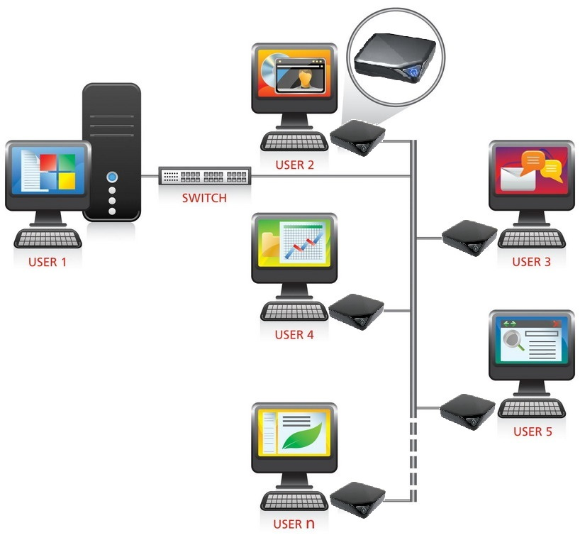
CAP Theorem
CAP stands for Consistency, Availability and Partition Tolerance.
Consistency means, when we consider a single time frame, every client should read the same data.
To achieve this, when a certain client update data, the updates should be instantly forwarded to all the nodes.
Other than that, partially corrupted transactions won’t save.
This means, if a client couldn’t complete a transaction successfully, it won’t be saved and will be rolled-back.
emp
{_id : 1, Name : "Neha",
Dept : “CE”,
Salary: 25000}
emp
{_id : 1, Name : "Neha", Dept : “CE”,
Salary: 25000}

Slide 33
CAP Theorem
CAP stands for Consistency, Availability and Partition Tolerance.
Availability means the system must remain operational all the time.
Even if some nodes are down, the rest of the nodes must respond to the requests in a reasonable amount of time.
Partition tolerance means, when a part of the network gets compromised and some nodes become unreachable, the whole system must continue its work properly and should take necessary measurements to recover as quickly as possible.
emp
{_id : 1, Name : "Neha",
Dept : “CE”,
Salary: 25000}
emp
The CAP theorem states that a distributed system can provide only two of three desired properties: consistency, availability, and partition tolerance.
{_id : 1, Name : "Neha", Dept : “CE”,
Salary: 25000}

Slide 34
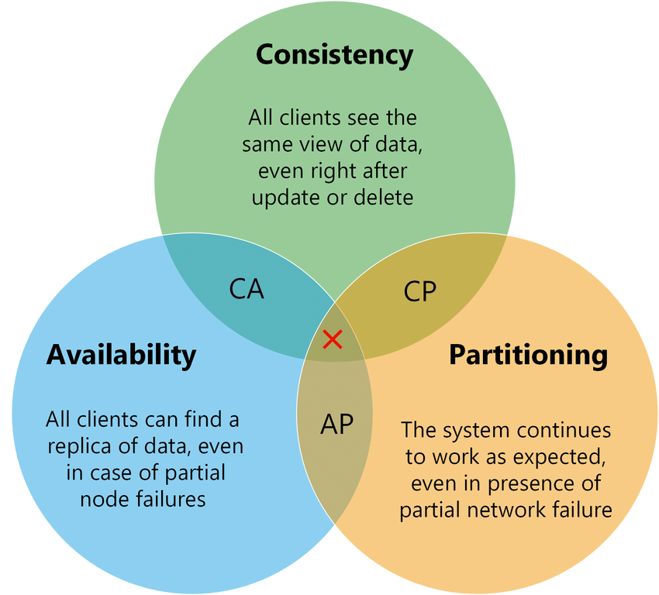
CAP Theorem
The CAP theorem states that a distributed system can provide only two of three desired properties: consistency, availability, and partition tolerance.

Slide 35
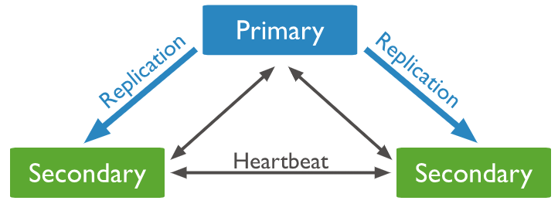
CAP Theorem | CP with MongoDB
MongoDB is a NoSQL database that stores data in one or more Primary nodes in the form of JSON files.
Each Primary node has multiple replica sets that update themselves asynchronously using the operation log file of their respective primary node.
The replica set nodes in the system send a heartbeat (ping) to every other node to keep track if other replicas or primary nodes are alive or dead.
If no heartbeat is received within 10 seconds, then that node is marked as inaccessible.

Slide 36
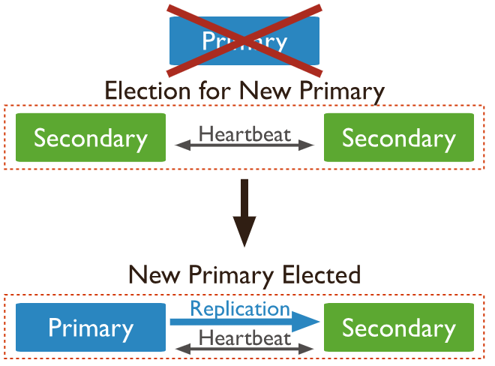
CAP Theorem | CP with MongoDB
If a Primary node becomes inaccessible, then one of the secondary nodes needs to become the primary node.
Till a new primary is elected from amongst the secondary nodes, the system remains unavailable to the user to make any new write query.
Therefore, the MongoDB system behaves as a Consistent system and compromises on Availability during a partition.

Slide 37
CAP Theorem | CP with MongoDB
Mongodb never allows write to secondary.
It allows optional reads from secondary but not writes.
So if your primary goes down, you can't write till a secondary becomes primary again.
That is how, you sacrifice High Availability in CAP theorem. By keeping your reads only from primary you can have strong consistency.
In mongoDB due to replica system continuing to operate even if a network partition or failure interrupts communication between some members.

Slide 38
Backup and recovery
Section - 10

Slide 39
Backup and recovery
Download MongoDB Command Line Database Tools. The mongodump tool is part of the MongoDB Database Tools package.
In MongoDB, mongodump tool is used to take the data backup.
It simply dumps all the data stored into a dump directory of MongoDB.
Backed-up data is in BSON format also known as BSON data dumps.
By default, the backup is stored in mongodb’s bin\dump folder to specify a different output directory we can use the –out option.
Mongodump is used in two ways with or without argument.
Without argument syntax is mongodump
With argument syntax is mongodump --db databaseName --collection collectionName --out c:\backup

Slide 40
Backup and recovery
In MongoDB, mongorestore utility is used to restore the backup data.
It restores the binary backup created by mongodump utility(i.e., BSON data dumps).
It can restore either an entire database backup or a subset of the backup.
It also restores the indexes which are created for any collection inside that database.
By default, mongorestore looks for a database backup in mongodb’s bin\dump folder which is also the default folder for mongodump command for dumping the backup.
To restore all the database syntax is mongorestore dump
To restore a specific collection syntax is mongorestore --db databaseName --collection collectionName directory\collectionName.bson

Slide 41
Create User & add Role in MongoDB
Section - 11

Slide 42
Create user & add role in MongoDB
In MongoDB, we are allowed to create new users for the database.
Every MongoDB user only accesses the data that is required for their role.
A role in MongoDB grants privileges to perform some set of operations on a given resource.
In MongoDB, users are created using createUser() method.
This method creates a new user for the database, if the specified user is already present in the database then this method will return an error.
Syntax
Example
db.createUser(
{ user: “username",
pwd: “password",
roles:[
{role: “roles" ,
db:“database"}]})
db.createUser(
{ user: "firoz",
pwd: "baba",
roles:[
{role: "read" ,
db:"test"}]})

Slide 43
List the user & drop/delete user
To list all users, use mongosh to query the system.users collection.
To remove a user from a MongoDB database use dropUser method.
Syntax
Syntax
use admin
db.system.users.find()
show users
Example
db.dropUser(“username”)

Slide 44
Replication and Sharding
Section - 12

Slide 45
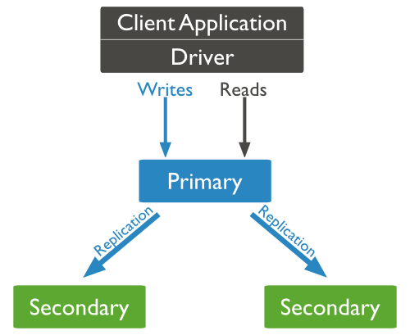
Replication
Replication is the process of synchronizing data across multiple servers.
Replication provides redundancy and increases data availability with multiple copies of data on different database servers.
Replication protects a database from the loss of a single server.
Why Replication?
To keep your data safe
High (24*7) availability of data
Disaster recovery
No downtime for maintenance (like backups, index rebuilds, compaction)
Read scaling (extra copies to read from)
Replica set is transparent to the application

Slide 46
How Replication Works in MongoDB?
MongoDB achieves replication by the use of replica set.
A replica set is a group of mongod instances that host the same data set.
In a replica, one node is primary node that receives all write operations.
All other instances, such as secondaries, apply operations from the primary so that they have the same data set.
Replica set can have only one primary node.
Replica set is a group of two or more nodes (generally minimum 3 nodes are required).
In a replica set, one node is primary node and remaining nodes are secondary.
All data replicates from primary to secondary node.
At the time of automatic failover or maintenance, election establishes for primary and a new primary node is elected.
After the recovery of failed node, it again join the replica set and works as a secondary node.

Slide 47
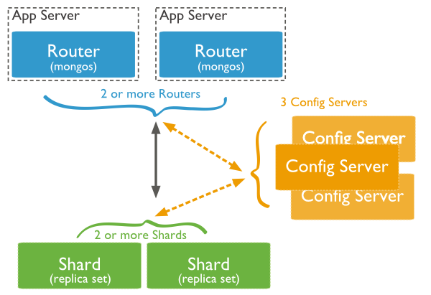
Sharding
Sharding is the process of storing data records across multiple machines and it is MongoDB's approach to meeting the demands of data growth.
As the size of the data increases, a single machine may not be sufficient to store the data nor provide an acceptable read and write throughput.
Sharding solves the problem with horizontal scaling.
With sharding, you add more machines to support data growth and the demands of read and write operations.

Slide 48
Why Sharding?
Sharding adds more server to a data field automatically adjust data loads across various servers.
The number of operations each shard manage got reduced.
It also increases the write capacity by splitting the write load over multiple instances.
It gives high availability due to the deployment of replica servers for shard and config.
Total capacity will get increased by adding multiple shards.

Slide 49
Sharding
Shards − Shards are used to store data. They provide high availability and data consistency.
In production environment, each shard is a separate replica set.
Config Servers − Config servers store the cluster's metadata. This data contains a mapping of the cluster's data set to the shards.
The query router uses this metadata to target operations to specific shards.
In production environment, sharded clusters have exactly 3 config servers.

Slide 50
Sharding
Query Routers − Query routers are basically mongo instances, interface with client applications and direct operations to the appropriate shard.
The query router processes and targets the operations to shards and then returns results to the clients.
A sharded cluster can contain more than one query router to divide the client request load. A client sends requests to one query router. Generally, a sharded cluster have many query routers.

Slide 51
Cursor
Section - 13

Slide 52
Cursor
In MongoDB, when the find() method is used to find the documents present in the given collection, then this method returned a pointer which will points to the documents of the collection, now this pointer is known as cursor.
Or in other words we can say that a cursor is a pointer, and using this pointer we can access the document.
By default, cursor iterate automatically, but you can iterate a cursor manually.
The following example gets the cursor object and assign it to a variable.
To display the content of a cursor.
Syntax
Example
var cursor_name = db.collection_name.find()
var emp = db.employees.find()
Syntax
Example
cursor_name
emp

Slide 53
Cursor
cursor.next() returns the next document from the result set.
cursor.forEach() iterates the cursor to apply a JavaScript function to each document from the cursor.
Example
emp.next()
Example
emp.(forEach(printjson))

Slide 54
Database Management System - II (DBMS-II)
2101CS302
Prof. Firoz A. Sherasiya
Computer Science and Engineering Department
firoz.sherasiya@darshan.ac.in
9879879861

