Slide 1
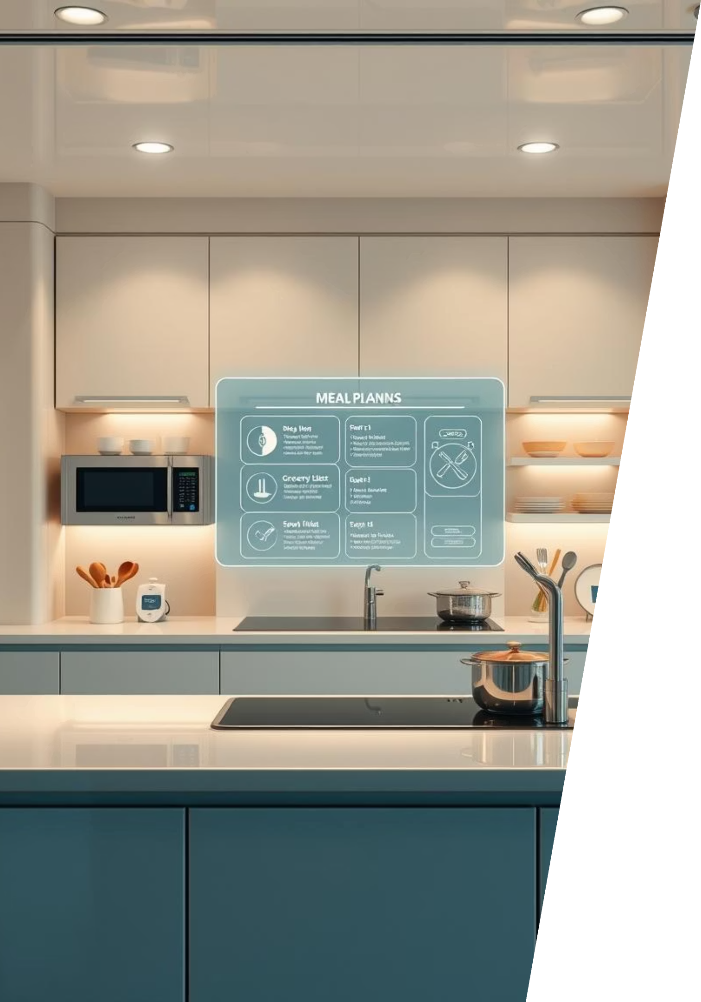


GrocyGo: AI-Powered Smart Grocery & Meal Planning
Revolutionising home kitchens and reducing food waste through intelligent planning.
Pritkumar Vekariya
22SE02IE059
B.Tech (ITE)

Slide 2
Solving Everyday Grocery Challenges
Most households grapple with common grocery challenges: forgetting existing inventory, purchasing duplicate items, and the pervasive issue of food waste. GrocyGo emerges as an AI-driven SaaS solution, seamlessly connecting a user's home inventory with a powerful recipe suggestion engine and smart shopping list generator.
Overbuying
Food Wastage
Time Loss
Lack of real-time awareness of current stock leads to unnecessary purchases.
Ingredients expire or remain unused due to inefficient meal planning.
Manual meal planning and shopping list creation consume valuable time.

Slide 3
GrocyGo's Core Features
Our platform is designed to provide a comprehensive solution for modern meal planning and grocery management, focusing on efficiency and user experience.
Intuitive Web Application
1
A modern UI/UX ensures a seamless and engaging user experience across all features.
AI Recipe Recommendations
2
Intelligent suggestions based on your available ingredients, minimising waste.
AI Shopping List Generation
3
Automatically creates smart lists for missing ingredients, streamlining your trips.
Real-Time Inventory Sync
4
Firebase integration keeps your home inventory constantly updated and accessible.
Robust Backend Infrastructure
5
Node.js handles API communication and integrates seamlessly with ML models.

Slide 4
The GrocyGo Methodology
Our approach combines robust data management with advanced machine learning to deliver precise and helpful culinary recommendations.
1
Data Collection
2
Inventory Integration
8,000+ recipe dataset with names, ingredients, time, images, and links
Fetch user inventory from Firebase
3
ML Model
4
Frontend
Match available ingredients to recipes
React.js and Flutter (landing page, dashboard, recipe page)
Suggest recipes even if some ingredients are missing
Generate missing ingredient shopping lists
5
Backend
6
UI Design
Node.js + Python FastAPI for ML
Futuristic and clean with illustrations for engagement
This systematic methodology ensures accuracy, efficiency, and a truly smart user experience from inventory to plate.

Slide 5
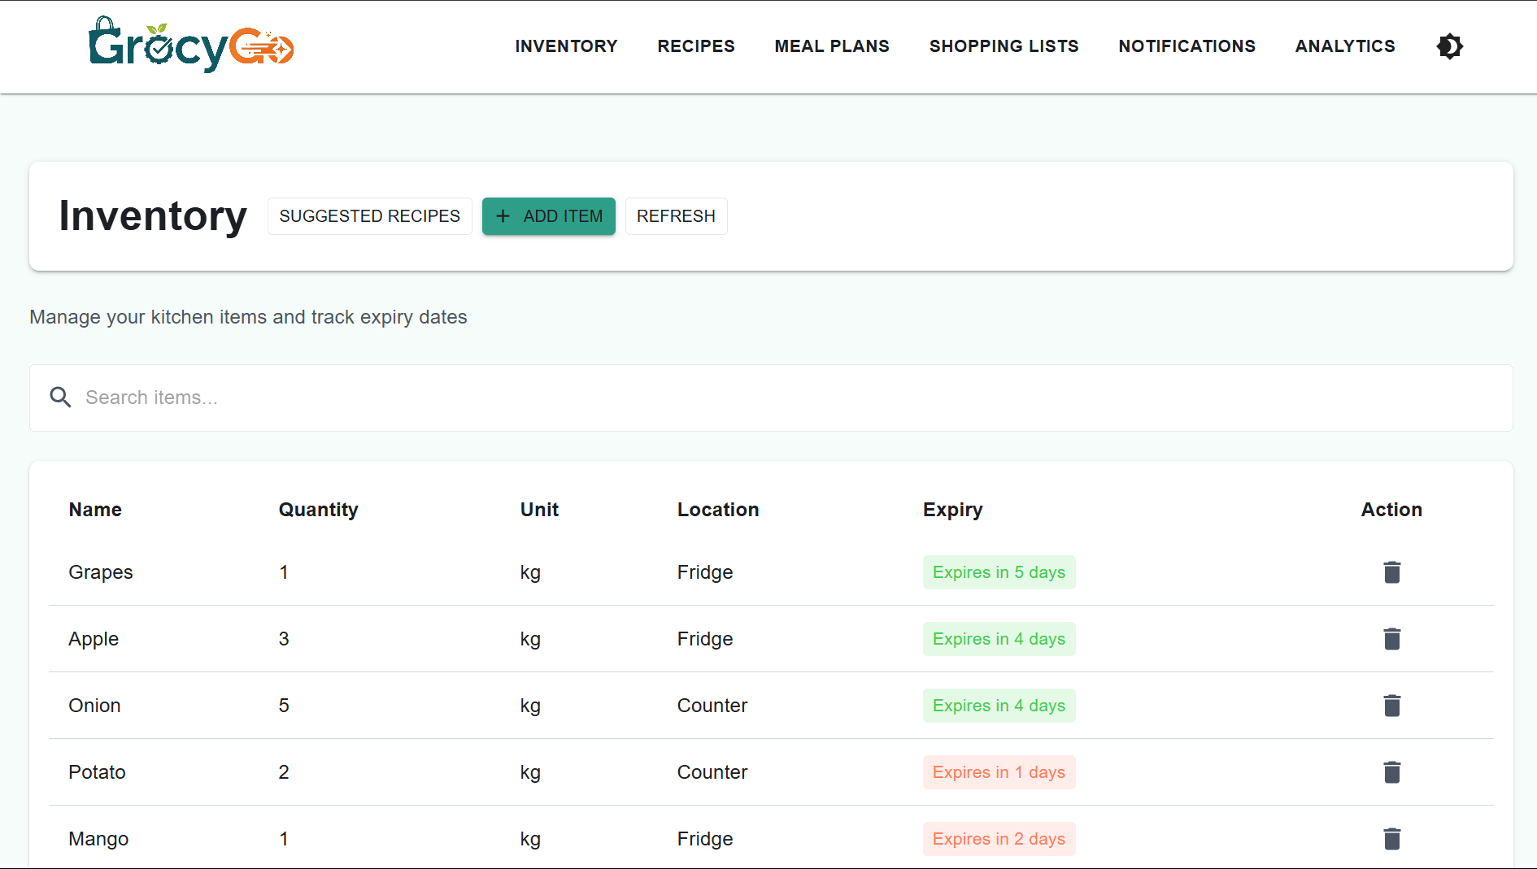
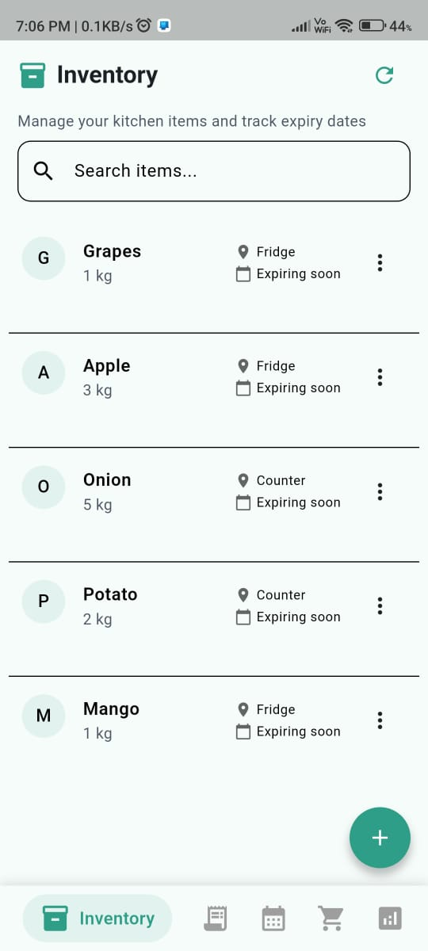
Evidence in Action
Visual and functional proof of our progress, showcasing key features and backend operations.

Slide 6
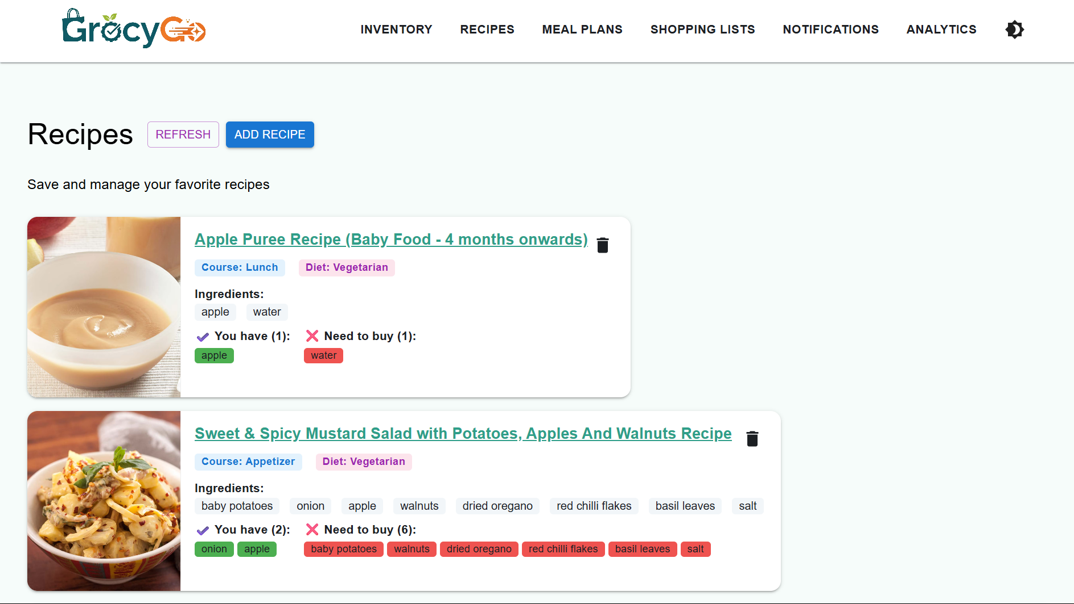
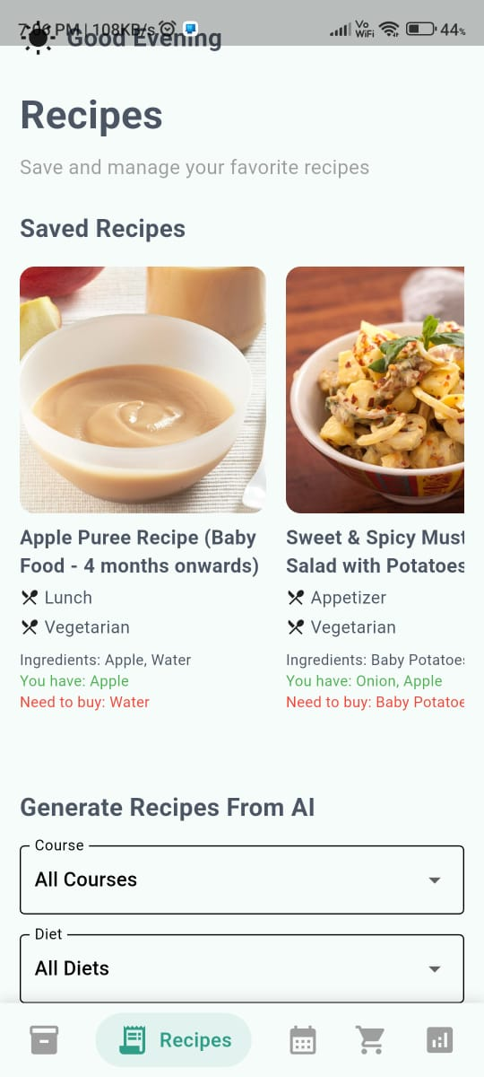

Slide 7
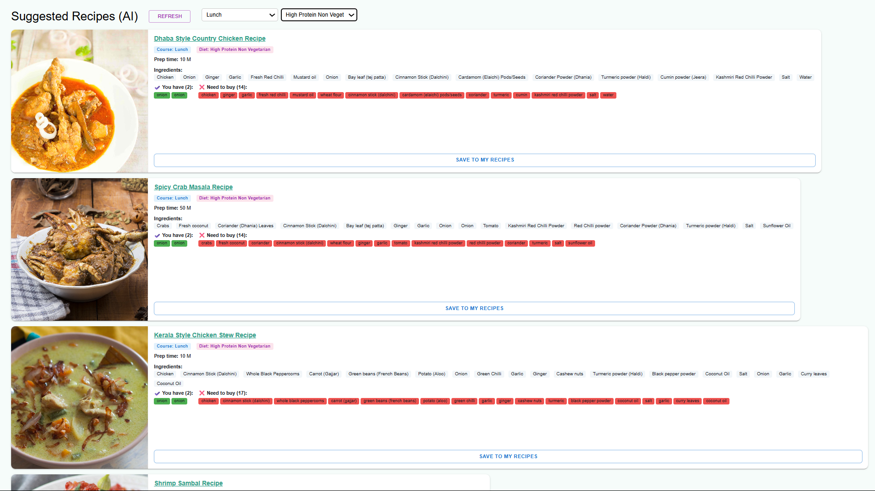
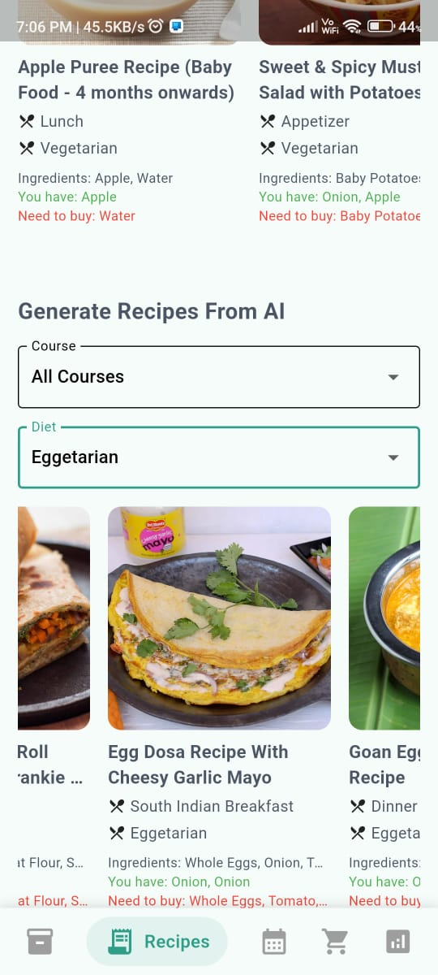

Slide 8
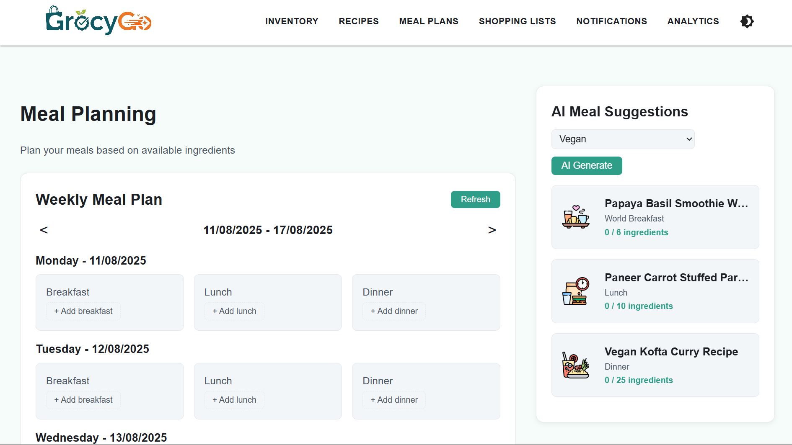
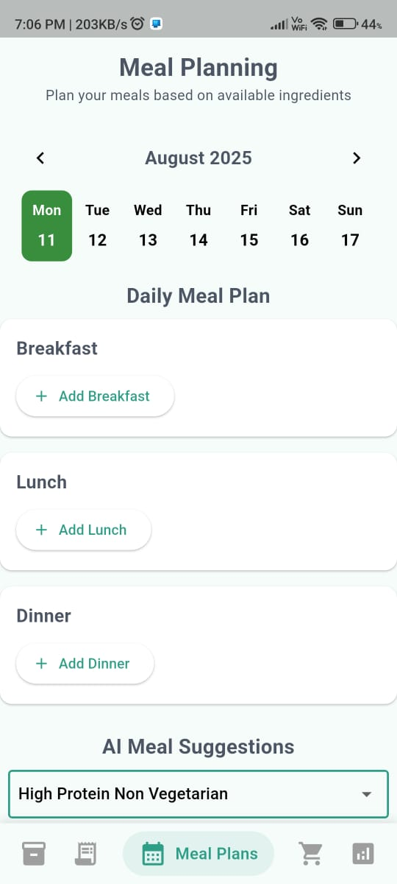

Slide 9
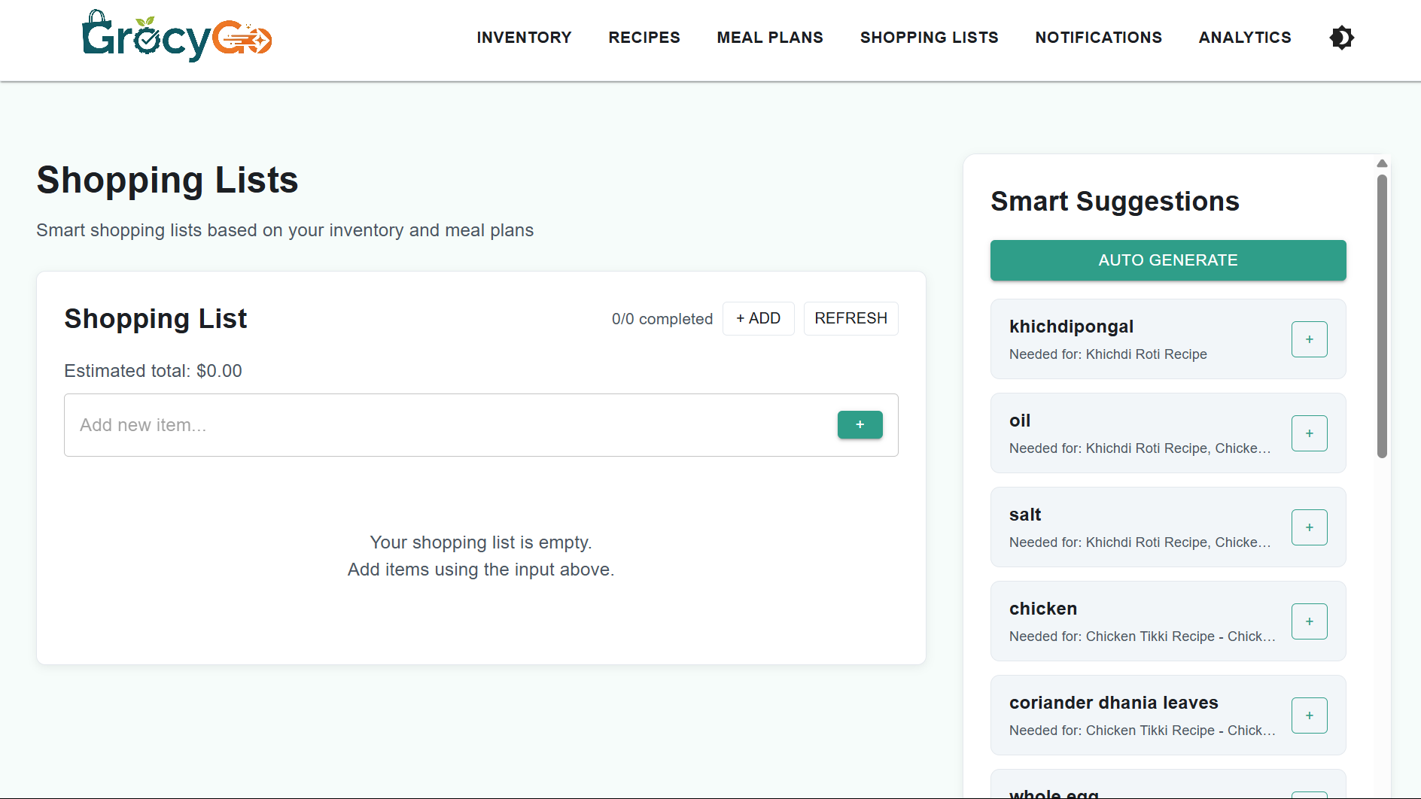
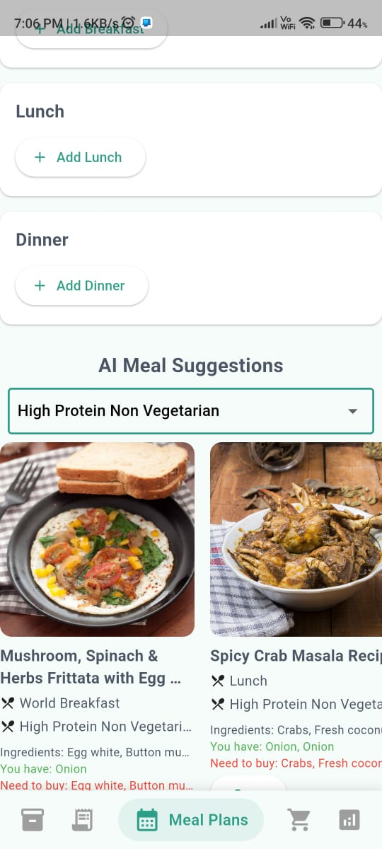

Slide 10
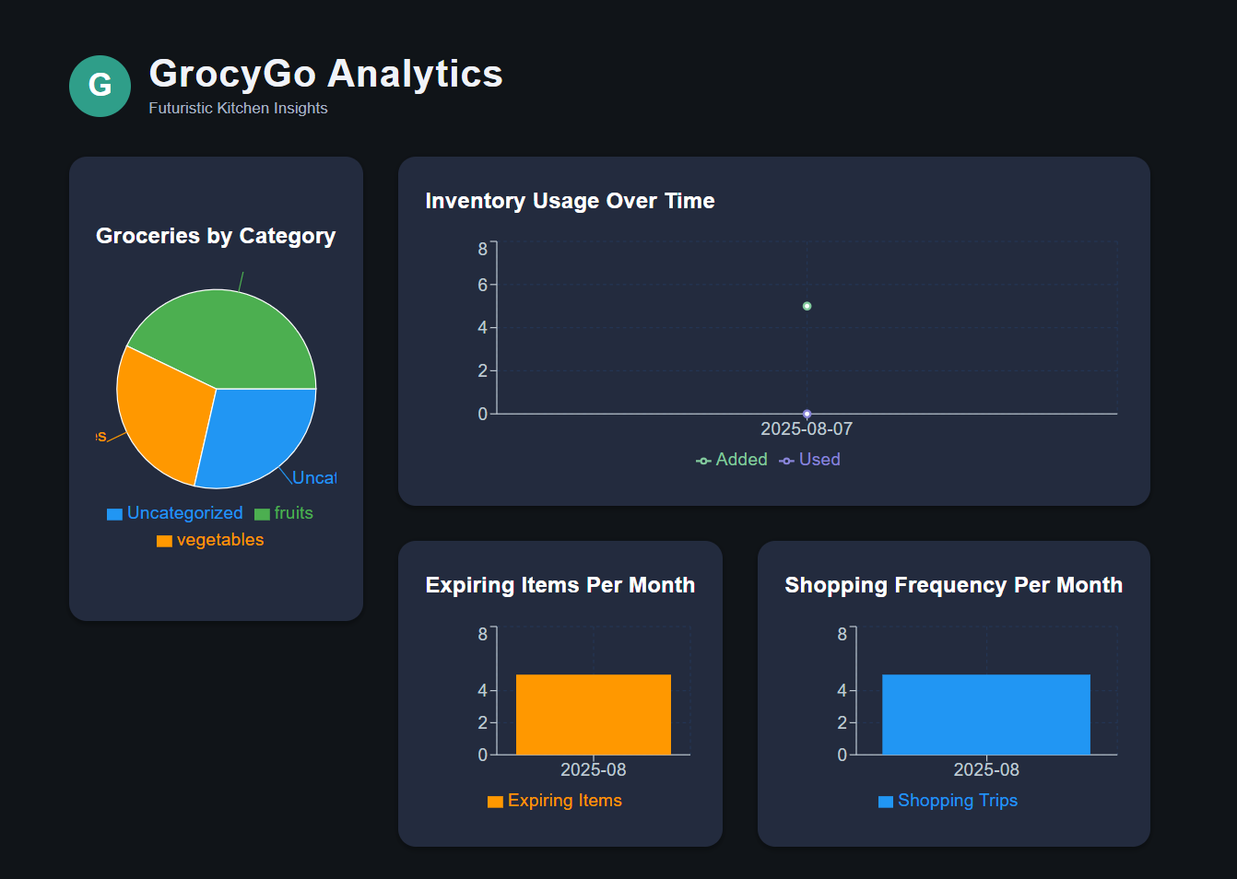

Slide 11
Navigating Development Challenges
Addressing technical hurdles to ensure a robust and user-friendly platform.
1
Ingredient Name Mismatches
2
Large Dataset Preprocessing
Utilizing natural language processing to detect ingredient synonyms, ensuring accurate matching of diverse names like "RIngan" and "Brinjal".
Implementing advanced data cleaning and normalization techniques to improve recipe matching accuracy across our extensive 8,000+ recipe database.
3
Handling Partial Matches
4
Balancing Accuracy & Speed
Deploying a fuzzy matching algorithm to suggest relevant recipes even when an exact ingredient match is not found.
Strategically caching frequently accessed recipe results to significantly improve response times, while maintaining high model accuracy.
Our proactive approach to problem-solving ensures a resilient and highly effective GrocyGo platform.

Slide 12
GrocyGo: Your Partner in Smart Living
GrocyGo is set to transform how households manage their food, offering a powerful blend of convenience, efficiency, and sustainability. We are committed to making meal planning and grocery shopping not just easier, but smarter and more enjoyable.
"Our mission is to empower users to eat well, save time, and reduce waste, one smart grocery list at a time."
Join us in building the future of intelligent home management.

