Slide 1


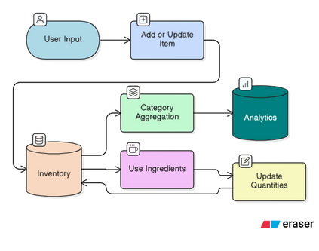
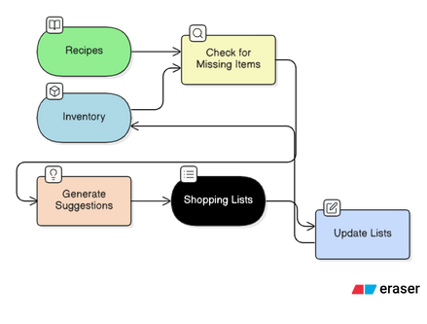
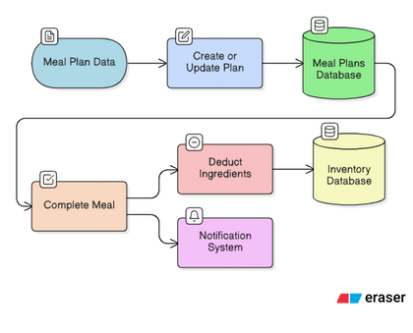
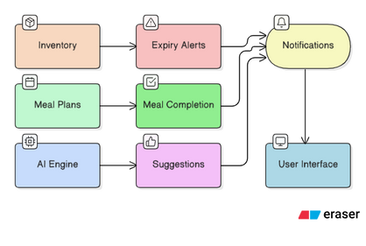
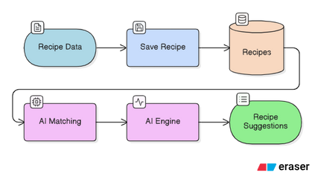
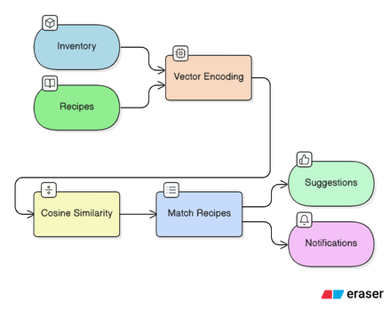
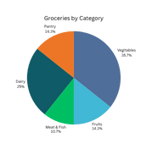
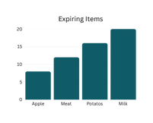
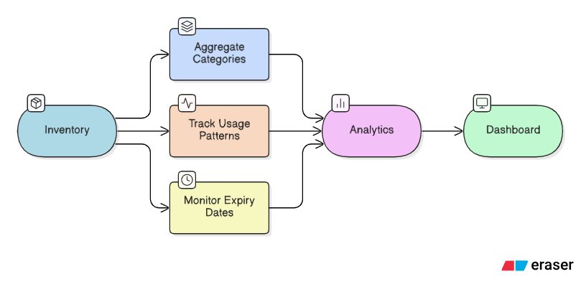
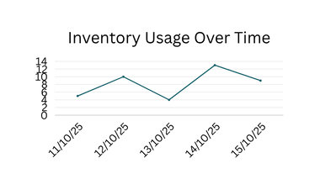
School of
Engineering
Smart Grocery Inventory, AI Recipes & Meal Planner System
Student Name (Enrollment Number) : Pritkumar Vekariya (22SE02IE059)
Mentor Name : Mr. Adarsh Kushwaha, Designation to Lecturer (SOE)
Department and Institution Name : B.tech (IT&E) School of Engineering
INTRODUCTION
Modern households struggle with tracking groceries, planning meals, and managing shopping lists efficiently.
Manual methods lead to
Forgotten items
Unplanned meals
Food wastage
Inefficient shopping
GrocyGo is a multi-platform system (Web + Mobile + Backend + AI) designed to automate grocery tracking, meal suggestions, and shopping list creation.
METHODOLOGY
Tools & Technologies
Frontend: React.js (Web), Flutter (Mobile)
Backend: Node.js + Express
AI Engine: Dataset-based recipe filtering
Dataset: 8000+ recipes (CSV)
Charts: React charting libraries
Architecture: MVC + REST API
Process Flow
Inventory Management
Meal Planning
Recipe Managment
Analytics Generation
Shopping List Managment
Notification Managment
AI Suggetion Engine
OBJECTIVES
Track groceries with quantity, expiry, and location
Suggest AI-powered recipes based on 8000+ dataset
Auto-generate smart shopping lists
Plan weekly meals (breakfast/lunch/dinner)
Reduce food waste with expiry alerts
Provide analytics for usage and shopping patterns
Build a scalable multi-platform system (React + Flutter + Node.js)
RESULTS & DISCUSSION
Key Outcomes
Automated tracking reduced manual effort
AI suggestions improved meal decision-making
Shopping list accuracy increased with auto-generated items
Expiring items identified early → reduced waste
Analytics provided insights into category usage & purchase behavior
Visual Results
Include:
Pie chart (Grocery categories)
Bar chart (Expiring items per month)
Line graph (Usage trends)
Table or screenshot examples
Small analytics dashboard preview
Performance
AI suggestions responded < 1 sec
Smooth UI across web and mobile
Efficient dataset filtering
CONCLUSION
GrocyGo successfully provides an intelligent, user-friendly solution for household grocery management.
It integrates Web, Mobile, Backend, and AI to deliver:
Smart inventory
Efficient meal planning
Accurate shopping lists
Useful analytics
Reduced food wastage
Applications
Smart kitchens
Hostel/PG food management
Small restaurants
Family grocery coordination
Limitations
Dataset-based AI (not deep-learning)
No cloud-based multi-user sync yet
Future Enhancements
Barcode/QR scanning
Voice assistant integration
Cloud database & real-time sync
AI nutritional analysis
Auto grocery ordering

