Slide 1
UNIFIED MENTOR
ID : UMIP270557
Role : Data Analyst Intern
By Prit Deriya

Slide 2
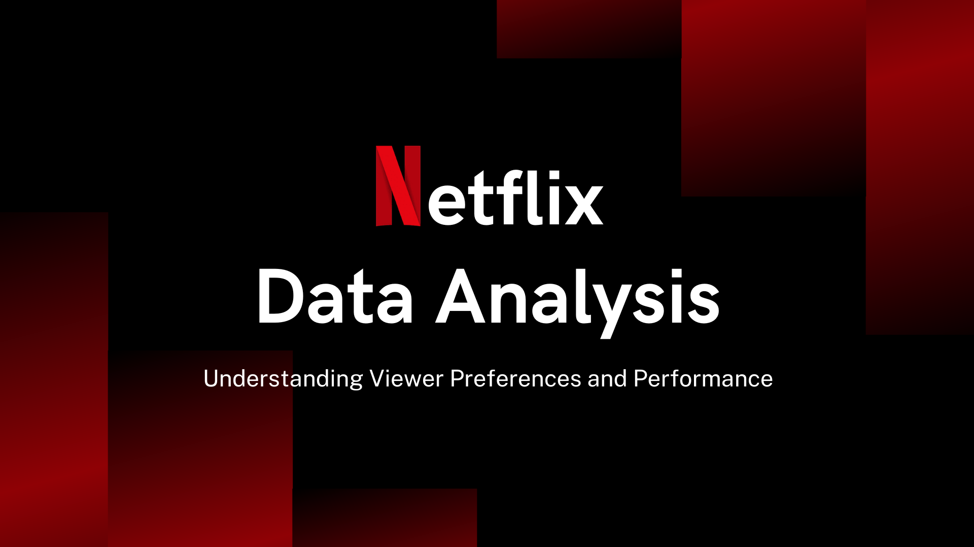

By Prit Deriya

Slide 3
Process
Import and clean the Netflix dataset using Pandas in Python and Power BI.
Analyze data trends and distributions using summary statistics and visualizations in Python.
Create charts like bar charts and pie charts with Matplotlib and Seaborn.
Build dynamic dashboard with Power BI for exploring the data.
Extract key trends and patterns, such as top and release year trends.
By Prit Deriya

Slide 4
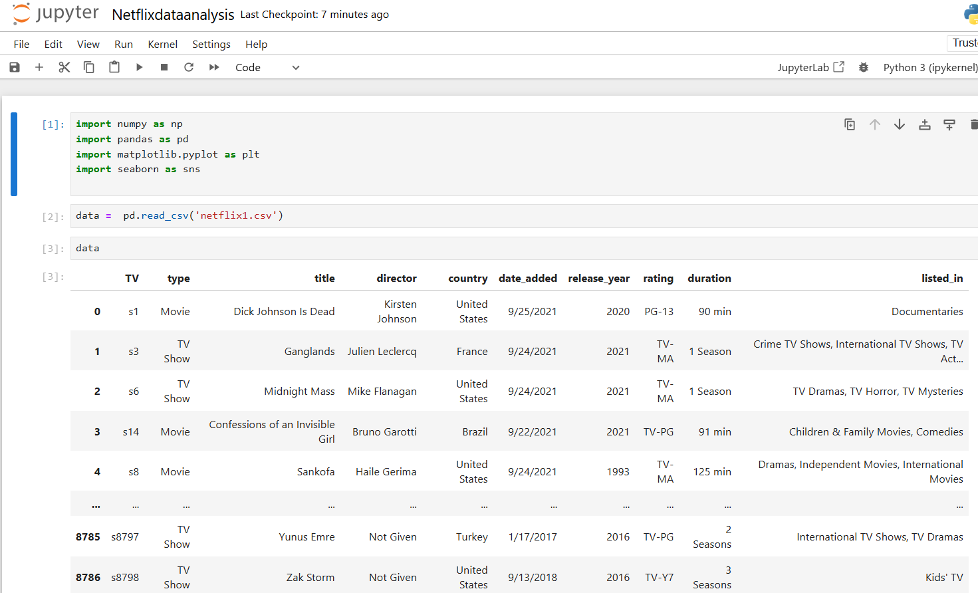
Importing Libraries and Modules
By Prit Deriya

Slide 5
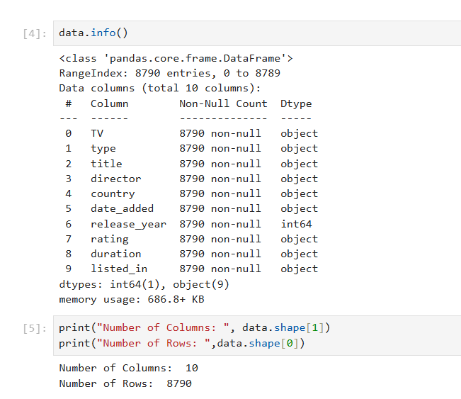
Checking the Info
By Prit Deriya

Slide 6
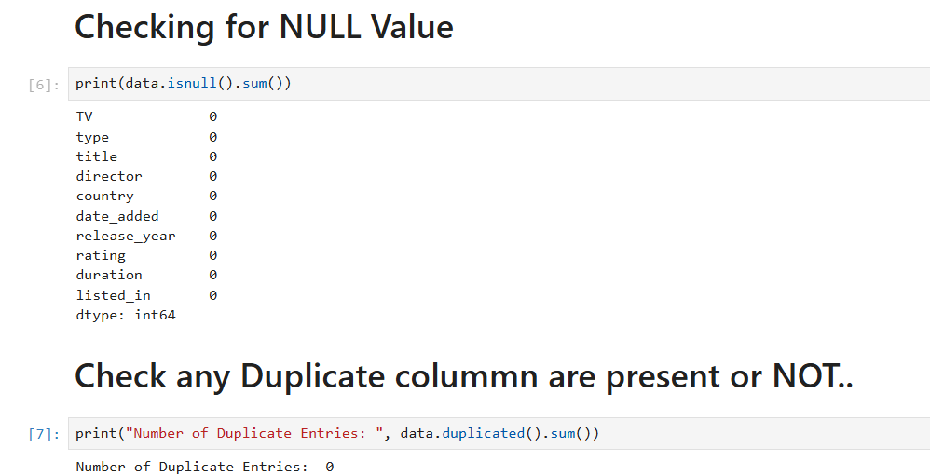
Data Cleaning
By Prit Deriya

Slide 7
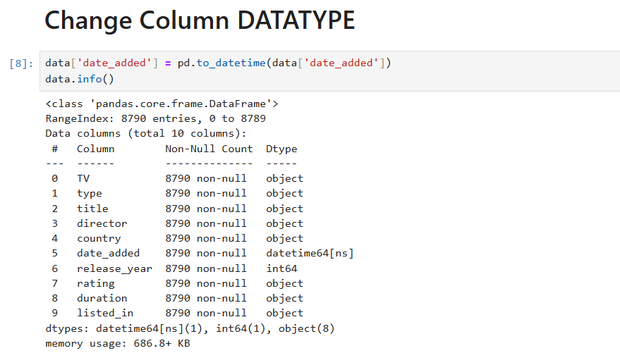
Continue…
By Prit Deriya

Slide 8
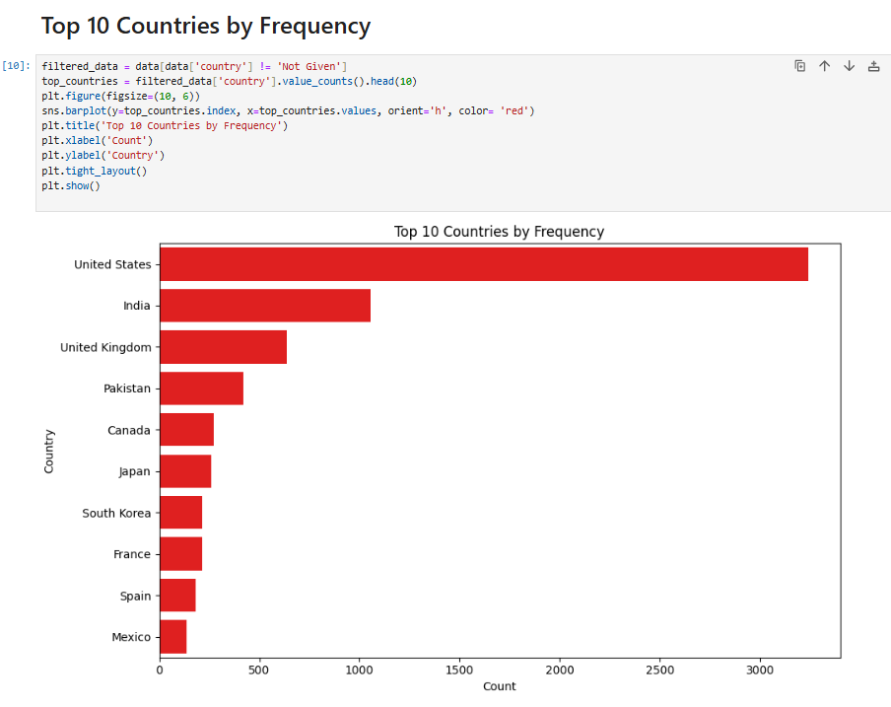
DATA VISUALIZATION
By Prit Deriya

Slide 9
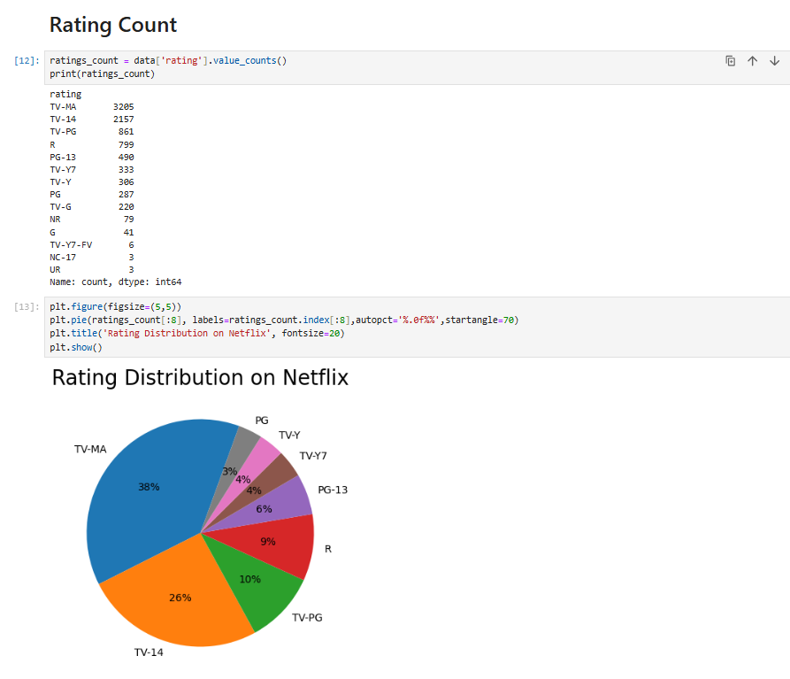
Continue…
By Prit Deriya

Slide 10
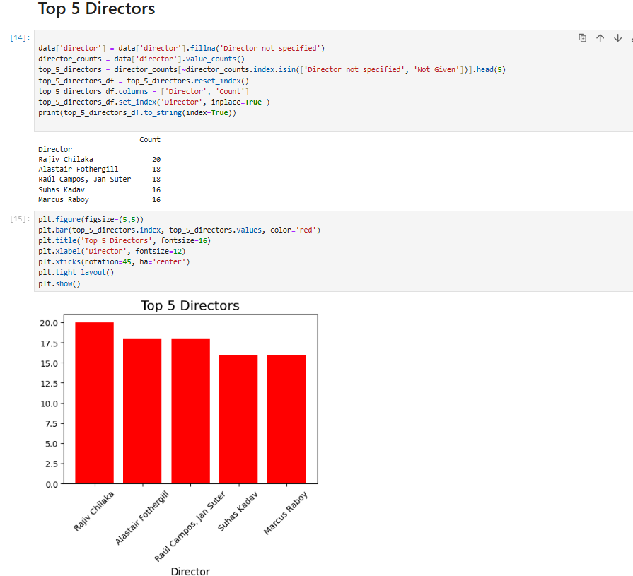
Continue…
By Prit Deriya

Slide 11
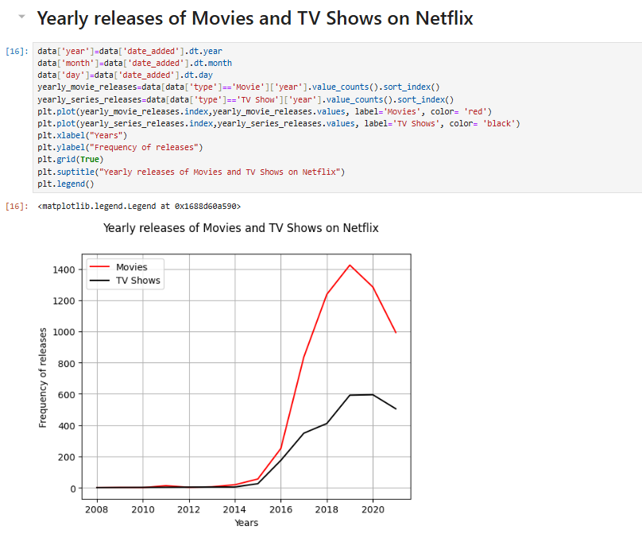
Continue…
By Prit Deriya

Slide 12
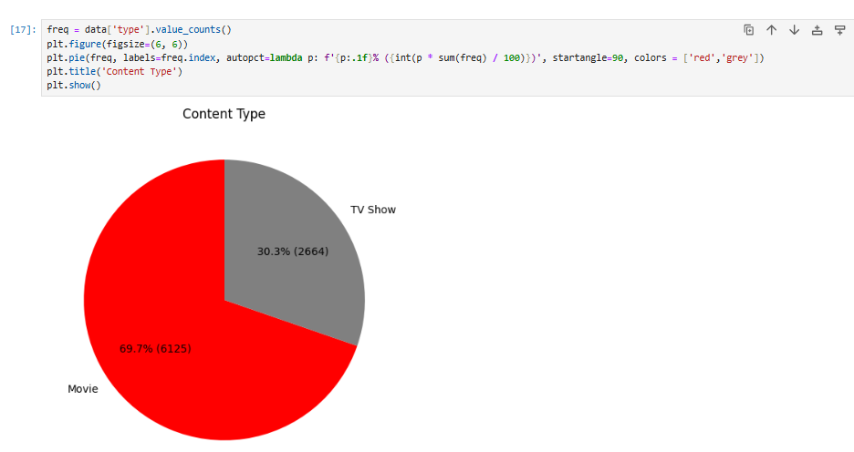
Continue…
By Prit Deriya

Slide 13
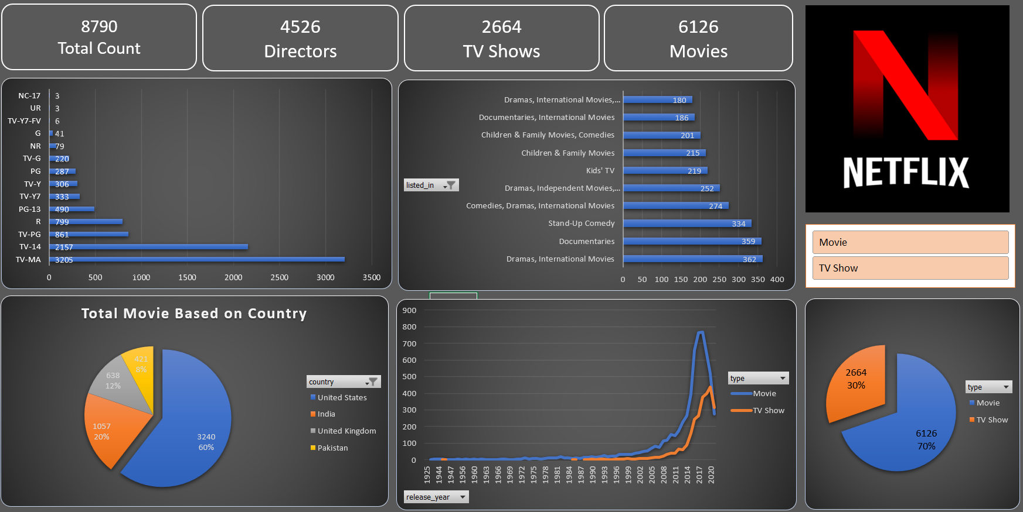
DATA VISUALIZATION Using EXCEL
By Prit Deriya

