Slide 1
UNIFIED MENTOR
ID : UMIP270557
Role : Data Analyst Intern
By Prit Deriya

Slide 2
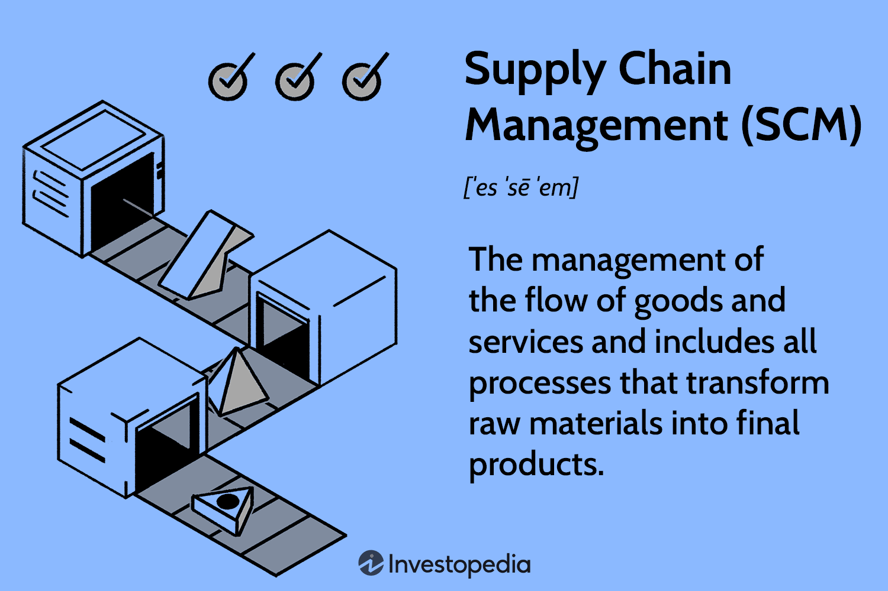
By Prit Deriya

Slide 3
Analysis
Manufacturing Cost per Unit is essential for various business function
Cost Control & Budgeting: Helps track cost changes over time, enabling cost reductions and efficiency improvements.
Pricing Strategy: Ensures products are priced to cover costs and achieve profitability.
Performance Benchmarking: Compares costs with industry standards to assess efficiency
Lead time Per unit produced :
manufacturer efficiency
Shipping Time and Shipping Cost per order
Customer Satisfaction: Faster, reliable shipping enhances customer satisfaction. Analyze to reduce delays.
Cost Optimization: High shipping costs lower profits.
Order Profitability: High shipping costs can impact low-margin product profitability
By Prit Deriya

Slide 4
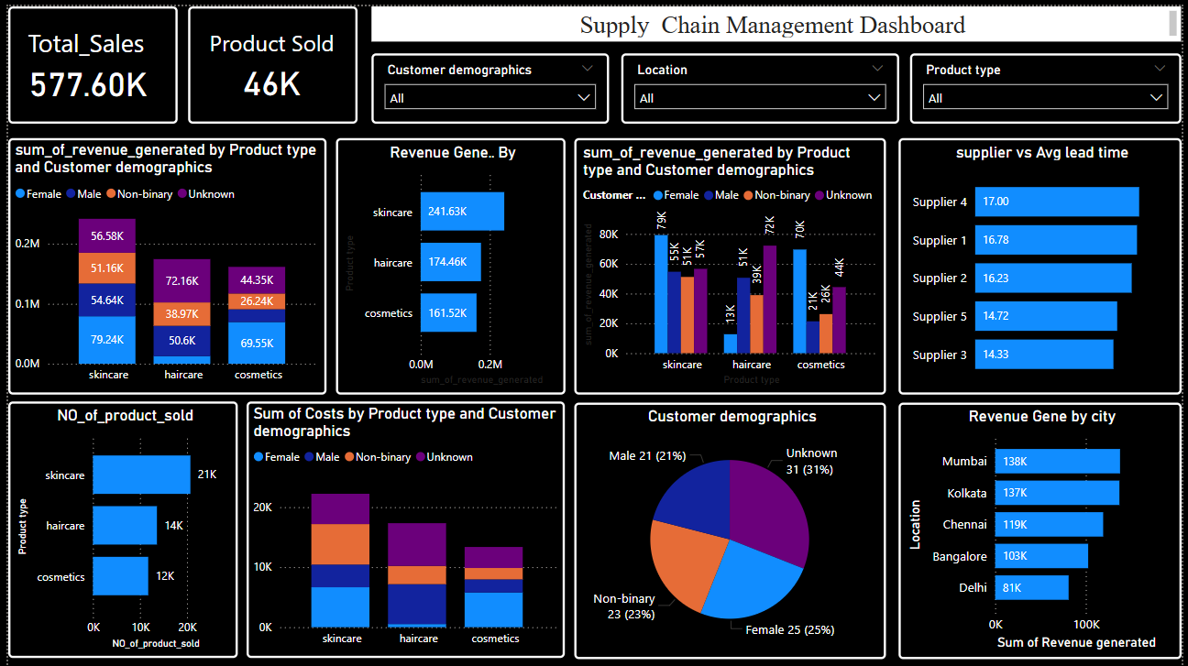
Analysis
By Prit Deriya

Slide 5
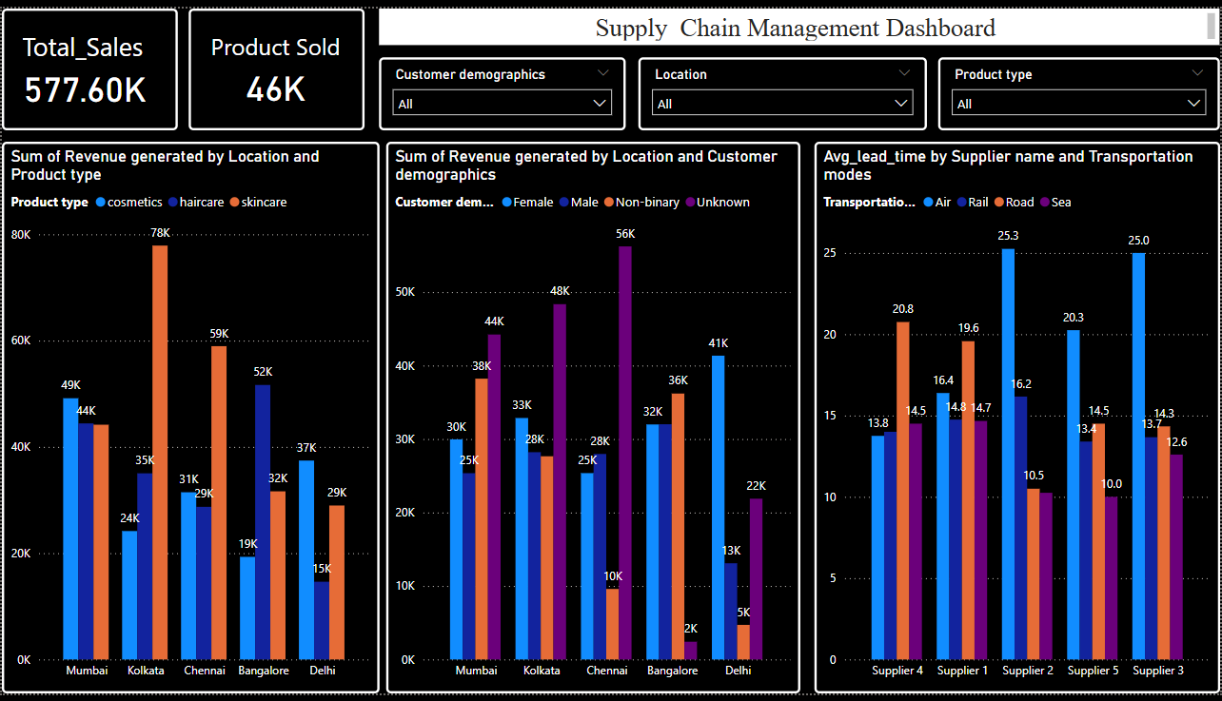
Analysis
By Prit Deriya

Slide 6
Analysis
Total Sales : 577.60k
Total Product Sold : 46k
Highest Revenue Generated By : Skincare (241.63k & 79k by Female)
City wise Revenue Generated :
Mumbai : Highest Revenue generated by Cosmetics Product
Kolkata : Highest Revenue generated by Skincare Product
Chennai : Highest Revenue generated by Skincare Product
Bangalore : Highest Revenue generated by Haircare Product
Delhi : Highest Revenue generated by Cosmetics Product
Most of Revenue generated by Male in Bangalore
Most of Revenue generated by Female in Chennai
Female Person Spend her 49% Money on Skincare Product , 43% on Cosmetics Product , and 8% on Haircare Product
Male Person Spend his 43% Money on Skincare Product , 40% on Haircare Product , and 27% on Cosmetics Product
By Prit Deriya

