Slide 1
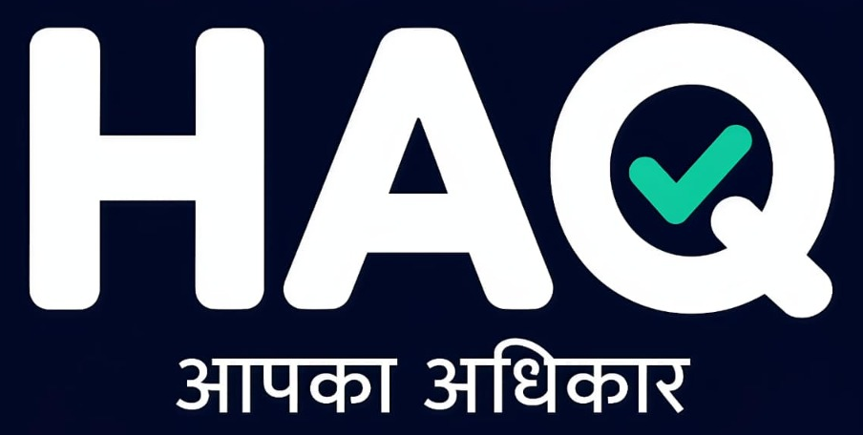
India's First Multimodal Civic AI & Deterministic Kiosk Shield
"Official Government Rules, Made Usable. Know the Rule. Audit the Reality. Claim Your Rights."
BUILD THE AI FOR YOU 2026 (Craftora) • ROUND 2 BUILD SPRINT
Team PreetIQ: Pritam Bairwa (Lead & Architect) | Sonali Agarwal | Vikas Bairwa
Live GitHub Repository: https://github.com/pritam088/HAQ

Slide 2
01 • THE PROBLEM & REALITY
The Silent $10 Billion Kiosk Overcharging Crisis
Over 800M+ citizens visit CSC and e-Mitra kiosks for vital public services, facing systemic extortion.
🚨 Severe Information Asymmetry
Statutory limit for Caste/Income certificates is strictly ₹100.
Kiosks routinely extort ₹250 to ₹500 from rural citizens citing 'urgent tatkal charges' (+250% overcharge).
🚫 Form 33 Receipt Violations
Operators collect cash without providing the mandatory 16-digit e-Mitra computer token receipt. Handwritten or verbal cash leaves citizens powerless.
👥 Fear & Middleman Dependence
Rural citizens fear hostility from local operators and cannot comprehend dense English gazette circulars. Middlemen capitalize on this illiteracy.

Slide 3
02 • THE TRANSFORMATION
The Broken Citizen Journey vs. The HAQ Shield
❌ THE BROKEN STATUS QUO
1. Citizen visits kiosk for Caste Certificate (Jati Praman Patra).
2. Operator demands ₹350 in cash under pretext of 'tatkal babu charges'.
3. Kiosk hands over a fake handwritten slip without a Form 33 token.
4. Citizen is unable to verify statutory government rate.
5. Result: ₹250 illegally pocketed with zero accountability.
🛡️ THE HAQ SHIELD
1. Citizen snaps slip photo or speaks in Hindi: 'मुझसे ₹350 लिए बिना रसीद के'.
2. Gemini Multimodal Vision & Deterministic Engine audits in 1 second.
3. Instant Finding: Statutory Fee is ₹100. ₹250 is an ILLEGAL SURCHARGE.
4. Auto-detects missing Form 33 token; flags Clause 12 ₹5,000 kiosk penalty.
5. 1-Click Action: Printable SDO Legal Notice, 181 Sampark Draft & WhatsApp alert.

Slide 4
03 • TECHNICAL ARCHITECTURE
Zero-Hallucination Pipeline & Deterministic Law Engine
Mathematical fee calculations are 100% deterministic code. Generative AI is used strictly for perception & explanation.
1. Citizen Input
Thermal / handwritten slip photo or Hindi voice query via Web Speech API.
2. Gemini 3.5 Flash
Multimodal Vision extracts service name, rupees paid, token, and kiosk ID.
3. Gazette Engine
Deterministic arithmetic matching DoIT&C Notification F1(23)/DoIT/Tech/11.
4. Citizen Redressal
Instant SDO Legal Notice, Rajasthan Sampark 181 draft, and direct SSO bypass.
5. Supabase Sync
Cloud intelligence sync + localStorage offline resilient cache (Zero Crashes).

Slide 5
04 • LIVE CAPABILITIES
4 Groundbreaking Innovations Built for Round 2
📷 Multimodal Receipt OCR
Visual inspection of kiosk thermal slips and handwritten vouchers. Identifies 16-digit Form 33 computer tokens and flags counterfeit handwritten slips.
🎙️ Hindi Voice In & Audio Out
Designed for rural citizens who cannot type English. Native speech recognition ('बोलकर बताएं') and Hindi speech synthesis ('सुनकर समझें') for 100% accessibility.
⚖️ Printable Legal Notice
1-click generation of formal representation under Section 7 of Rajasthan Act 2011 for Joint Director (DoIT&C) and District Collector DeGS inquiry.
🤖 Hak Saathi (हक साथी) AI
Context-aware bilingual legal copilot powered by Gemini 3.5 Flash. Delivers bold, citation-backed answers on eMitra rights without bureaucratic jargon.

Slide 6
05 • GROUNDED STATE SERVICES
Officially Notified Rates & Guaranteed Timelines
Grounded in Rajasthan Guaranteed Delivery of Public Services Act 2011 & DoIT&C Rate Notification F1(23)
Service Name | Max Authorized Fee | Statutory Delivery | Regulatory Legal Source
Caste Certificate (जाति प्रमाण पत्र) | ₹100 (₹40 Govt + ₹50 Kiosk + ₹10 Print) | 15 Working Days | DoIT&C Gazette F1(23)
Income Certificate (आय प्रमाण पत्र) | ₹100 (₹40 Govt + ₹50 Kiosk + ₹10 Print) | 10 Working Days | Revenue Dept Circular
Domicile Certificate (मूल निवास) | ₹100 (₹40 Govt + ₹50 Kiosk + ₹10 Print) | 15 Calendar Days | Public Service Act 2011
Ration Card Addition (खाद्य सुरक्षा) | ₹100 (₹50 Govt + ₹50 Kiosk Fee) | 30 Calendar Days | Food & Civil Supplies Order
Jamabandi Land Records (जमाबंदी नकल) | ₹50 (₹20 Govt + ₹30 Kiosk Fee) | Same Day Delivery | Apna Khata Bhulekh Order

Slide 7
06 • VERIFICATION SCENARIOS
3 Interactive Test Cases Built for Hackathon Evaluation
Evaluators can test realistic kiosk scenarios in 1 click at /payments/check with zero configuration.
🚨 Scenario A: High Overcharge
Input: ₹350 charged for Income Certificate (No Receipt).
• HAQ Detection: Maximum statutory fee is ₹100.
• Result: ₹250 Illegal Overcharge flagged.
• Finding: Form 33 Violation detected.
• Enforcement: Triggers Clause 12 ₹5,000 regulatory penalty notice for SDO inquiry.
⚠️ Scenario B: Handwritten Slip Trap
Input: ₹200 charged for Caste Certificate with handwritten paper slip.
• HAQ Detection: ₹100 statutory rate.
• Result: ₹100 unauthorized difference.
• Finding: Non-compliant manual slip (no 16-digit eMitra token).
• Enforcement: Drafts Rajasthan Sampark 181 grievance.
✅ Scenario C: Fully Compliant Kiosk
Input: Paid exact ₹100 with official computerized Form 33 receipt.
• HAQ Detection: Fee matches official gazette.
• Result: ₹0 Overcharge.
• Finding: 100% compliant eMitra kiosk.
• Enforcement: Issues verified audit certificate.

Slide 8
07 • TECHNICAL EXECUTION
Enterprise-Grade Architecture & 24 Automated Tests
Evaluating Pillar 2: Technical Execution, Stability & Zero-Crash Fallbacks
Next.js 16.4 (Turbopack)
Full static generation (25/25 pages compiled with 0 errors), partial prefetching, sub-second routing.
24 Vitest Unit Tests
100% test passing rate covering arithmetic edge cases, working days calculations, and penalty triggers.
Supabase Cloud Sync
Live PostgreSQL cloud database with seamless offline fallback to localStorage. App never crashes.
Gemini 3.5 Flash
Latest high-speed multimodal vision model for slip OCR and natural language civic guidance.

Slide 9
08 • SOCIAL IMPACT & SCALE
Protecting 80M Citizens & Aligning with UN SDG 16
Evaluating Pillar 1: Real-World Significance, Scale, and Systemic Change
80,000+
Kiosks in Rajasthan alone where HAQ can directly audit and eliminate predatory charges.
₹4,800 Cr
Estimated annual citizen savings protected from illegal surcharges and fake urgency fees.
SDG 16.5
Substantially reduce corruption and bribery in all their forms through public fee transparency.
Pan-India CSC
Extensible architecture ready to onboard 500,000+ Common Service Centres across 28 states.

Slide 10
09 • TEAM & VISION
Team PreetIQ: Why HAQ Wins Build The AI For YOU 2026
Pritam Bairwa
Team Leader & Architect
Next.js 16, Gemini Multimodal Vision, Voice AI & Full-Stack Engine
Sonali Agarwal
Product Strategy
Citizen UX Research, Ground-Truth Validation & Grievance Flow Design
Vikas Bairwa
Legal Data Engineering
DoIT&C Gazette Digitization, Act 2011 Timeline Rules & Case Mapping
"When citizens know the rule, corruption loses its power. HAQ is every citizen's digital right."
100% Functional MVP • Grounded in Official Rajasthan Law • 24 Automated Tests • Ready for Statewide Citizen Rollout

