Slide 1

Basic Details of the Team & Problem Statement
Organization Name: ITSC
PS Code: HT-02
Problem Statement Title: Virtual Hospital Platform
Team Name: Health Catalyst
Team Leader Name: Pritam Kumar
Institute Name: Sagar Institute of Science Techology and Research
Theme Name: HealthTech

Slide 2
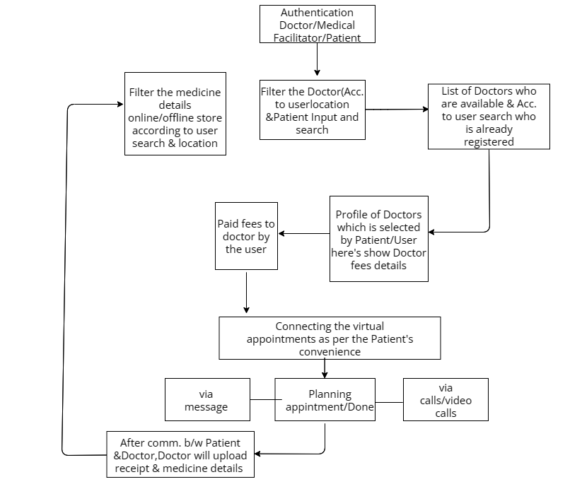
Idea/Approach Details
Process Flow
The idea behind the Virtual Hospital platform is to leverage technology to overcome barriers to accessing healthcare, particularly for individuals in both rural and urban areas who may face challenges such as limited access to doctors and healthcare facilities.
Virtual Consultations:The platform enables users to schedule virtual consultations between patient and doctor via video or chat consultations.
Local Clinical Facility:Users can search for facilities based on their location such as hospitals, clinics, pharmacies, and diagnostic centers.
Remote Diagnostics: It involves. patients to input symptoms, medical history, and relevant health information.
Prescription Services: Digital prescriptions based on remote diagnostics and virtual consultations.
User Education and Engagement: Integrated educational resources to empower users with health knowledge and preventive care practices.
Multilingual Support: This approach ensures that individuals who speak languages other than the primary language of the healthcare system can access and understand healthcare information, communicate effectively with healthcare providers.
Technology Stack
Front-End | Back-End | DataBase
HTML | NodeJS | MongoDB
CSS | ExpressJS
JavaScript | NPM Packages
BootStrap

Slide 3
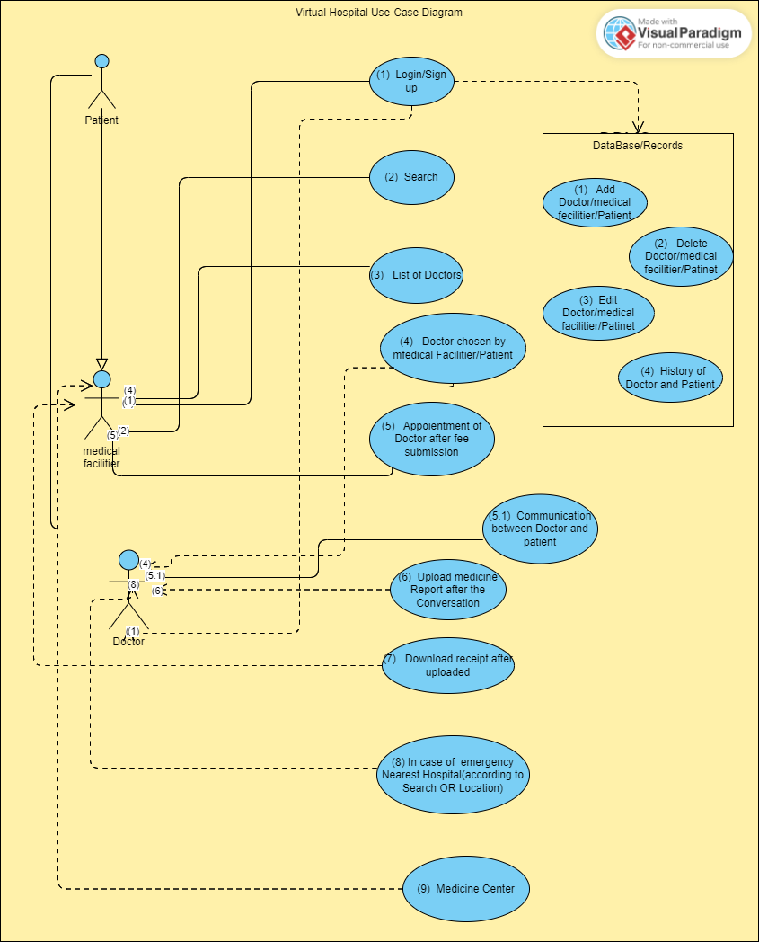
Idea/Approach Details
Describe Your Use Cases Here
Describe Your Dependencies Here
Text Editor : Visual Studio Code
Version Control : GitHub
Web Browser : Chrome / Firefox
Package Managers: Node.js , NPM
Web Server: Node.js
Database : MongoDB
Backend Framework : Express.js, Node.js, NPM
Frontend Framework/Library: HTML, CSS, JavaScript, BootStrap library

Slide 4
Team Member’s Details
Sr. No. | Name of Team Member | Branch | Stream | Year
1. | Pritam Kumar | B.Tech | CSE | III
2. | Komal Kumari | B.Tech | CSE | III
3. | Veerendra Sahu | B.Tech | CSE | III
4. | Amit Athiya | B.Tech | EC | III
5. | Ojasv Dixit | B.Tech | CSE | III
Team Mentor’s Details
Sr. No. | Name of Mentor | Category | Expertise | Domain Experience
1. | Dharmendra .N. Jha | Academic/Industry | ML/Blockchain etc | Domain Experience in Year

Slide 5
Important Points
Kindly keep the maximum slides limit to 4 pages
All the topics should be utilized for description of your idea
Try to avoid paragraphs and post your idea in points
Keep your explanation precisely and easy to understand
Idea should be unique and novel. If it has a business potential more weightage will be given.
Apart from this PPT abstract of your idea will be asked separately while submitting
You need to save the file in PDF and upload the same on portal. No PPT, Word Doc or any other format will be supported
You can delete this slide (Important Points) when you upload the details of your idea on SISTec Innovation Hackathon Portal.

