Slide 1
Network Traffic Flow Classification
By Pritam Das

Slide 2
Index
Title
Slide No
Objective
Data Source
Technologies used
Methodology
Machine Learning Model Performance
Machine Learning Model Performance Comparison
Most Important Features by AdaBoost
Model performance
Confusion Matrix
ROC Curve and AUC Score
Overfitting and Underfitting Comparison
Conclusion
Future scope
3
4
5
6
7
8
9
10
11
12
13
14
15

Slide 3
Objective
Develop a machine learning model to accurately classify network traffic into normal and various attack categories
Analyze network flow data based on packet-level features, protocol behavior, traffic duration, and statistical indicators
Uncover hidden patterns and key features contributing to malicious activities and intrusion attempts
Support cybersecurity teams and network administrators in designing proactive threat detection and mitigation strategies
Promote data-driven security decision-making to strengthen organizational network protection and optimize resource allocation

Slide 4
Data Source
Dataset:
DDos.pcap_ISCX.csv
Contains network traffic flow records like:
Incident details such as flow duration, timestamp, and total packets transmitted
Network-level information including source IP, destination IP, source port, destination port, and protocol type
Traffic behavior features such as total forward packets, total backward packets, packet length statistics, and flow bytes per second
Statistical flow-based features including mean packet size, inter-arrival time, header length, and flag counts
Attack classification details including traffic label (Benign or DDoS Attack)
Flow status indicators representing normal or malicious network activity

Slide 5
Technologies used
Python: Data preprocessing, model experimentation
Jupyter Notebook: For model development (model.ipynb)
Machine Learning: Random Forest, Ada Boosting, XgBoost, Catboost, LightGBM for predicting network traffic flow classification.
Deep Learning: ANN for predicting network traffic flow classification.
Power BI: Data visualization and interactive dashboard (LA_Crime_Dashboard_from_2020_to_2024.pbix)
Libraries Used: pandas, numpy, matplotlib, seaborn, scikit-learn, tensorflow, XGBoost, LightGBM, CatBoost, cloudpickle, dill

Slide 6
Methodology
Data Preparation
Loaded DDos.pcap_ISCX.csv
Dropped irrelevant data, filtered null values and duplicates.
Data Preprocessing
Encoded categorical variables with LabelEncoder
Standardized features with StandardScaler
Made data pipeline using ColumnTransformer
Modelling and Evaluation
Split dataset in train and test set
Trained Deep Learning model ANN and different Machine Learning models like Random Forest, AdaBoost, CatBoost etc.
Evaluated with accuracy, precision, recall, F1-score, confusion marix, ROC curve and AUC score.
Selected best model, retrained with full dataset and saved the model (model.pkl).

Slide 7
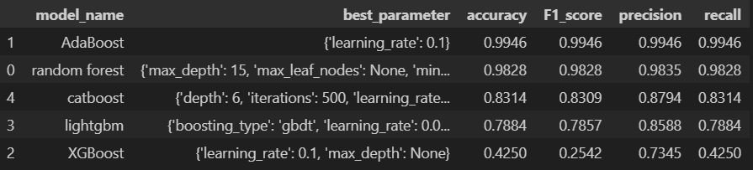
Machine Learning Model Performance
best model is: AdaBoost
best parameter is: {'learning_rate': 0.1}

Slide 8
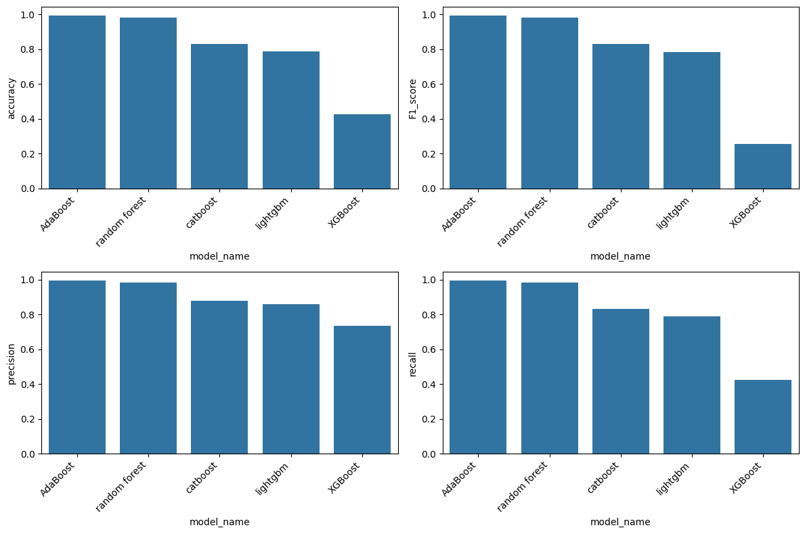
Machine Learning Model Performance Comparison

Slide 9
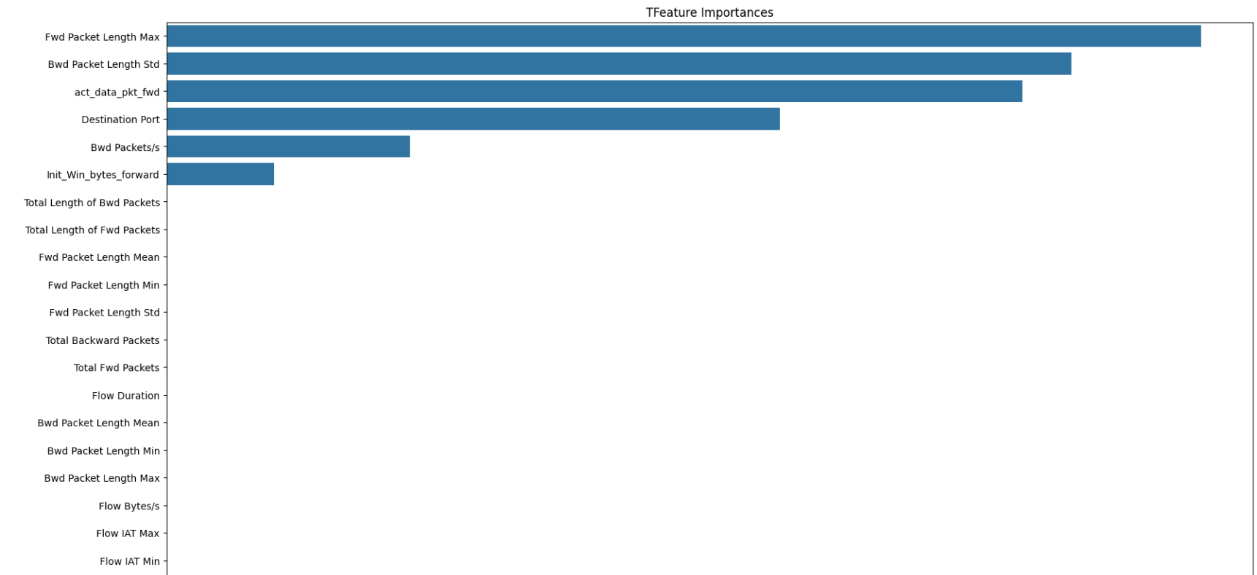
Most Importance Features by AdaBoost

Slide 10
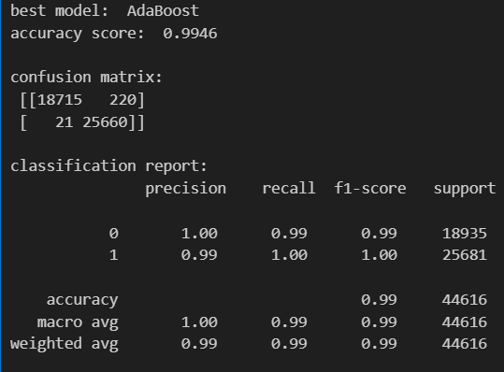
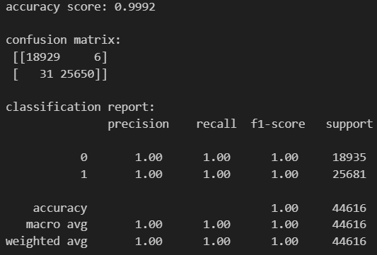
Model Performance
Machine Learning
Deep Learning

Slide 11
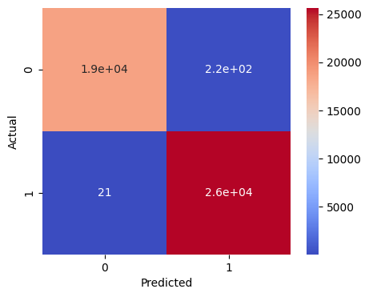
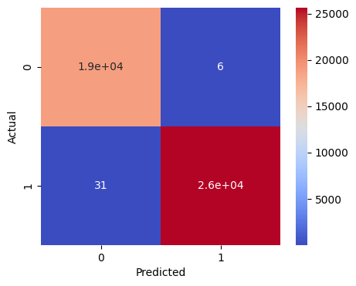
Confusion Matrix
Machine Learning
Deep Learning
True Values: 44579
Fake Values: 37
True Values: 44375
Fake Values: 241

Slide 12
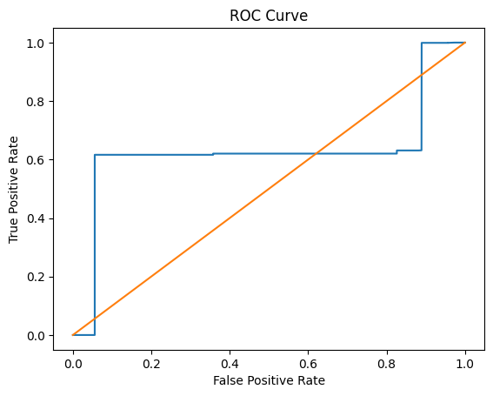
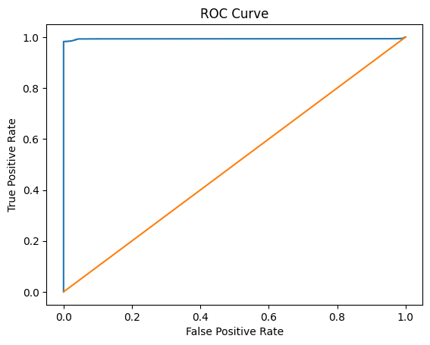
ROC Curve and AUC Score
Machine Learning
Deep Learning
AUC Score: 0.6272
AUC Score: 0.993

Slide 13
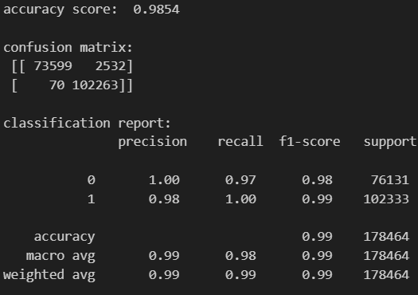
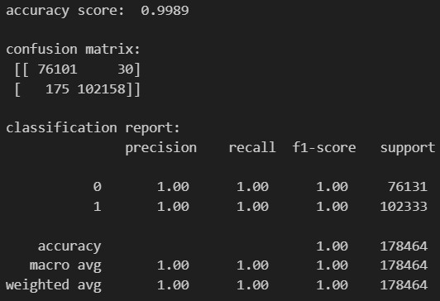
Overfitting and Underfitting Comparison
Machine Learning
Deep Learning

Slide 14
Conclusion
Performed comprehensive data cleaning and preprocessing on the network traffic flow dataset to ensure accuracy, consistency, and reliability of intrusion detection analysis
Engineered advanced statistical and traffic-based features to effectively distinguish between benign and malicious network behavior
Applied multiple supervised machine learning algorithms including Decision Tree, Random Forest, Extra Trees, and XGBoost to classify normal and attack traffic
Addressed class imbalance using resampling techniques to enhance detection of minority attack classes and reduce false negatives
Evaluated model performance using accuracy, precision, recall, F1-score, and ROC-AUC, and implemented ensemble learning to further improve detection robustness
Developed an interactive Power BI dashboard to visualize traffic distribution, attack patterns, model performance metrics, and key security insights for stakeholders
The project demonstrates how machine learning, ensemble modeling, and interactive data visualization can significantly improve intrusion detection accuracy, optimize security resource allocation, and strengthen an organization’s overall cybersecurity posture

Slide 15
Future Scope
Extend the dataset with real-time or streaming network traffic data to enable continuous intrusion monitoring and live threat detection
Apply advanced deep learning techniques such as LSTM, GRU, and Transformer-based models to capture sequential and temporal attack patterns
Integrate anomaly detection methods (Autoencoders, Isolation Forest) to detect zero-day and previously unseen cyber attacks
Incorporate advanced explainability techniques such as SHAP or LIME to improve model transparency and support security analysts in decision-making
Deploy the solution as a real-time intrusion detection system (IDS) using Flask/FastAPI with dashboard integration for live monitoring
Adapt and scale the framework for enterprise-level networks, cloud environments, and IoT ecosystems to strengthen large-scale cybersecurity infrastructure

Slide 16

Feedback
Please give me feedback of my project.
Your feedback will encourage and motivate me.
Click here for feedback form

Slide 17
Thank you..

