Slide 1
Retain Price Prediction
By Pritam Das

Slide 2
Index
Title
Slide No
Objective
Data Source
Technologies used
Methodology
Model performance
Mean Absolute Error Comparison
Root Mean Squared Error Comparison
R2 Score Comparison
Streamlit app
Conclusion
Future scope
3
4
5
6
7
8
9
10
11
12
13

Slide 3
Objective
Develop a machine learning model to accurately determine optimal pricing for retail products by analyzing historical sales data, competitor pricing, and product-specific factors.
Identify key demand, temporal, and competitive patterns influencing price sensitivity to enhance profitability and market competitiveness.
Support retail managers in making data-driven pricing decisions that balance revenue growth, customer retention, and inventory efficiency.
Enable informed strategic planning for dynamic pricing, promotional design, and long-term business sustainability through predictive insights.

Slide 4
Data Source
Dataset:
  retail_price.csv
Contains power consumption records like:
  Date: Transaction or observation timestamp
  Product_ID: Unique identifier for each product
  Product_Category: Category or type of retail product
  Store_ID: Unique code representing different stores or outlets
  Price: Selling price of the product at a given time
  Units_Sold: Number of units sold during the period
  Competitor_Price: Average competitor price for the same or similar product
  Cost: Procurement or manufacturing cost of the product
  Promotion: Indicates whether a promotional offer or discount was active
  Revenue: Total revenue generated (Price × Units_Sold)
  Lag_Price: Previous period’s price used as the target variable for price prediction

Slide 5
Technologies used
Python: Data preprocessing, model experimentation and UI design
Jupyter Notebook: For model development (model.ipynb)
Machine Learning: Linear Regression, Ridge Classification, Decision Trees, Random Forest, Gradient Boosting, Ada Boosting, XgBoost, Catboost, LightGBM, Support Vector Machine for predicting lag_price
Power BI: Data visualization and interactive dashboard (retail_price_dashboard.pbix)
Libraries Used: pandas, numpy, scikit-learn, matplotlib, seaborn, xgboost, catboost, lightgbm, cloudpickle, dill, streamlit, shap

Slide 6
Methodology
Data Preparation
  Loaded retail_price.csv
  Change column name s to sales_rate.
  Removed irrelevant columns.
Exploratory Data Analytics
  Correlation heatmap for analyzing the factors affecting lag_price
Data Preprocessing
  Standardized numerical features with StandardScaler
  Encoded categorical features with LabelEncoder
  Built a pipeline of StandardScaler and LabelEncoder
Modelling and Evaluation
  Split dataset in trained and test set
  Trained different models like LinearRegression, DecisionTree etc. with hyperparameter tuning.
  Evaluated models with Mean Absolute Error, Root Mean Squared Error and R2 Score
  Final model selected by maximum R2 Score, then trained with full dataset and saved the pipeline
Streamlit app interface
  Built an interactive app interface using streamlit.
  Takes data and predicts lag_price with explaination.

Slide 7
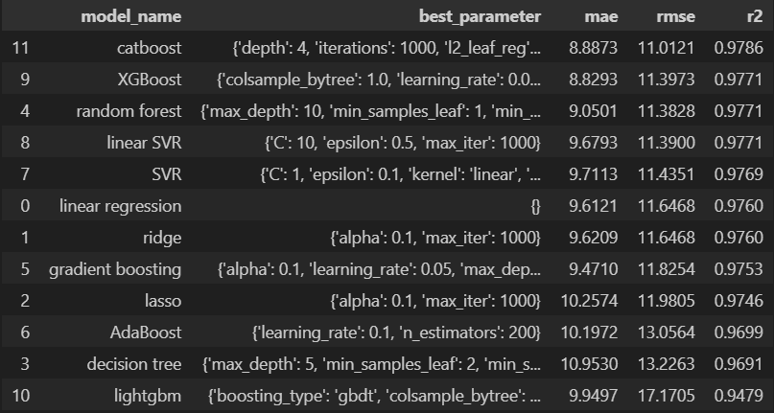
Model Performance
Best model: CatBoost
Mean Absolute Error: 8.887258458025372
Root Mean Absolute Error: 11.012054795145996
R2 score: 0.978578032144269

Slide 8
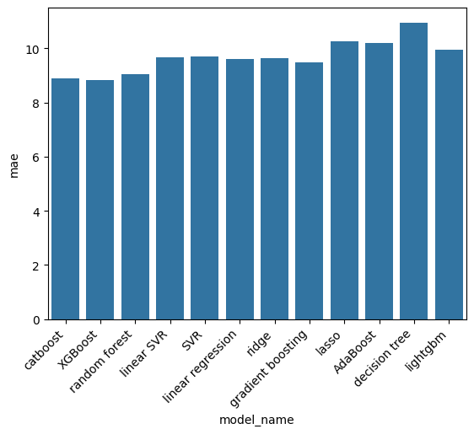
Mean Absolute Error Comparison

Slide 9
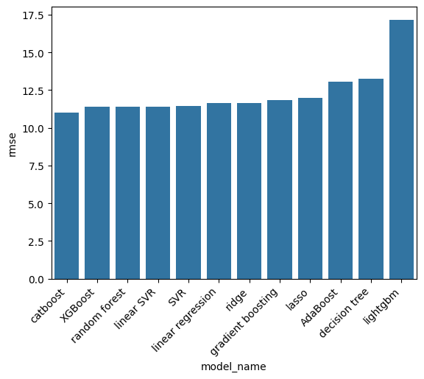
Root Mean Square Error Comparison

Slide 10
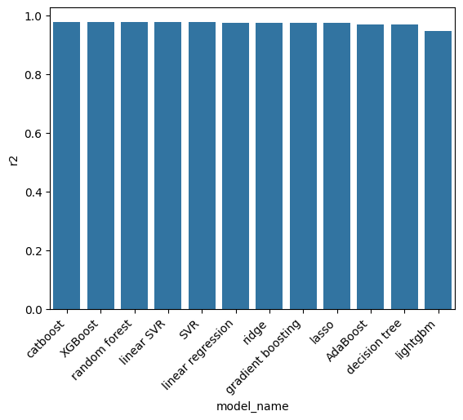
R2 Score Comparison

Slide 11
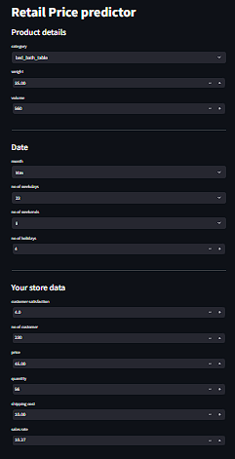
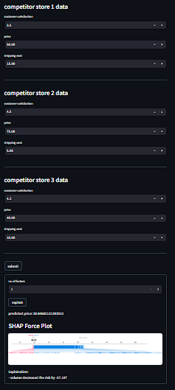


Streamlit App
Project link: pritam2005das/Retail-Price-Predictor
Try it live: Retail Price Predictor

Slide 12
Conclusion
Performed extensive data preprocessing and feature engineering on the retail dataset to prepare key variables such as product attributes, competitor pricing, and temporal factors for modeling.
Developed and trained machine learning models, evaluating multiple regression algorithms to accurately predict optimal retail prices based on market and product conditions.
Implemented an interactive Streamlit web application that allows users to input store and competitor details, generate real-time price predictions, and interpret results using SHAP explainability.
Created a Power BI dashboard to visualize pricing trends, competitor comparisons, and model-driven insights for decision-making support.
The project demonstrates how machine learning and interactive analytics can enable data-driven price optimization, improving profitability, competitiveness, and strategic pricing efficiency in retail operations.

Slide 13
Future Scope
Model Enhancement: Integrate advanced deep learning models such as XGBoost, LightGBM, or Neural Networks to better capture complex nonlinear relationships between price, demand, and competitor behavior.
Dynamic Pricing Automation: Deploy a real-time dynamic pricing engine that automatically adjusts product prices based on demand forecasts, competitor movements, and inventory levels.
Expanded Data Integration: Incorporate external datasets such as economic indicators, seasonal trends, and customer sentiment data from social media to improve prediction accuracy.
Real-Time Deployment: Host the predictive model as an API for live retail systems, enabling automated and adaptive pricing recommendations across multiple sales channels.
Cross-Category Scalability: Extend the model to handle multiple product categories and store types, ensuring scalability across different retail segments.
Enhanced Visualization: Upgrade the Power BI dashboard with “what-if” scenario analysis, elasticity simulation, and revenue optimization insights to support strategic decision-making.

Slide 14

Feedback
Please give me feedback of my project.
Your feedback will encourage and motivate me.
Click here for feedback form

Slide 15
Thank you..

