Slide 1


ANALYSIS ON GOOGLE PLAY STORE APPS

Slide 2
HELLO!
I am Pritam Dhoke

Slide 3
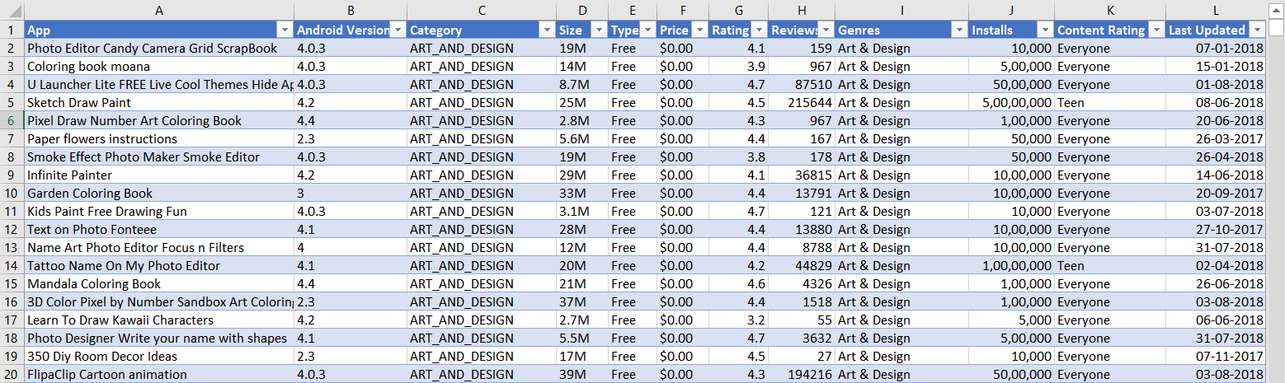
INTRODUCTION
Dataset for this project is taken from Kaggle.com
It consists of in total of 10841 rows and 13 columns.
Dataset includes the following Columns:

Slide 4
THREE PROCESS CARRIED OUT ON DATASET USING “TABLEAU PREP BUILDER”
EXTRACTION
TRANSFORMATION
LOADING

Slide 5
Apps >4.5 Rating & Varies By Size
1st
OBJECTIVE
There are Slicers in the dashboard to select Size

Slide 6
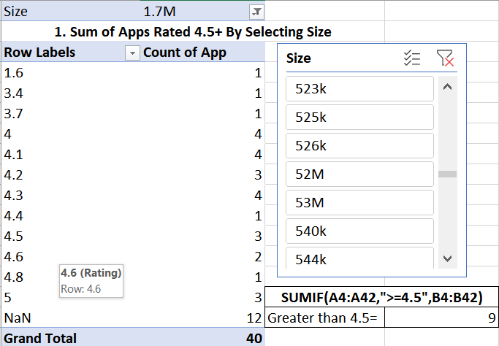
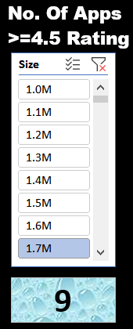
FORMULA & VISUALIZATION
= SUMIF(Calculation!A4:A42,">=4.5",Calculation!B4:B42)
PIVOT CHART
SLICER FOR SIZE

Slide 7
No. of teens uses Paid or Free app
^{2nd}
OBJECTIVE
List is inserted to change the category

Slide 8
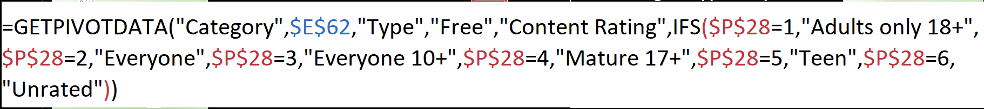
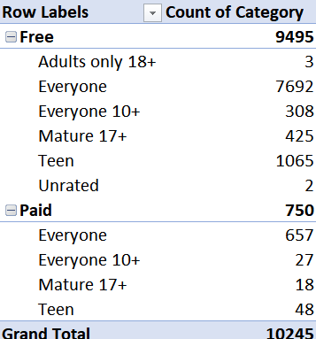
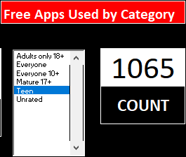
FORMULA & VISUALIZATION

Slide 9
Percentage of Free and Paid Apps
^{3rd}
OBJECTIVE
There are Slicers in the dashboard to select Size

Slide 10
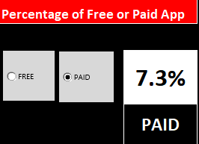
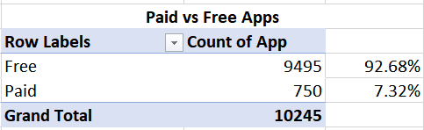
FORMULA & VISUALIZATION
Radio Button can be used to select FREE or PAID app

Slide 11
Percentage of Apps Last Update
^{4th}
OBJECTIVE
Year is dived into 4-quarter and Bar chart is build

Slide 12
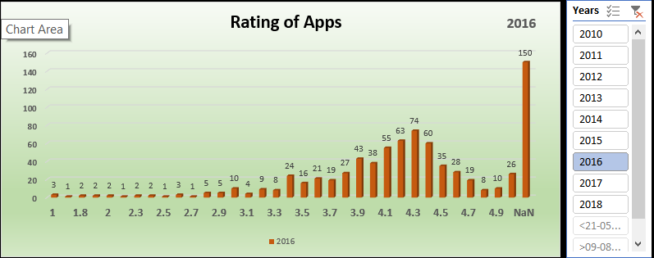
FORMULA & VISUALIZATION

Slide 13
Distribution of User Ratings by Years
^{5th}
OBJECTIVE
The dataset is of 2010 to 2018 that means 8 years.

Slide 14
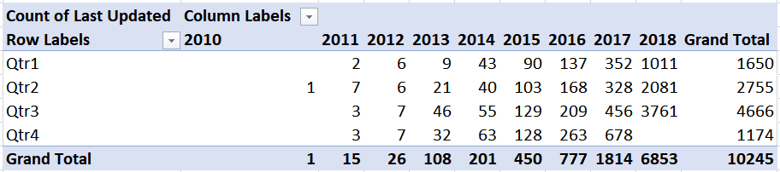
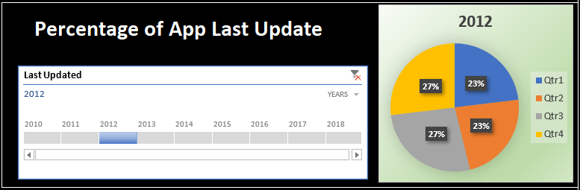
FORMULA & VISUALIZATION

Slide 15

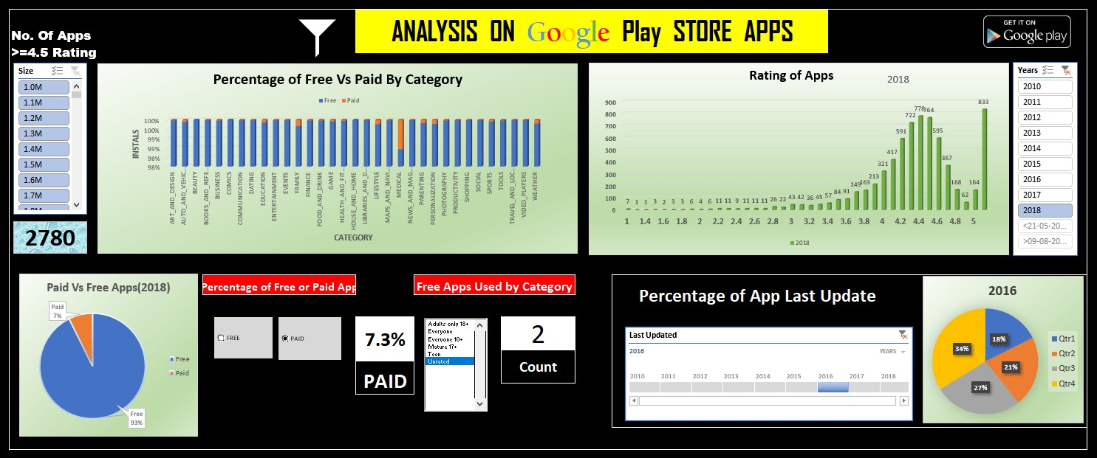
DASHBOARD

Slide 16
LET’S REVIEW SOME RESULT
Maximum Number of Apps in the Store are from the "Family' and 'Game' Category.
The costliest App is 'I am Rich- Trump Edition', which is of $400!
Almost 93% of the Apps are free in the Play Store.
Most of the Apps hold a rating of above 4.0 easily.

Slide 17
THANKS!
Special thanks to all the people who helped throughout my project.

Slide 18
Any questions?

