Slide 1
Scientific Calculator
Name : Pritam
Section : K17RZ
Group : 3

Slide 2
Introduction
A scientific calculator is a type of electronic calculator, usually but not always handheld, designed to calculate problems in science, engineering, and mathematics. They have almost completely replaced slide rules in traditional applications, and are widely used in both education and professional settings.

Slide 3
PURPOSE
Scientific calculators are used widely in situations that require quick access to certain mathematical functions.
Especially those that were once looked up in mathematical tables, such as trigonometric functions or logarithms.
And for those who are not reliable in carrying hardware.

Slide 4
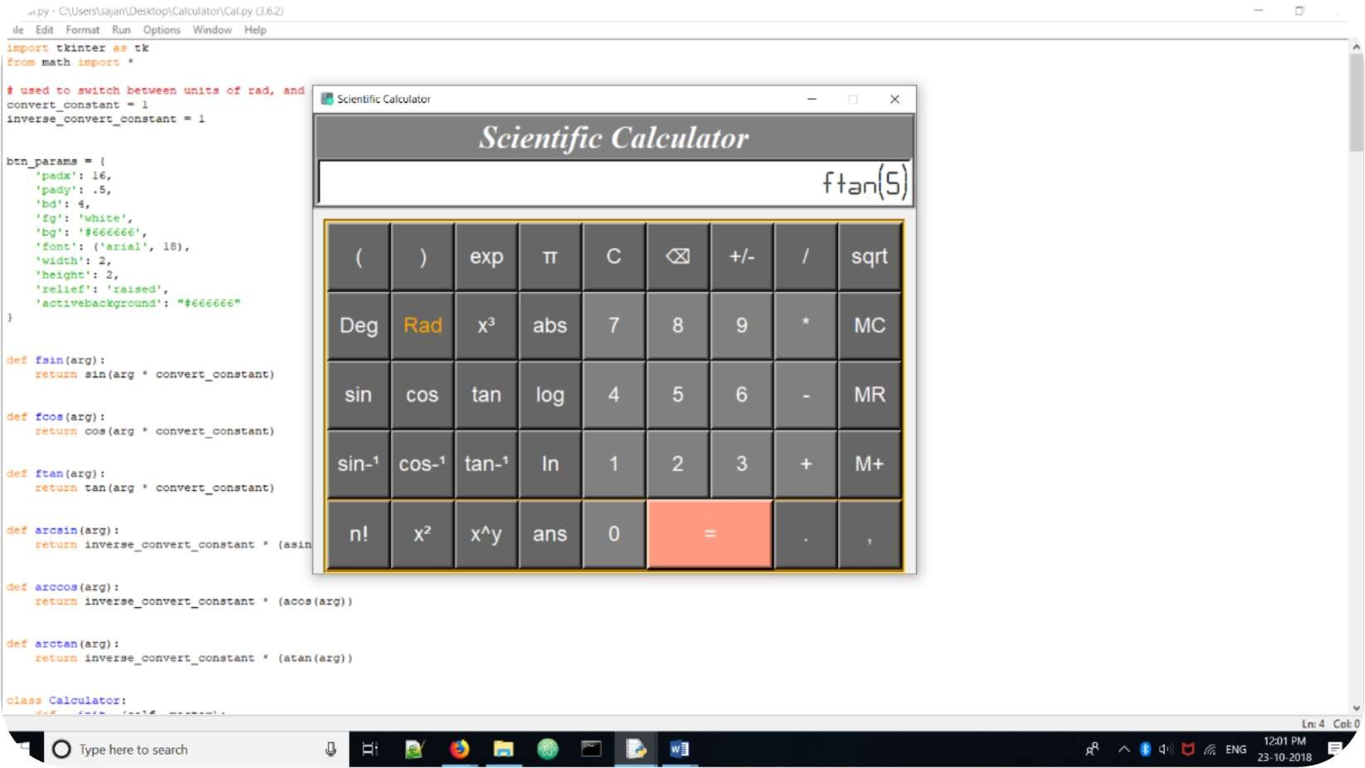
Screenshots

Slide 5
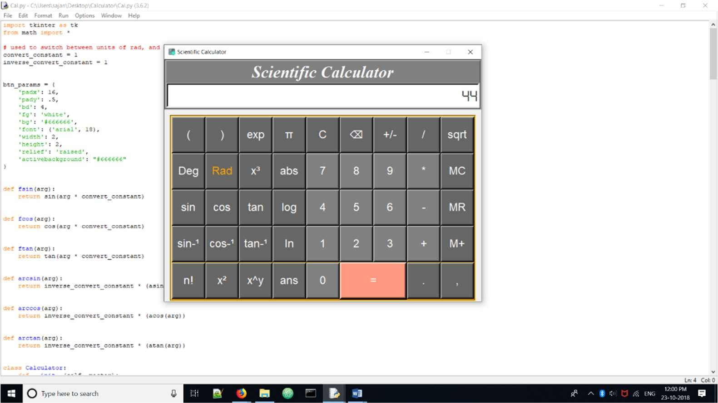
Addition

Slide 6
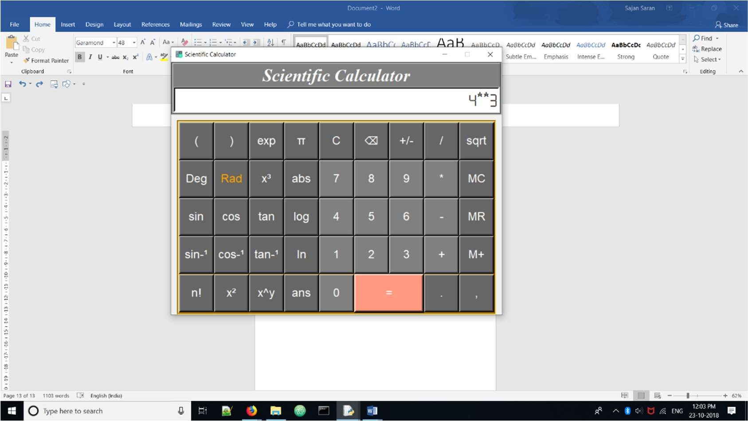
Power

Slide 7
Important Code
import tkinter as tk
from math import *
# used to switch between units of rad, and deg
convert_constant = 1
inverse_convert_constant = 1
.
.
.
root = tk.Tk()
b = Calculator(root)
root.title("Scientific Calculator")
root.geometry("680x520+50+50")
root.iconbitmap("calc-icon.ico")
root.resizable(False, False)
root.mainloop()

