Slide 1
From Committee to Continuum
Can Markets Price Default Faster Than Rating Agencies?
A structural credit-risk model tested against a real bank failure
MS37025 · Managing Financial Services and Institutions
Department of Management Studies, NIT Warangal
Dhritabrata Swarnakar

Slide 2
AGENDA
Roadmap
01
The setup
02
The critique
How India rates bank credit risk today
Why ratings are structurally slow to move
03
The model
04
The mechanics
Merton / KMV, built from first principles
A Monte Carlo check of the formula
05
The case
06
The verdict & limits
Yes Bank, 2018-2020, market vs. agencies
What won, and where the model breaks for banks
07
The synthesis
Why both signals are needed
2

Slide 3
01 · THE SETUP
What a credit rating actually is
A credit rating is an agency's opinion, on a letter scale, of how likely a borrower is to miss a payment. CRISIL, ICRA and CARE are the main Indian agencies rating bank debt.
AAA
AA
A
BBB
BB & below
Very low risk
Low risk
Moderate
Adequate
Speculative / junk
A bank has several ratings at once
Senior bonds — highest claim, so highest rating
Tier II subordinated bonds — absorb losses after senior debt, rated lower
AT-1 bonds — can be written down at a capital trigger, rated several notches below senior debt
Short-term instruments (CDs) — rated separately for near-term liquidity
3

Slide 4
01 · THE SETUP
How a rating is produced
1
2
3
Evidence gathering
Committee decision
Surveillance
Audited accounts, RBI filings, management meetings. For a bank: capital adequacy, asset quality, profitability, funding.
A panel votes on the grade. The output is a judgement call, not the result of a formula.
Reviewed at least yearly, and after major events. An outlook (positive/stable/negative) or a watch can signal a change is pending.
Three properties this bakes in
Committee-based (judgement, not a formula) · Periodic (the grade moves in discrete steps) · Disclosure-dependent (agencies see what the bank reports, when it reports it)
4

Slide 5
02 · THE CRITIQUE
Why ratings are sticky by design
Agencies aim to be through-the-cycle: a rating meant to hold across ordinary ups and downs, not flip with every price move.
Investor mandates and bond covenants reference ratings, so frequent flips would force repeated buying and selling.
A downgrade has consequences, so agencies wait for documented evidence — evidence that typically arrives on a quarterly disclosure calendar.
Net effect: the rating moves late, and in discrete steps, even while true credit quality is moving continuously.
This recurs globally
Enron (2001): still investment grade in late Nov 2001; cut to junk on 28 Nov, days before its 2 Dec bankruptcy filing.
2007-09 crisis: AAA-rated mortgage securities were downgraded in bulk from mid-2007, after losses had already begun to show.
Both are background here
Yes Bank, next, is the local test of the same pattern.
5

Slide 6
02 · THE CRITIQUE — YES BANK, 2018
The gap, in one number
CARE upgrades Yes Bank to AAA
First downgrade (ICRA + CARE)
5 July 2018
28 November 2018 — 146 days later
-48%
The RBI's ruling on the CEO's term reached the market on 21 Sep 2018 — the share fell 29% that single day.
The AAA rating did not move on that day, or for the following ten days.
CARE placed AAA on watch ~1 Oct; ICRA followed on watch 17 Nov; the downgrade itself landed 28 Nov.
Share-price fall over those 146 days
6

Slide 7
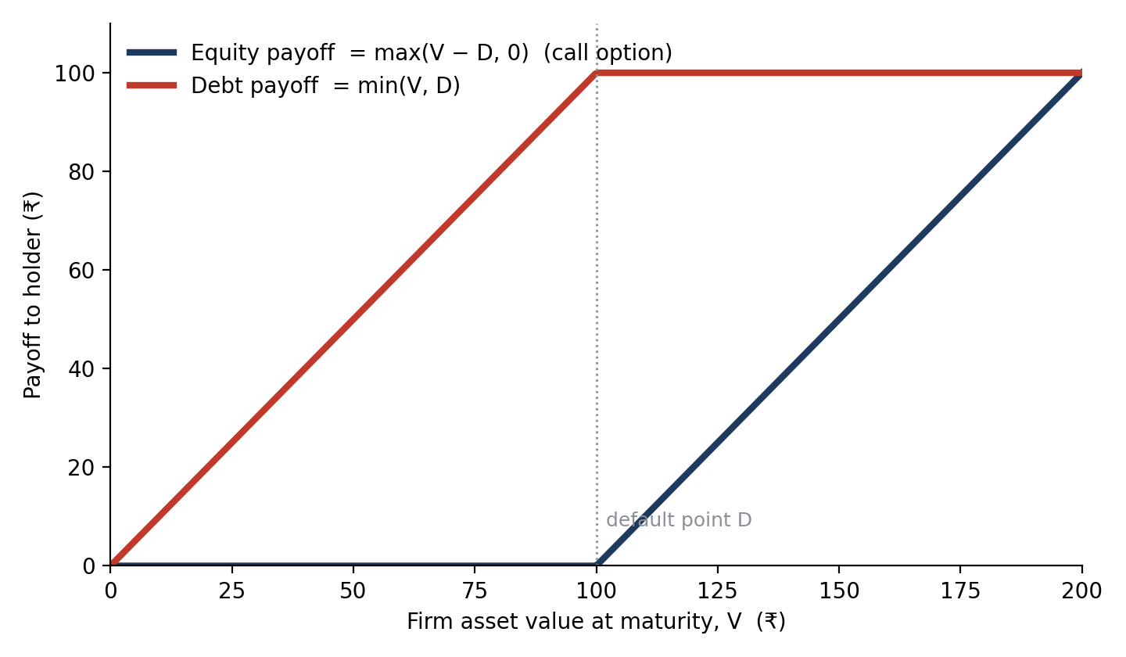
03 · THE MODEL — FOUNDATIONS
The alternative: equity is a call option
Set up the simplest firm
Financed by equity plus one zero-coupon bond of face value D, due at time T.
If assets V_T > D: debt is repaid in full; shareholders keep V_T − D.
If V_T < D: shareholders get nothing (limited liability); lenders take the assets.
Shareholder payoff = max(V_T − D, 0) — exactly a call option on the assets, struck at D.
Default = the option expires worthless. Option-pricing maths can therefore be turned around to read default risk out of daily equity prices.
7

Slide 8
03 · THE MODEL — FOUNDATIONS
Prerequisite: how asset value moves
Asset value can't go negative and moves in percentage terms — so we model the log of V as normal (lognormal V), using geometric Brownian motion (GBM):
dVₜ / Vₜ = μ dt + σ dWₜ
μ
drift: average yearly % growth
σ
volatility: st. dev. of yearly % growth
dWₜ
random shock ~ N(0, dt), i.i.d.
Solved forward, this gives:
Vₜ = V₀ · exp[ (μ − σ²/2)·T + σ√T · Z ], Z ~ N(0,1)
ln(Vₜ) is normal — which is exactly the lognormal shape a positive, percentage-driven quantity should have.
8

Slide 9
03 · THE MODEL — FOUNDATIONS
Why μ − σ²/2, and why it isn't CAGR
Volatility drag
Why CAGR is the wrong input
An asset worth 100 that rises 50% then falls 50% ends at 75, not 100. The arithmetic average return is 0%, but the outcome is a loss. Randomness costs compounding — the cost is about ½σ² per year.
CAGR is a geometric average: the constant rate that turns a start value into the realised end value. Over long samples, CAGR ≈ μ − ½σ² — it already has the drag baked in.
Mean of Vₜ grows at μ.
Median (typical path) grows at μ − ½σ².
Worked check: V₀=120, μ=8%, σ=25%.
Mean end value = 120·e^0.08 = 130.0
Median end value = 120·e^(0.08−0.03125) = 126.0
Put CAGR in place of μ, and the formula subtracts the drag twice: once when CAGR was measured, once again by −½σ². The input must be the arithmetic expected return μ.
9

Slide 10
03 · THE MODEL — CORE FORMULA
Distance to default: a distance in σ units
DD = [ ln(V/D) + (μ − σ²/2)·T ] / (σ·√T) PD = N(−DD)
V
D
μ
σ
T
asset value today (estimated, not observed)
default point: debt the assets must cover
expected asset drift (arithmetic mean)
asset volatility
horizon in years
What it computes
Worked example
How many standard deviations separate the expected asset value from the default point. Numerator = today's log-cushion plus expected drift. Denominator = the size of one σ of uncertainty over the horizon.
V=120, D=100, μ=8%, σ=25%, T=1:
DD = [ln1.2 + (0.08−0.03125)] / 0.25 = 0.924
PD = N(−0.924) = 17.8%
Larger DD = safer. DD near 0 means the expected outcome sits right at the default point.
10

Slide 11
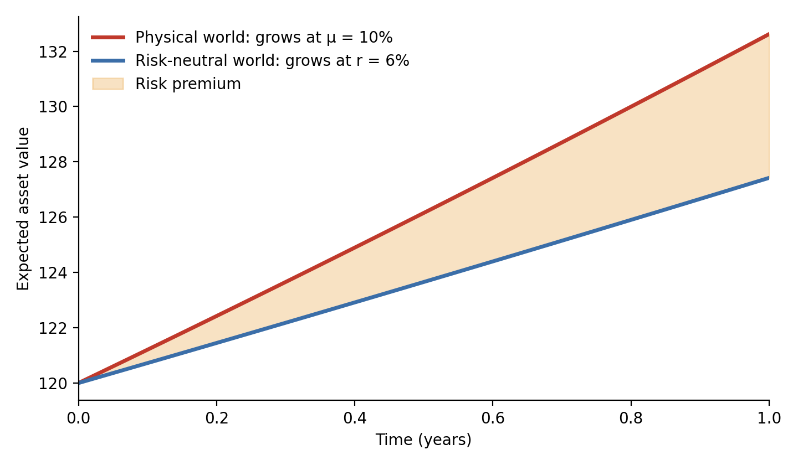
03 · THE MODEL — TWO WORLDS
Two probabilities from the same model
Risk-neutral ≠ real world
Risk-neutral pricing values options via no-arbitrage: as if all assets grew at the risk-free rate r. It gives the right price, not a forecast.
PD_physical = N(−DD), using real drift μ.
PD_risk-neutral = N(−d₂), same formula with μ replaced by r.
Since μ > r (investors demand a risk premium), PD_physical < PD_risk-neutral.
Worked example: d₂ = 0.844 → risk-neutral PD = 19.9%, vs. physical PD = 17.8%. Use risk-neutral for pricing bonds; physical for judging how likely default actually is.
11

Slide 12
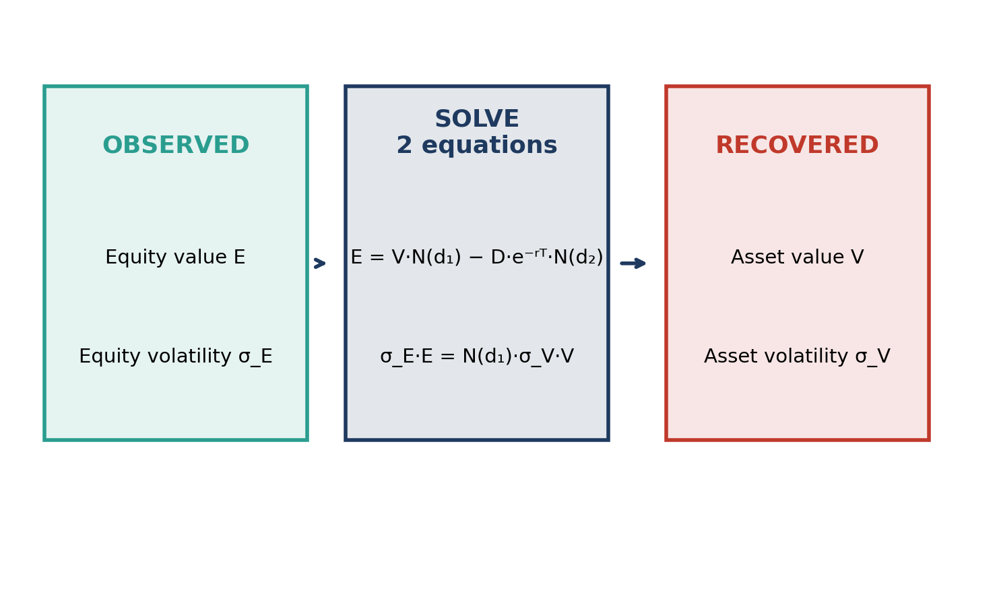
03 · THE MODEL — FROM THEORY TO DATA
Making it usable: V and σ aren't observable
Only equity trades
Two equations, two unknowns:
E = V·N(d₁) − D·e^(−rT)·N(d₂)
σ_E·E = N(d₁)·σ_V·V
Given observed E, σ_E and balance-sheet D, solve numerically for V and σ_V. This is exactly what yes_bank_dd.py does for every trading day.
12

Slide 13
03 · THE MODEL — FROM THEORY TO INDUSTRY
KMV's practical refinements
1. The default-point convention
2. DD → EDF, not N(−DD)
Real firms rarely default the moment assets dip below total liabilities — they often keep operating while long-dated debt isn't yet due.
KMV convention:
D = short-term debt + ½ × long-term debt
(for a one-year horizon)
This is an empirical convention, not a theorem.
Real asset returns have fat tails — the normal curve understates how often firms actually default.
So KMV ranks firms by DD, then looks up what fraction of firms at that DD level actually defaulted within a year, from its own historical database.
That empirical fraction is the Expected Default Frequency (EDF). DD ranks; EDF is the calibrated probability.
13

Slide 14
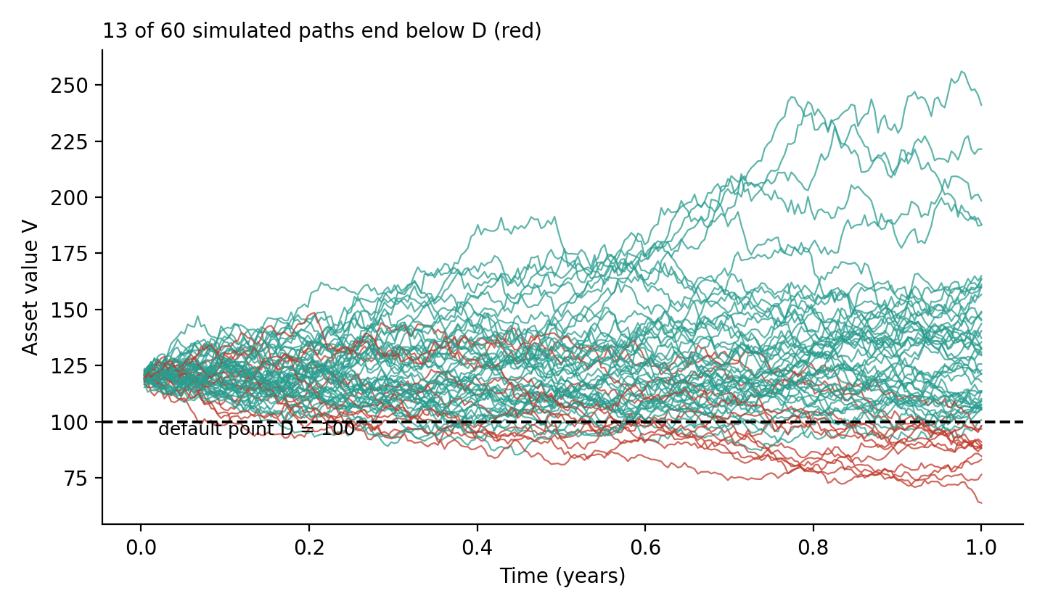
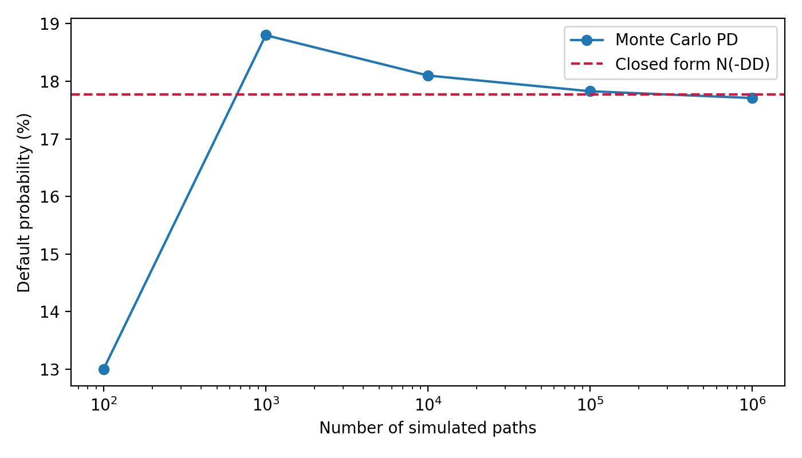
04 · THE MECHANICS
The mechanics: simulate it and count
Algorithm: simulate many GBM asset paths → count the share ending below D → compare with the closed form N(−DD). At V=120, D=100, μ=8%, σ=25%: 1,000,000 paths give 17.71% vs. the formula's 17.77%.
14

Slide 15
05 · THE CASE
The case: Yes Bank, 2018-2020
Test: did the market-implied distance to default deteriorate before the rating agencies' downgrades, and before the RBI's intervention?
What “default” means here
Yes Bank never missed a senior bond payment before the intervention.
The trigger was regulatory: an RBI moratorium on 5 March 2020 under Section 45 of the Banking Regulation Act, 1949 — withdrawals capped at Rs 50,000, board superseded.
Merton defines default as assets falling below debt; the RBI acted on a supervisory view the bank could not meet its liabilities as they fell due.
Test uses three markers in order: rating actions, the RBI moratorium, and ICRA's own [ICRA] D default label the next day.
15

Slide 16
05 · THE CASE
Data and method
Equity
Default point D
Daily close × shares outstanding. 231.0 cr shares to mid-Aug 2019, then 254.9 cr after the QIP.
Total liabilities (deposits + borrowings + other) from the balance sheet published at that time — what a market participant could actually see.
Volatility σ_E
Rates & drift
Trailing 60-day daily log-returns, annualised by √252.
r = 6%, T = 1 year. Physical DD uses μ = 10%; d₂ uses μ = r. Both plotted; a robustness check follows.
16

Slide 17
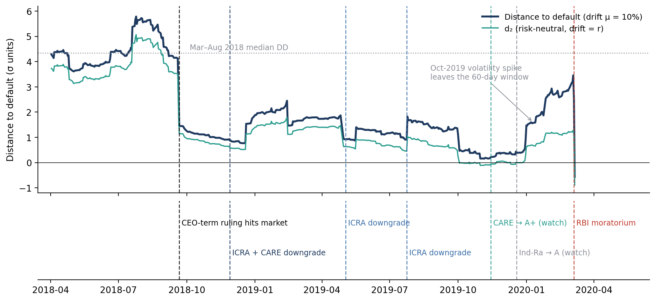
05 · THE CASE — RESULTS
Distance to default vs. the rating actions
DD collapses on the day of each stress event, well ahead of the matching rating action — except at the moratorium itself.
17

Slide 18
05 · THE CASE — RESULTS
Reading the lag, episode by episode
Episode
Market signal (DD)
Agency response
CEO-term ruling
(Sep 2018)
Falls from 4.2 to 1.5 on 21 Sep 2018
CARE watch +10d · ICRA watch +57d · first downgrades +68d
Q4 FY19 loss
(Apr 2019)
1.9 → 0.9 on 30 Apr 2019
ICRA downgrade +3d · India Ratings +8d
Slide into FY19
divergence (2019)
First below 0.5 on 3 Oct; low of 0.15 on 5 Nov
CARE cut +42d · India Ratings +77d
Moratorium
(Mar 2020)
3.45 on 4 Mar — highest since Sep 2018
RBI acts 5 Mar · ICRA [ICRA] D on 6 Mar
18

Slide 19
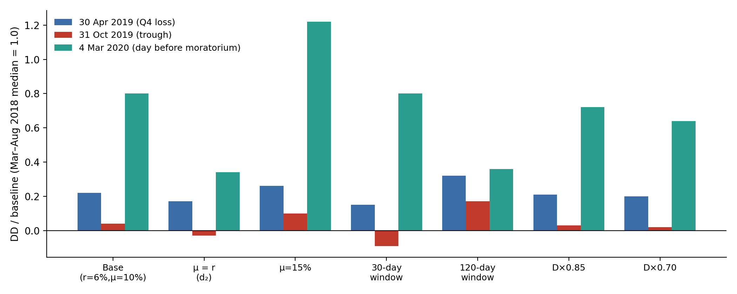
05 · THE CASE — ROBUSTNESS
Is the timing an artefact of the assumptions?
Across seven variants (drift, volatility window, and a 15-30% haircut on D), the April and October 2019 warnings survive every time, and the March 2020 read stays elevated in every variant. The level moves with the assumptions; the timing does not.
19

Slide 20
06 · VERDICT & LIMITS
The verdict
The market moved first — but did not time the intervention
In every downgrade episode, DD collapsed on the day of the stress news, ahead of the agencies by 3 to 68 days.
But on 4 March 2020, the day before the moratorium, DD stood at its highest reading since September 2018 — the regulator acted on private supervisory information and an unpublished quarterly loss.
What DD gave was a persistent, correct warning of chronic distress. What ratings gave was slower, stepwise confirmation. Neither predicted the date.
Two honest qualifications: (1) market and agencies often reacted to the same public news, so “faster” partly means “trades daily vs. meets periodically”, not “knows more.” (2) DD also fell sharply in Sep 2018 and partly recovered without a failure — a fixed alarm threshold would have given a long run of false alarms first.
20

Slide 21
06 · VERDICT & LIMITS
Where Merton breaks, specifically for banks
Deposits aren't bonds
Asset quality is opaque
Short-term, runnable liabilities that behave like debt but aren't traded — the default point is inherently ambiguous.
V is inferred from the equity price; RBI divergence reports show reported vs. supervisor-assessed NPAs differing by thousands of crores.
Regulatory forbearance
The credit-spread puzzle
Rules that delay recognising bad loans keep reported assets above economic value; a bank can be economically insolvent yet still open.
Merton-type models empirically understate real-world spreads for investment-grade issuers (Huang & Huang, 2012) — the normal curve underweights tail losses.
Estimation error throughout
V, σ_V, D, μ and the vol window are all chosen or estimated; an old volatility spike leaving the window moved DD by more than credit quality changed.
21

Slide 22
07 · SYNTHESIS
Use both — neither signal is enough alone
Rating agencies
Market-implied models
+ Use private, qualitative information
+ Stable; anchor mandates & regulation
− Slow; move in steps, after the evidence is in
+ Continuous, fast, cheap to update
+ No committee needed
− Noisy; blind to losses the market can't see; needs traded equity
Real risk management and regulation read both: the committee's judgement and the market's price.
Where this idea led next: Vasicek's one-factor extension of the Merton model underlies the Basel IRB capital formula.
22

Slide 23
Thank you
Questions & discussion
Dhritabrata Swarnakar · MS37025, Department of Management Studies, NIT Warangal

