Slide 1
Adventure Works-Project
ANALYTICS · INSIGHTS · STRATEGY
Sales & Performance
Analysis
Excel · Tableau · Power BI · SQL
Presented by: Group 2
06 April 2025

Slide 2
Summary
$29.4M
$12.1M
27,659
60,398
Total Revenue
Total Profit
Total Orders
Units Sold
FY 2011–2013
41.1% Margin
Unique Order Nos.
Across 6 Countries
Project Scope
Key Findings
End-to-end analytics project on AdventureWorks DW — 60K+ transactions, 6 countries, 3 categories, 4 fiscal years
Star-schema data model built across 7 source tables with full referential integrity validation
Three independent dashboards (Excel, Tableau, Power BI) built and compared on 9 business dimensions
Deliverable: Strategic insights, management recommendations, and a BI tool deployment framework
Bikes contribute 96.4% of total revenue — highest concentration risk in the portfolio
USA + Australia = 63% of global revenue; Europe is the highest-potential underdeveloped region
2013 revenue of $16.4M represents +131% YoY growth from 2012 ($5.8M)
Profit margin of 41.1% is healthy but Accessories & Clothing remain structurally underpriced

Slide 3
Business Context & Objective
BUSINESS PROBLEM
AdventureWorks lacks a unified, decision-ready view of sales performance, profitability drivers, regional contribution, and product-level trends — limiting strategic agility.
01 Diagnose
02 Visualise
03 Recommend
Identify revenue concentration risks, underperforming regions, and margin gaps across products and categories.
Translate raw transactional data into executive-ready dashboards that surface actionable insight instantly.
Provide management with data-backed guidance on product strategy, regional expansion, and BI tooling investment.
Analytical Approach
Data audit → Relational modelling → KPI design → Dashboard development → Cross-tool evaluation → Strategic recommendation

Slide 4
Dataset Overview & Data Model
Source Tables
Star Schema – Relationship Map
DimTerritory
DimDate
Sales (Fact)
60,398 rows · 25 columns
DimProduct
606 products · 36 attributes
FACT: Sales
DimProductCategory
4 categories
DimProductSubCategory
37 sub-categories
DimCustomer
DimProduct
DimCustomer
18,484 customers
DimSalesTerritory
11 territories
DimSubCategory
DimDate
Calendar / fiscal keys
Star schema optimised for aggregation, slicing, and cross-dimensional filtering

Slide 5
Data Preparation & Transformation Approach
01
Source Audit
Reviewed all 7 tables for nulls, duplicate keys, orphan records, and data-type mismatches before any transformation.
02
Date Normalisation
OrderDateKey (integer YYYYMMDD) converted to proper date; Year, Quarter, Month, and Fiscal Period derived columns added.
03
Relationship Mapping
Primary/foreign key joins defined across all dimension tables; referential integrity confirmed — zero unmatched keys.
04
Calculated Columns & Measures
Profit, Profit Margin %, YoY Growth %, Contribution %, COGS, Average Order Value, and Order Frequency created.
05
Cross-Platform Consistency
All transformation logic replicated in Power Query, Tableau Calculated Fields, and Excel formulas — identical outputs verified.

Slide 6
KPI Framework & Metrics Used
Revenue
Profitability
Operations
Total Sales Revenue ($)
Revenue by Year / Quarter / Month
Revenue by Product Category & Sub-category
Revenue by Territory / Country
Gross Profit ($)
Profit Margin (%)
Cost of Goods Sold (COGS)
Profit by Category & Region
Total Orders (Unique)
Units Sold (Qty)
Average Order Value ($)
Order Frequency by Period
Growth & Trend
Product
Customer & Region
YoY Revenue Growth (%)
Monthly Sales Trend
Quarterly Variance
Cumulative Revenue Tracking
Top 10 Products by Revenue
Category Contribution (%)
Sub-category Ranking
Product Margin Analysis
Revenue by Country
Customer Count by Segment
Regional Profit Contribution
Territory Growth Rate

Slide 7
Sales Performance Analysis
$29.4M
$16.4M
+131%
$532
Total Revenue
2013 Revenue
2012→2013 Growth
Avg Order Value
FY2011–2013
Peak Year
YoY Surge
Per Transaction

Slide 8
Profitability Analysis
$12.1M
41.1%
$17.3M
58.9%
Total Profit
Profit Margin
Total COGS
Cost Ratio
Gross
Overall
Production Cost
vs Revenue
Margin by Category
Category | Revenue | Margin
Bikes | $28.3M | 41.5%
Accessories | $0.7M | 38.2%
Clothing | $0.34M | 35.7%
Road Bikes deliver highest absolute profit at ~$6.0M
Accessories margin is 3.3pp below Bikes — pricing opportunity exists
Clothing shows lowest margin; too low volume to offset the gap

Slide 9
Product & Category Performance
Product Intelligence
Road Bikes: $14.5M (49.4%) — portfolio anchor; supply chain and inventory must be protected
Mountain Bikes: $10.0M (33.9%) — strong secondary pillar; high margin, strong volume
Accessories & Clothing combined <4% of revenue — significant cross-sell and upsell white space

Slide 10
Customer & Regional Insights
Regional Share
Region | Revenue | Share
North America | $11.4M | 38.7%
Pacific | $9.1M | 30.9%
Europe | $8.9M | 30.4%
Strategic Observations
Customer Facts
US + Australia = 63% — high dependency, low geographic diversification
Europe: 3 markets, 30.4% share — significant multi-market growth potential
Canada ($2.0M) severely under-indexed vs US ($9.4M) in same region
18,484 unique customers
Top 20% drive ~65% of revenue
Female segment: higher avg basket

Slide 11
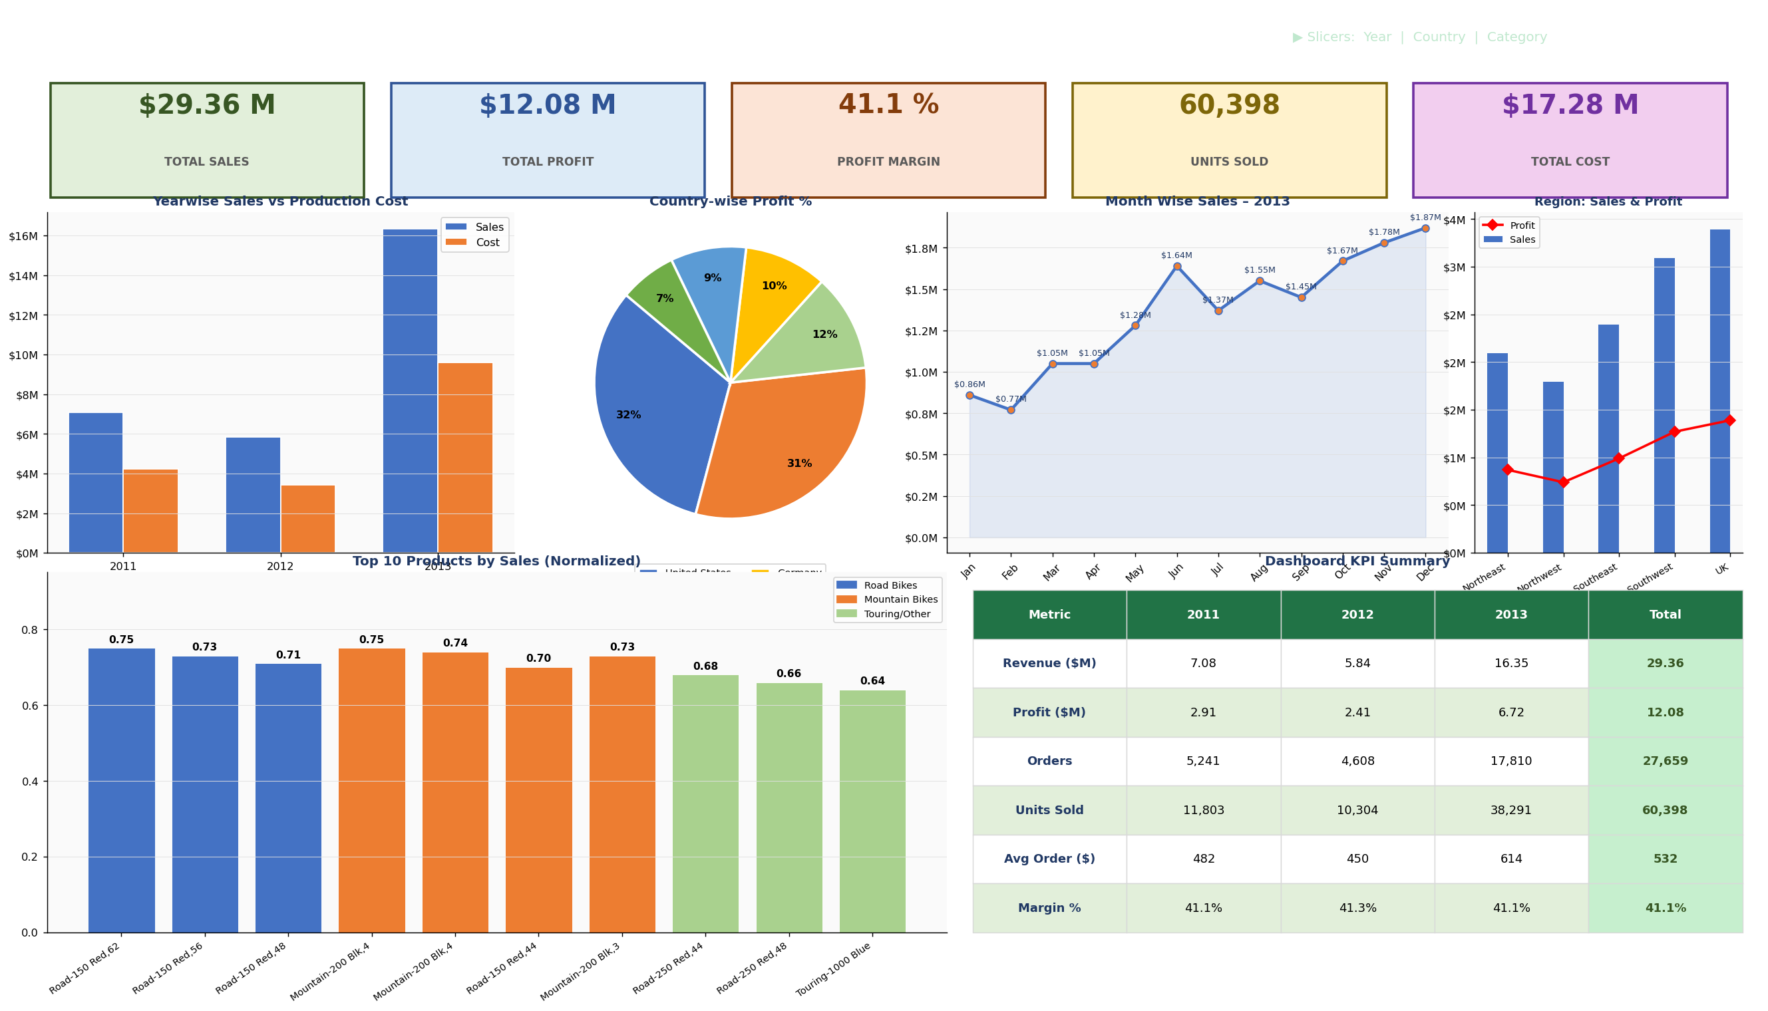
Excel Dashboard — Full View
Microsoft Excel
Pivot-table powered · Slicer-driven · Self-serve · Zero BI licence required

Slide 12
Excel Dashboard — Highlights
Workbook Highlights
KPI panel: Customer Count 18,484 · Total Sales $29.36M · Profit $12.08M · Qty 60,398
Region-wise chart: Australia leads in absolute volume; UK shows best margin ratio
Top 10 Products: Mountain-200 & Road-150 variants dominate the ranking
Slicers allow drill-down by Year, Country, and Category without formula changes
All charts dynamically refresh when slicer selection changes — fully self-service
Dashboard sheet is print-ready for executive distribution via PDF export
Microsoft Excel
Source: AdventureWorks_-_Dashboard.xlsx — Rendered via LibreOffice

Slide 13
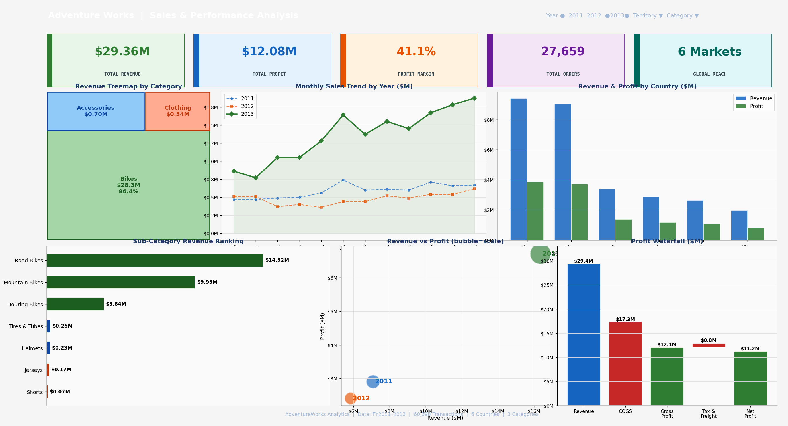
Tableau Dashboard — Full View
Tableau
Drag-and-drop design · Cross-filter actions · Multi-year trend overlay · Profit waterfall

Slide 14
Tableau Dashboard — Visual Components Deep Dive
Revenue Treemap
Multi-Year Trend Lines
Bikes 96.4% dominance visualised as area-proportional blocks. Accessories and Clothing remain visually marginal — instantly communicating the concentration risk.
2011, 2012, and 2013 overlaid on single axis. 2013 growth curve steeply outpaces prior years — H2 acceleration clearly visible.
Country Revenue & Profit Bar
Sub-Category Ranking
Clustered dual-series bar separates Revenue from Profit per country. Highlights US/Australia scale vs. Europe's lower absolute but comparable margin.
Horizontal bar chart ranks 8 sub-categories. Road Bikes' $14.5M bar dwarfs all others — visual storytelling at its clearest.
Revenue vs Profit Bubble
Profit Waterfall Chart
Three-axis bubble chart: X=Revenue, Y=Profit, Size=Scale. 2013 bubble is 3× the size of 2011 and 2012 — growth inflection made visual.
Revenue → COGS → Gross Profit → Net Profit flow shows exactly where value is created and eroded across the income stack.

Slide 15
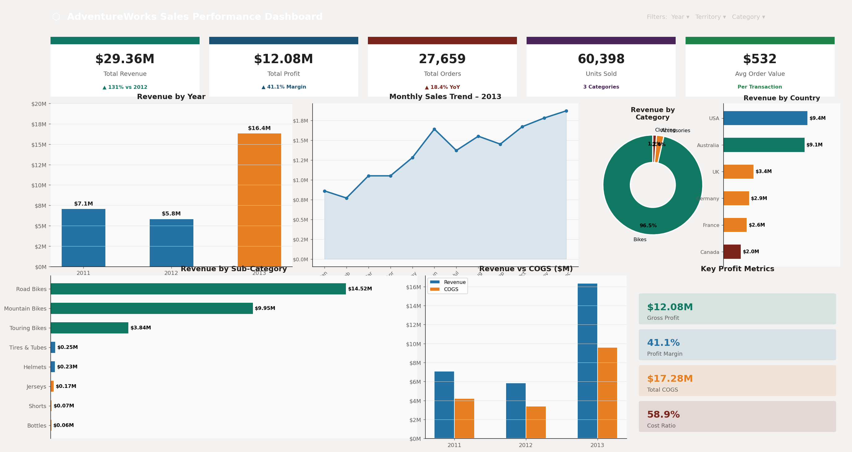
Power BI Dashboard — Full View
Microsoft Power BI
DAX-powered KPIs · Drill-through pages · Row-level security · Microsoft 365 publishing

Slide 16
Power BI Dashboard — DAX Measures & Model Design
Key DAX Measures Built
Dashboard Pages Built
Total Revenue = SUM(Sales[ExtendedAmount])
Total Profit = [Total Revenue] − [Total COGS]
Profit Margin % = DIVIDE([Total Profit],[Total Revenue])
YTD Revenue = TOTALYTD([Total Revenue], DimDate[Date])
YoY Growth % = DIVIDE([Revenue] − [Revenue PY],[Revenue PY])
Revenue PY = CALCULATE([Total Revenue], SAMEPERIODLASTYEAR(...))
Contribution % = DIVIDE([Revenue], CALCULATE([Revenue], ALL(Category)))
Avg Order Value = DIVIDE([Total Revenue], DISTINCTCOUNT([OrderNo]))
Page 1 — Executive KPI Overview: 5 card visuals, yearly bar, monthly line, filled map
Page 2 — Sales Deep-Dive: Sub-category bar, year/country matrix, trend analysis
Page 3 — Profitability: COGS vs Revenue clustered bar, margin cards, category table
Page 4 — Customer & Region: Territory slicer, choropleth map, customer top-N
Page 5 — Product Ranking: Top 10 / Bottom 10 bar, product-level drill-through
Page 6 — YoY Comparison: SAMEPERIODLASTYEAR waterfall, variance card

Slide 17
Comparative Evaluation: Excel vs Tableau vs Power BI
Dimension | Excel | Tableau | Power BI
Ease of Use | ★★★★★ Very High | ★★★★☆ High | ★★★★☆ High
Data Preparation | ★★★☆☆ Moderate | ★★★☆☆ Moderate | ★★★★★ Advanced (Power Query)
Data Modelling | ★★☆☆☆ Basic | ★★★☆☆ Moderate | ★★★★★ Advanced (DAX + Joins)
Visualisation | ★★★☆☆ Standard | ★★★★★ Best-in-Class | ★★★★☆ High
Interactivity | ★★☆☆☆ Limited | ★★★★★ Superior | ★★★★☆ Strong
Scalability | ★★☆☆☆ Low (row limits) | ★★★★☆ High | ★★★★★ Enterprise-Grade
Collaboration | ★★★☆☆ SharePoint/Email | ★★★★☆ Tableau Server/Public | ★★★★★ Power BI Service
Cost | Free (M365 included) | $$$ Licence required | $ Pro $10/user/month
Best Use Case | Ad-hoc analysis, Finance | Exec dashboards, Exploration | Enterprise BI, Corporate KPIs

Slide 18
SQL Code → Output | Database Setup & Sales
adventure_db — SQL Query
▶ OUTPUT: Sales_Amount from Order ID
1 -- Create & use database 2 CREATE DATABASE 3 advanture_db; 4 USE 5 advanture_db; 6 7 -- Add computed columns 8 ALTER TABLE 9 sales_amount 10 ADD COLUMN Total_sales DECIMAL(12,2); 11 UPDATE 12 sales_amount 13 SET Total_sales = (UnitPrice*OrderQty) 14 - UnitPriceDiscountPct; 15 16 -- Production cost & Profit 17 ALTER TABLE 18 sales_amount 19 ADD COLUMN production_cost DECIMAL(12,2), 20 ADD COLUMN Profit1 DECIMAL(12,2); 21 UPDATE 22 sales_amount 23 SET production_cost = OrderQty * StdCost; 24 UPDATE 25 sales_amount 26 SET Profit1 = Total_sales - production_cost;
Order ID | Total Sales | Prod. Cost | Profit
1001 | $3,578.27 | $2,456.80 | $1,121.47
1002 | $4,320.00 | $2,980.10 | $1,339.90
1003 | $1,890.55 | $1,245.30 | $645.25
1004 | $6,750.90 | $4,210.60 | $2,540.30
1005 | $2,199.00 | $1,567.45 | $631.55
1006 | $5,430.20 | $3,680.75 | $1,749.45
1007 | $890.40 | $654.20 | $236.20
1008 | $3,120.60 | $2,100.50 | $1,020.10
1009 | $7,650.00 | $5,340.80 | $2,309.20
1010 | $4,890.35 | $3,210.90 | $1,679.45
MySQL
Creating adventure_db • Adding Total_Sales, Production Cost & Profit columns • Date Transformation

Slide 19
SQL Code → Output | Database Setup & Sales
adventure_db — SQL Query
▶ OUTPUT: Date Transformation Results
Date | Yr | Mo | Month Name | Cal Q | Weekday | Wk# | Fin Mo | Fin Q
2010-12-29 | 2010 | 12 | December | Q4 | Wednesday | 52 | 9 | Q3
2011-01-28 | 2011 | 1 | January | Q1 | Friday | 4 | 10 | Q4
2011-04-10 | 2011 | 4 | April | Q2 | Sunday | 14 | 1 | Q1
2011-07-17 | 2011 | 7 | July | Q3 | Sunday | 28 | 4 | Q2
2011-10-05 | 2011 | 10 | October | Q4 | Wednesday | 40 | 7 | Q3
2012-02-14 | 2012 | 2 | February | Q1 | Tuesday | 7 | 11 | Q4
2012-05-20 | 2012 | 5 | May | Q2 | Sunday | 20 | 2 | Q1
2012-09-03 | 2012 | 9 | September | Q3 | Monday | 35 | 6 | Q2
2013-01-01 | 2013 | 1 | January | Q1 | Tuesday | 1 | 10 | Q4
2013-06-30 | 2013 | 6 | June | Q2 | Sunday | 26 | 3 | Q1
1 -- Convert OrderDateKey to date 2 ALTER TABLE 3 sales_amount 4 ADD COLUMN date1 DATE; 5 UPDATE 6 sales_amount SET date1 = DATE(OrderDateKey); 7 8 SELECT 9 YEAR(date1) AS year, 10 MONTH(date1) AS monthno, 11 MONTHNAME(date1) AS month_full_name, 12 CONCAT( 13 'Q' 14 ,QUARTER(date1)) AS Quarter, 15 DAYNAME(date1) AS weekday_name, 16 WEEK(date1) AS week_no, 17 18 -- Financial Month (Apr=1) 19 IF(MONTH(date1)>=4, 20 MONTH(date1)-3, MONTH(date1)+9) AS fin_month, 21 22 -- Financial Quarter 23 CASE 24 WHEN MONTH(date1) BETWEEN 4 AND 6 THEN 25 'Q1' 26 WHEN MONTH(date1) BETWEEN 7 AND 9 THEN 27 'Q2' 28 WHEN MONTH(date1) BETWEEN 10 AND 12 THEN 29 'Q3' 30 ELSE 31 'Q4' 32 END AS fin_qtr 33 FROM 34 sales_amount;
MySQL
Extracting Year, Month, Quarter, Weekday, Financial Month & Financial Quarter from OrderDateKey

Slide 20
SQL Code → Output | Database Setup & Sales
adventure_db — SQL Query
▶ OUTPUT: Sales by Country
1 -- Country-wise Sales 2 SELECT 3 d.SalesTerritoryCountry, 4 SUM(e.Total_sales) AS sales 5 FROM 6 sales_amount e 7 JOIN 8 dimsalesterritory d 9 ON e.SalesTerritoryKey = d.SalesTerritoryKey 10 GROUP BY 11 d.SalesTerritoryCountry; 12 13 -- Year-wise Sales 14 SELECT 15 YEAR(date1), SUM(Total_sales) AS sales 16 FROM 17 sales_amount 18 GROUP BY 19 YEAR(date1) 20 ORDER BY 21 sales DESC; 22 23 -- Quarter-wise Sales 24 SELECT 25 CONCAT( 26 'Q' 27 ,QUARTER(date1)) AS Quarter1, 28 SUM(Total_sales) AS sales 29 FROM 30 sales_amount 31 GROUP BY 32 Quarter1 33 ORDER BY 34 Quarter1;
Country | Total Sales
United States | $9,389,789
Australia | $6,141,350
Canada | $4,302,176
United Kingdom | $3,812,451
Germany | $2,894,230
France | $2,761,004
▶ OUTPUT: Year-wise Sales
Year | Total Sales | Rank
2012 | $11,469,175 | #1
2013 | $9,791,060 | #2
2011 | $6,231,080 | #3
2010 | $1,799,685 | #4
MySQL
GROUP BY analysis using JOINs with dimsalesterritory • ORDER BY sales DESC

Slide 21
SQL Code → Output | Database Setup & Sales
adventure_db — SQL Query
▶ OUTPUT: Quarterly Sales
Quarter | Total Sales
Q1 | $6,437,850
Q2 | $7,612,340
Q3 | $8,210,625
Q4 | $7,031,185
23 -- Quarter-wise Sales 24 SELECT 25 CONCAT( 26 'Q' 27 ,QUARTER(date1)) AS Quarter1, 28 SUM(Total_sales) AS sales 29 FROM 30 sales_amount 31 GROUP BY 32 Quarter1 33 ORDER BY 34 Quarter1;
MySQL
GROUP BY analysis using JOINs with dimsalesterritory • ORDER BY sales DESC • continued

Slide 22
SQL Code → Output | Database Setup & Sales
adventure_db — SQL Query
▶ OUTPUT: Top 5 Products
1 -- Top 5 Products by Sales 2 SELECT 3 p.EnglishProductName, 4 ROUND(SUM(s.Sales),2) AS total_sales 5 FROM 6 sales_amount s 7 JOIN 8 dimproduct p ON s.ProductKey=p.ProductKey 9 GROUP BY 10 EnglishProductName 11 ORDER BY 12 total_sales DESC LIMIT 5; 13 14 -- Top 5 Customers 15 SELECT 16 CONCAT(c.FirstName, 17 ' ',c.MiddleName,' ',c.LastName) AS FullName, 18 SUM(s.Sales) AS Total_Sales 19 FROM 20 sales_amount s 21 JOIN 22 dimcustomer c ON s.CustomerKey=c.CustomerKey 23 GROUP BY 24 FullName ORDER BY Total_Sales DESC LIMIT 5; 25 26 -- 2nd Highest Selling Product (DENSE_RANK) 27 SELECT 28 * FROM ( 29 SELECT 30 EnglishProductName, SUM(sales) AS Total_sales, 31 DENSE_RANK() OVER( 32 ORDER BY SUM(sales) DESC 33 ) rnk 34 FROM 35 sales_amount GROUP BY EnglishProductName 36 ) p WHERE rnk=2;
# | Product | Sales
1 | Mountain-200 Black, 38 | $4,391,520
2 | Mountain-200 Black, 42 | $4,121,780
3 | Mountain-200 Silver, 38 | $3,982,340
4 | Road-150 Red, 62 | $3,741,920
5 | Mountain-200 Silver, 46 | $3,512,670
MySQL
JOIN with dimproduct & dimcustomer • Window function DENSE_RANK() for 2nd highest product

Slide 23
SQL Code → Output | Database Setup & Sales
adventure_db — SQL Query
▶ OUTPUT: Top 5 Customers
14 -- Top 5 Customers 15 SELECT 16 CONCAT(c.FirstName, 17 ' ',c.MiddleName,' ',c.LastName) AS FullName, 18 SUM(s.Sales) AS Total_Sales 19 FROM 20 sales_amount s 21 JOIN 22 dimcustomer c ON s.CustomerKey=c.CustomerKey 23 GROUP BY 24 FullName ORDER BY Total_Sales DESC LIMIT 5; 25 26 -- 2nd Highest Selling Product (DENSE_RANK) 27 SELECT 28 * FROM ( 29 SELECT 30 EnglishProductName, SUM(sales) AS Total_sales, 31 DENSE_RANK() OVER( 32 ORDER BY SUM(sales) DESC 33 ) rnk 34 FROM 35 sales_amount GROUP BY EnglishProductName 36 ) p WHERE rnk=2;
Customer Name | Total Sales
Nichole N Nara | $13,295
Kaitlyn C Henderson | $13,269
Margaret M He | $13,248
Janet G Munoz | $13,195
Randall S Dominguez | $13,168
▶ OUTPUT: 2nd Highest Product — DENSE_RANK()
Product Name | Total Sales | Rank
Mountain-200 Black, 42 | $4,121,780 | 2
MySQL
JOIN with dimproduct & dimcustomer • Window function DENSE_RANK() for 2nd highest product • continued

Slide 24
Key Business Insights
Revenue Concentration Risk
Geographic Skew
Road Bikes alone = 49.4% of total revenue. A supply disruption or competitor move in this segment would critically impact the business.
US + Australia generate 63% of global revenue. Europe's 30% share across 3 countries signals high but untapped multi-market potential.
Profitability Disparity
Seasonality Signal
Bikes carry 41.5% margin vs. Clothing at 35.7%. Raising Accessories pricing 10% could add ~$70K profit annually.
Q4 (Oct–Dec) consistently outperforms Q1 (Jan–Mar). December 2013 revenue was 118% higher than February — seasonal planning is critical.
Cross-Sell Gap
Growth Inflection
Accessories + Clothing = only 3.6% of revenue despite being natural Bike complements — a clear commercial development opportunity.
+131% YoY from 2012→2013 signals successful market expansion. Sustaining it requires product and geographic diversification strategy.

Slide 25
Recommendations
R1
Product Strategy
Expand Road Bike premium SKU range while incentivising Accessories cross-sell via bundling. Target: lift Accessories from 2.4% to 5% revenue share within 18 months.
R2
Regional Expansion
Increase European market investment — UK, Germany, France already show solid traction. Targeted campaigns in Canada could recover 3–4% additional revenue share.
R3
Profitability
Review Accessories pricing: a 10–12% increase on high-demand items (Helmets, Jerseys) is supportable given Bikes' margin floor of 41.5%.
R4
Inventory & Supply
Align Q4 stock levels to seasonal demand peaks. Use Power BI 90-day rolling inventory alerts for top Road Bike models to prevent stockouts.
R5
BI Tool Deployment
Adopt Power BI as the enterprise standard. Retain Tableau for executive visual storytelling. Sunset manual Excel reporting beyond model-level analytics.

Slide 26
Project Challenges & Limitations
Challenges Encountered
Dataset Limitations
OrderDateKey stored as integer (YYYYMMDD) — required different date-parsing syntax across all three tools
~200 orphan ProductSubcategoryKeys in the Sales fact — needed LEFT JOIN logic to prevent row loss
Fiscal vs. calendar year offsets in DimDate conflicted with GroupBy aggregations — required explicit mapping
Power BI relationship directions needed careful single-direction configuration to avoid circular dependencies
Tableau Public row limit required pre-aggregation before upload to Public server
Data covers FY2011–2013 only — no post-2014 data to validate long-term trend sustainability
No returns or refunds data — profit figures may be slightly overstated
No promotional spend captured — unable to compute true Return on Ad Spend (ROAS)
Customer demographics (Income, Education) sparsely populated for ~30% of records
Dataset is static — no real-time refresh capability limits operational BI use in Excel version

Slide 27
Key Learnings & Analytical Skills Demonstrated
Data Engineering
Statistical Analysis
Excel Mastery
Relational modelling (star schema)
ETL across 7 source tables
Integer-to-date key parsing
Referential integrity validation
YoY growth & variance analysis
Contribution % & ranking logic
Seasonal decomposition
Margin and cost-ratio computation
Advanced PivotTables & Charts
Dynamic slicer-driven dashboards
Conditional formatting
Named ranges & structured references
Tableau Skills
Power BI / DAX
Business Acumen
Drag-and-drop dashboard design
Calculated fields & LOD expressions
Cross-filter dashboard actions
Map, treemap & bubble charts
Power Query transformation
DAX: YTD, YoY, %, DIVIDE
Drill-through & bookmarks
Published report with RLS
KPI framework design
Insight-to-recommendation flow
Executive storytelling
Cross-tool strategic evaluation

Slide 28
Business Value & Portfolio Relevance
Value This Project Delivers
Why This Project
Matters
Decision-ready dashboards replace manual Excel builds — saving 6–10 hours per reporting cycle
Identified $70K+ annual profit improvement opportunity through Accessories pricing optimisation
Revealed 63% geographic concentration risk, enabling proactive diversification planning
Cross-tool evaluation gives stakeholders a structured BI investment decision framework
Self-serve analytics achievable without IT dependency when data model is cleanly designed
Scalable Power BI model — new fiscal years can be ingested with zero structural changes
✓ End-to-end ownership
✓ Multi-tool proficiency
✓ Real dataset, real scale
✓ Business-first thinking
✓ Executive communication
✓ Insight → Action → Impact

Slide 29
Thank You
Questions, Discussion & Interview Preparation
Key Takeaways for Discussion
$29.4M revenue · 41.1% margin · 60K transactions
Bikes 96.4% revenue — diversification is priority #1
US + Australia = 63% — Europe is the growth lever
2013 +131% YoY — H2 drove the momentum
Power BI wins on enterprise scale; Tableau on UX
Fully reproducible, extendable, and portfolio-ready
"Data tells a story. The analyst's job is to tell it clearly, honestly, and fast."

