Slide 1
Apriori Algorithm in Action: A Market Basket Analysis of Supermarket Transactions
Pritam Channawar

Slide 2
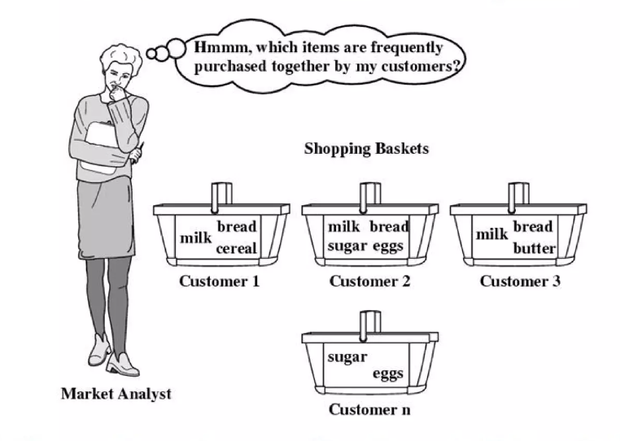
Market Basket Analysis

Slide 3
Why Market Basket Analysis?
Build best recommendations engine.
Improve product recommendations on an e-commerce store.
Cross-sell products in a retail setting.
Improve inventory management.
Upsell products.

Slide 4
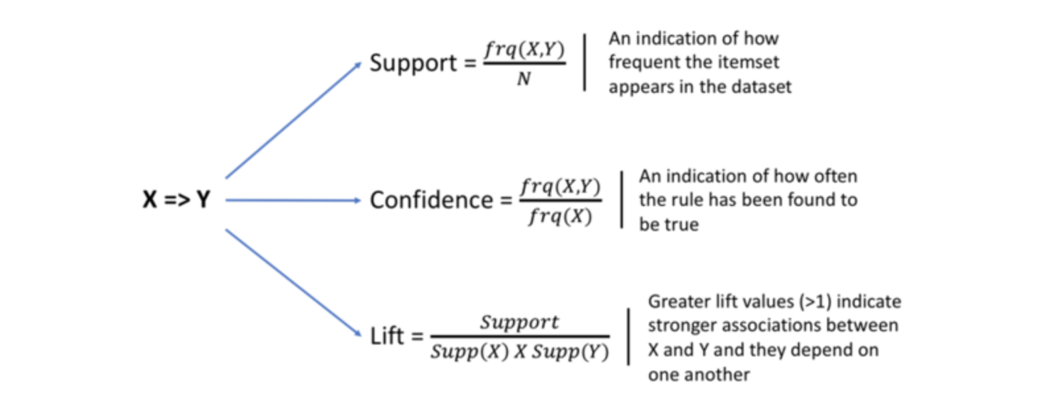
Support Confidence and lift

Slide 5
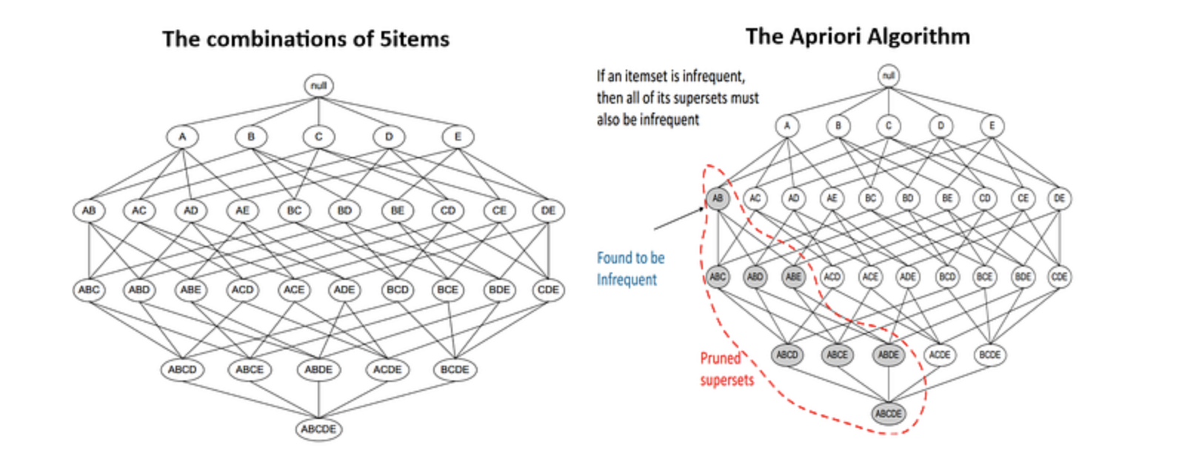
Apriori Algorithm

Slide 6
How Apriori Algorithm works?
1
2
3
Computing the support for each individual item.
Deciding on the support threshold.
Selecting the frequent items.
4
5
6
Finding the support of the frequent itemsets.(pruning)
Repeat for larger sets.
Generate Association Rules and compute confidence.Compute lift.

Slide 7
Data Cleaning
Dataset used : Supermarket transactions from Kaggle
There were a total of 7,501 transactions, each containing between 1 and 20 items
Data Cleaning

Slide 8
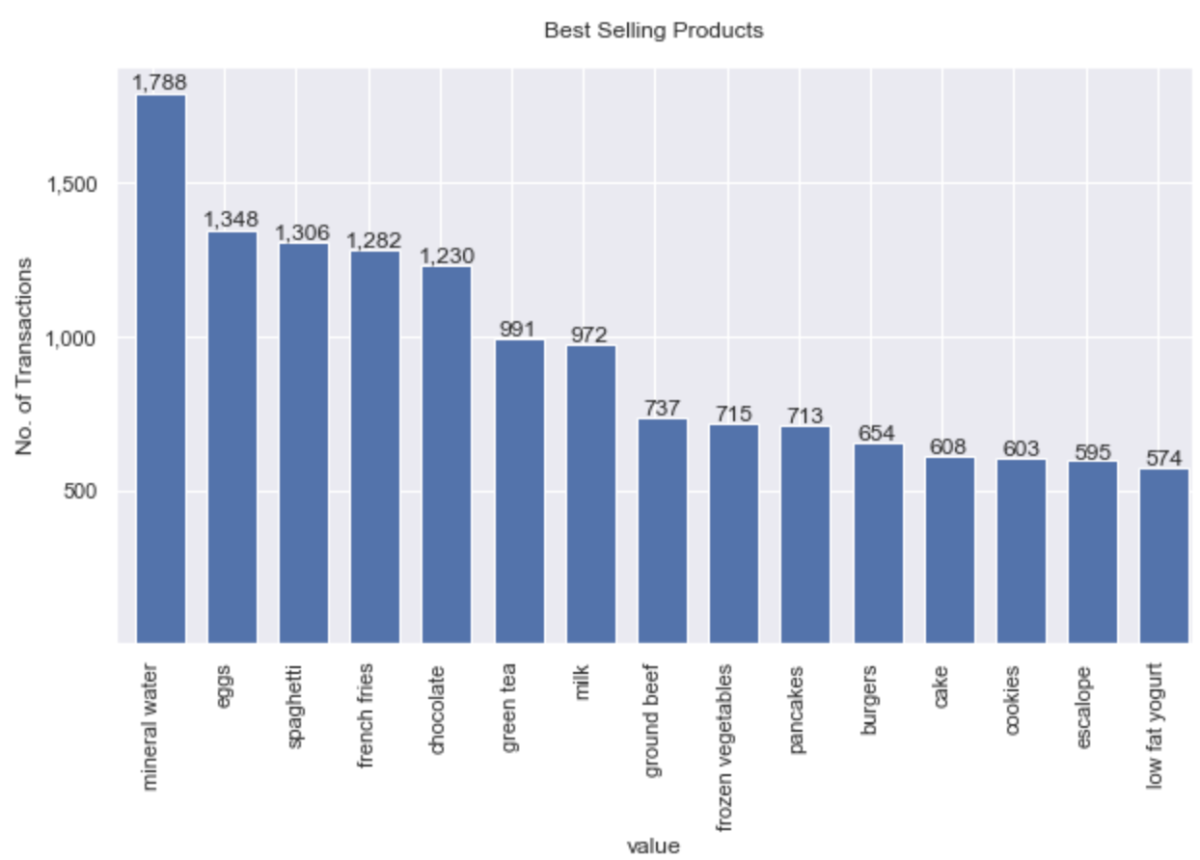
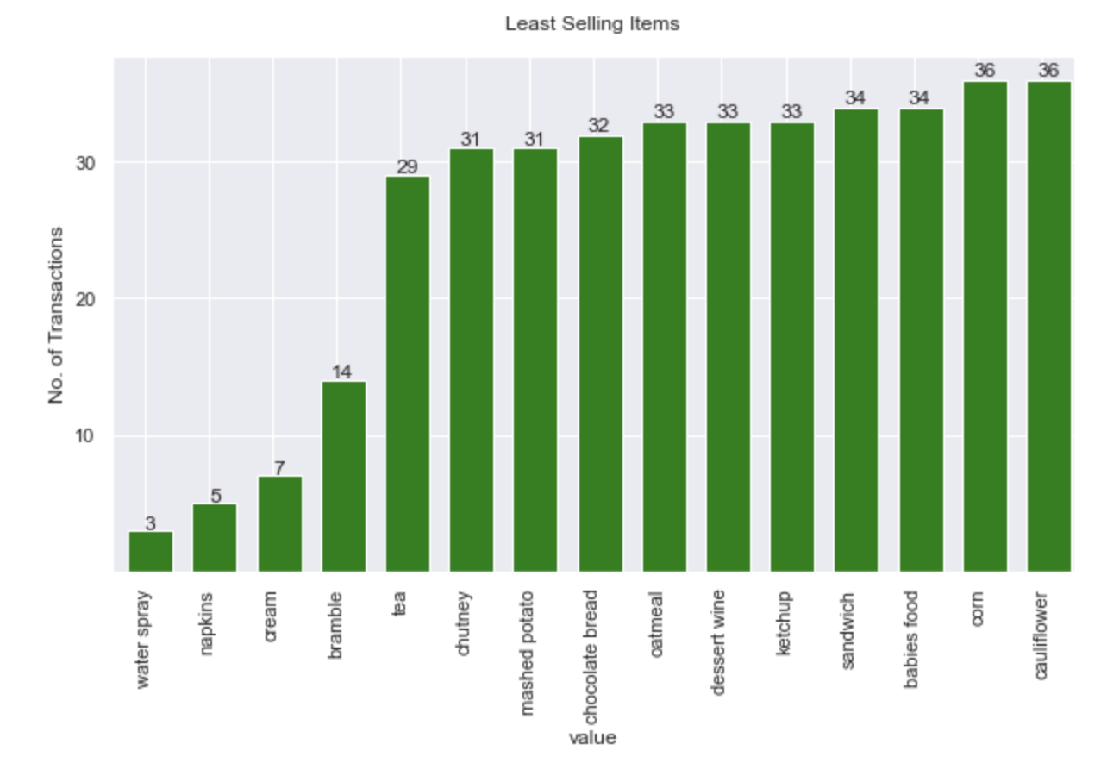
EDA

Slide 9
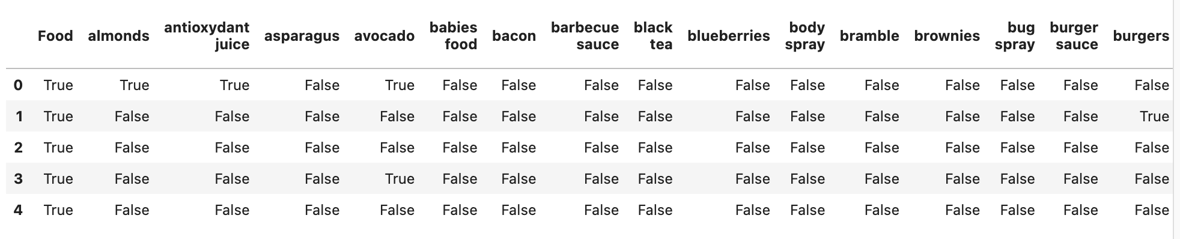
Onehot encoding

Slide 10
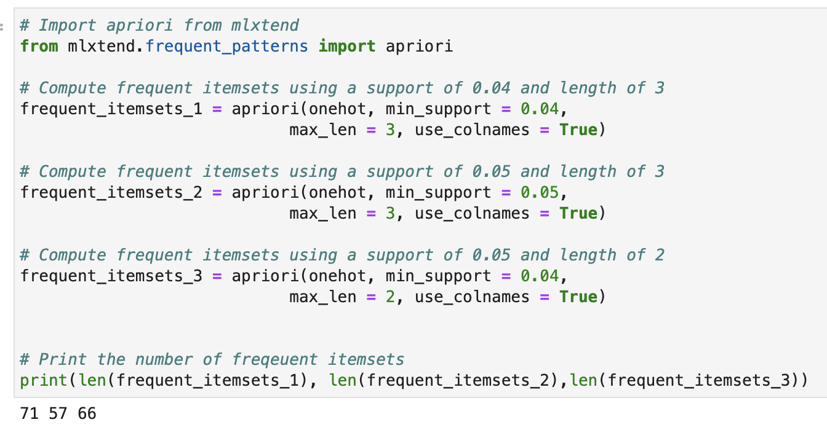
Identifying frequent itemsets with Apriori

Slide 11
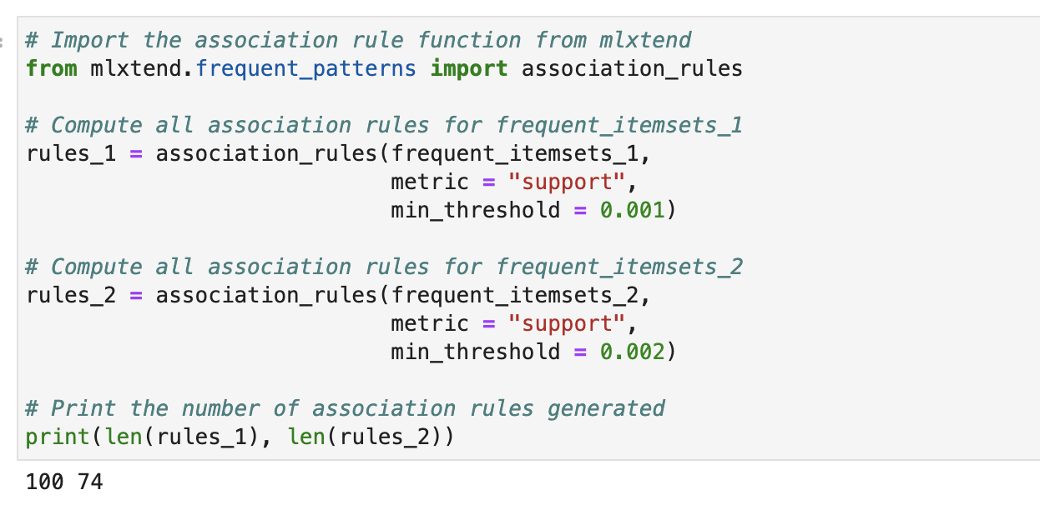
Generating Association rule

Slide 12
Pruning
Basic Apriori results pruning
Apriori prunes itemsets.
Applies minimum support threshold.
Modified version can prune by number of items
Pruning with lift, confidence, scatter plot

Slide 13
Pruning
Basic Apriori results pruning
Apriori prunes itemsets.
Applies minimum support threshold.
Modified version can prune by number of items
Pruning with lift, confidence, support

Slide 14
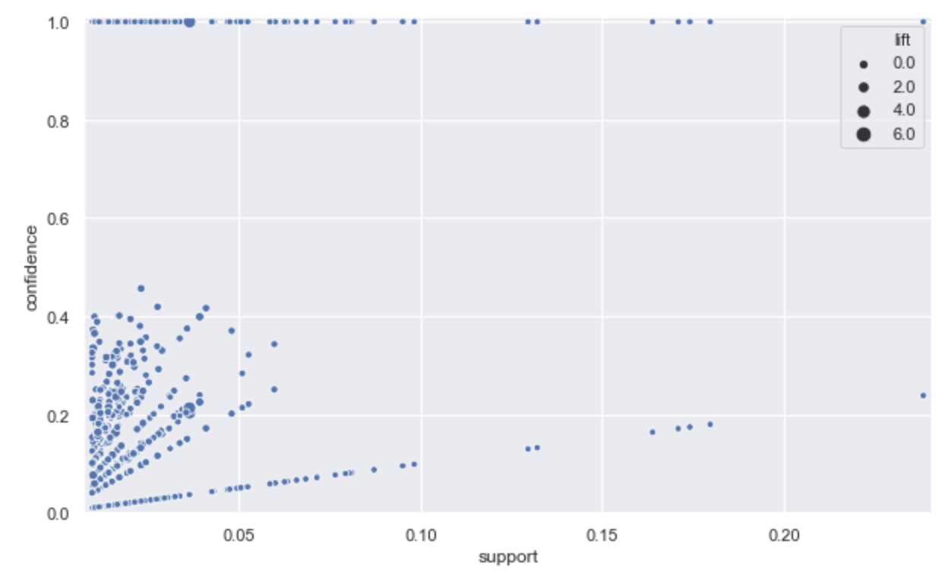
Scatter Plot
If you look at the plot carefully, you'll notice that the highest values of lift are always at the support-confidence border for any given value of confidence.

Slide 15
Conclusion

Slide 16
Thank You

