Slide 1




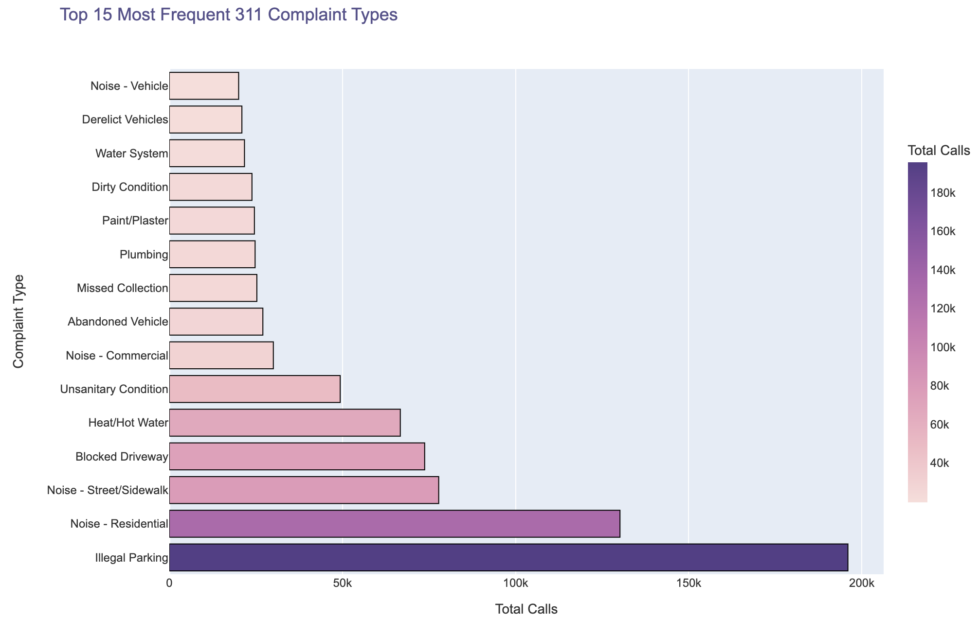
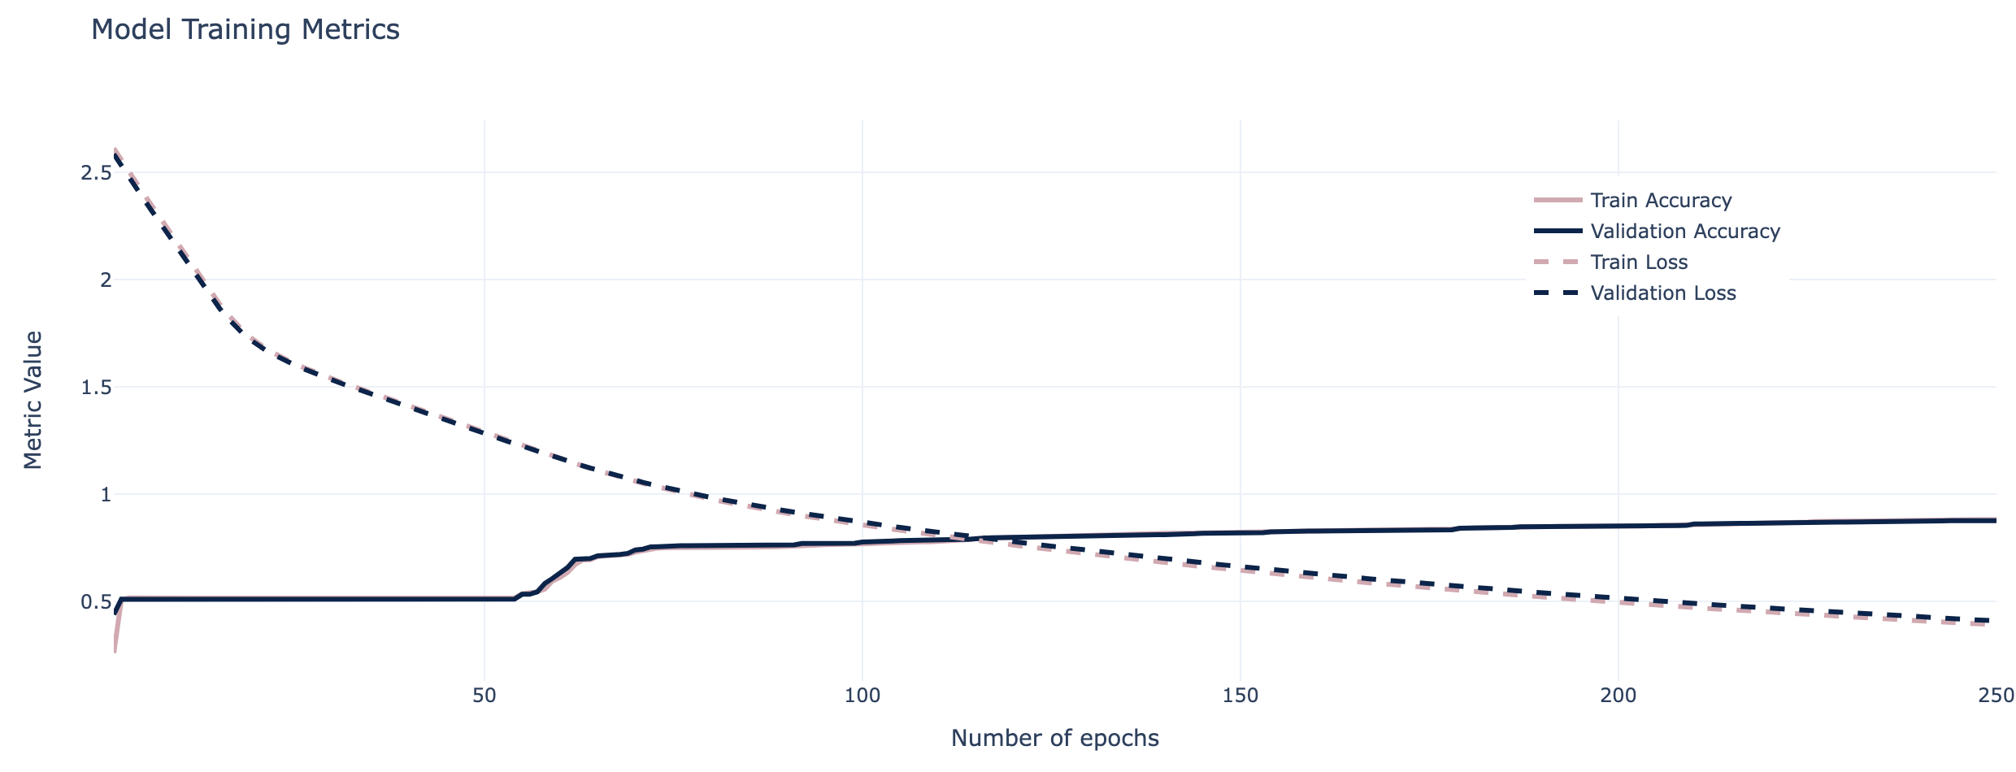
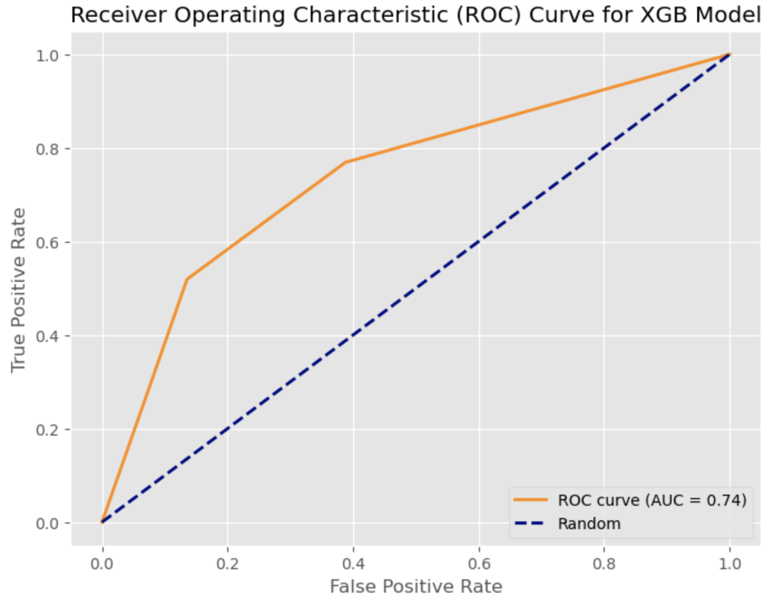
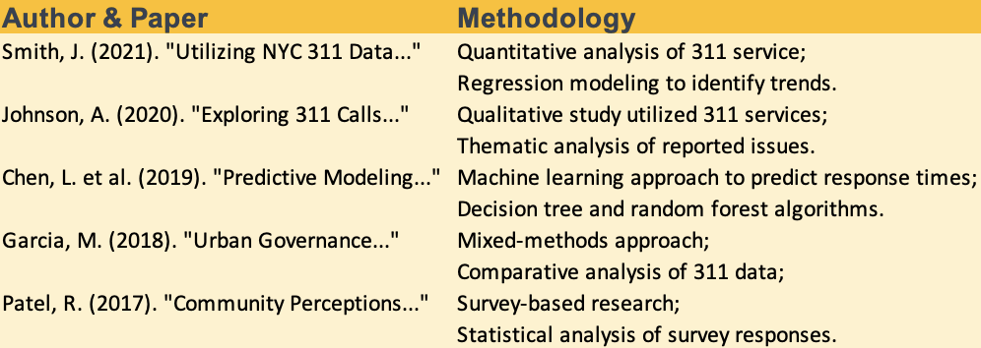
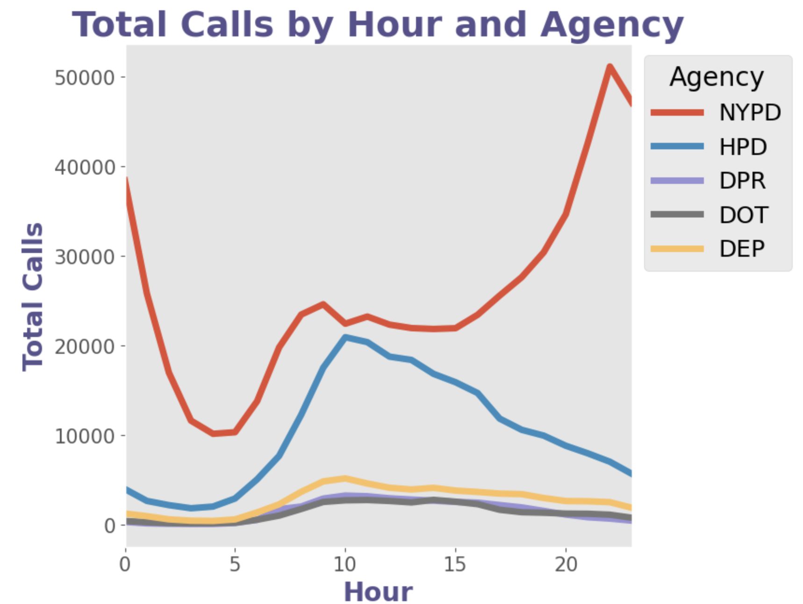
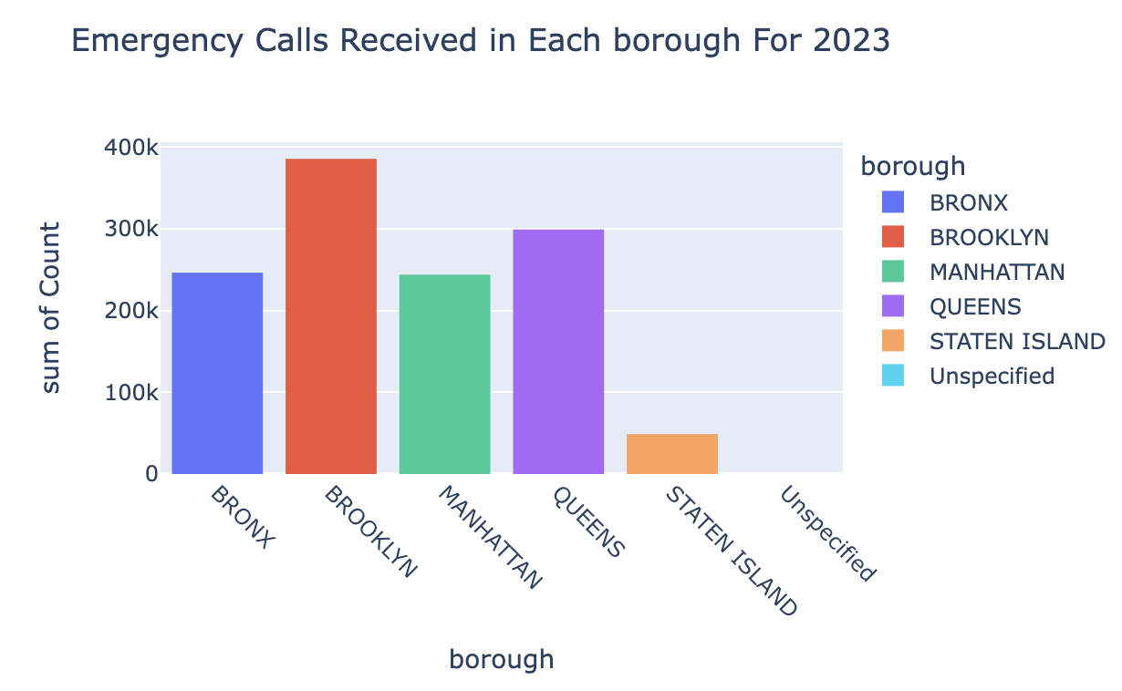
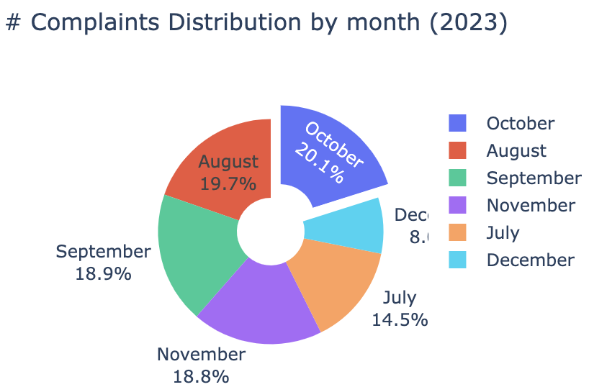
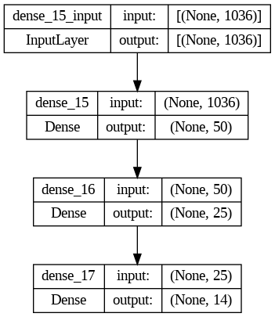
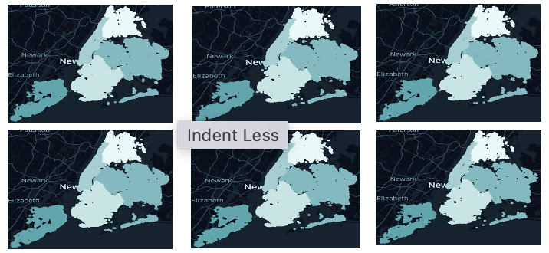
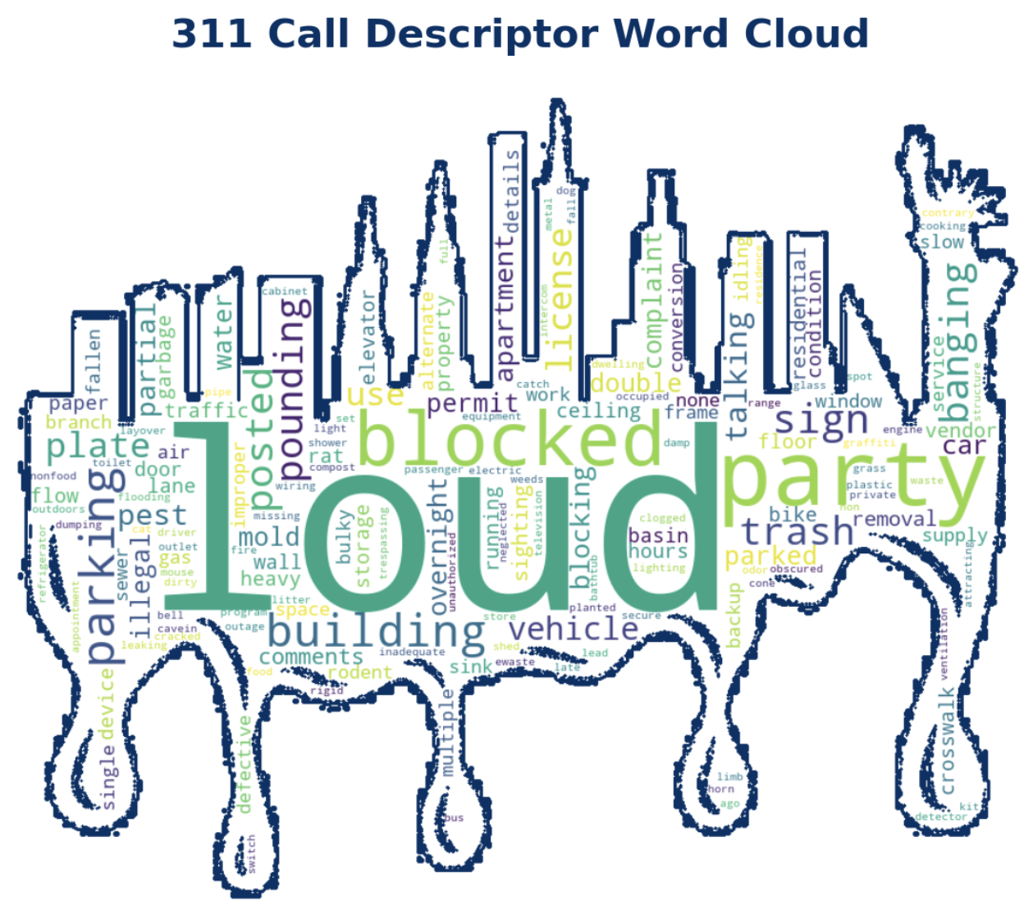
Analyzing NYC 311 Service Requests:
Identifying Patterns, Prioritizing Issues, & Improving Public Services
Student: Pritam Channawar
Analytics Capstone Project, Pace University
Introduction
Most Frequent Call Types
Ridge Regression
Results
NYC 311: U.S. phone number for non-emergency municipal services, issue reporting, and information requests.
Various government departments handle requests based on the issue.
Challenge: High volume of requests (over 24 million since 2010).
Impact: Slower city responses, affecting service quality and citizen satisfaction.
Goal: build neural network model to classify agency name using call description.
Developed predictive model that can accurately predict total time taken to resolve a call based on Hour at which call is received at the Agency.
Ridge regression model performed well with RMSE 0.24
“Illegal Parking” is the most frequent complaint type.
There is total 14 agencies to handle calls, the NYPD responded to just over 50% of all 311 calls
XGBoost Model
The goal is to build a model that can accurately predict the type of complaint based on the time of day and the city where the complaint was filed.
The best-performing model had ~94% accuracy on the test data and 66.2% accuracy on the random subset.
It performed most successfully on calls assigned to the NYPD, HBD and DPR.
Top 5 Agencies
Literature Review - NYC 311 Request
Calls to the NYPD peak at the earliest and latest hours of the day. ( 8PM and 5AM)
Results
Accuracy: 0.708
Precision: 0.719
Recall: 0.708
F1 Score: 0.697
Conclusion & Future Work
The description of a 311 call, after being encoded as numeric data, is a strong predictor of the agency that responded to the call.
Illegal parking complaints make up the majority of 311 calls and are assigned to the NYPD.
Training a similar classifier on a more extensive and diverse dataset could potentially streamline the allocation of government agencies to non-emergency requests, enhancing efficiency.
Develop classifier for automatic agency referral using large and more diverse set of description data.
Keras Neural Network (KNN)
The NYPD is responsible for responding to most 311 calls, and some agencies respond to very few.
it’s important to adjust how we evaluate a model’s accuracy: 50% accuracy in classifying the agency does not indicate a strong performance.
The calls’ descriptors, unsurprisingly, were far more effective. There were just over 800 unique descriptors.
Calls that received responses from minority agencies were oversampled.
A KNN Sequential model, which is appropriate when attempting to build a model with a single input and output, was created to classify the agency.
Performance was also evaluated on a random subset of the original data.
Data Collection
NYC OPEN DATA: 311 Service Requests from 2010 to Present
○ Sample included 1.5 million requests (Jul-Dec. 2023)
NYC311 system stores request details: problem types, locations, resolution times, description, borough, status. (47 columns)
Chose only 23 features for analysis.
Most calls to other top agencies are made during the day
Brooklyn has highest call records.
References
Data: 311 Service Requests from 2010 to Present NYC OpenData, Retrieved from, https://data.cityofnewyork.us/Social-Services/311-Service-Requests-from-2010-to-Present/erm2-nwe9 .
Kontokosta, C. E., Weiss, M., Snively, C. (OCTOBER 2017). "NYC311”.
Mulligan, K., Cuevas, C., Grimsley, E., Chauhan, P., Bond, E. (March 2019). "Justice Data Brief: Understanding New York City’s 311 Data."
Chekmarova, M. M. (May 2020). "The Role of Civic Technology in Facilitating Citizen-Government Engagement: A Study of NYC311."
Minkoff, S. (April 2015). "NYC 311: A Tract-Level Analysis of Citizen-Government Contacting in New York City."
Daily Call Volume by Month
Most Frequent Words used in Call Description
Words related to the following appeared most frequently:
    ○ loud
    ○ illegal parking
    ○ blocked
    ○ party
    ○ music

