Slide 1
Scalable Database Midterm FALL 2022
By
Pritam Channawar
Ari Perez
Manas Vani

Slide 2
Content
Introduction
Dataset
Problem definition
EDA
Feature Correlation
Self defined Function
Outliers
Slicing
Unstructured Data Processing
Conclusion

Slide 3
Introduction
Performing an EDA (Exploratory Data Analysis) on a dataset of our choice.
An EDA on a dataset involves cleaning the data and performing initial investigations to check any hypotheses we may have.
For this project we performed many different operations on the data to show that we could manipulate them using different Python libraries widely used in the Data Science field.
Here we will discuss our findings.

Slide 4
Dataset
We used a dataset on Gender Pay Gap from the General Social Survey on wages (1974-2018)
There is no Unstructured data in the dataset.
Number of features: 11
1. Year - the survey year
2. Base Income - the respondent's base income (in constant 1986 USD)
3. Age - the respondent's age in years
4. Occupation Code - respondent's occupation code (2010)
5. Occupation Category - recode of the occupation code into one of 11 main categories
6. Occupation Prestige - respondent's occupational prestige score (2010)

Slide 5
Dataset
7. Number of Children - number of children (0-8)
8. Work Status - the work status of the respondent (full-time, part-time, temporarily not working, unemployed (laid off), retired, school, housekeeper, other)
9. Gender - respondent's gender (male or female)
10. Degree Level - respondent's degree level (Less Than High School, High School, Junior
College, Bachelor, or Graduate)
11. Marital Status - respondent's marital status (Married, Widowed, Divorced, Separated,
Never Married)

Slide 6
Problem Definition
To Perform Exploratory Data Analysis (EDA) in order to predict whether a person’s wages are positively or negatively affected by a number of different categories i.e. Occupation, Gender, Marital Status, Age, Year, Number of Children, Work Status, and Degree.
We hypothesize that Gender, Age, Year and Degree will be highly correlated with wages, but we also seek to observe any other relationships we can infer from the dataset.

Slide 7
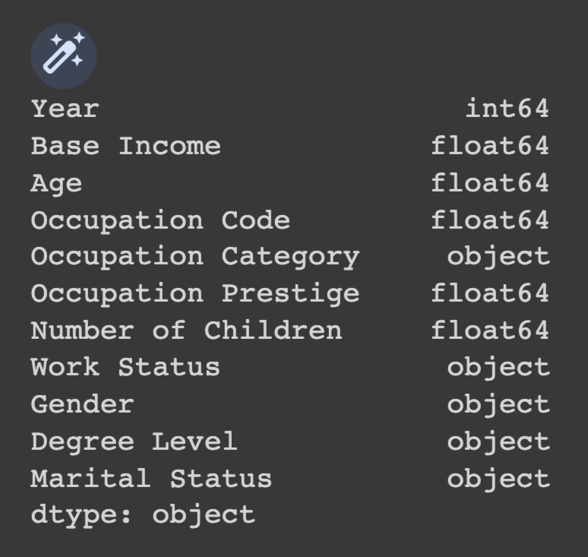
Datatype of features

Slide 8
Data cleaning
Apply functions:
Check null values
Check duplicates
Delete unwanted columns
Delete null values
Check unique values
We have changed categorical features to numerical features

Slide 9
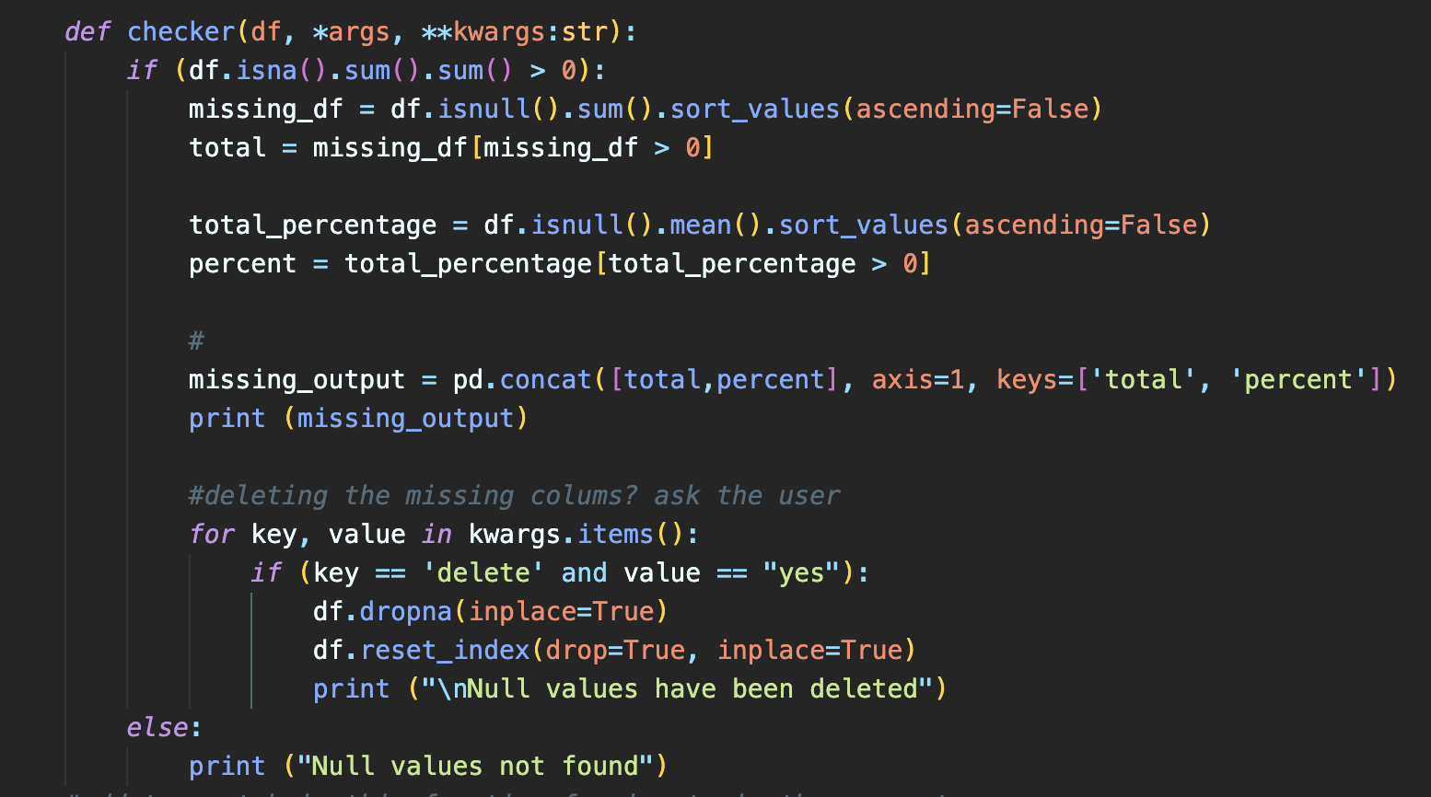
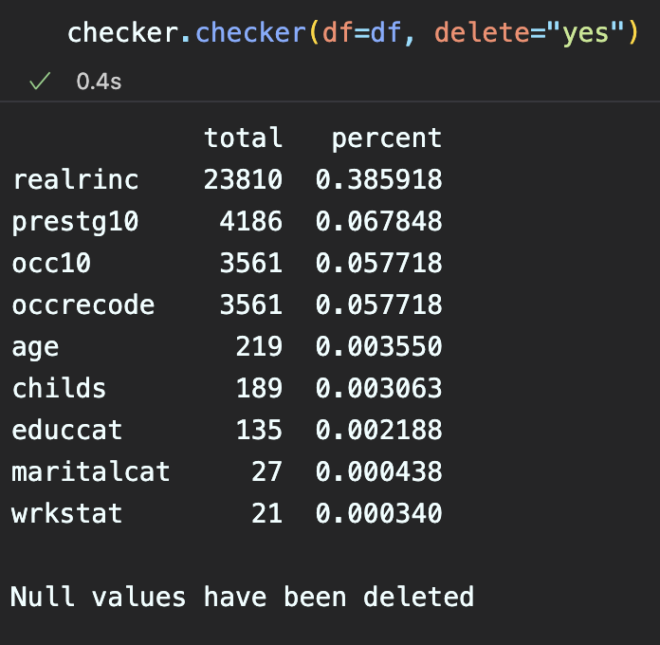
Self-defined function #1
We created function that will display the total and percentage of "null" data for each feature. Moreover, it will also delete the null values if delete="yes" is entered in the function call.

Slide 10
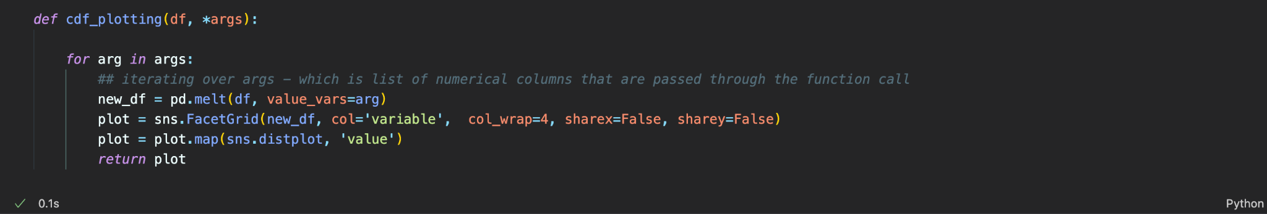
Self-defined function #2

Slide 11
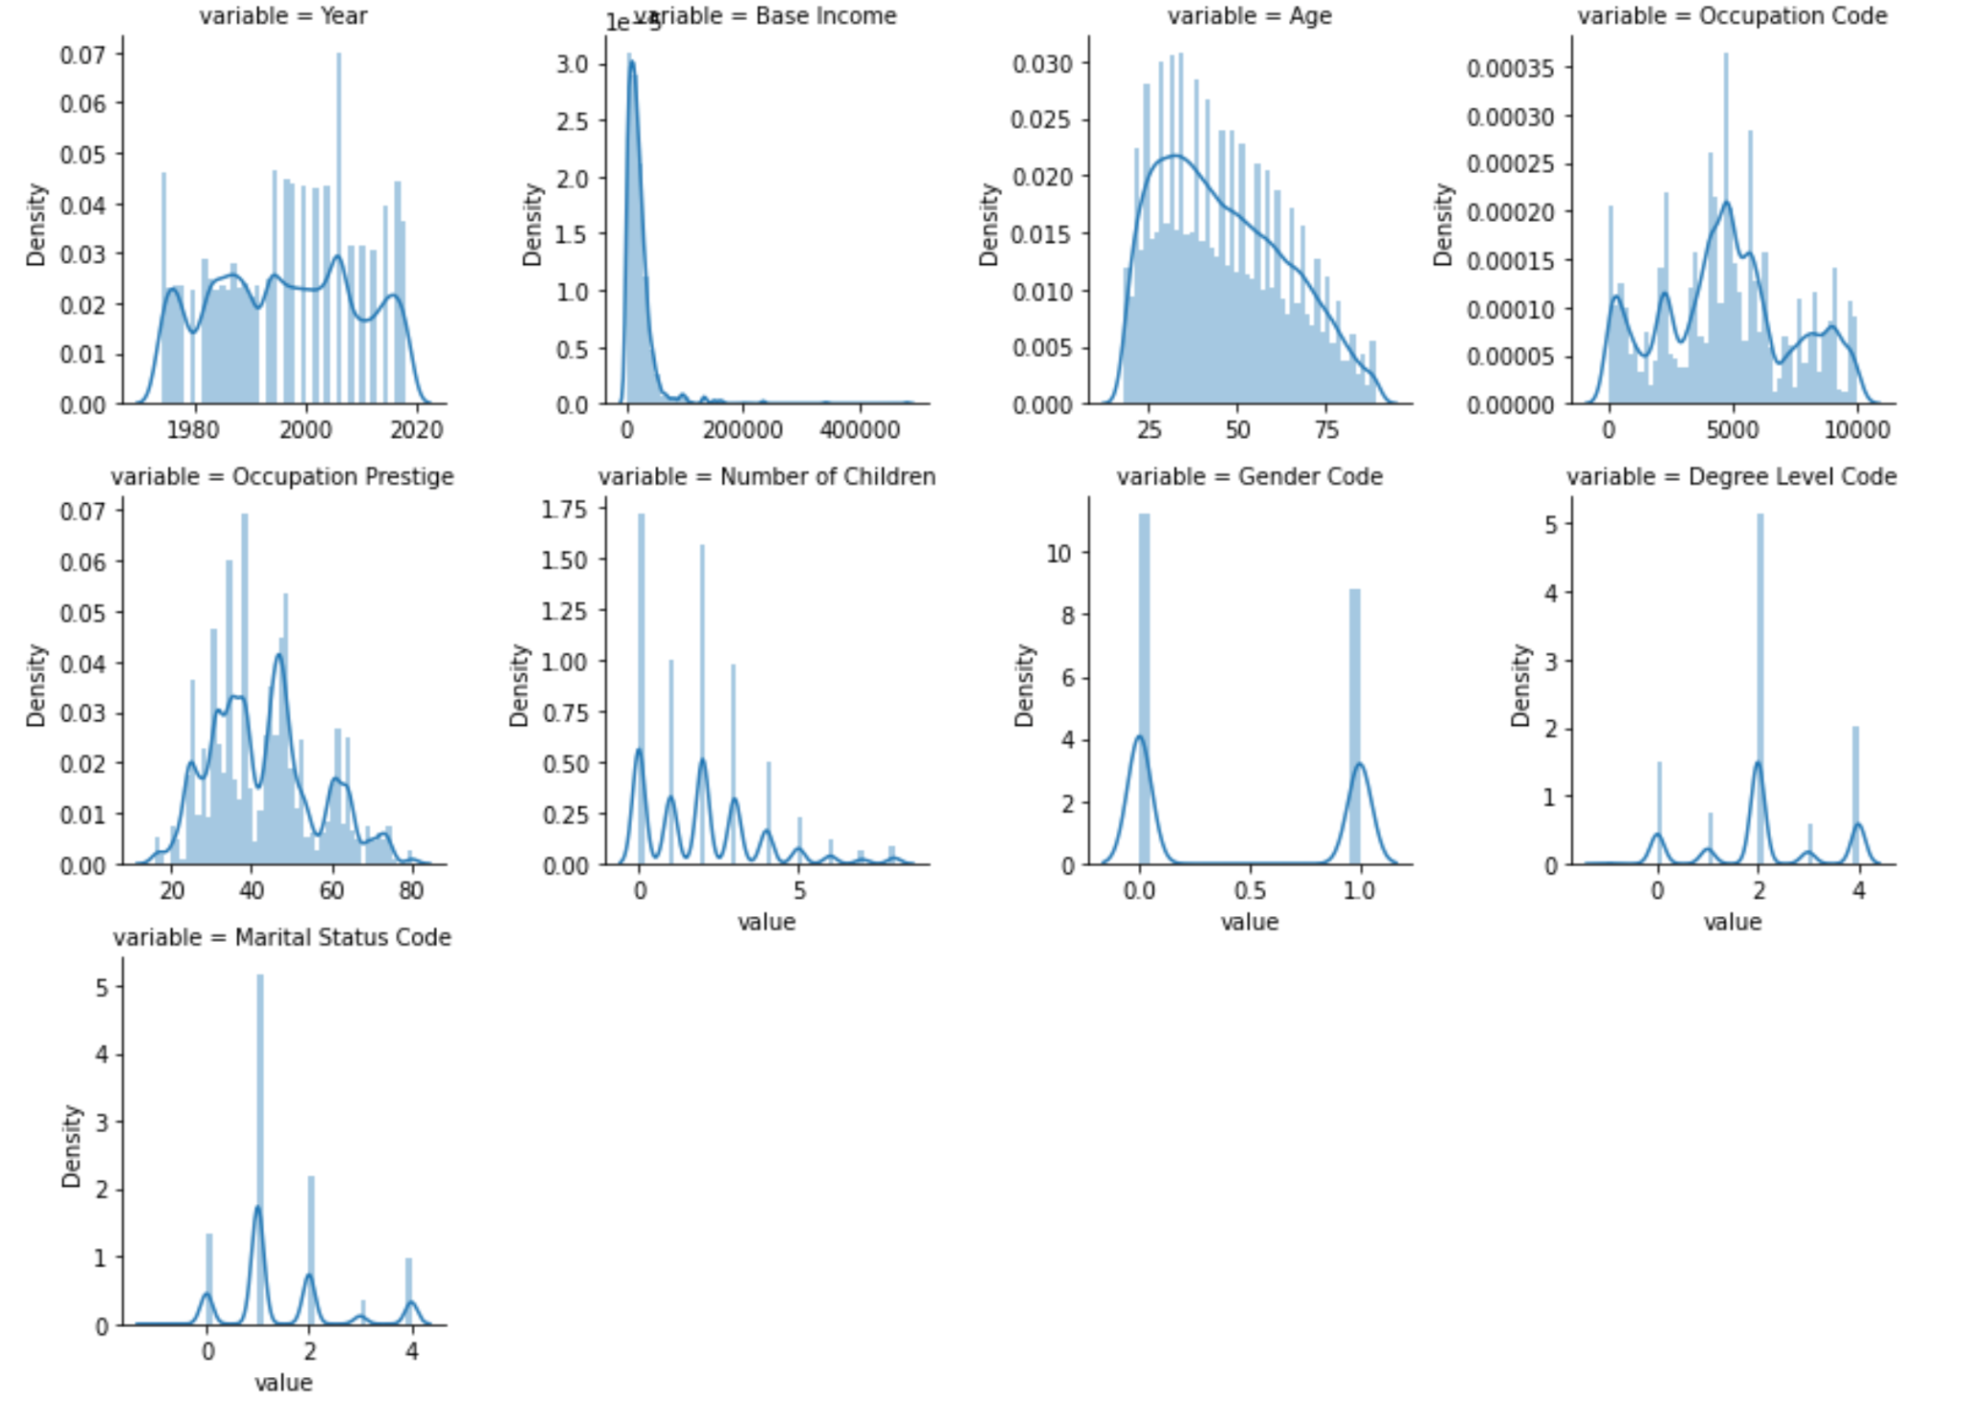
Distribution of Numerical Features

Slide 12
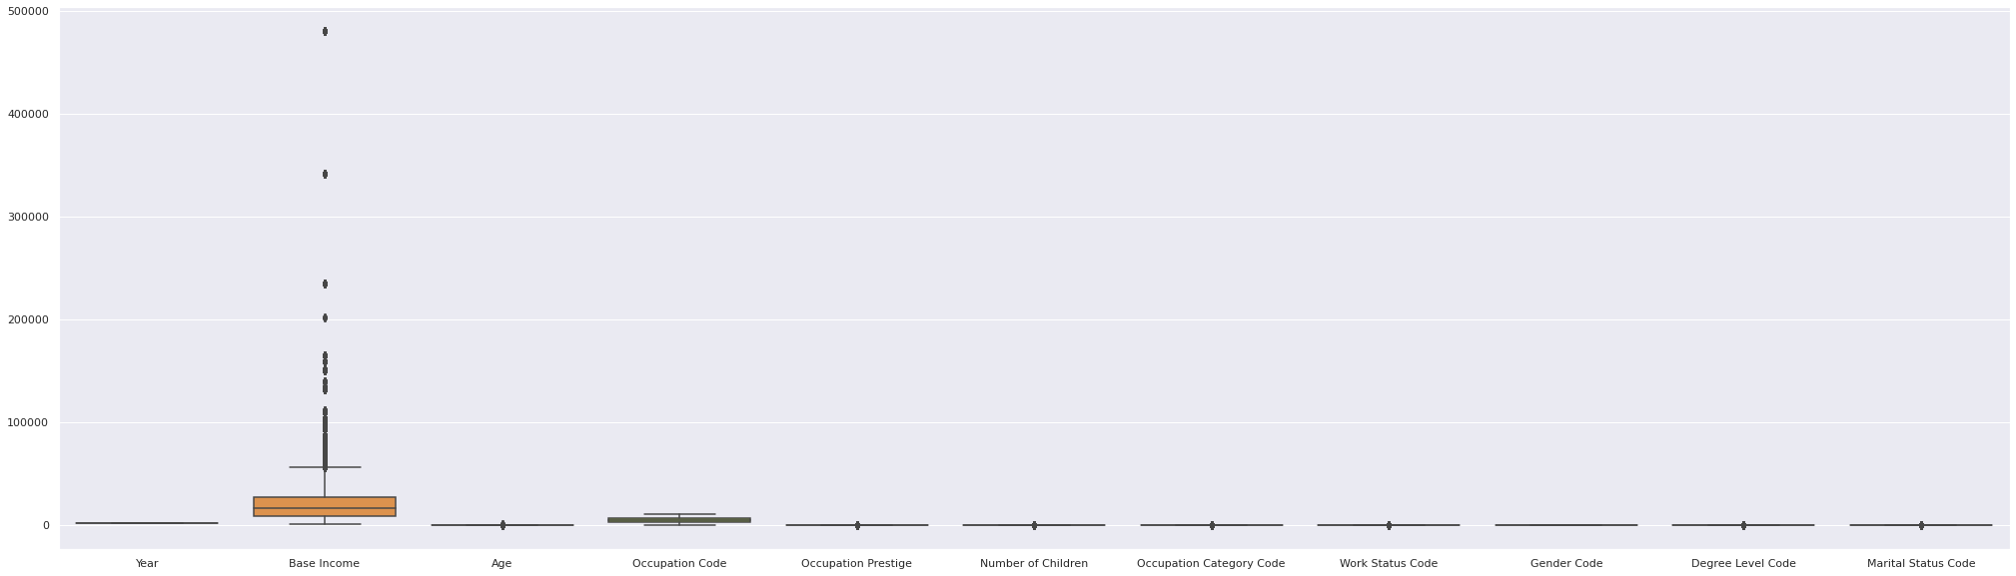
Outliers using box plot
Notes:
Used the boxplot to visually identify outliers

Slide 13
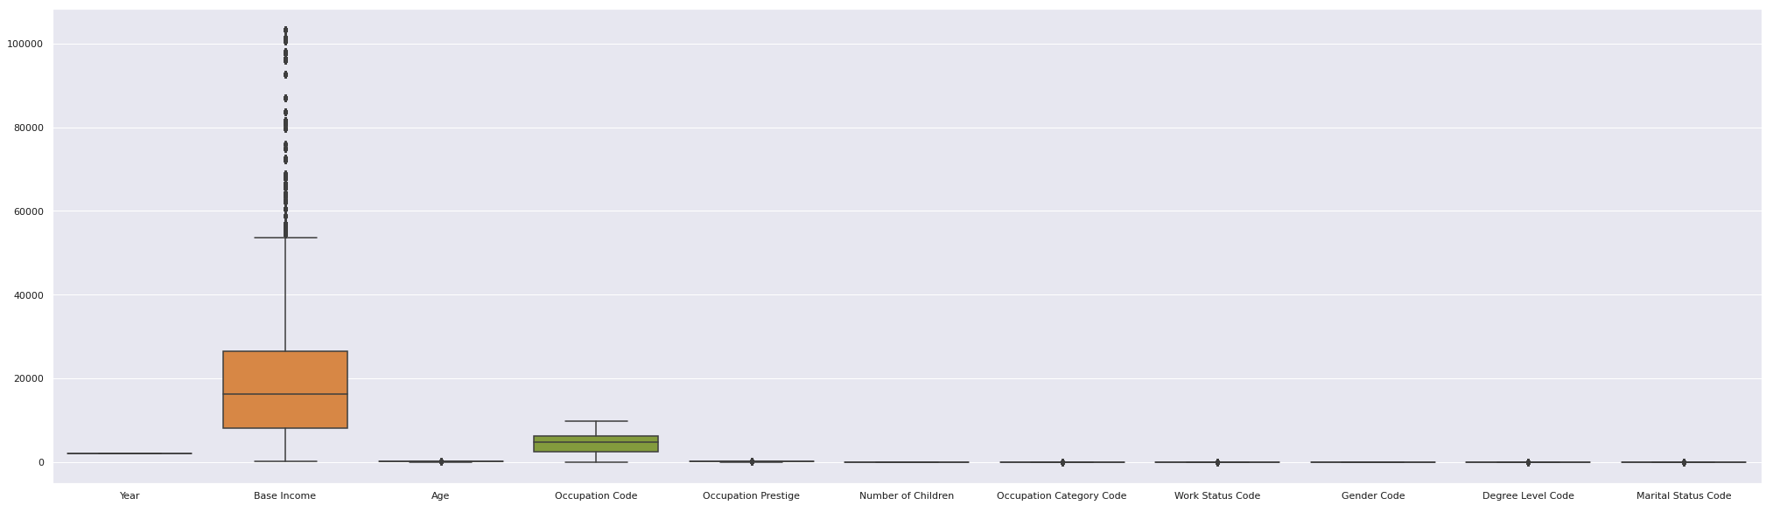
Box plot after removing outliers
Notes:
After removing the outliers, here’s the resulting new boxplot

Slide 14
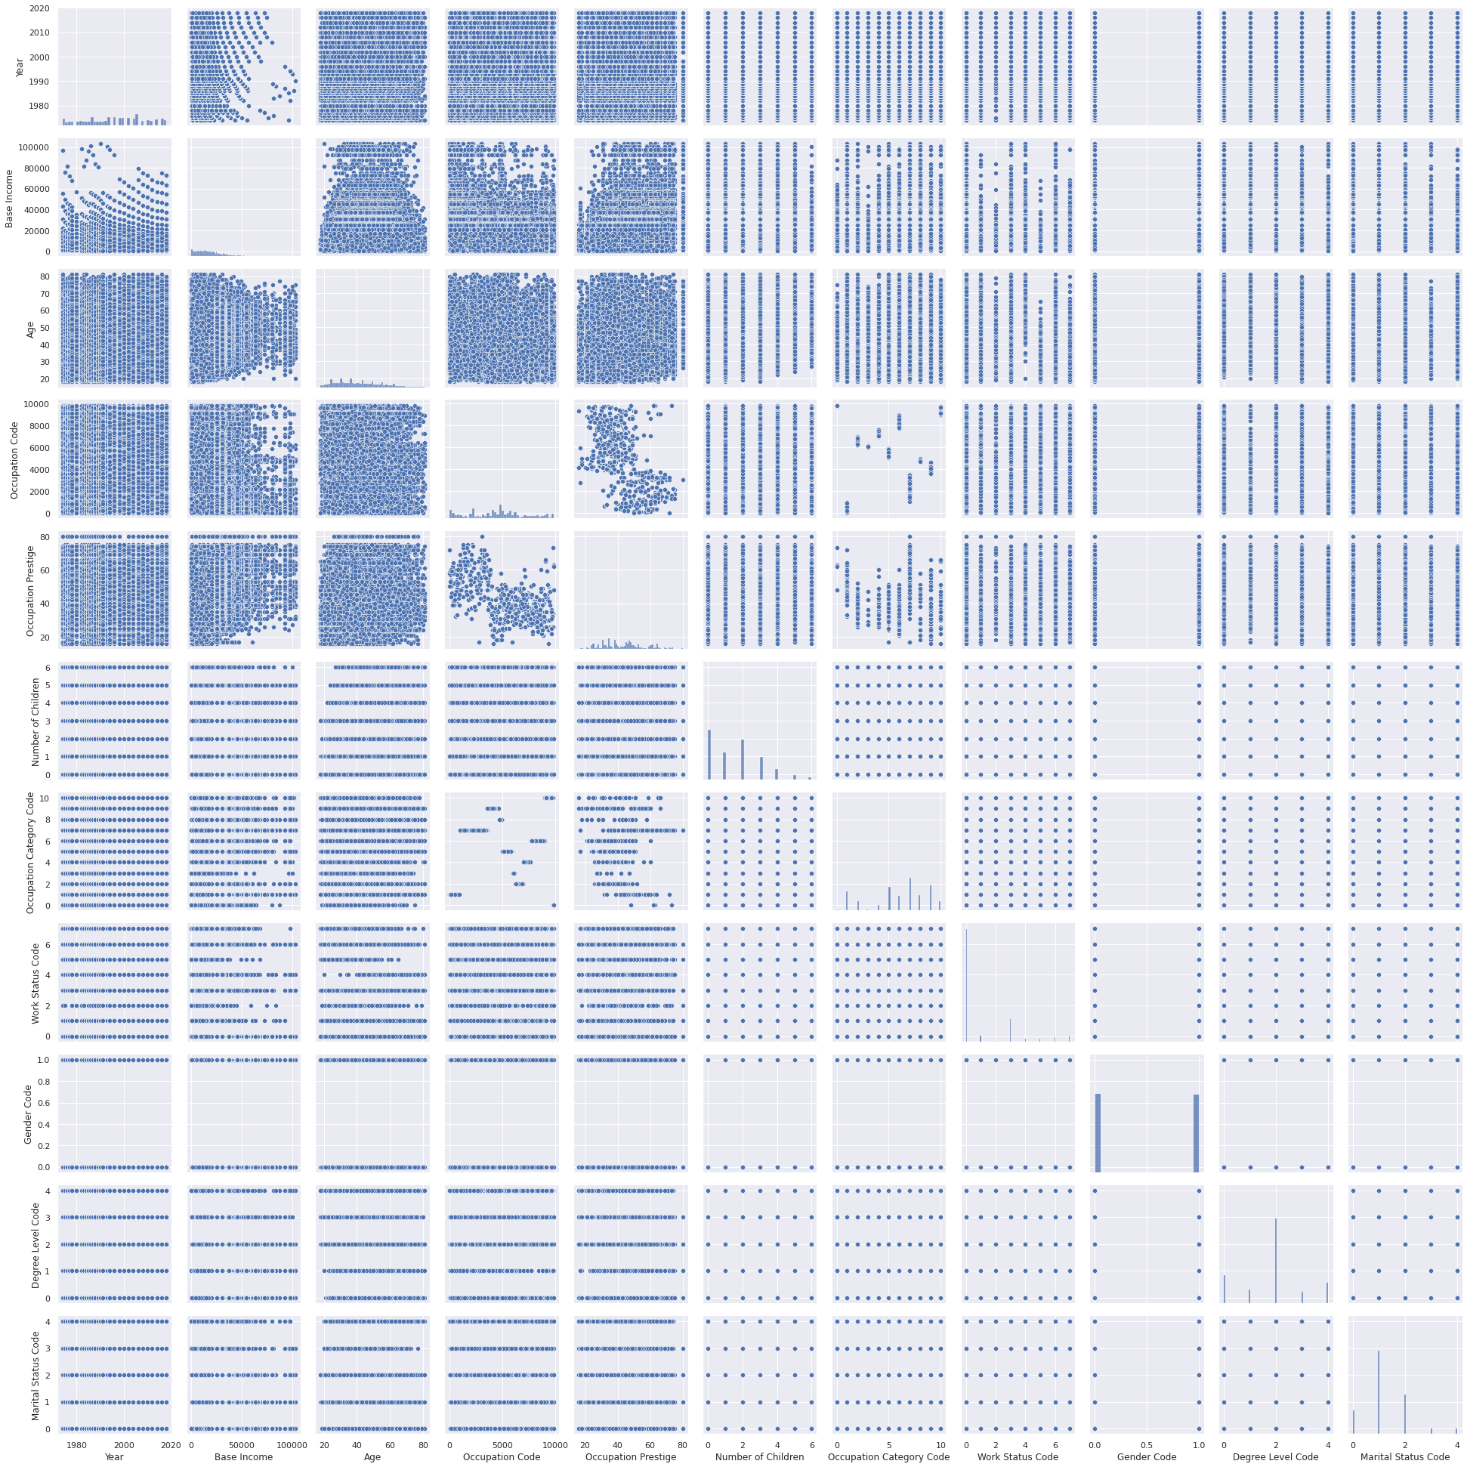
Plot features against each other using a pair plot
Notes:
We created a pairplot graph to show all of the features graphed against each other

Slide 15
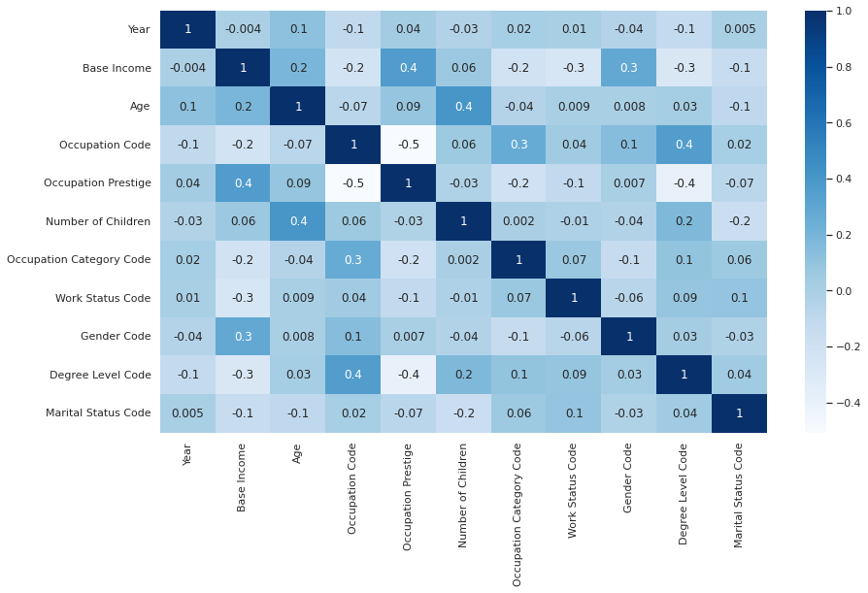
Correlation Heatmap
Notes:
Here’s the heatmap showing the correlations between each feature

Slide 16
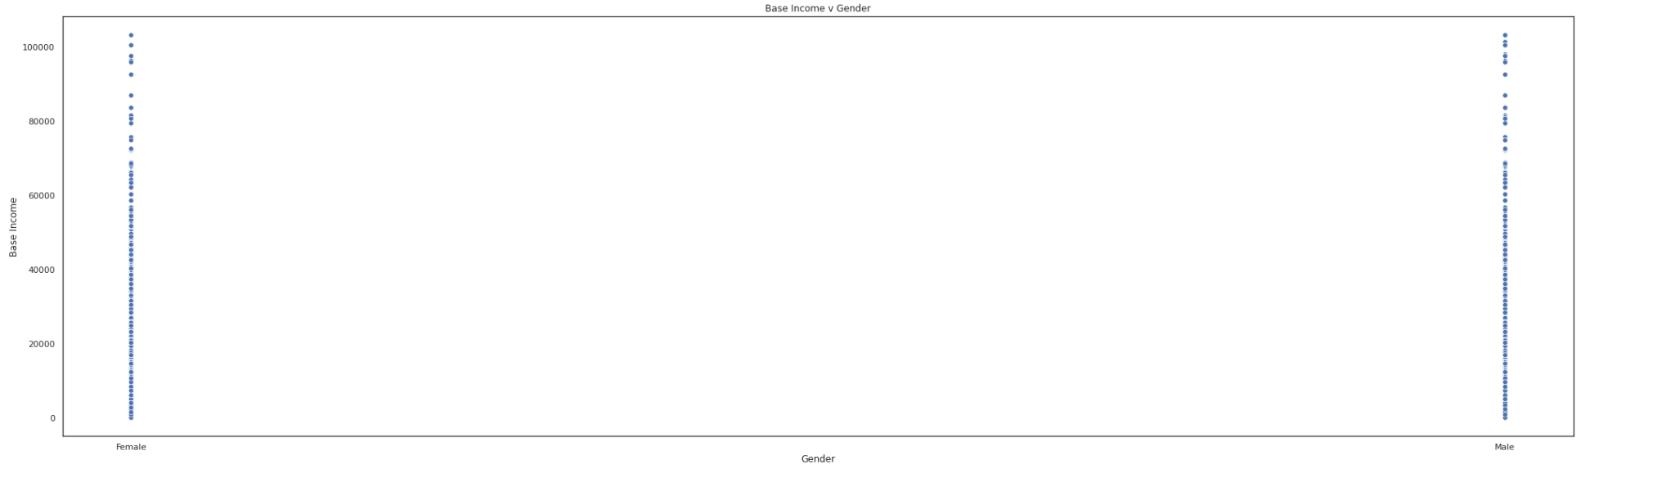
Base Income v Gender (0.3)
Notes:
Gender had the highest correlation to gender (which we hypothesized)

Slide 17
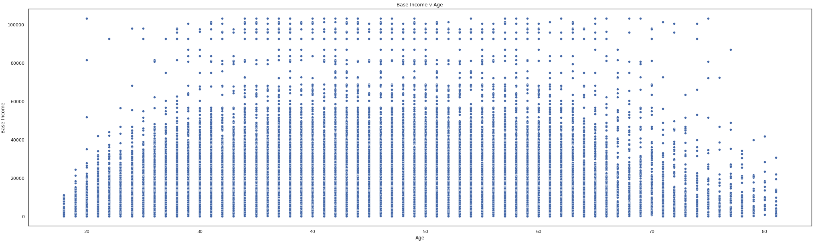
Base Income v Age (0.2)
Notes:
Age had the second highest (which we also hypothesized)

Slide 18
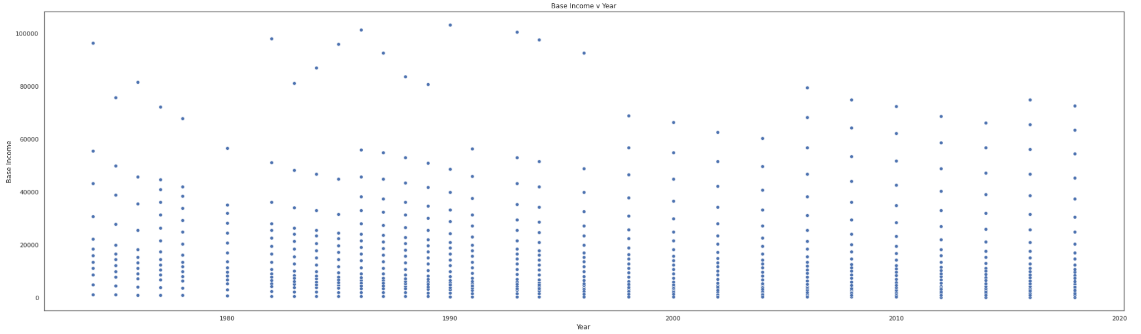
Base Income v Year (-0.004)
Notes:
Interestingly, year had no correlation really to base income

Slide 19
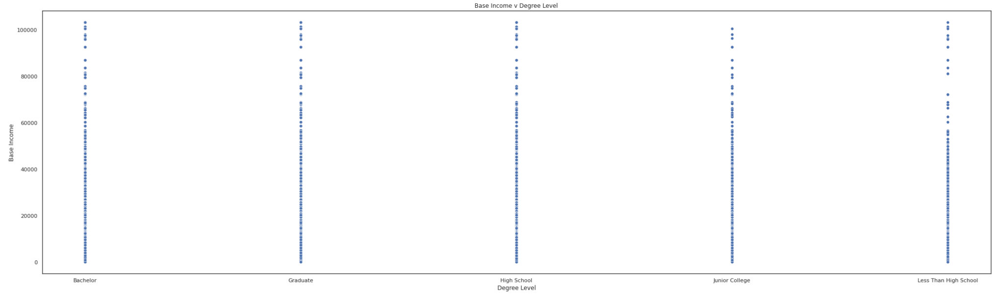
Base Income v Degree Level (-0.3)
Notes:
Most inversely correlated

Slide 20
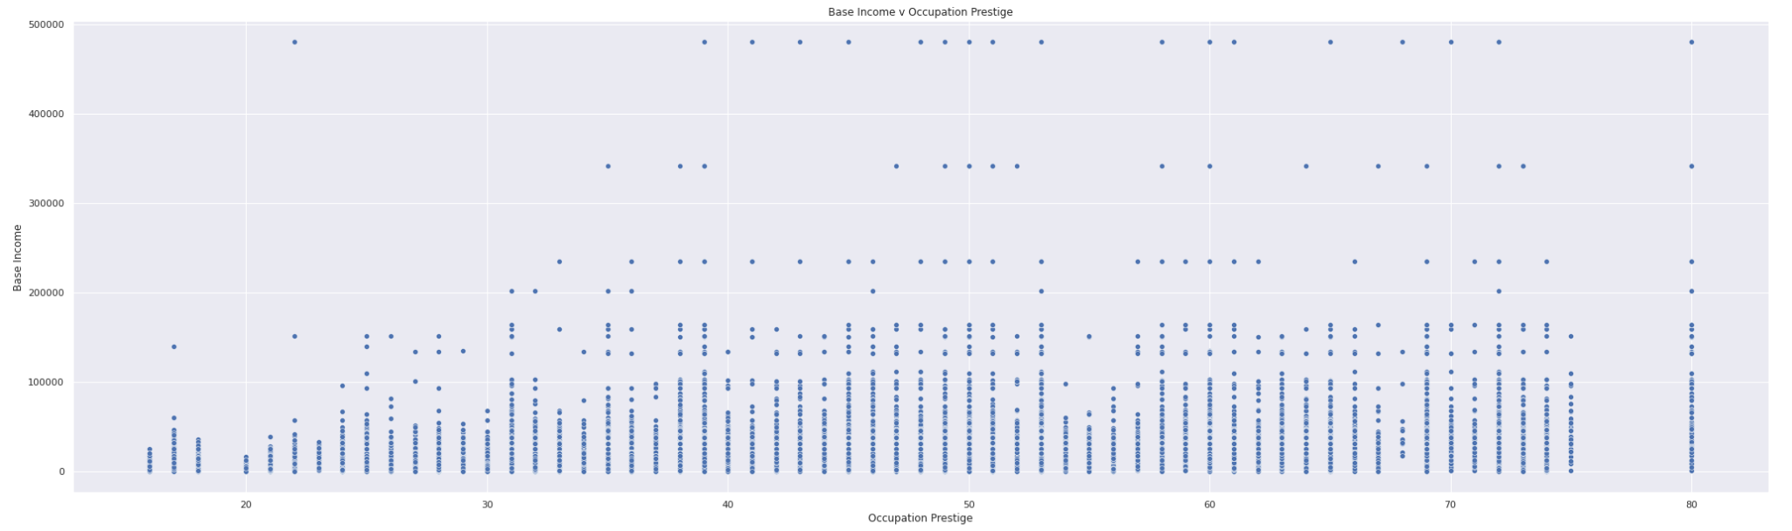
Base Income v Occupation Prestige (0.4)
Notes:
Another interesting point… Occupation prestige had the highest correlation to base income

Slide 21
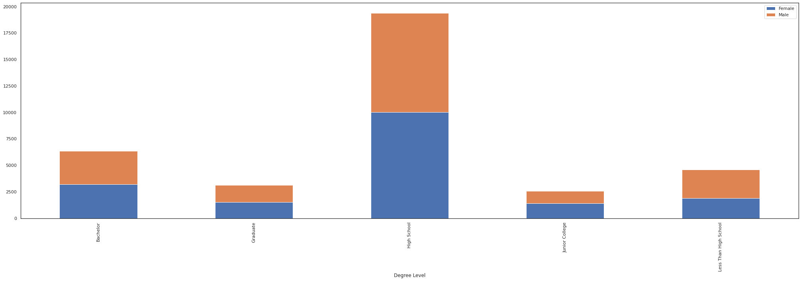
Grouped Bar plot for Degree Level v Gender
Notes:
Use this to visualize if there were any degree levels skewed one way or the other based on gender. We could see that in the case of “less than high school”, more men than women seemed to make up this group.

Slide 22
Slicing
#return records of male gender
df.loc[df['Gender'] == 'Male’]
#return records which has occupation other than Business/Finance
df.loc[df['Occupation Code'] != 'Business/Finance’]
#return records after year 2000
df.loc[df['Year'] > 2000]

Slide 23
Unstructured data processing
Audio file as input data(.wav file)
Library from scipy.io import wavfile
Read file : wavfile.read()
Open file in read mode:
wave.open("BabyElephantWalk60.wav",’r’)
Plot Signal wave
Play audio file
from IPython.lib.display import Audio
Audio(data, rate= y)

Slide 24
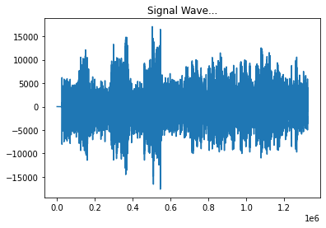
Plot audio to signal waves

Slide 25
Conclusion
After performing the EDA, we found that several factors, specifically Occupancy Prestige, Work Status, Degree Level, and Gender, were highly correlated with wages.
Interestingly, Number of Children and Year had the least correlation with wages, making our hypotheses mostly correct, with Year being the only exception.
Successfully demonstrated unstructured data processing such as open, read, write, conversion to csv file, plot visualizations, play file on dashboard.

Slide 26

Thank you!

