Slide 1

Final Year Project
An Effective Communication System for Deaf & Dumb People
Notes:
An Effective Communication System for Deaf & Dumb People Using OpenCV & Machine Learning

Slide 2
Developed By-
Subhajit Samanta
Pritam Sinha
Susmita Debnath
Pritam Das
Trinita Biswas
Shibam Sarkar
Supervised Under -
Ms. Bidyutmala Saha
Assistant Professor, CSE
Notes:
Assistant Professor, CSE

Slide 3

Introduction
SLIDE 1
Objective
SLIDE 2
Flowchart
SLIDE 3
System Requirements
SLIDE 4
Implementation
SLIDE 5
Conclusion
SLIDE 6

Slide 4
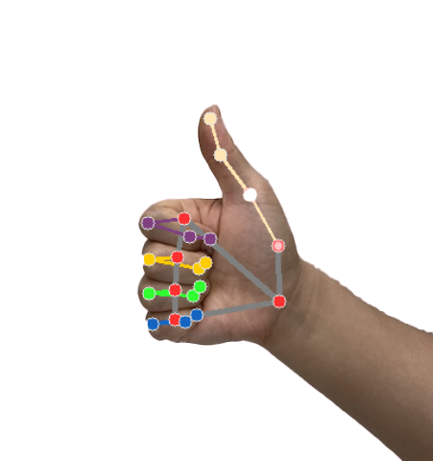
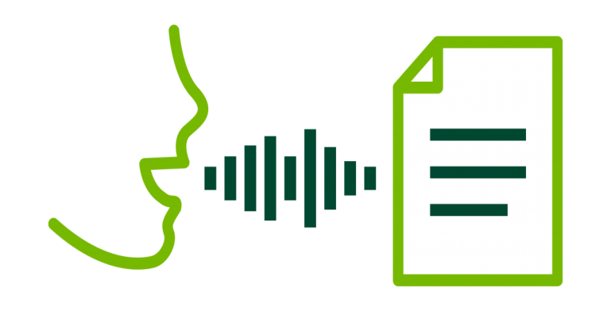
Introduction
Nearly 30 million people suffer from hearing disability and face tremendous social problem. In this Project, we used technology to improve accessibility of disabled people.
We use hand sign recognition and Speech to Text converter system (using OpenCV & Machine Learning) to design the app as a personal translator for deaf people.
The application is developed for hand-held devices with inbuilt sensors (laptop/tab/smartphones) and its main features are as under:-
i) Easy face to face communication between deaf & dumb and normal people.
ii) Software based writing and internet browsing.
iii) Safety alert email with location for deaf & dumb people.
Notes:
Nearly 30 million people suffer from hearing disability and face tremendous social problem. In this Project, we used technology to improve accessibility of disabled people.
We use hand sign recognition and Speech to Text converter system (using OpenCV & Machine Learning) to design the app as a personal translator for deaf people.
The application is developed for hand-held devices with inbuilt sensors (laptop/tab/smartphones) and its main features are as under:-
i) Easy face to face communication between deaf & dumb and normal people.
ii) Software based writing and internet browsing.
iii) Safety alert email with location for deaf & dumb people.

Slide 5
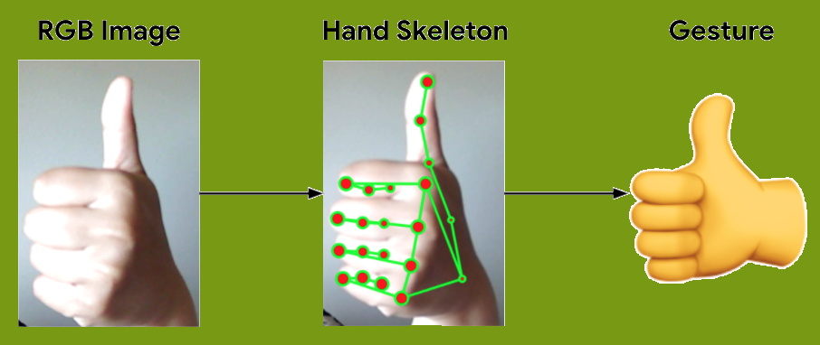
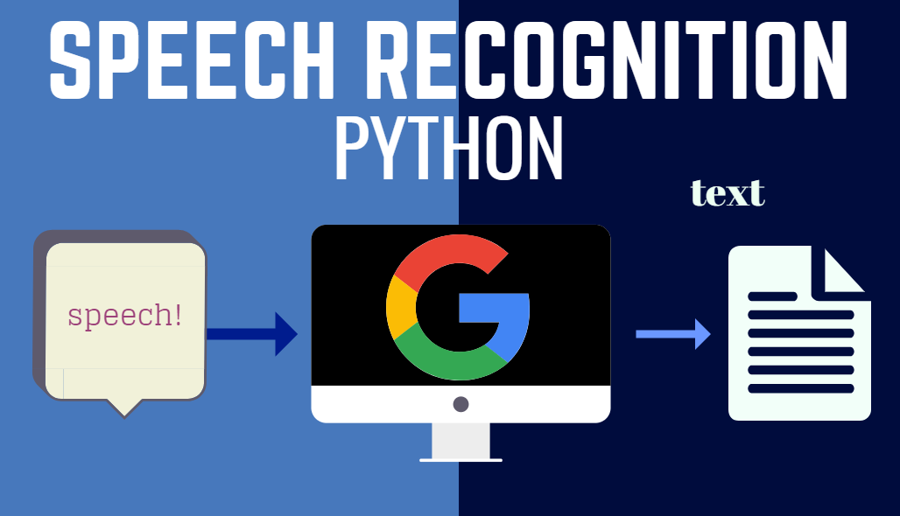
Objective
The main objective of our project is –
This app uses inbuilt camera of the device for capturing hand gestures of deaf people and microphone to capture voice of normal people.
It uses OpenCV and Machine Learning algorithms to create a CNN (Convolutional Neural Network) to compare hand gesture and give a text output.
It uses advanced Speech Recognition and Natural Language Processing System by Google API service (gTTS) to convert voice input into text and corresponding sign images.
Notes:
The main objective of our project is –
As most of the deaf people (around 2 million) use ASL (American Sign Language) as their primary language, we develop the app to train and easily communicate using ASL.
This app uses inbuilt camera of the device for capturing hand gestures of deaf people and microphone to capture voice of normal people.
It uses OpenCV and Machine Learning algorithms to create a CNN (Convolutional Neural Network) to compare hand gesture and give a text output.
It uses advanced Speech Recognition and Natural Language Processing System by Google API service (gTTS) to convert voice input into text and corresponding sign images.

Slide 6

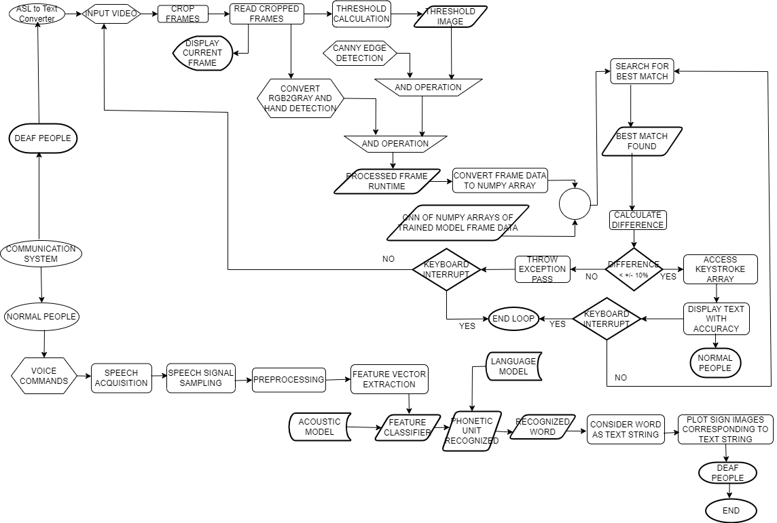
Flowchart

Slide 7



System Requirements
Application File Type : Python File (.py file)
Application Interface : GUI (Graphical User Interface)
Language Used : Python
Python version : 3.10
Library Packages/ modules Used :
i) OpenCV-python
ii) Mediapipe
iii) numpy
iv) Keras
Code Editor Used : Visual Studio Code/ VS Code Editor
Operating System : Windows 8.1 and above
Hardware Requirements :
CPU : 1.6 GHz and above
RAM : 1 GB and above
Laptop inbuilt webcam
Laptop inbuilt microphone
Notes:
Application File Type : Python File (.py file)
Application Interface : GUI (Graphical User Interface)
Language Used : Python
Python version : 3.10
Library Packages/ modules Used :
i) OpenCV-python
ii) Mediapipe
iii) numpy
iv) Keras
Code Editor Used : Visual Studio Code/ VS Code Editor
Operating System : Windows 8.1 and above
Hardware Requirements :
CPU : 1.6 GHz and above
RAM : 1 GB and above
Laptop inbuilt webcam
Laptop inbuilt microphone

Slide 8
Phase 1 Implementation
Data Set Creation
Image Capture:
Use cv2.VideoCapture() to get a video capture object for the camera.
Set up an infinite while loop and use the read() method to read the frames using the above created object.
Use cv2.imshow() method to show the frames in the video.
Breaks the loop when the user clicks a specific key.
Hand tracking:
To find hand shape within a RGB image hand tracking is used. Hand tracking is done with the help of two-level tracking system using modified Kanade-Lucas-Tomasi (KLT) tracking algorithm.
Notes:
To find hand shape within a RGB image hand tracking is used. Hand tracking is done with the help of two-level tracking system using modified Kanade-Lucas-Tomasi (KLT) tracking algorithm.

Slide 9
Hand Landmark Detection:
The predictions made by the holistic model are saved in the results variable from which we can access the landmarks using results.right_hand_landmarks, results.left_hand_landmarks respectively.
Draw the detected landmarks on the image using the draw_landmarks function from drawing utils.
Hand Skeleton Shape Calculation:
Hand skeleton shape calculated by the movement and rotation of joints with respect to their neighbours. The KNN or K-Nearest Neighbour algorithm is used for this calculation.
Convert hand skeleton shape value to numpy array:
Stores hand landmarks in a numpy array.
Notes:
Stores hand landmarks in a numpy array.

Slide 10
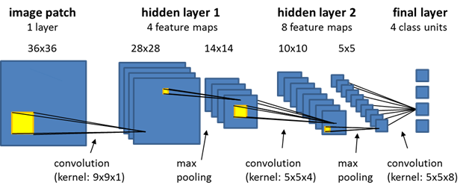
Phase 2 Implementation
Train Model
CNN algorithm has two main processes: convolution and sampling.
Convolutional Process: Use a trainable filter Fx, deconvolution of the input image (the first stage is the input image, the input of the after convolution is the feature image of each layer, namely Feature map), then add a bias bx, we can get convolution layer Cx.
Sampling Process: n pixels of each neighbourhood through pooling steps, become a pixel, and then by scalar weighting Wx+1 weighted, add bias bx+1, and then by an activation function, produce a narrow n times feature map Sx+1.
Notes:
CNN algorithm has two main processes: convolution and sampling.
Convolutional Process: Use a trainable filter Fx, deconvolution of the input image (the first stage is the input image, the input of the after convolution is
the feature image of each layer, namely Feature map), then add a bias bx, we can get convolution layer Cx.
Sampling Process: n pixels of each neighbourhood through pooling steps, become a pixel, and then by scalar weighting Wx+1 weighted, add bias bx+1,
and then by an activation function, produce a narrow n times feature map Sx+1.

Slide 11
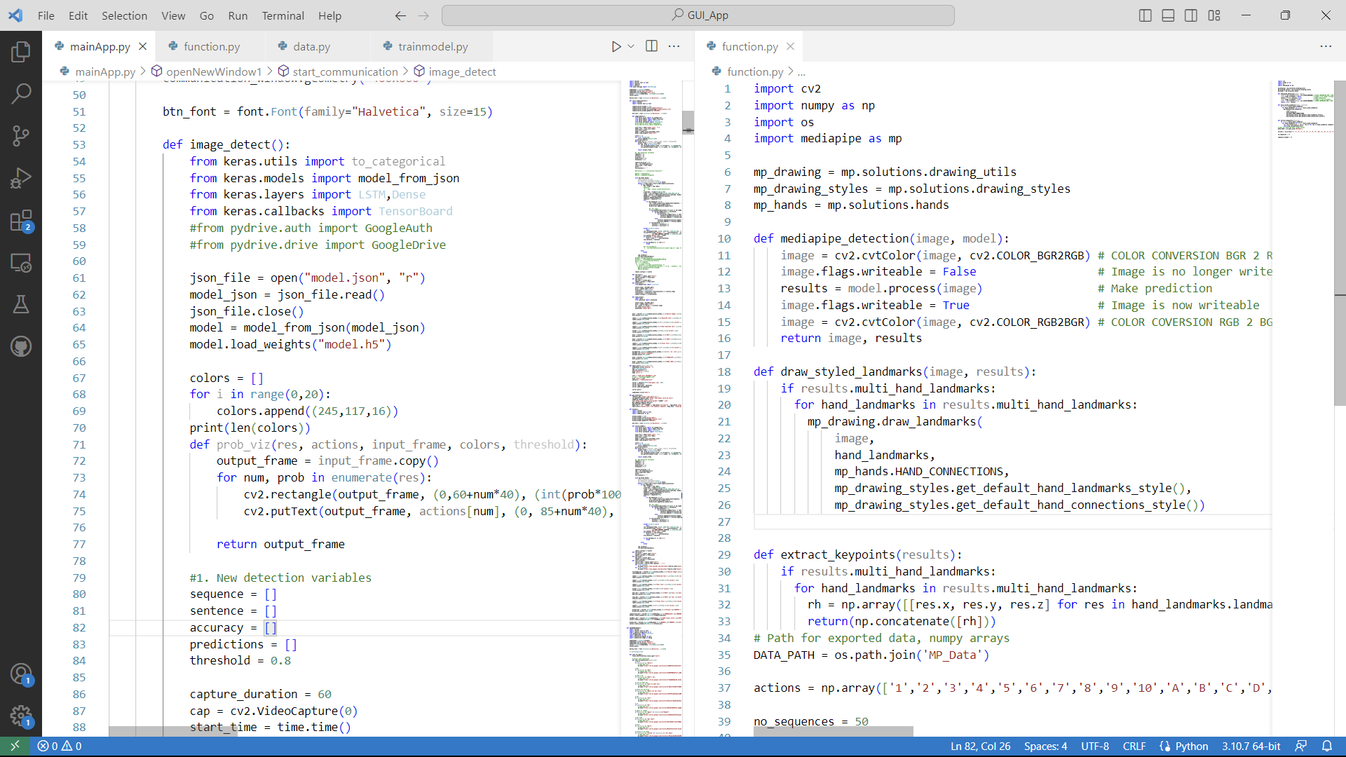
Phase 3 Implementation
Code
Notes:
Code

Slide 12
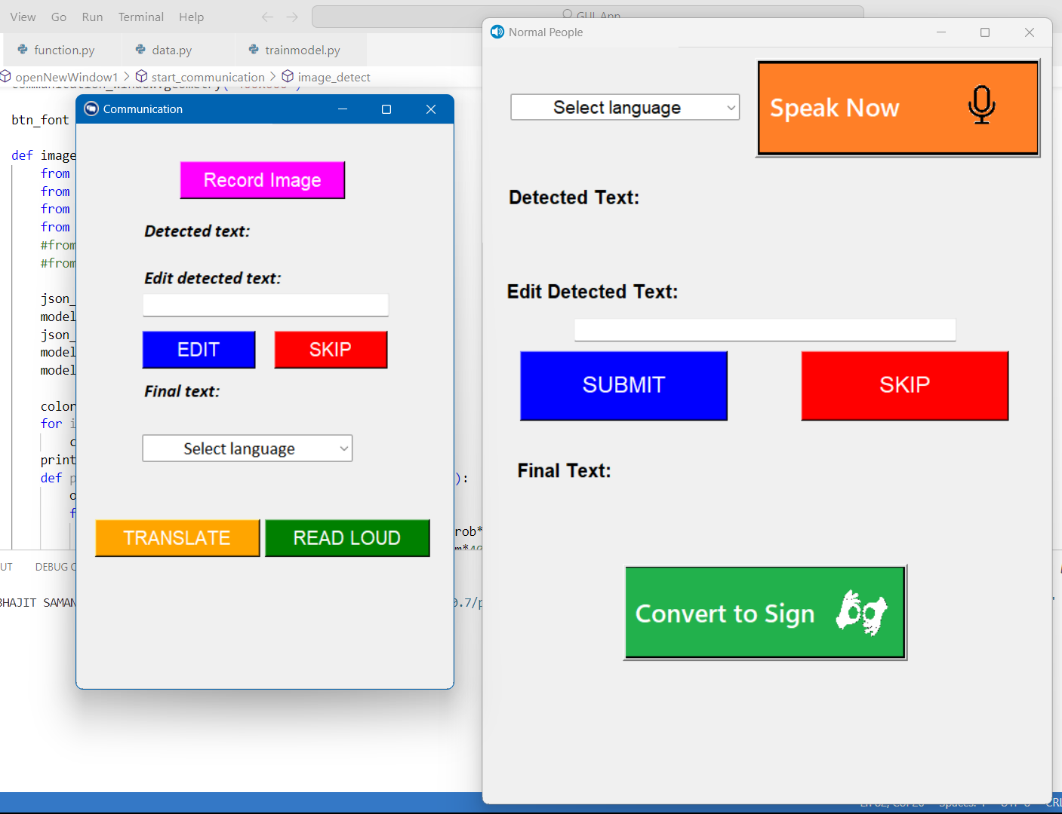
Phase 4 Implementation
User Interface
Notes:
User Interface

Slide 13
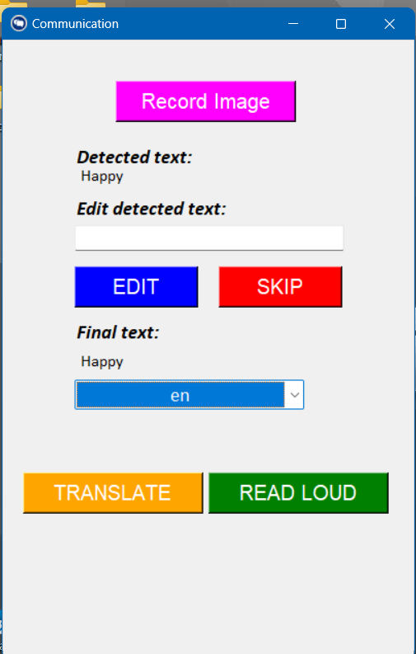
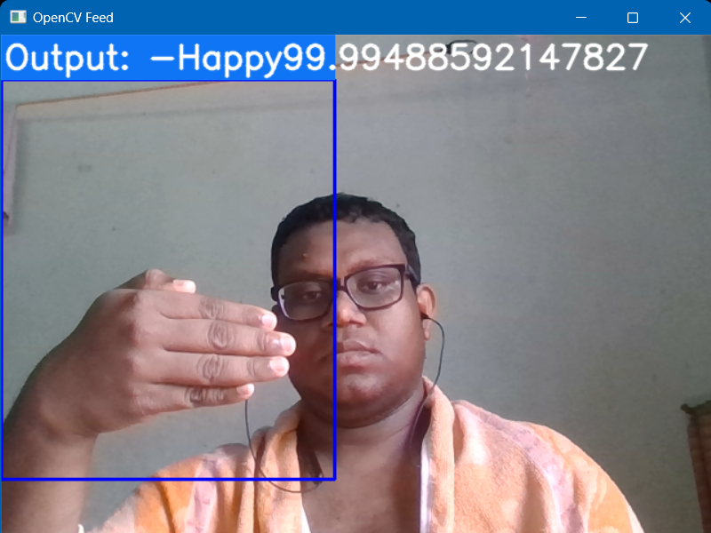
Phase 5 Implementation
Test Cases 1
Notes:
Test Cases

Slide 14
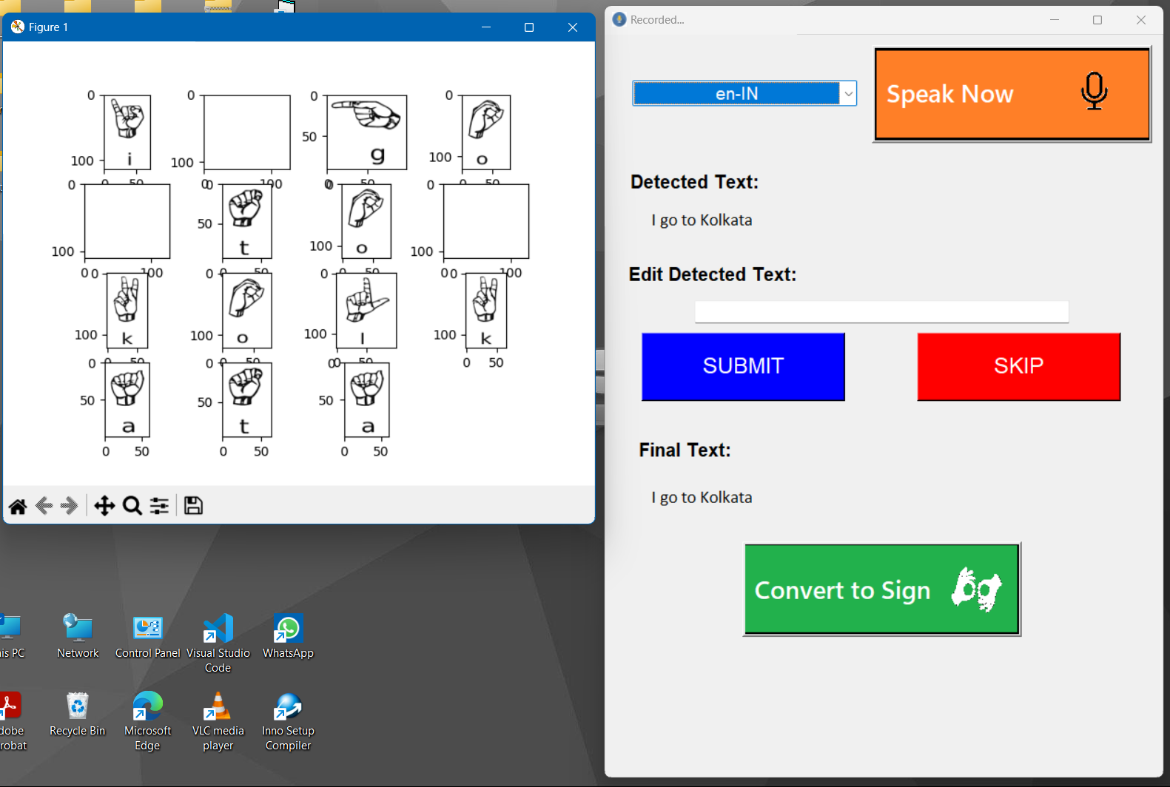
Test Cases 2

Slide 15
Phase 6 Implementation
Future Studies
Currently our application is developed for laptop. This can also be used for Android Smartphone or tablet. The application is dynamic and secure.
This also can be implemented in any Android based IOT device like smart speaker at bank or railway counter to make the service easy for deaf people.
This also can be developed as a module or API and can be implemented as a future of a video chat service, which will facilitate the education of deaf people.
Notes:
Currently our application is developed for laptop. This can also be used for Android Smartphone or tablet. The application is dynamic and secure.
This also can be implemented in any Android based IOT device like smart speaker at bank or railway counter to make the service easy for deaf people.
This also can be developed as a module or API and can be implemented as a future of a video chat service, which will facilitate the education of deaf people.

Slide 16
Conclusion
One of the most common disability in people is deaf and dumb.
This project can help them to communicate with normal people with the help of Machine Learning.
This translator can translate hand sign language to corresponding English word and also translate speech of normal people to sign images.
This application can be used to teach deaf and dumb kids in attractive way with colors and pictures.
Notes:
One of the most common disability in people is deaf and dumb.
This project can help them to communicate with normal people with the help of Machine Learning.
This translator can translate hand sign language to corresponding English word and also translate speech of normal people to sign images.
This application can be used to teach deaf and dumb kids in attractive way with colors and pictures.

