Slide 1
PRITAM KUNDU · EXPLORATORY SQL PROJECT
Zepto Inventory & Product Analysis
Examining product pricing, discounts, stock availability and category inventory patterns.
MySQL 8.0 · MySQL Workbench

Slide 2
DATASET
Dataset and database structure
Product SKU records in the zepto_sql_project database, stored in the zepto table.
Field group | Key fields
Product identity | Category and name
Pricing | MRP and discountedSellingPrice
Discount | Discount percentage
Weight | weightGrams
Inventory | Quantities and stock status

Slide 3
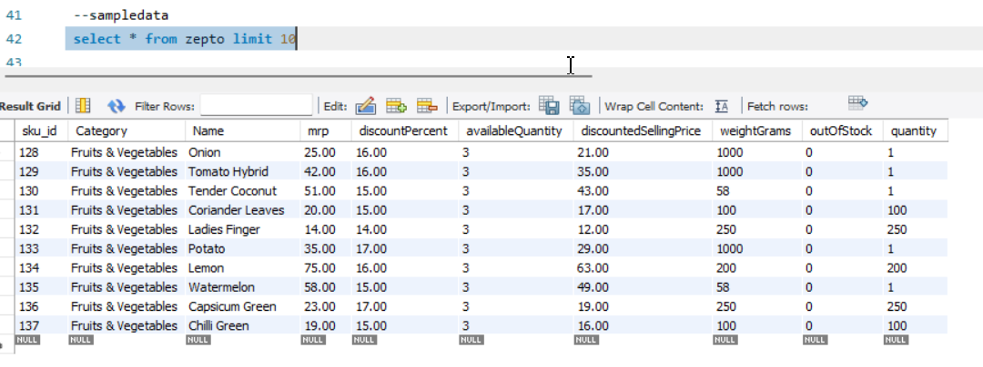
EXPLORATION
Exploration and data quality checks
Record counts
Completeness
Count records and inspect sample rows.
Check nulls across fields.
MySQL Workbench screenshot placeholder
Coverage
Repeated names
Review categories and stock status.
Investigate shared names across variants.
Exploration and data quality checks
Variants can share names, so repeats were investigated rather than automatically deleted.

Slide 4
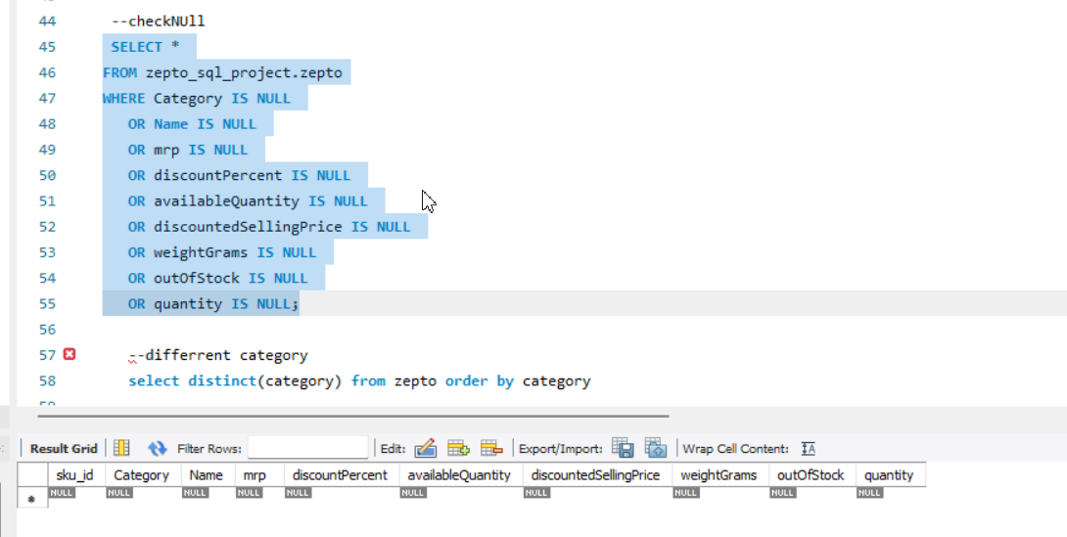
PREPARATION
Cleaning and transformation
01
02
03
04
Identify
Remove
Convert
Check
Find zero prices.
Remove records with zero MRP.
Divide MRP and selling price by 100: paise to rupees.
Check cleaned values.
MySQL Workbench screenshot placeholder
Zero-MRP removal, currency conversion and cleaned values

Slide 5
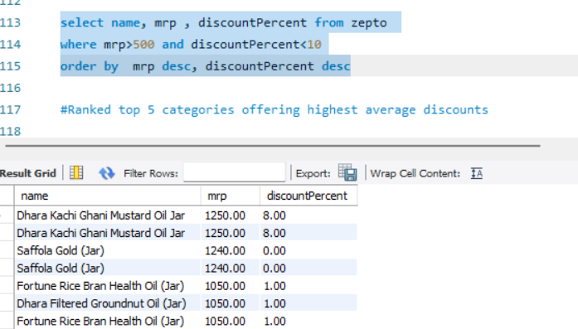
PRICING
Product pricing and discount analysis
Analysis | Scope
Listed discounts | Highest listed discounts
High-MRP products | MRP above ₹500 with discount below 10%
Price per gram | Weights of at least 100 grams
MySQL Workbench screenshot placeholder
Pricing and discount queries
Discount consistency check
Initially examined
30 records only

Slide 6
INVENTORY
Inventory and category-level analysis
Analysis | Calculation or scope
Estimated inventory value | \operatorname{SUM}(\text{discountedSellingPrice}\times\text{availableQuantity})
Inventory weight | \operatorname{SUM}(\text{availableQuantity}\times\text{weightGrams})
Category stockouts | Category stockout rates
High-MRP stockouts | Out-of-stock products above ₹300 MRP
MySQL Workbench screenshot placeholder
Inventory aggregations and category-level queries

Slide 7
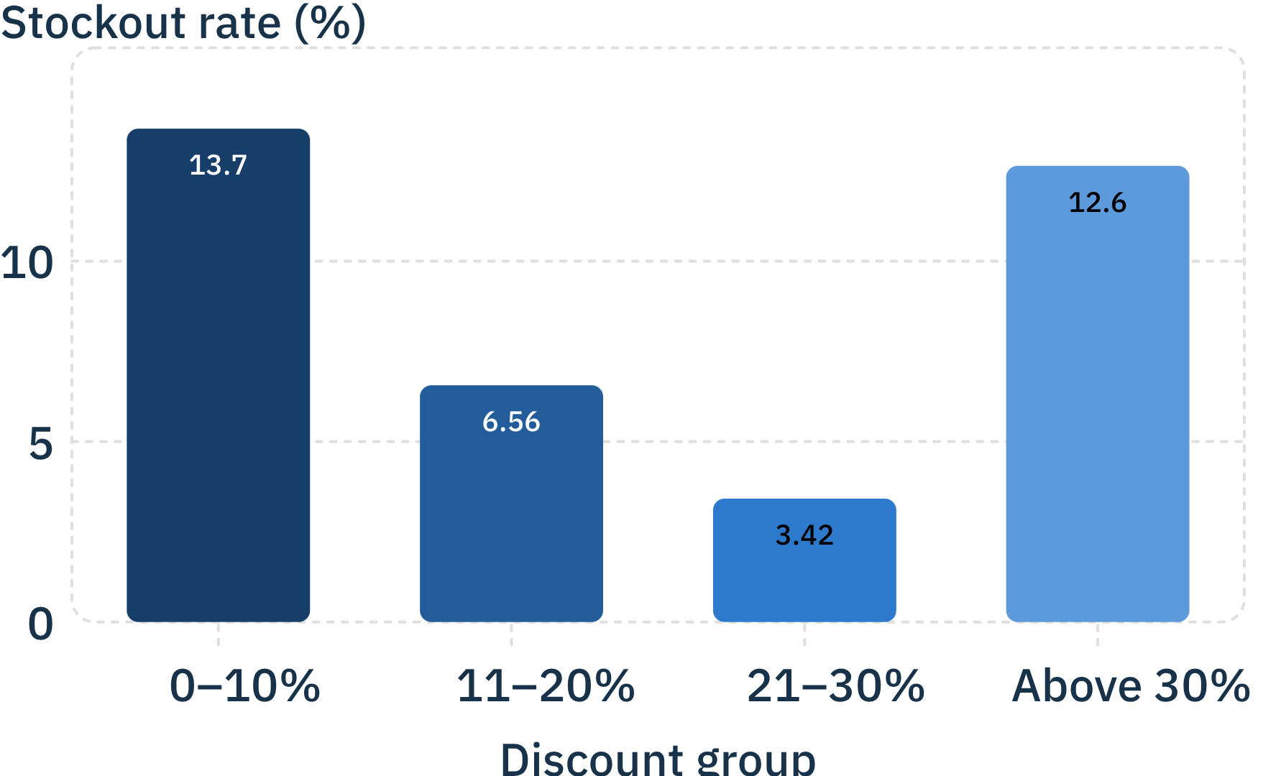
REPORTED RESULTS
Stockout rates vary across discount groups
Stockout rate (%) by discount group
Discount | Products | Out of stock
0–10% | 2,919 | 399
11–20% | 579 | 38
21–30% | 146 | 5
Above 30% | 87 | 11
Rates do not increase consistently with higher discounts and do not establish causation.

Slide 8
PROJECT SCOPE
Takeaways, limitations and next steps
SQL skills demonstrated through exploration, data quality checks, cleaning, transformation and category-level aggregation.
Snapshot limitations
Author’s next steps
No sales revenue, margins or velocity.
No cause of stockouts established.
Estimated inventory value is not revenue.
Complete full-dataset discount validation.
Improve documentation.
Publish SQL scripts and presentation on GitHub.

