Slide 1

PCA & Free Energy Landscape GROMACS

Slide 2

Free Energy Landscape
This plot is a visualization known as a Free Energy Landscape (FEL) or Gibbs Energy Landscape. It typically represents the free energy as a function of two reaction coordinates or principal components (PCs), often derived from Principal Component Analysis (PCA) of molecular dynamics (MD) simulation data.

Slide 3
Axes (PC1 and PC2):
The x-axis (PC1) and y-axis (PC2) correspond to the first and second principal components, respectively. These components are the directions in which the data shows the most significant variance, effectively capturing the essential motions or conformations of the system being studied (like a protein or a molecular complex).
Color Gradient (Gibbs Free Energy):
The color gradient represents the Gibbs free energy (G) in kilojoules per mole (kJ/mol).
Blue/Green Regions: These are the areas of low Gibbs free energy, corresponding to stable states or conformations that the system is most likely to occupy. These are often interpreted as local or global minima in the free energy landscape.
Red Regions: These represent areas of high Gibbs free energy, indicating less favorable or unstable states that the system is less likely to occupy.
Interpretation:
Clusters: The blue and green clusters in the plot correspond to the most stable conformational states of the system. The system is likely to remain in these states for more extended periods during the simulation.
Transitions: The red regions between clusters indicate energy barriers that the system would need to overcome to transition from one stable state to another.

Slide 4
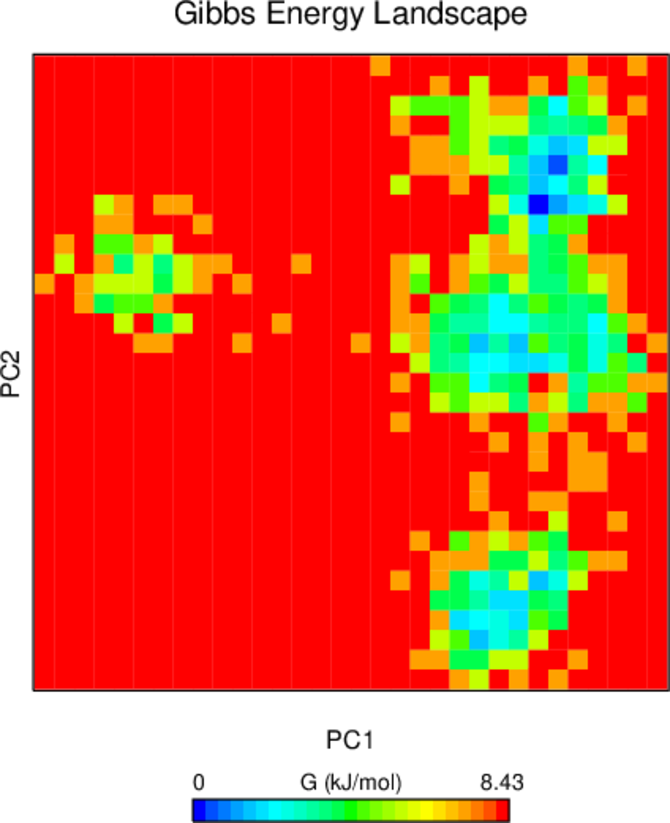
Possible Reasons for Separate Clusters on PC2:
Distinct Conformational States:
The protein might have multiple stable conformational states that are quite different from each other. These states are represented by separate clusters on the plot. The distance between these clusters along PC2 indicates how different these conformations are.
Energy Barriers:
The separation along PC2 could indicate the presence of significant energy barriers between these conformational states. These barriers make it less likely for the protein to transition directly from one state to another without undergoing intermediate steps.
Structural Transitions:
The protein might undergo large structural rearrangements that result in distinctly different conformations. For example, a protein might switch between an "open" and "closed" conformation, and these distinct states would be represented by separate clusters.
Partial Flexibility or Localized Motion:
The separation along PC2 might reflect localized flexibility in certain regions of the protein. If a specific domain or segment of the protein has a few distinct modes of movement or orientations, this could result in separated clusters on the plot.

Slide 5
PCA and Free Energy Landscape for Protein-Ligand Complexes:
When performing PCA on a protein-ligand complex, the goal is to understand how the binding of the ligand influences the overall dynamics of the protein and how the complex as a whole explores its conformational space.
Combined Motion Analysis:
When performing PCA on a protein-ligand complex, the principal components will describe the most significant collective motions of both the protein and the ligand.
This can include the ligand's binding modes, the protein's conformational changes in response to ligand binding, and the dynamics of the binding site.
Influence of the Ligand:
The presence of the ligand might introduce new conformational states or stabilize specific conformations of the protein, which would be reflected in the PCA.
The FEL could reveal how the ligand stabilizes certain protein conformations by showing new low-energy regions (blue/green) that might not be present in the protein-only simulation.
Clusters in the PCA Plot:
Separate clusters in the PCA plot could represent different binding modes of the ligand or different conformations of the protein-ligand complex.
For example, one cluster might represent the complex with the ligand bound tightly in a specific orientation, while another might represent a state where the ligand is loosely bound or partially dissociated.
Protein-Ligand Interaction Dynamics:
PCA can help you understand the flexibility of the binding site and how the protein adjusts its structure to accommodate the ligand. This is crucial for understanding binding affinity and specificity.
The FEL will provide insights into which conformational states are most energetically favorable and how the protein-ligand complex transitions between these states.

