Slide 1
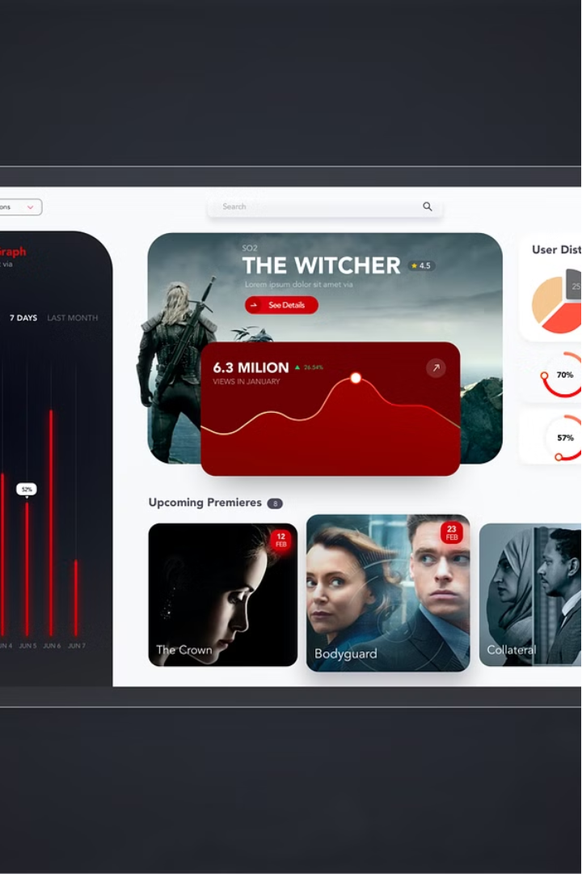


Netflix IMDB Score Dashboard
Problem Statement: Create an engaging Power BI Dashboard analyzing Netflix shows' IMDb scores. Visualize ratings, genres, and trends to derive insights into viewer preferences.
by Prateek Pritam

Slide 2
Visualizing Netflix Show Ratings, Genres, and Trends.
Ratings Analysis
Genre Breakdown
Trending Content
Visualize the distribution of IMDb scores across the Netflix catalog to identify top-rated and underperforming titles.
Analyze the prevalence of different genres on Netflix and how they correlate with viewer ratings and preferences.
Uncover emerging trends in Netflix viewership by tracking changes in IMDb scores and popular new releases.

