Slide 1
Airline Safety Measure DSC_640(Executive Summary)
Professor: DR. Richard Bushart
Pritam Shrestha
Bellevue University
1000 Galvin Rd S, Bellevue, NE 68005 prishrestha@my365bellevue.edu

Slide 2
Used Matrices
I have used six different matrices to analyze the airlines safety concerns.
Airlines revenue(Domestic, International)
Safety records of US carriers
Motor vehicle Fatalities
Departing seats
Aircraft death per year
Death comparison between aircraft and motor vehicle

Slide 3
Data Sources
I have used following data sources:
Revenue data(https://www.transtats.bts.gov/Data_Elements.aspx?Data=3)
Safety_record_of_us_carriers_operating_world_wide(https://www.airlines.org/dataset/safety-record-of-u-s-air-carriers/#)
Airline Safety, Aviation Safety Network
Crash Datasets, https://data.world/datasets/crash
Economic Impact of Commercial Aviation By State, Airlines for America
Traffic and Capacity by Operating Region, Airline data project.
Data Catalog, Data.Gov

Slide 4
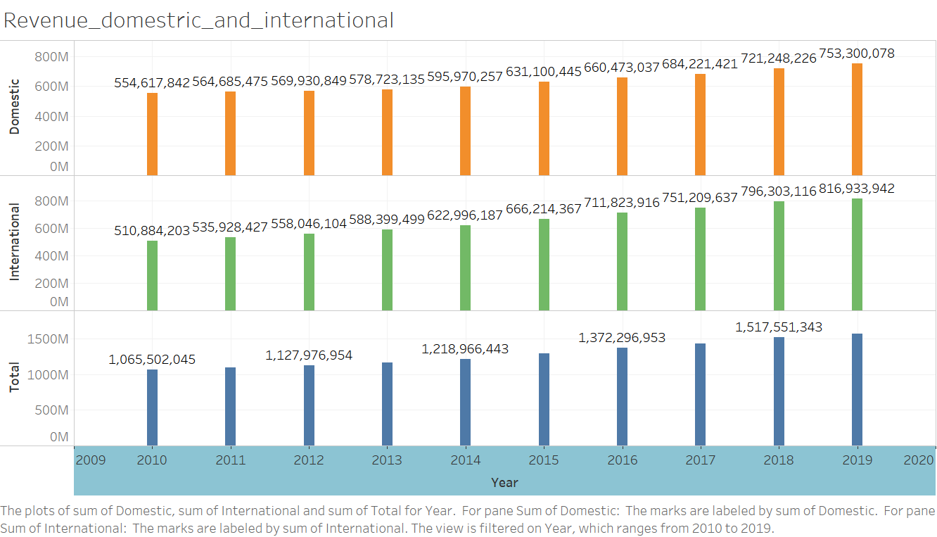
Airline Revenue (Domestic, international)

Slide 5
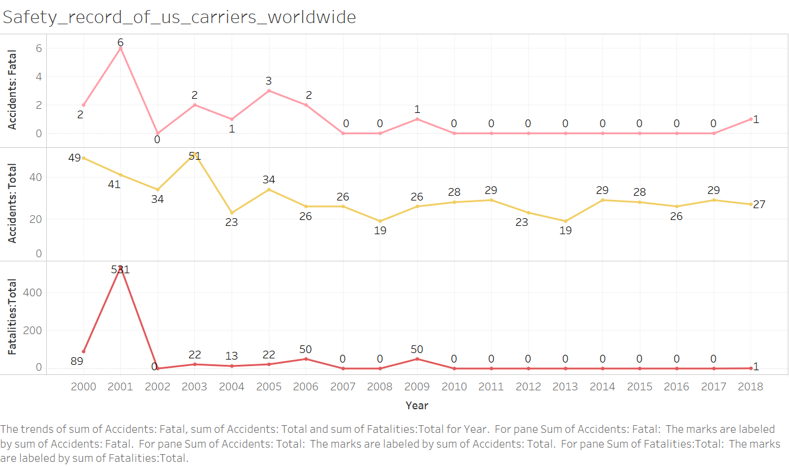
Safety records of US carriers

Slide 6
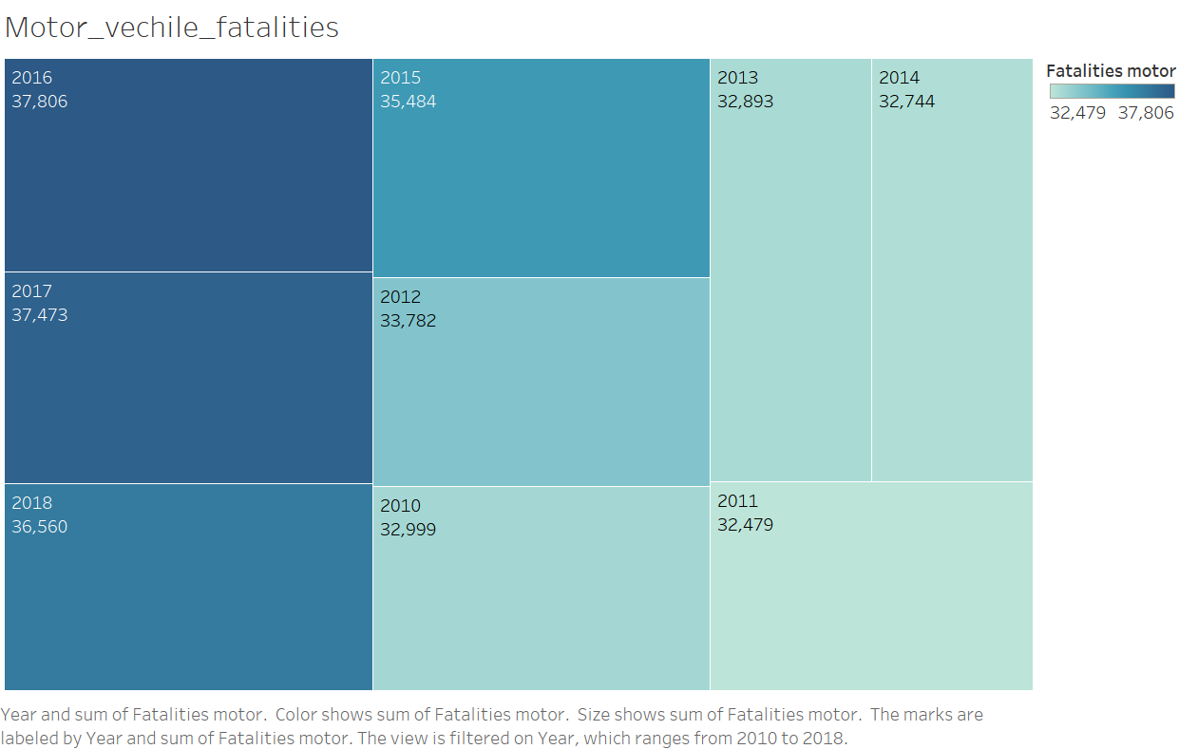
Motor vehicle fatalities per year

Slide 7
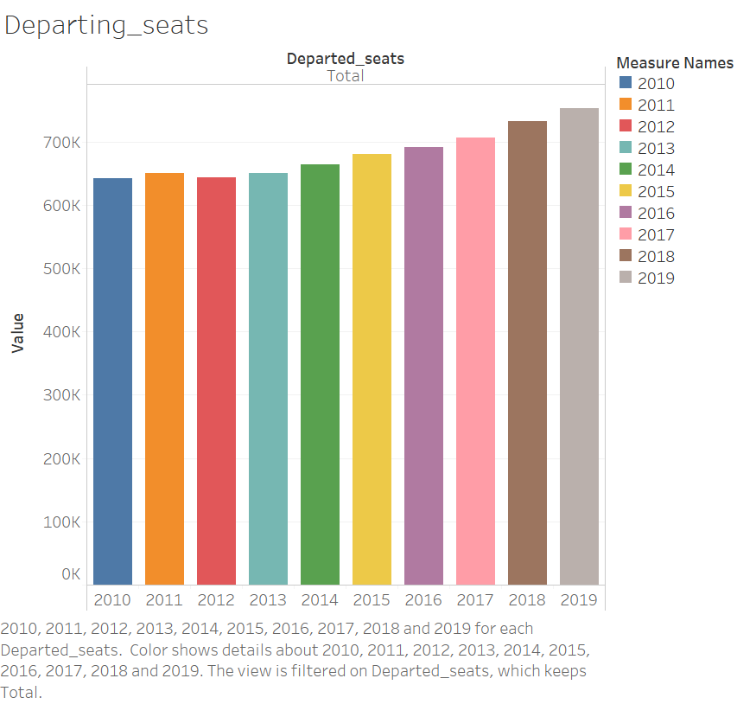
Departing seats of airlines

Slide 8
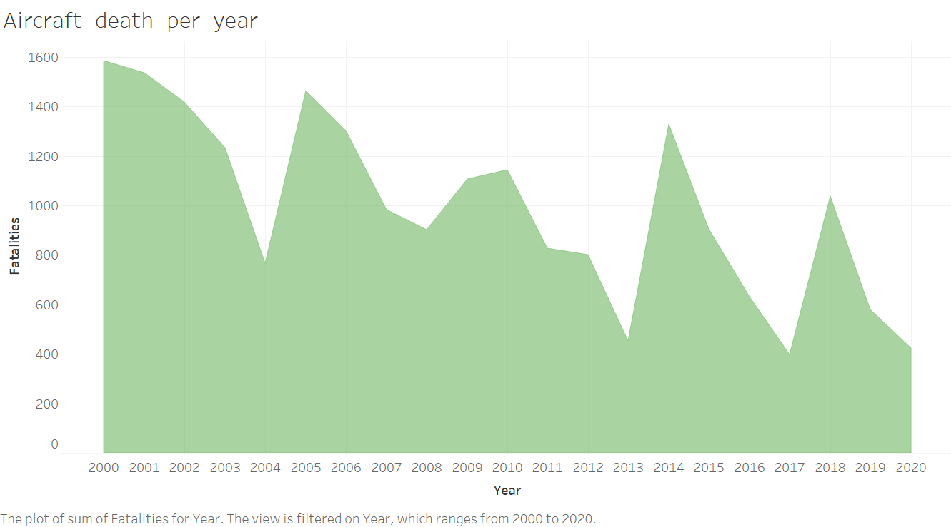
Aircraft death per year

Slide 9
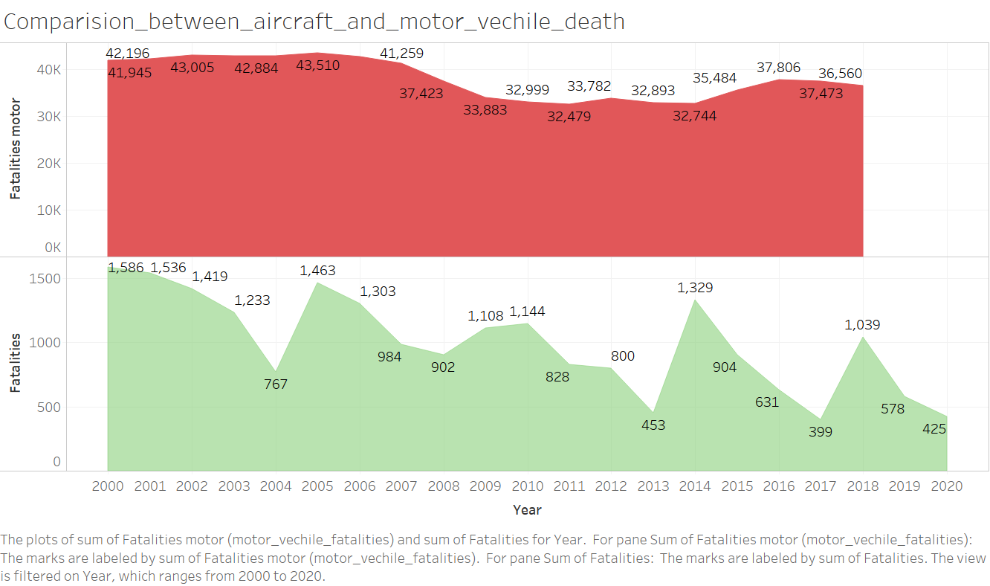
Death comparison between aircraft and motor vehicle

Slide 10
Findings/insights
A summary of airline safety and travel analytics.
Airline revenues are continuously growing.
Airline fatalities and incidents are far lower than motor vehicle.
Airline fatalities decreased over time compared to others.
Airline departed seats are continuously growing.

Slide 11
Result
Conclusion:
After finding above listed insights, airline travel is still more secure than other transportation medium.
References:
1) https://www.transtats.bts.gov/Data_Elements.aspx?Data=3.
2) https://www.airlines.org/dataset/safety-record-of-u-s-air-carriers/#
3) https://www.data.world/datasets/crash
Thank You !!!

