Slide 1
Creating different charts using different Methods
Professor: DR. Richard Bushart
Pritam Shrestha
Bellevue University
1000 Galvin Rd S, Bellevue, NE 68005 prishrestha@my365bellevue.edu

Slide 2
Used Methods
I have created different charts Using following methods.
Using Python Programming language
Using R Programming Language
Using Tableau
Name of the charts
Heat map
Spatial chart
Contour chart

Slide 3
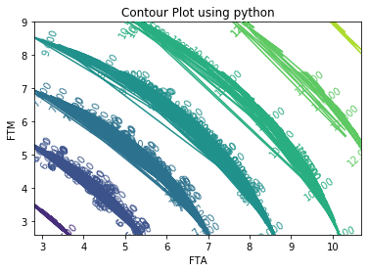
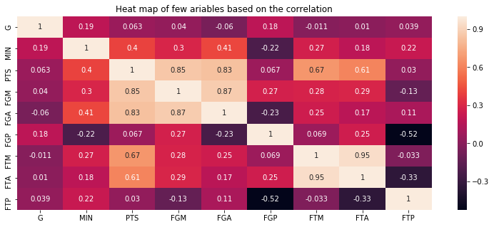
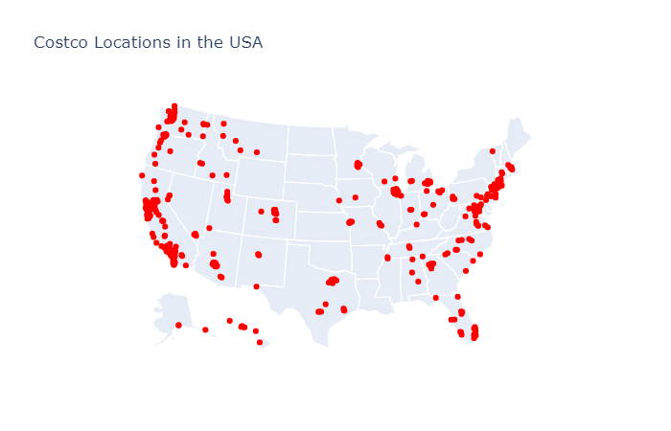
Heat map, Spatial chart and contour chart are created using python

Slide 4
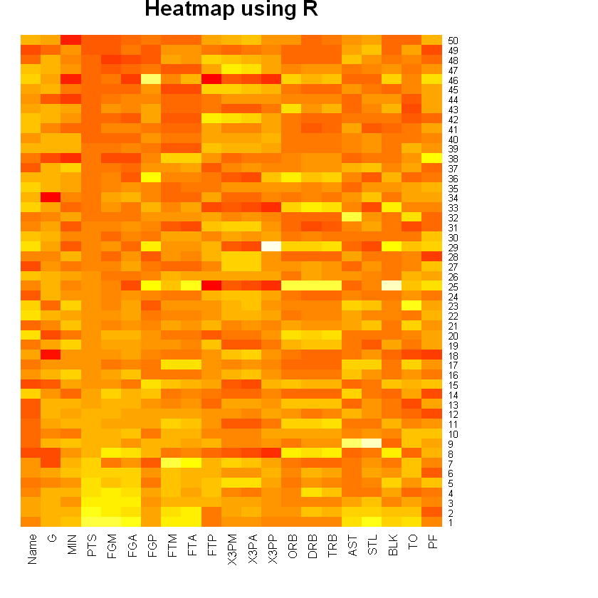
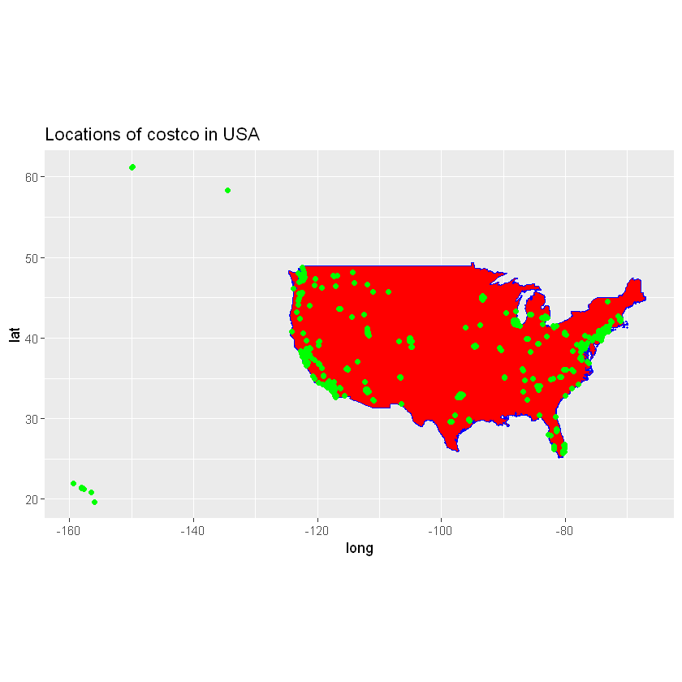
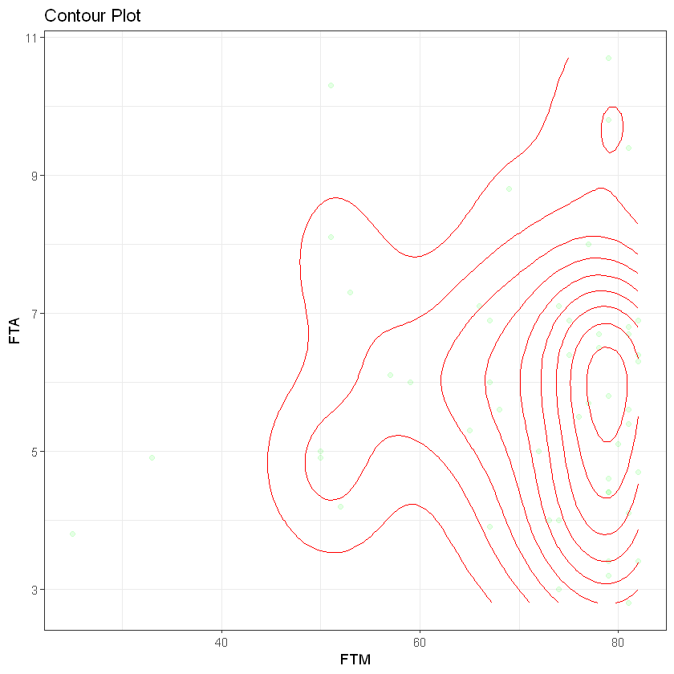
Heat map, Spatial chart and contour chart are created using R

Slide 5
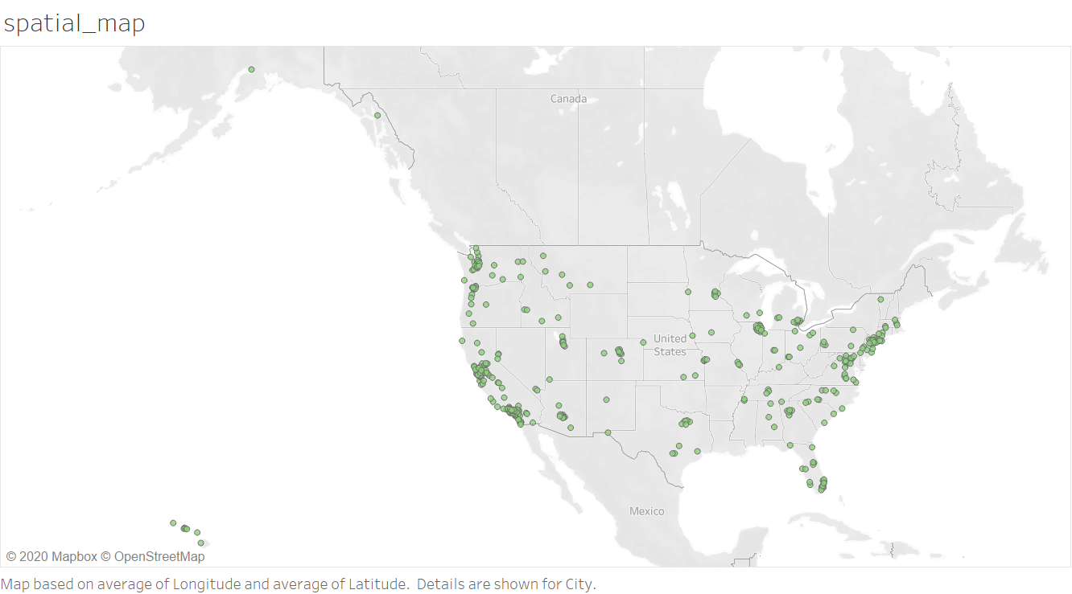
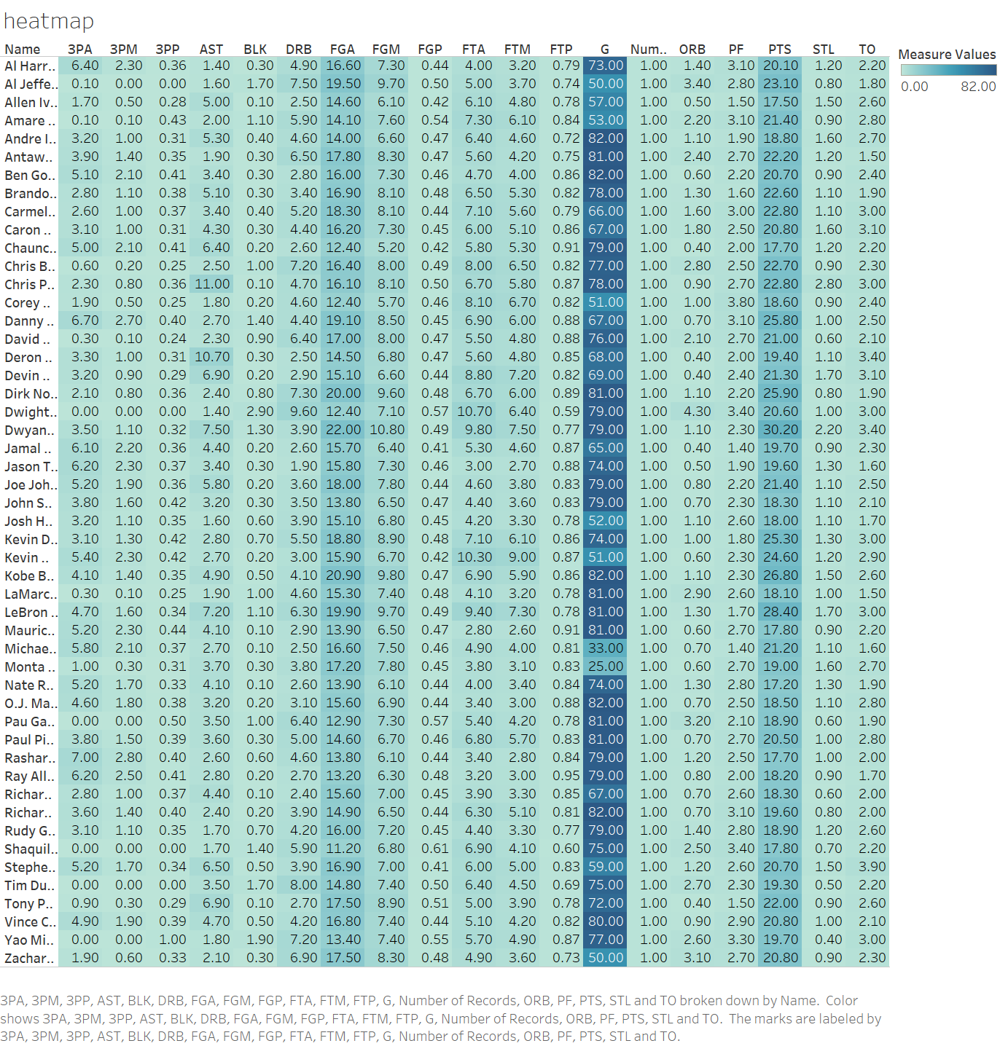
Heat map, Spatial chart and contour chart are created using Tableau

Slide 6
Result
Finally, I have created three different charts(heatmap, spatial chart and ) using three different methods (Python, R, Tableau) as a solution of exercise 5.2.
And attached all files and images.
References:
http://eriqande.github.io/rep-res-web/lectures/making-maps-with-R.html
https://matplotlib.org/gallery/images_contours_and_fields/image_annotated_heatmap.html
https://matplotlib.org/api/_as_gen/matplotlib.pyplot.contour.html
Thanks!!!

