Slide 1
Presentation on Airline Safety Measure
Professor: DR. Richard Bushart
Pritam Shrestha
Bellevue University
1000 Galvin Rd S, Bellevue, NE 68005 prishrestha@my365bellevue.edu

Slide 2
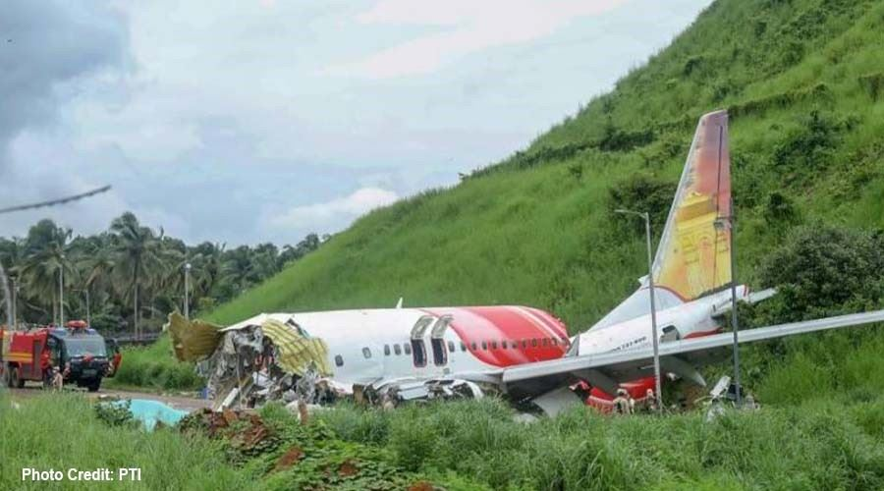
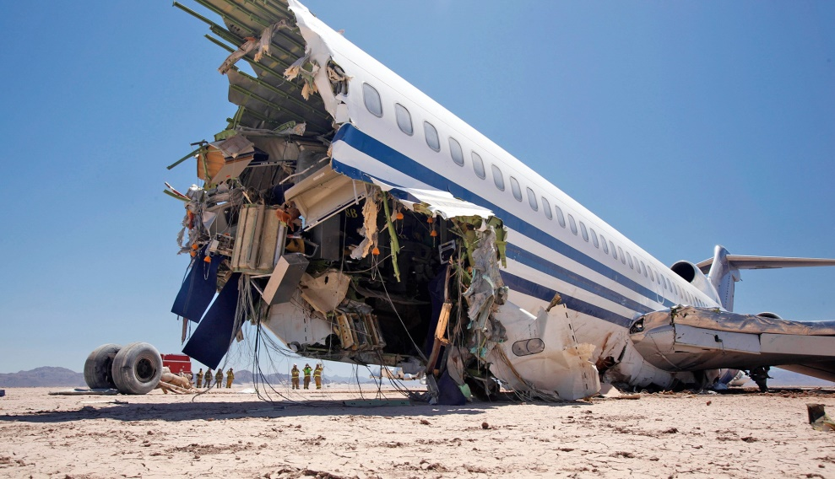
Recent Aviation Crashes:
On August 7, 2020, Air India Flight 1344 crashed with 190 people.
On May 22, 2020, Pakistan International Airlines flight 8303 crashed nearly all died.
On January 8 2020, Ukrainian Boeing 737 crashed in Tehran killing all 167 passenger and crew members.

Slide 3
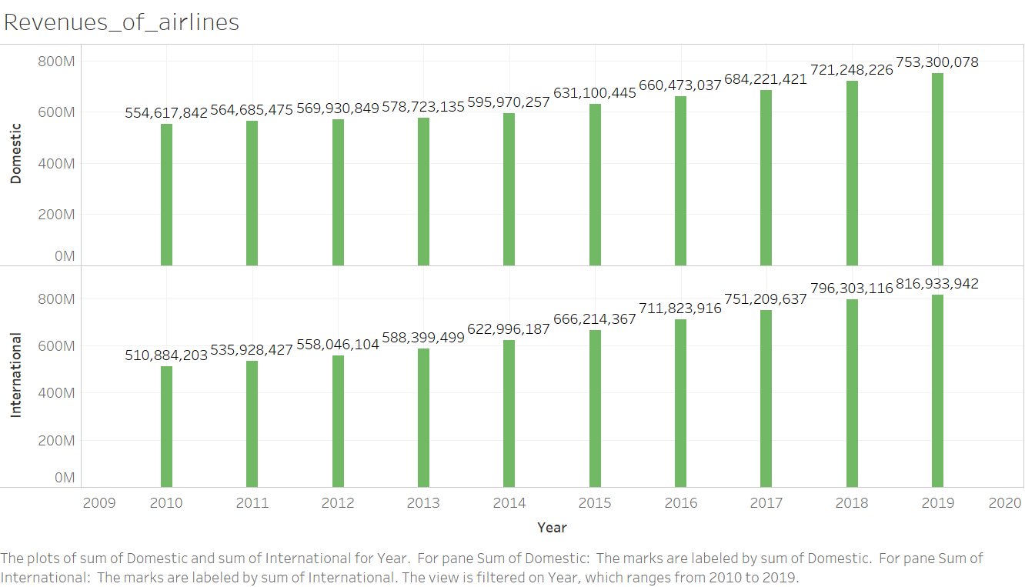
Are they still safe to travel?

Slide 4
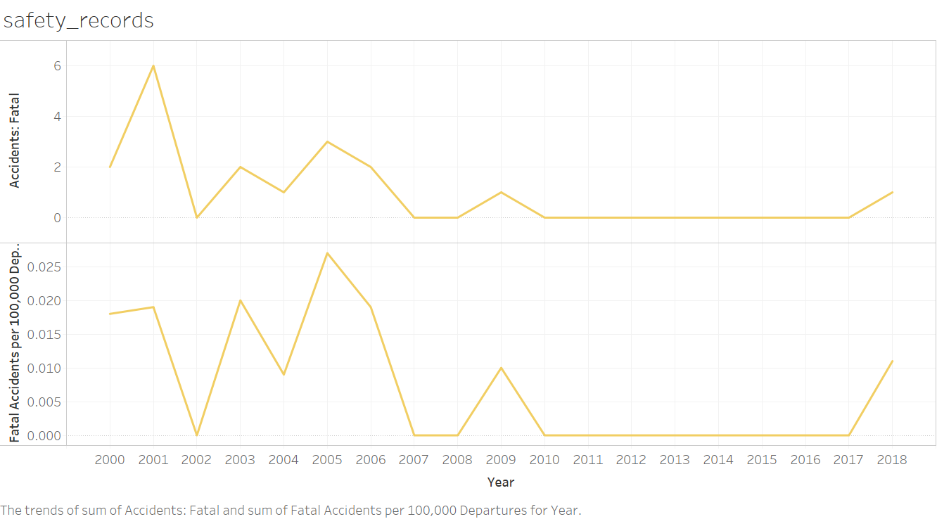
Are they still safe to travel?

Slide 5
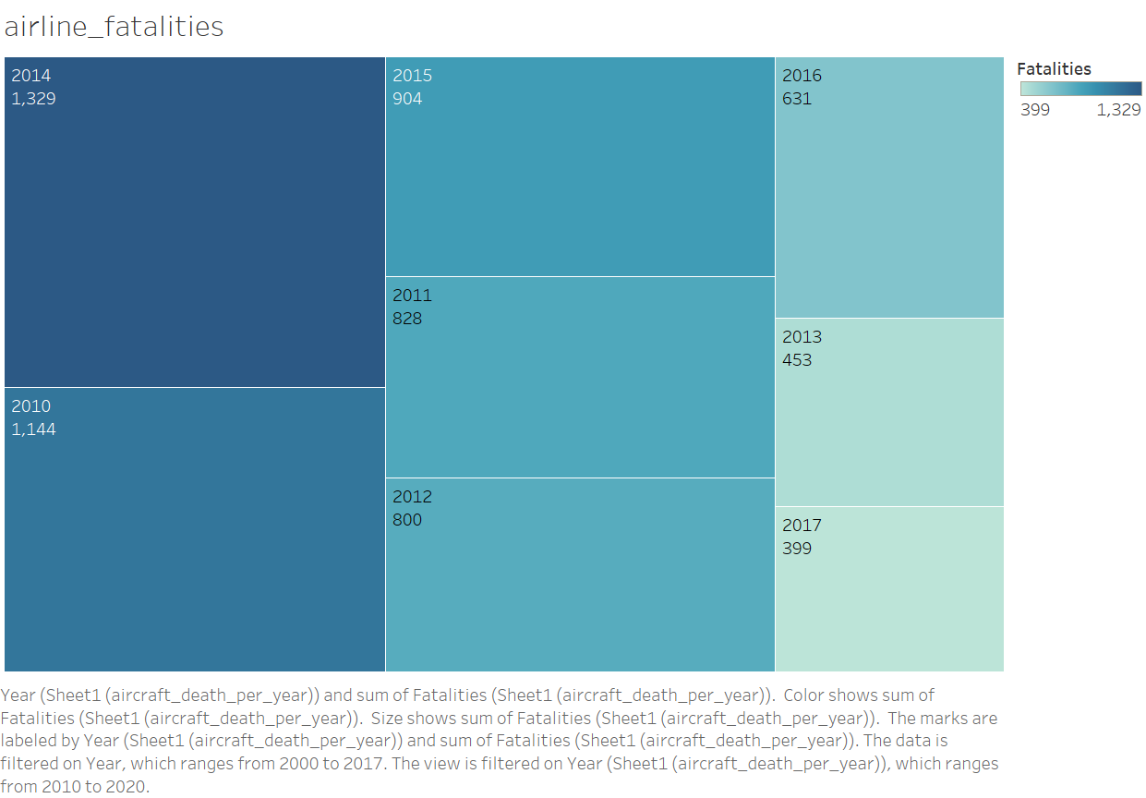
Are they still safe to travel?

Slide 6
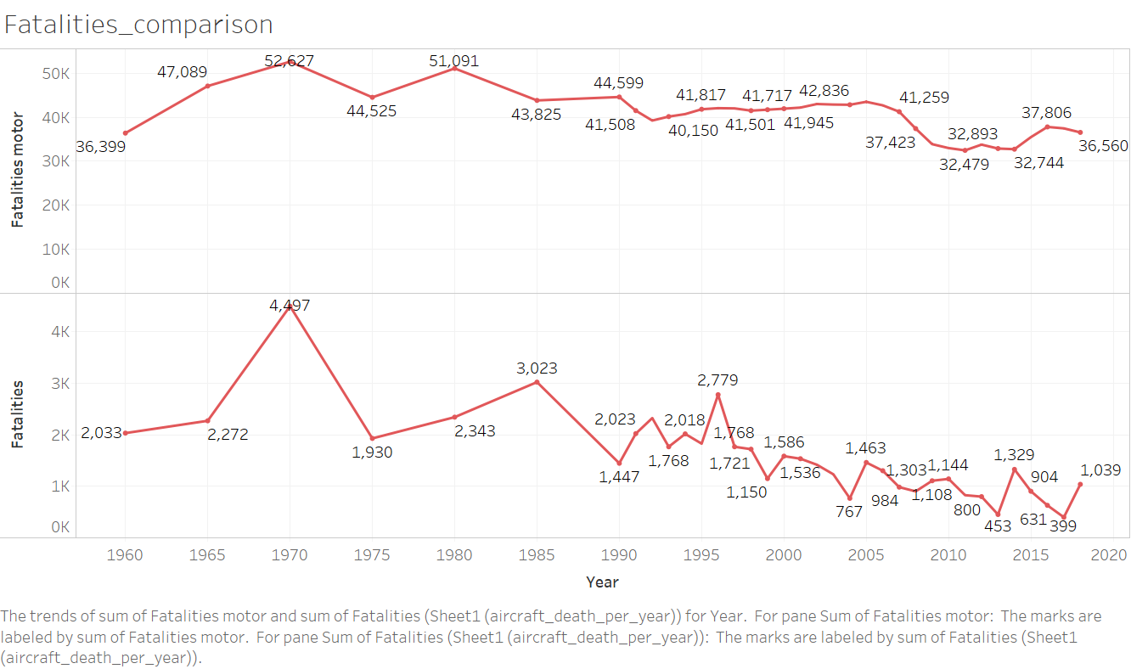
Are they still safe to travel?

Slide 7
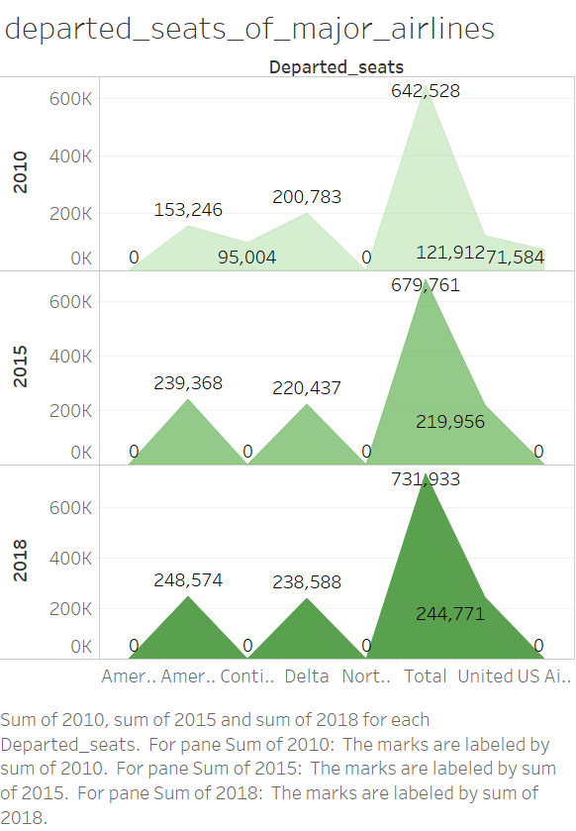
Are they still safe to travel?

Slide 8
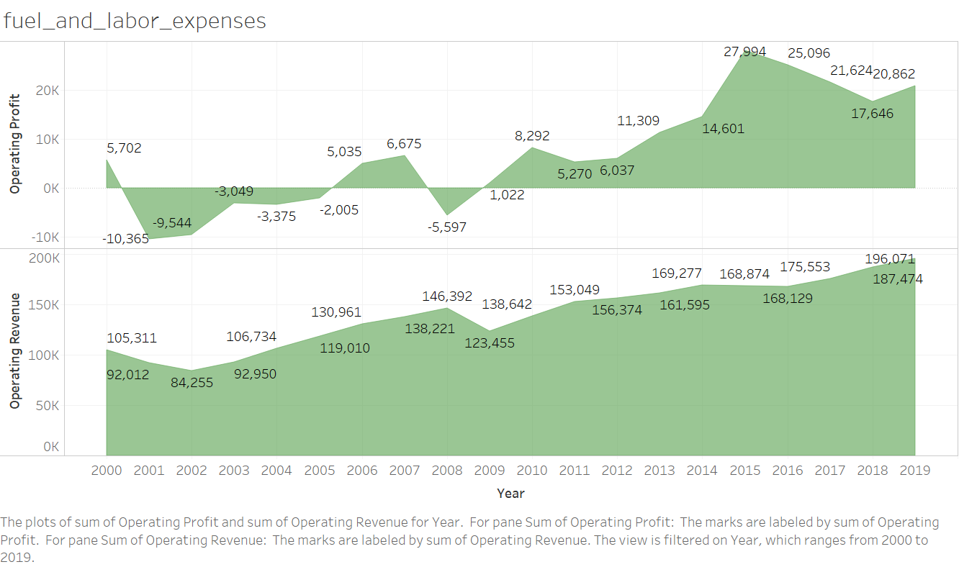
Are they still safe to travel?

Slide 9
Result
Conclusions:
Despite having few accidents and fatalities, air travel is extremely safe and has been consistently safe due to
Revenues are continuously growing.
Fatalities and accidents are far lower than motor vehicles.
Departed seats are increasing means more people are flying.
Operating cost and profit are increasing.
References:
1) Airline Safety, Aviation Safety Network
2) Crash Datasets, https://data.world/datasets/crash
3) Traffic and Capacity by Operating Region, Airline data project.
4) Revenue data (https://www.transtats.bts.gov/Data_Elements.aspx?Data=3)
5) US (https://www.airlines.org/dataset/safety- record-of-u-s-air-carriers/#)
Thanks!!!

