Slide 1
CREDIT EDA CASE STUDY
Prepared By
Pritamkumar Suryavanshi
Abhishek N R

Slide 2
PROBLEM STATEMENT
Two types of risk's are associated with Bank's decision :
If the applicant is likely to repay the loan , then not approving the loan results in loss of business to the company.
If the applicant is not likely to repay the loan , i.e. he/she is likely to default , then approving the loan may lead to a financial loss for the company.
When a client applies for a loan, there are four types of decisions that could be taken by the client/company
Approved
Cancelled
Refused
Unused Offer
Dataset consist of 2 files.
Application Data – contains client has payment difficulties.
Previous application – contains the data whether the previous application had been Approved, Cancelled, Refused or Unused offer.
The company wants to understand the driving factors behind the loan default i.e. the variables which are strong indicators of default.

Slide 3
Outliers and Missing Values in Application Data

Slide 4
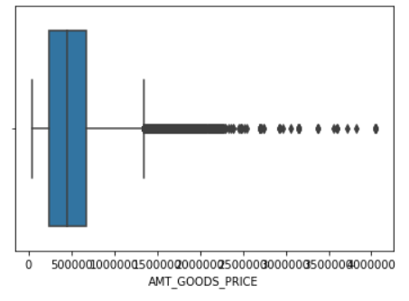
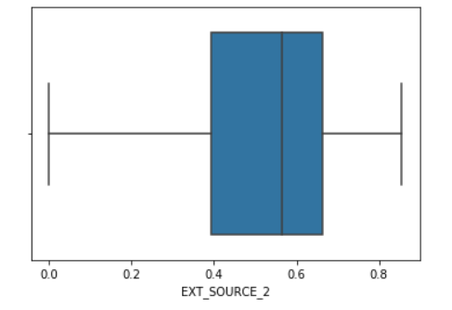
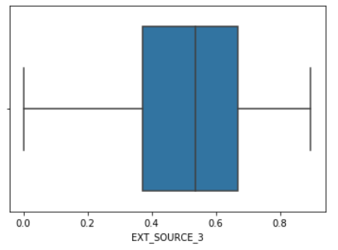
Outliers in Continuous Variables
Continuous Variable are - AMT_GOODS_PRICE, EXT_SOURCE_2, EXT_SOURCE_3.
Outliers are present in only AMT_GOODS_PRICE column and we can impute it using Median.

Slide 5
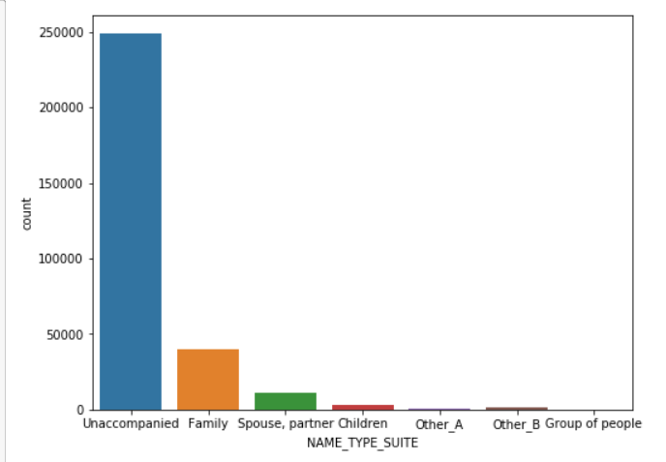
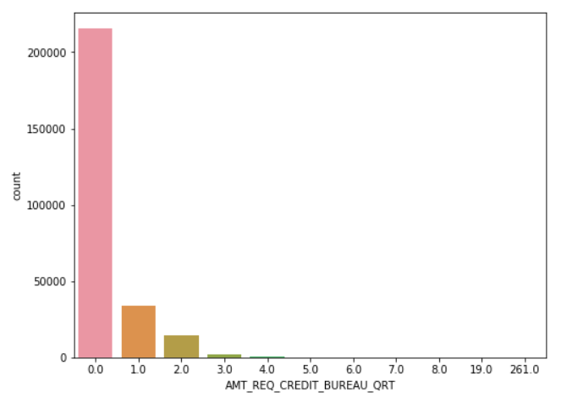
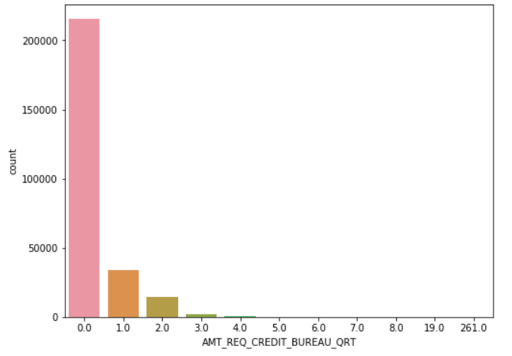
Missing Values in Categorical Variables
Categorical Variable are - AMT_REQ_CREDIT_BUREAU_QRT , NAME_TYPE_SUITE, DEF_30_CNT_SOCIAL_CIRCLE.
Impute missing values in categorical variables based on more no of occurrences.

Slide 6
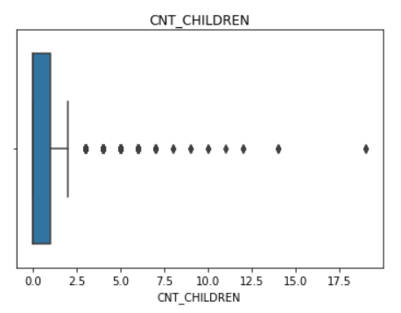
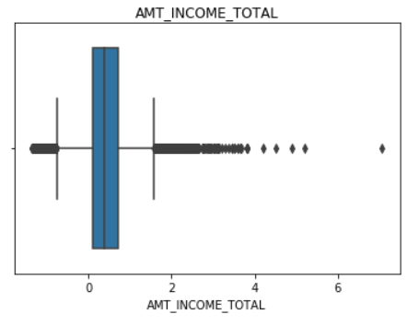
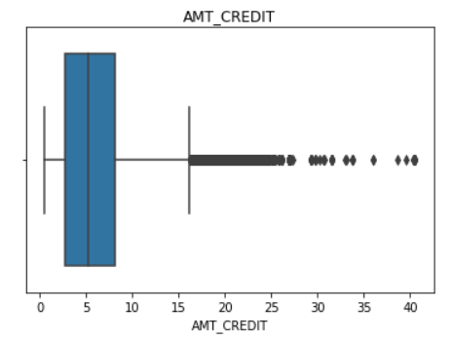
Outliers in Numerical Columns
Outliers in Numerical Columns - CNT_CHILDREN , AMT_INCOME_TOTAL , AMT_CREDIT.
Outliers are present in above numerical columns due to Max percentage value is greater than Mean , Mode and Median values.

Slide 7
Univariate Analysis in Categorical Variables for Target 0

Slide 8
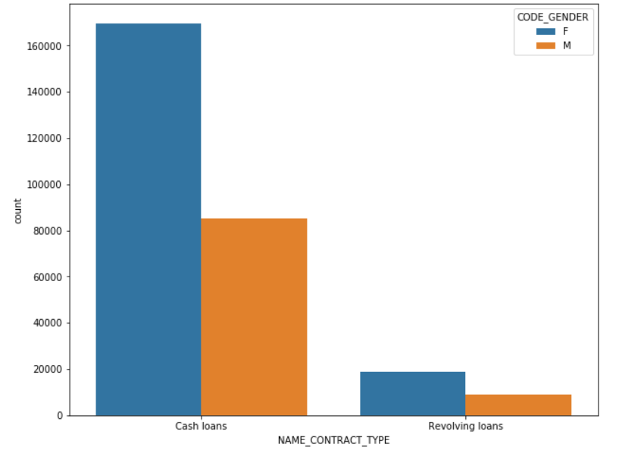
Observation Across Categorical Variables For TARGET0
Based on CONTRACT TYPE
We have concluded that
Contract Type Cash Loans is having higher number of credits than Revolving Loans contract type.
Credits are more in Female than Male.

Slide 9
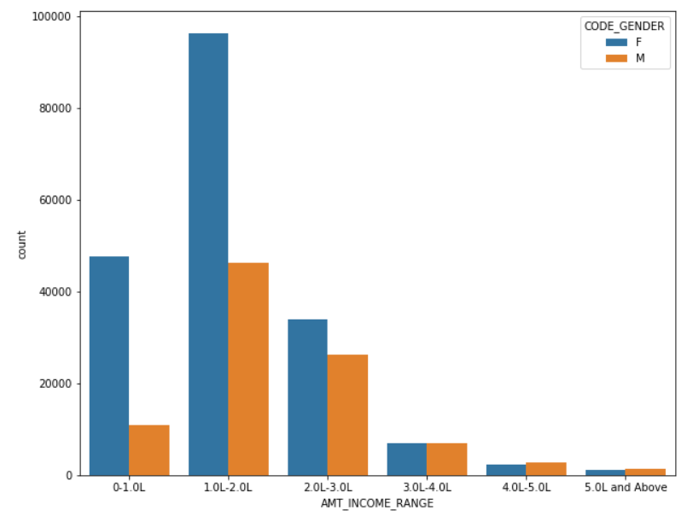
Based on INCOME RANGE
We concluded that
Females are leading in income range 0 to 2.0L than Male population.
Majority of the high Income range falls for Female between for 1.0L-2.0L and low in 4.0L-Above range.

Slide 10
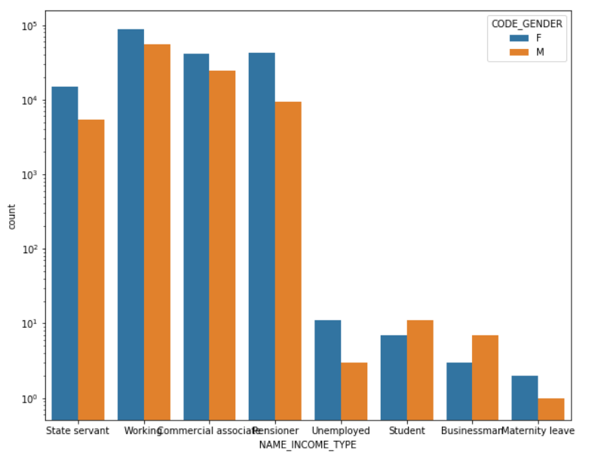
Based on INCOME TYPE
We concluded that
For income type Working , Commercial associate , Pensioner are having more credits than other income type.
For income type Student , Businessman and Maternity Leave income type has very no. of credits.

Slide 11
Univariate Analysis in Categorical Variables for Target1

Slide 12
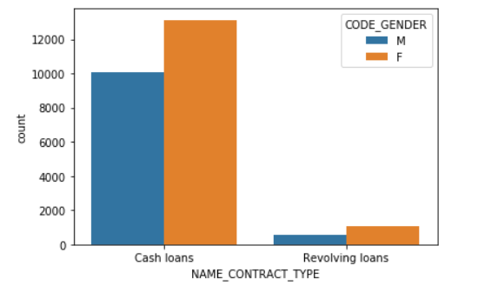
Observation Across Categorical Variables For TARGET1
Based on CONTRACT TYPE
We concluded that
Contract Type Cash Loans is having higher number of credits than Revolving loans contract type .
Females are having more counts than Male in both Contract type.

Slide 13
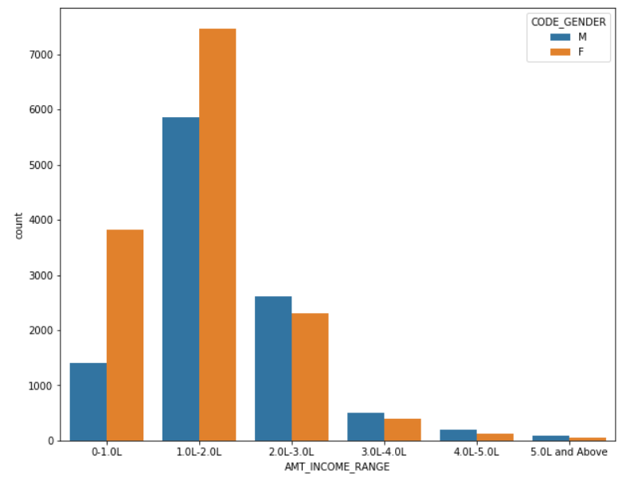
Based on INCOME RANGE
We concluded that
Income Range 0.-1.0L, 1.0L–2.0L are having high income range for Female as compared to Male population.
Very low income range is in 4.0L to above for both Male and Female.
Male income is more than female in 2.0 to 3.0 and above.

Slide 14
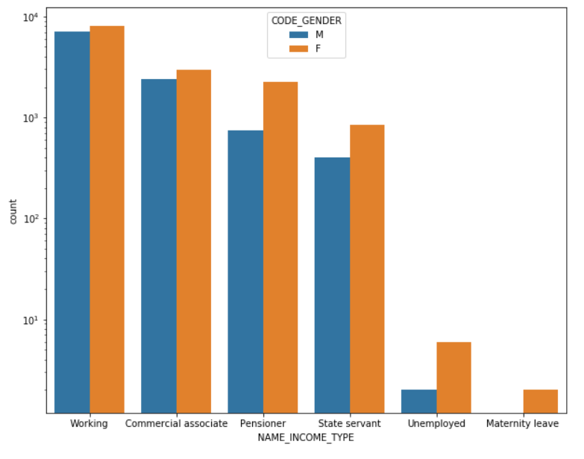
Based on INCOME TYPE
We concluded that
For the income type Working , Commercial Associate , Pensioner and State Servant are in descending order of Income Type.
Less income type is Maternity Leave.
Females are leading in all income type than Male.

Slide 15
Correlation on Numerical Column

Slide 16
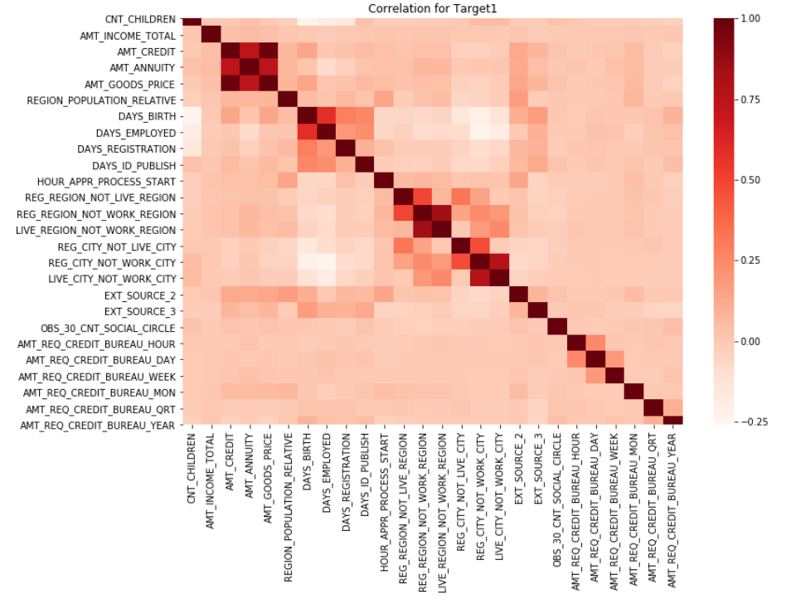
Correlation for Target 1
We conclude that
AMT_GOODS_PRICE and AMT_CREDIT are strong positively correlated.
AMT_GOODS_PRICE and AMT_ANNUITY are strongly correlated.
AMT_ANNUITY and AMT_CREDIT are strongly correlated.
LIVE_REGION_NOT_WORK_REGION and REG_REGION_NOT_WORK_REGION are strongly correlated.
LIVE_CITY_NOT_WORK_CITY and REG_CITY_NOT_WORK_CITY are strongly correlated.

Slide 17
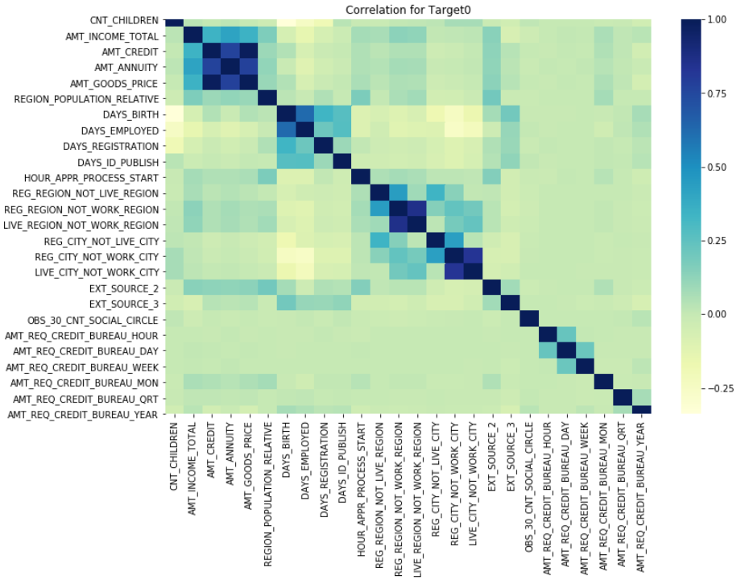
Correlation for Target0
We concluded that
AMT_GOODS_PRICE and AMT_CREDIT are strong positively correlated.
AMT_GOODS_PRICE and AMT_ANNUITY are strongly correlated.
AMT_ANNUITY and AMT_CREDIT are strongly correlated.
LIVE_REGION_NOT_WORK_REGION and REG_REGION_NOT_WORK_REGION are strongly correlated.
LIVE_CITY_NOT_WORK_CITY and REG_CITY_NOT_WORK_CITY are strongly correlated.

Slide 18
Univariate in Numerical Variables for Target0

Slide 19
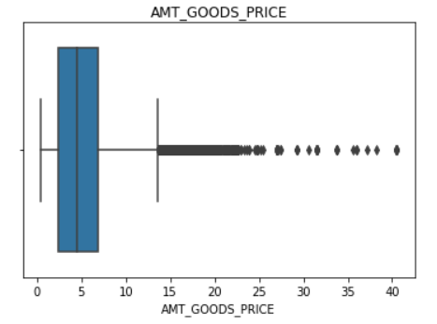
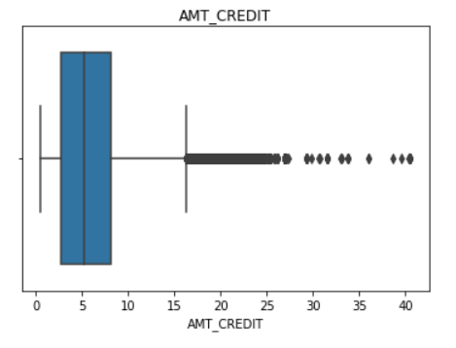
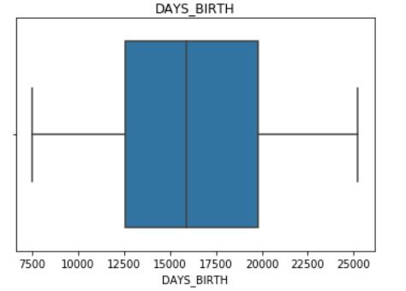
Outliers present in AMT_GOODS_PRICE and AMT_CREDIT and no outliers in DAYS_BIRTH for TARGET0

Slide 20
Univariate in Numerical Variables for Target1

Slide 21
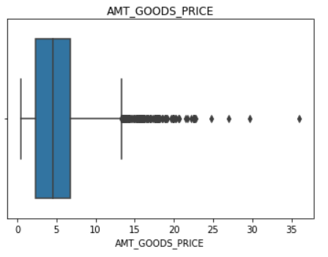
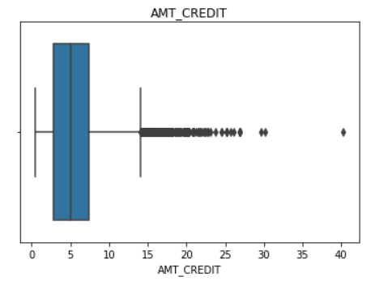
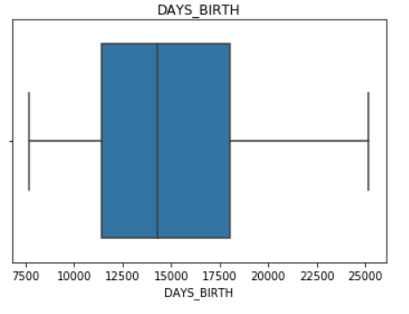
Outliers present only in AMT_GOODS_PRICE and AMT_CREDIT and no outliers in DAYS_BIRTH for TARGET1

Slide 22
Bivariate Analysis for Numerical Variable in Target0

Slide 23
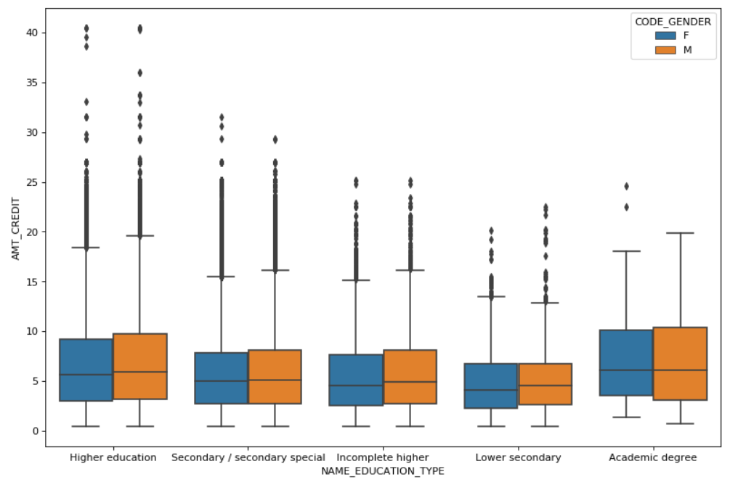
We concluded in Bivariate Analysis for Numerical variable in Target0 that
Male and Female with Academic degree and Higher education are having more credits in Education type than others.
Very less credits in Lower secondary education type.

Slide 24
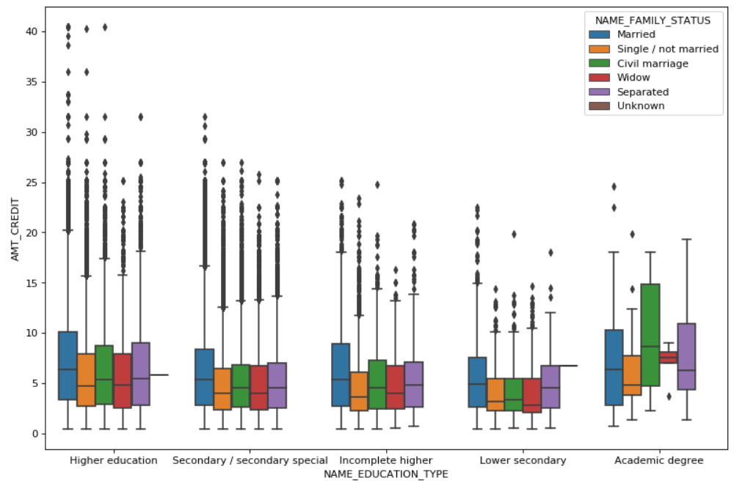
We concluded in Bivariate Analysis for Numerical variable in Target0 that
Married and Civil Marriage with academic degree are having more credits than others.
Lower secondary education type has less credits in all family status.

Slide 25
Bivariate Analysis for Numerical Variable in Target1

Slide 26
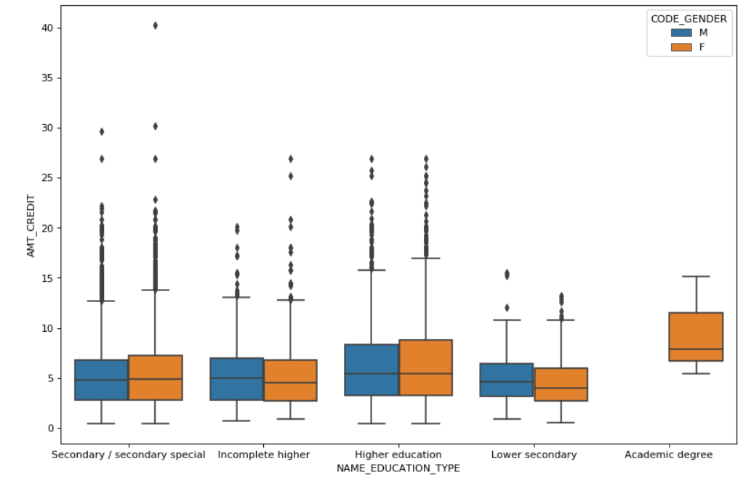
We concluded in Bivariate Analysis for Numerical variable in Target1 that
Female with Academic degree are having more credits than Male/Female with other education type.
Lower secondary education type has less credits for Male and Female gender.

Slide 27
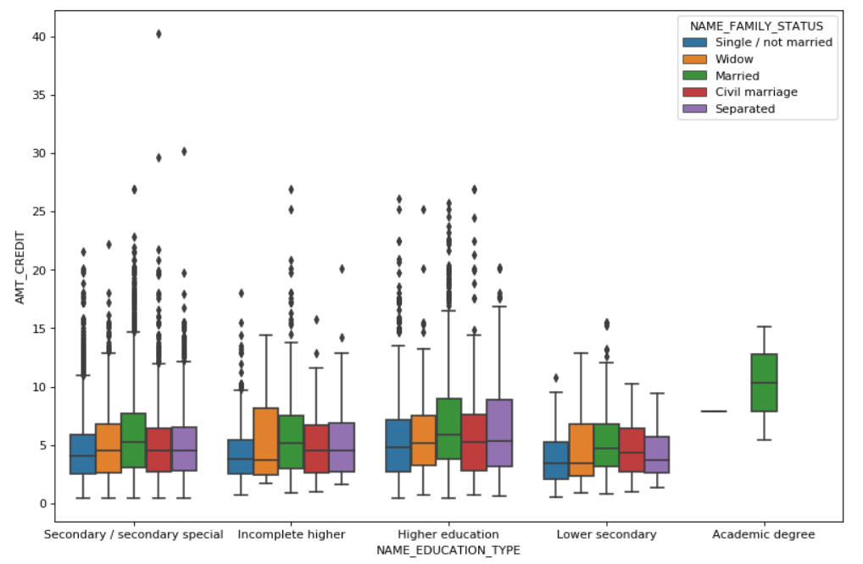
We concluded in Bivariate Analysis for Numerical variable in Target1 that
Married family status with Academic education type are having higher credits than others.
And After that married, separated are having more credits in Higher education and widow is having more credits than others in Incomplete higher.

Slide 28
Univariate Analysis on Merge Dataset
We merged Application data and Previous application dataset in new data frame called Merge_DF.

Slide 29
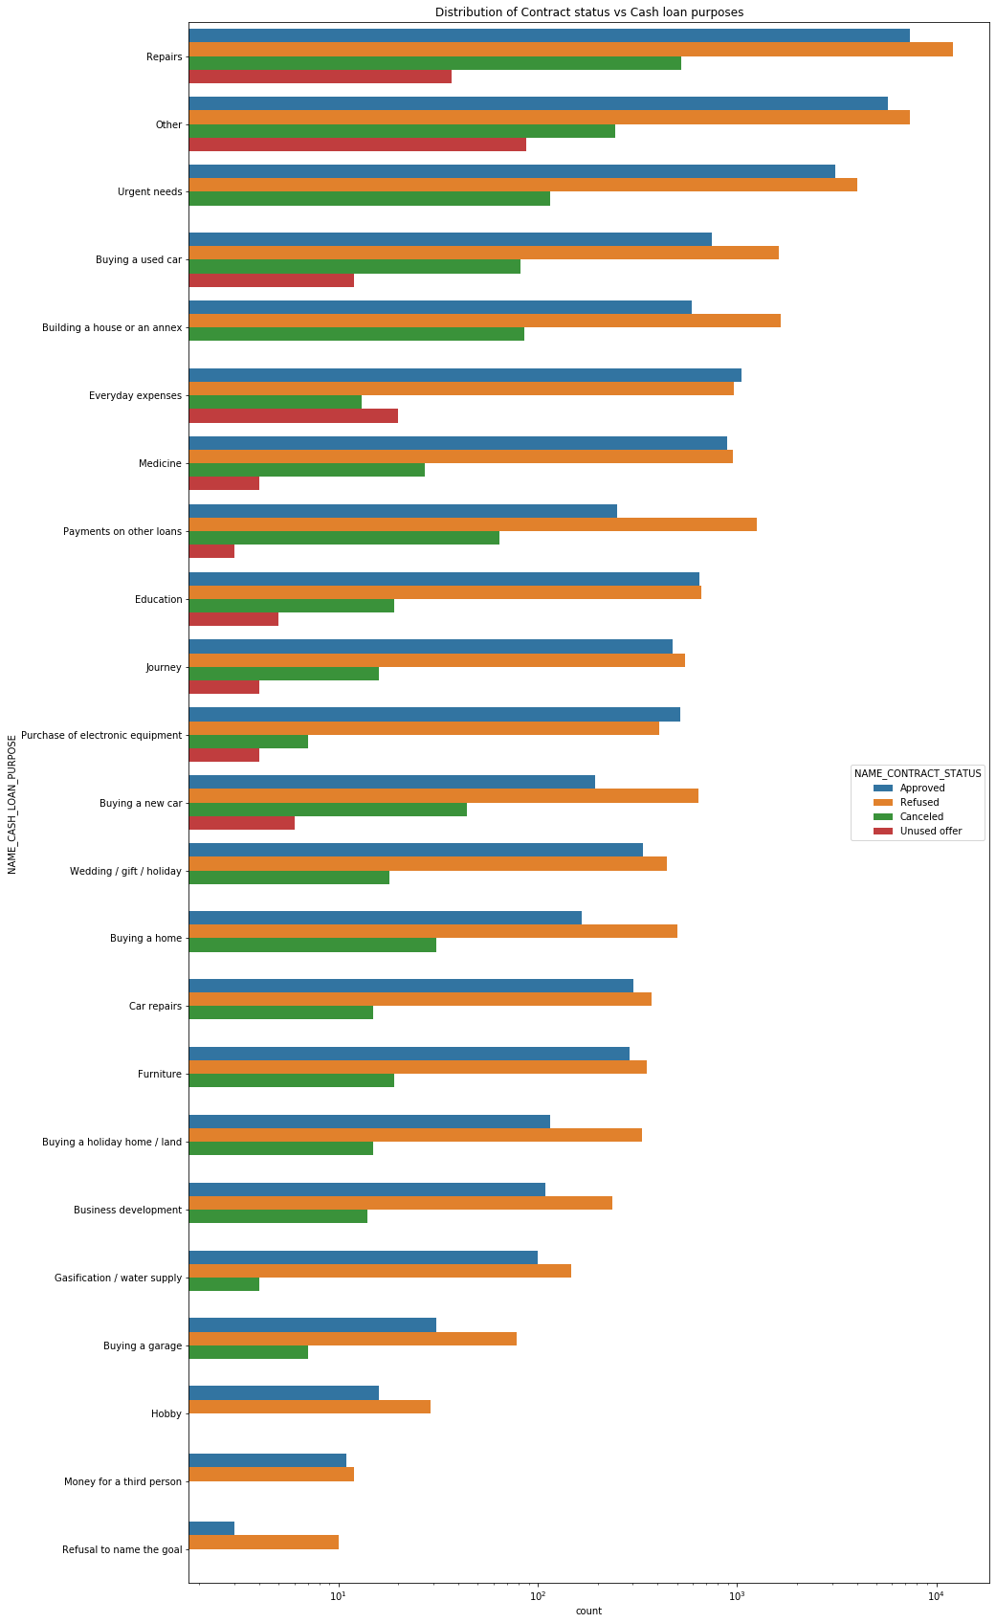
From this Univariate analysis on Merge Dataset –
Purpose 'Repairs' has more no. of loan rejection.
And for Education purpose we have equal no of Approved and Refused loans.
Everyday expenses are more approved than refused contract status.
Customers are spending very less on cash loans type of Refusal to name the goal.

Slide 30
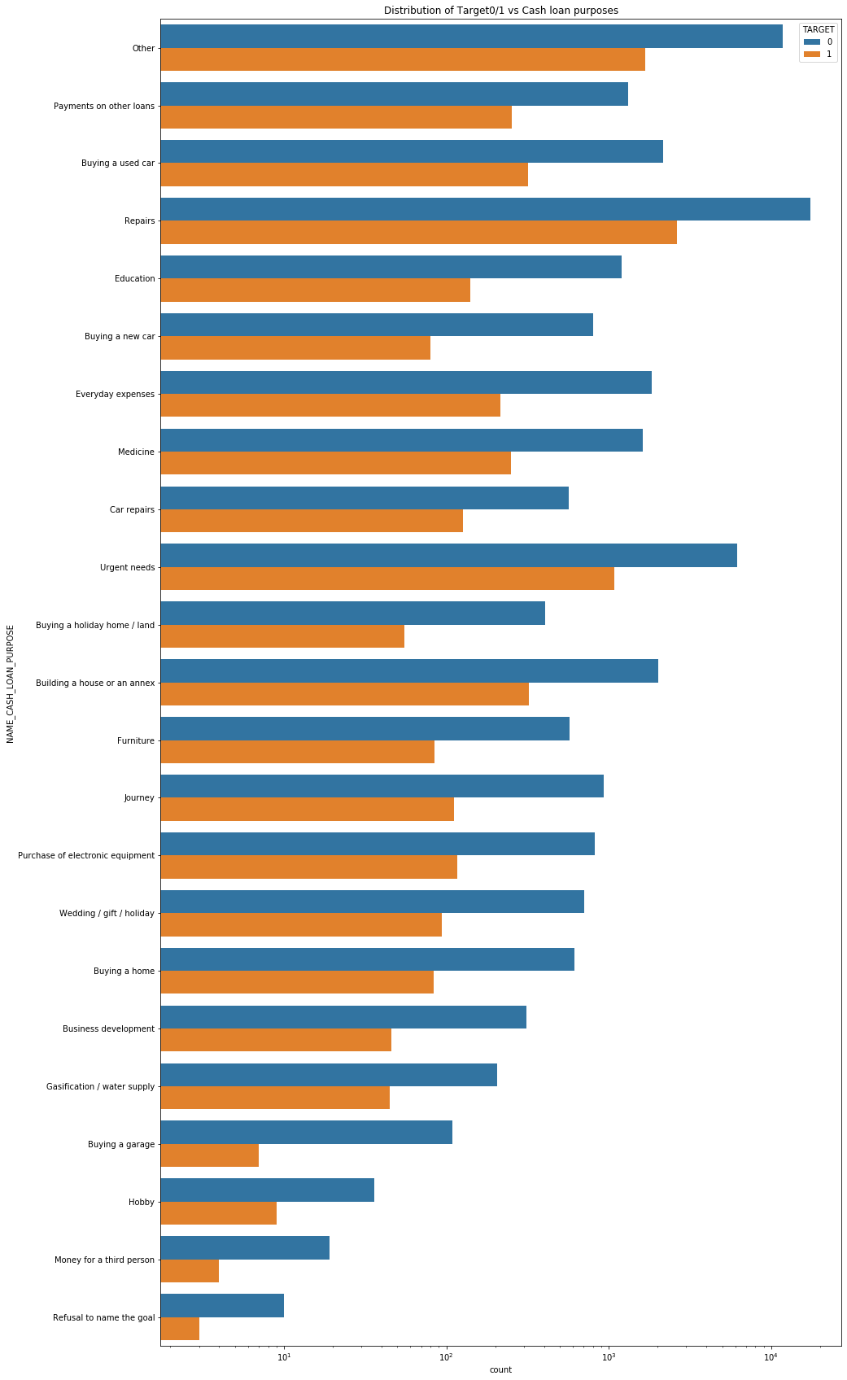
From the above Univariate analysis on Merge Dataset-
Loan Purpose 'Repairs' are having more difficulties at the time of payment.
And for education purpose we have equal no of approved and Refused loans.
Purchase of electronic equipment's and everyday expenses has more approved rate than refused, cancelled or unused offers.
Buying a new car and Refusal to name the goal are more likely to be refused more than approved.

Slide 31
Bivariate Analysis using Merge dataset

Slide 32
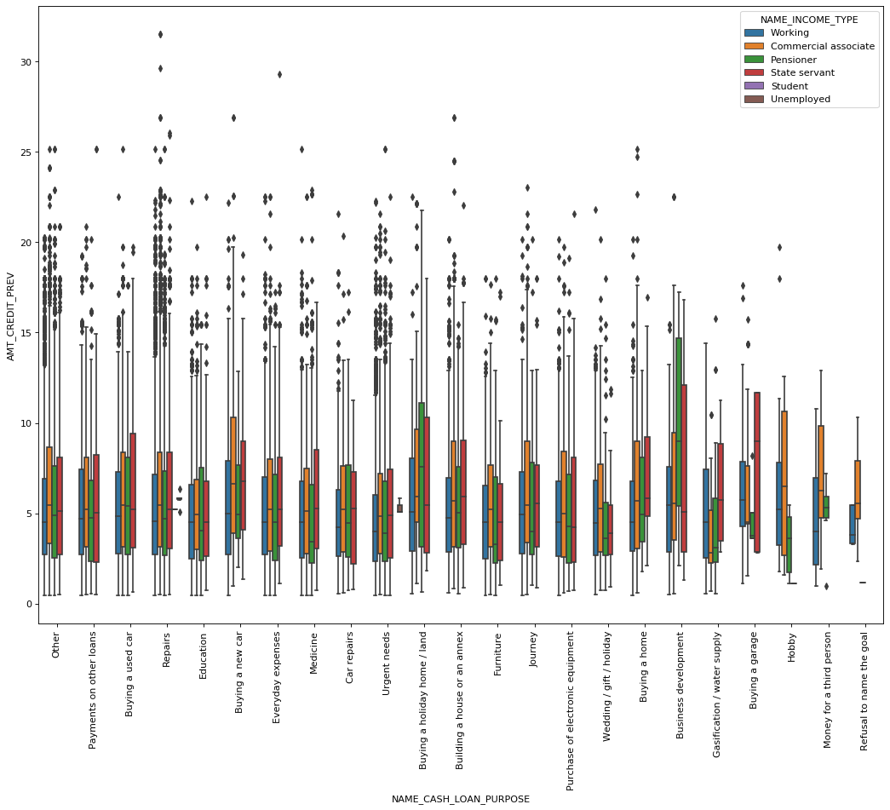
Bivariate analysis using Merge dataset , we concluded that
Business development and Buying a holiday home or land are having more credits than other cash loan purpose.
Very less credits on Refusal to name the goal cash loan purpose.
Buying a new car , buying a used car , everyday expenses , urgent needs , Building a house or an annex and journey all these columns are having significant amount of credits.

Slide 33
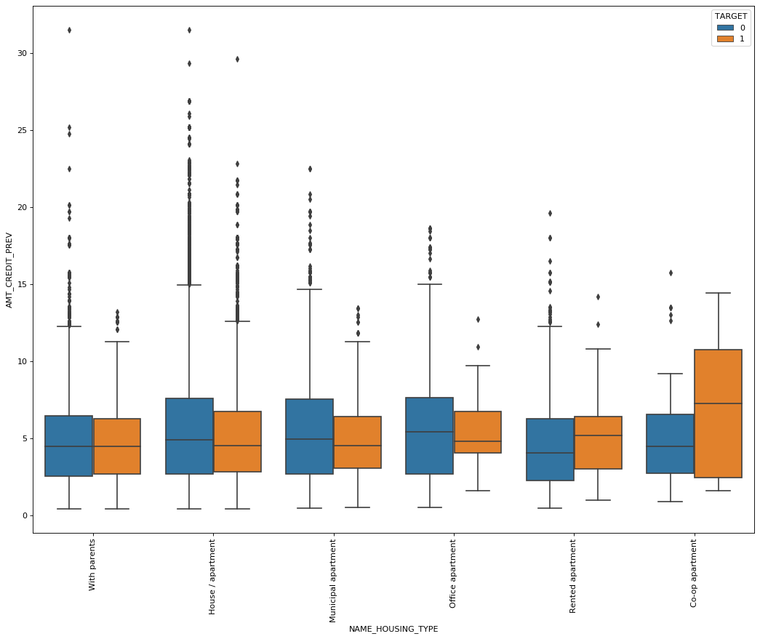
Bivariate analysis using Merge dataset , we concluded that
From the above bivariate analysis Co-op apartment are having more credit for Target1.
House/apartment , Municipal apartment and office apartment are having more credits for Target0.
Very less credits present in office apartment for Target1.
And Co-op apartment has very less credits for Target0.

Slide 34
CONCLUSION
Bank should provide priority to Housing type With Parents. House/apartment , Municipal and Office apartment customers for loans as they are having more no. of successful transactions as compared to Co-op apartment.
Bank Should focus on cash loan purpose for Buying a Business development , holiday home or land and buying a new car customers as they have less no of unsuccessful transactions.
Banks should consider contract type Student , Pensioner and Commercial Associate with housing type other than Co-op apartment for more successful transactions.
Bank should provide less priority to Repairs and Urgent need in Cash loan purposes and Income Type - Working are having more no. of unsuccessful transactions .
Bank should consider giving loans to customers who are having academic degree or higher education.

Slide 35
Thank You…!

