Slide 1
Candidacy Talk
Jonathan Pritchard
(Caltech)
Advisor
Marc Kamionkowski

Slide 2
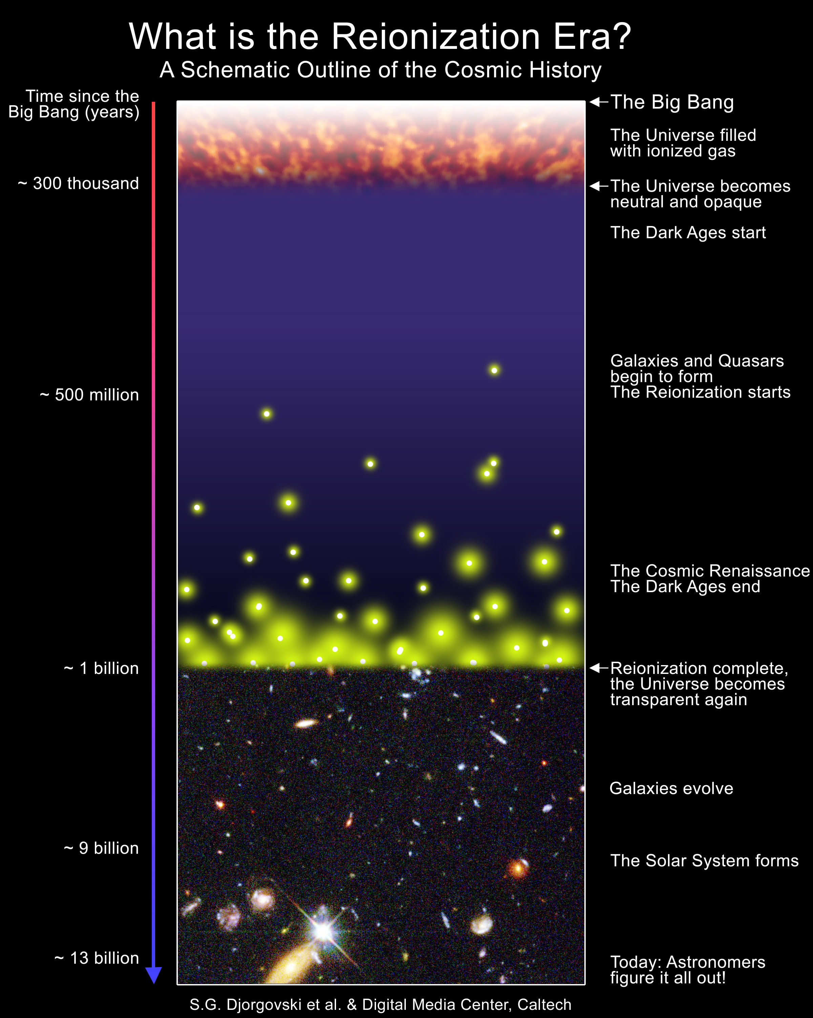
Overview
Tensor modes and the CMB
Spin-kinetic temperature
coupling in the 21 cm line
Imprints of reionization in
the galaxy power spectrum
Future work

Slide 3
Cosmic microwave background fluctuations from gravitational waves: An analytic approach
Jonathan Pritchard
Marc Kamionkowski
(Caltech)
Annals of Physics 318 (2005) 2-36

Slide 4
Overview
Gravitational waves produced during inflation provide a possible probe of the very early universe.
Much experimental interest in detecting the B mode polarisation signal.
Analytic understanding of the form of the power spectrum is useful in providing intuition.
Will describe the various elements that go into calculating the tensor power spectra and describe useful analytic approximations.
Hope to bring out the physics behind the maths.

Slide 5
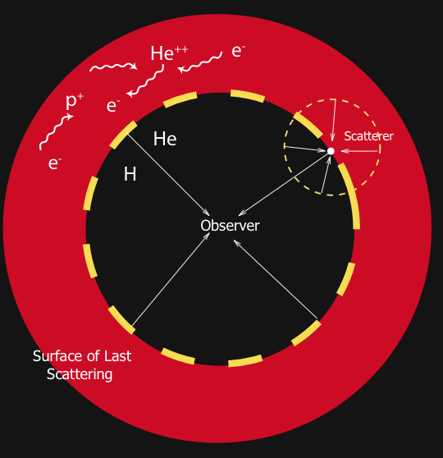
The Cosmic Microwave Background
Mechanical coupling of baryons
and photons via Thompson
scattering ends with
recombination
Photons scatter for last time
then free-stream to observer
CMB contains frozen snapshot
of perturbations at surface of
last scattering

Slide 6
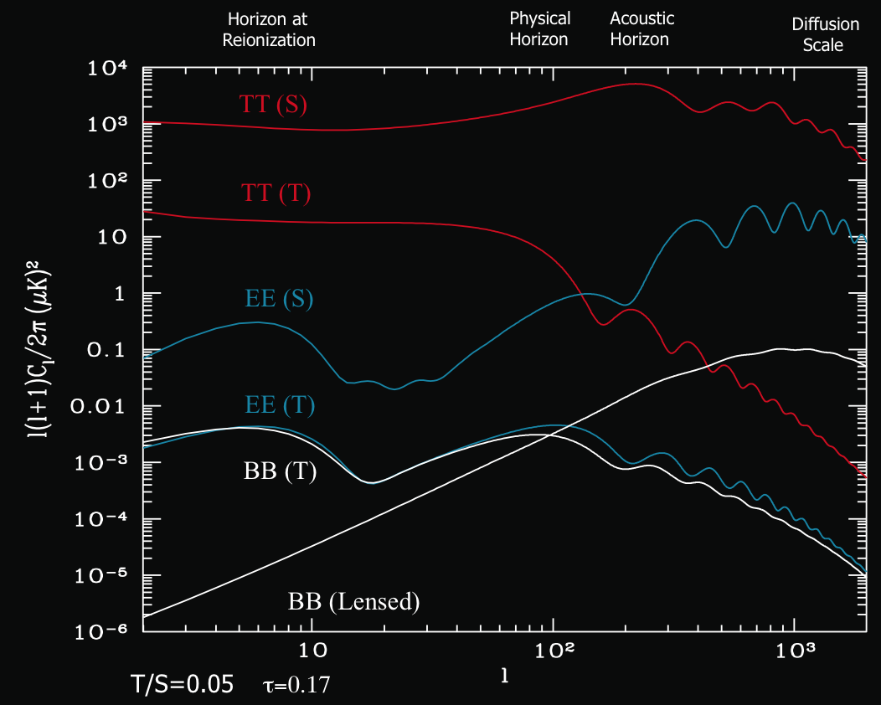
Power Spectra
Notes:
Sound horizon=147Mpc

Slide 7
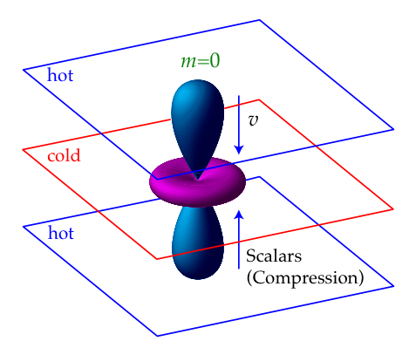
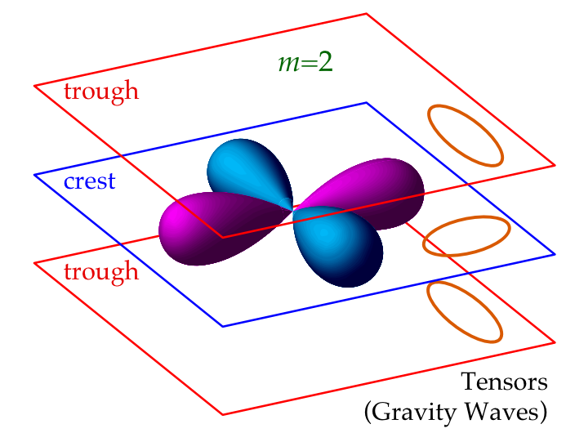
Temperature Anisotropies
Local distortion of space generates
temperature quadrupole
L=2 quadrupoles
k
e⁻
k
Decay of gravitational waves after
horizon entry leads to net increase in
temperature
“Integrated Sachs-Wolfe Effect” (ISW)
Hu & White 1997

Slide 8
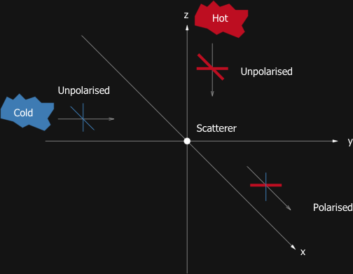


Polarisation of the CMB
Thompson
Scattering
E mode (Grad)
B mode (Curl)
Kamionkowski, Kosowsky
& Stebbins 1997
Tensor quadrupole doesn’t show axial
symmetry -> B mode polarisation
Zaldarriaga & Seljak 1997

Slide 9






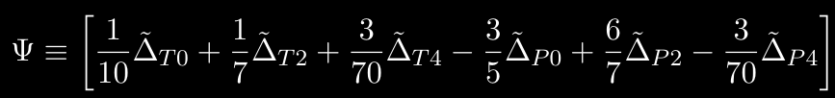




Line of Sight Formalism
Inflation
Anisotropies
X=(T,E,B)
Sources
Projection
Sources
Boltzmann Equations - dynamics
Gravitational Waves
Ionization history
Inflation - initial conditions
Polnarev 1985
Seljak & Zaldarriaga 1997
Notes:
Delta=DeltaT/T

Slide 10
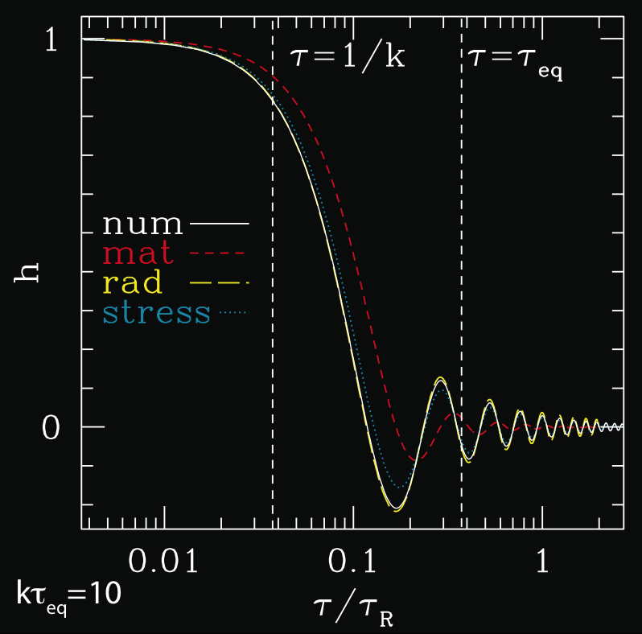

Gravitational Waves
Freestreaming
relativistic particles
e.g. neutrinos
anisotropic stress
Modes enter horizon and
decay
Background energy content
affects phase at SLS
Anisotropic stress damps
amplitude by ~0.8
Weinberg 2003

Slide 11
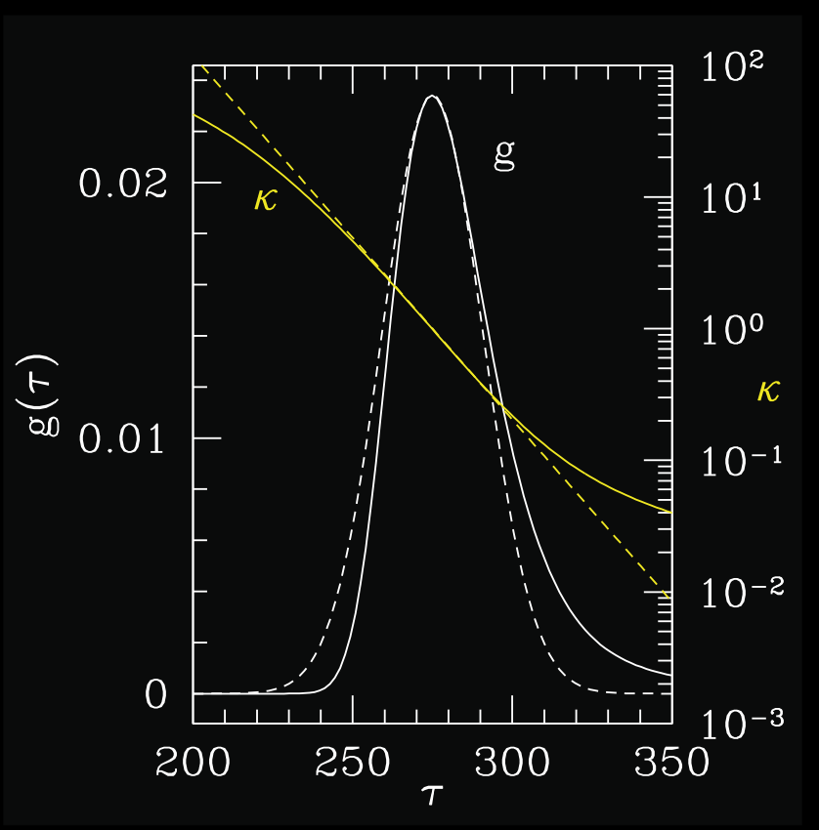
Sources
Visibility function is narrow and
centered at the time of
recombination
ISW
scattering
integrated
along LoS
localised
to SLS
scattering
localised
to SLS
Thompson scattering: T->P & P->T
Notes:
Psi describes Thompson scattering of photons -> T->P & P->T

Slide 12


Tight Coupling
Rapid Thompson scattering couples baryons and photons and prevents the growth of anisotropy
Recombination -> increasing m.f.p. -> anisotropy grows
Use large optical depth to simplify Boltzmann equations
If gravitational wave driving term varies slowly over the SLS,
i.e. kΔτ_{R}<<1, then
driving
term
width
of SLS

Slide 13
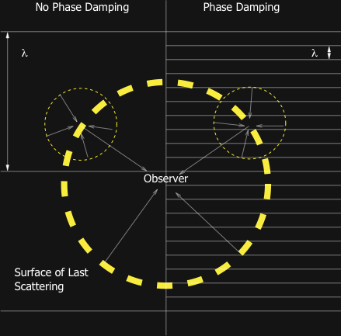
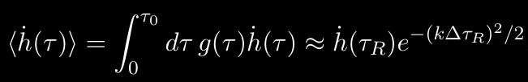
Phase Damping
On smaller scales, finite
size of SLS becomes
important
Different regions
contribute with different
phases
Exponentially suppresses
power on small scales

Slide 14

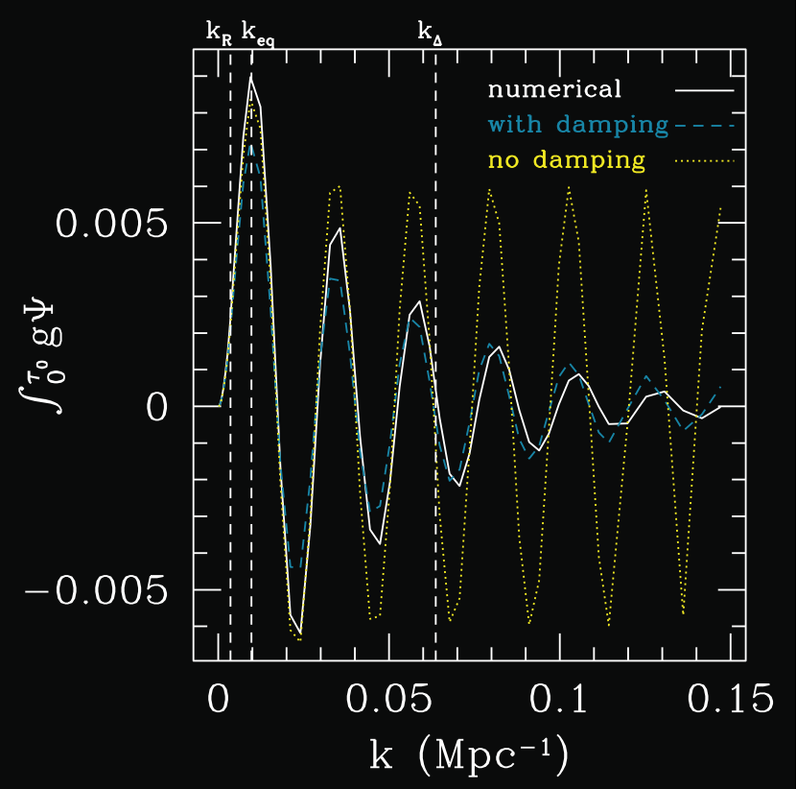
Source Evolution

Slide 15

Source Evolution

Slide 16
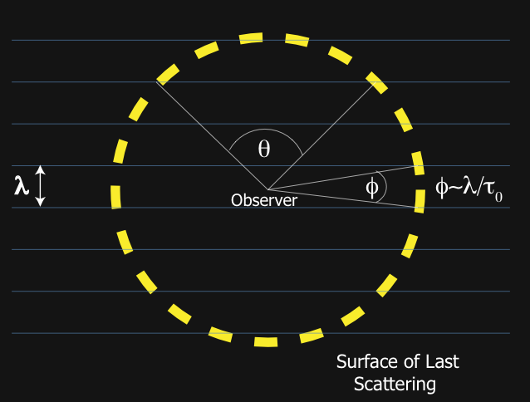
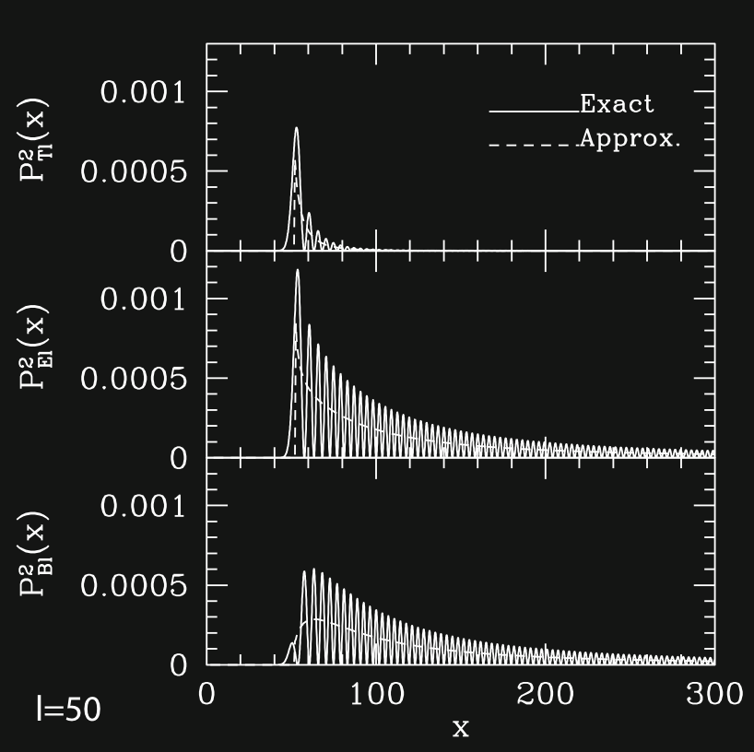

Projection I
peak at x~l
Peak l~k(lookback time)
Approximate using Debye’s
formula for spherical bessel
function when x>l
Debye 1909
Notes:
Debye - raindrops

Slide 17
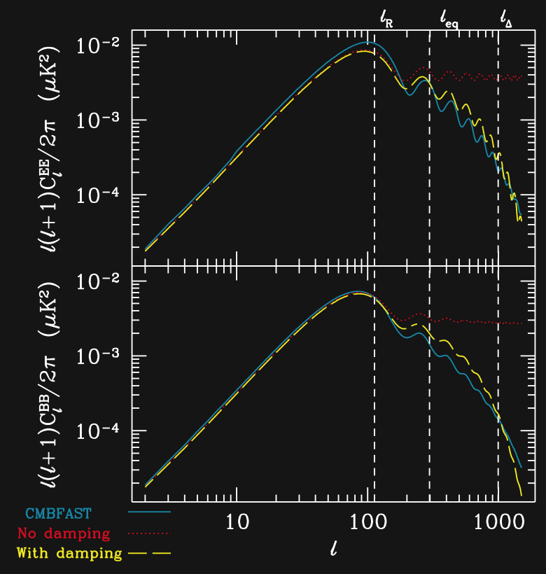
Analytical Model

Slide 18
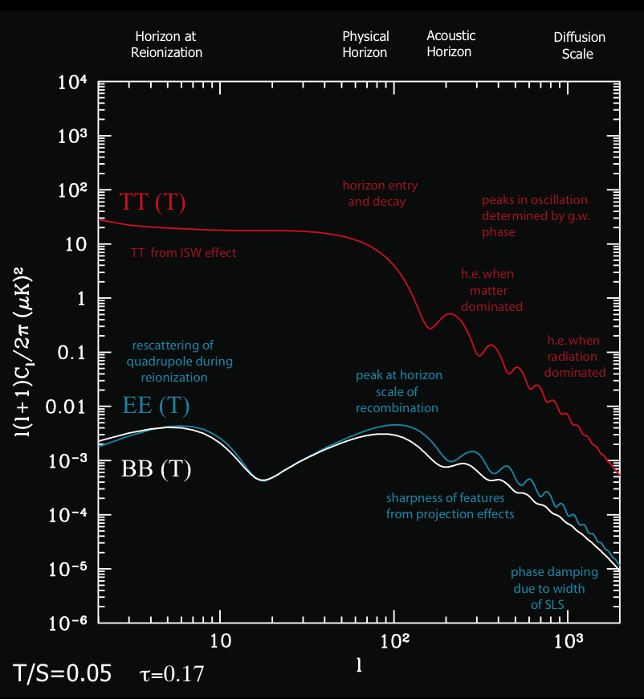
Conclusions z=1100
Phase damping important
for understanding decline
in power on small scales
Projection determines form
of the polarisation power
spectrum
Inclusion of anisotropic stress
suppresses tensor power by
~0.64 on small scales
Approximations reproduce
shape of power spectrum
with reasonable accuracy

Slide 19
Descending from on high: Lyman series cascades and spin-kinetic temperature coupling in the 21cm line
Jonathan Pritchard
Steve Furlanetto
(Caltech)
astro-ph/0508381
submitted to MNRAS

Slide 20
Overview
21cm studies provide a way of probing the first galaxies (Barkana & Loeb 2004)
Fluctuations in the Lyman α flux lead to 21cm fluctuations via the Wouthysen-Field effect
Previous calculations have assumed all photons emitted between Lyman β and Lyman limit are converted into Lyman α photons
Quantum selection rules mean that some photons will be lost due to the 2S->1S two photon decay
Here consider atomic physics to calculate the details of the cascade process and illustrate the effect on the 21cm power spectra

Slide 21
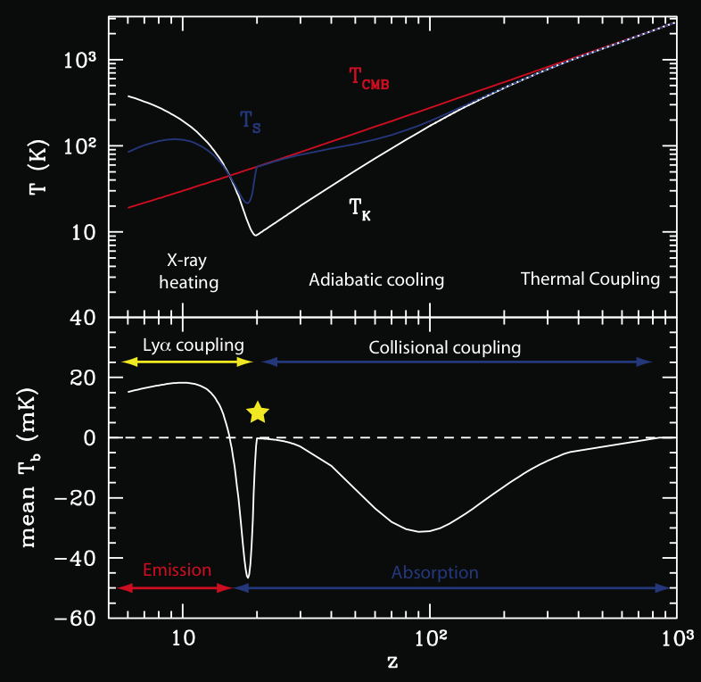
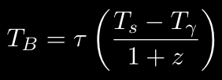
Thermal History
Use CMB backlight to probe
21cm transition
HI hyperfine structure
n₁
1₁S_{1/2}
λ=21cm
1₀S_{1/2}
n₀
n₁/n₀=3 exp(-hν₁₀/kT_{s})

Slide 22



21cm Fluctuations
Gas
Temperature
W-F
Coupling
Neutral
fraction
Velocity
gradient
Density
from density
inhomogeneities
IGM still
mostly
neutral
flux variations
In linear theory, peculiar velocities correlate with overdensities
Bharadwaj & Ali 2004
Anisotropy of velocity gradient term allows angular separation
Barkana & Loeb 2004
Notes:
Comment on information the different P_mu contain

Slide 23
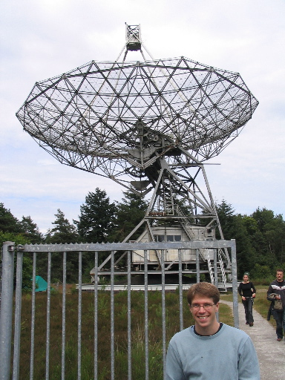
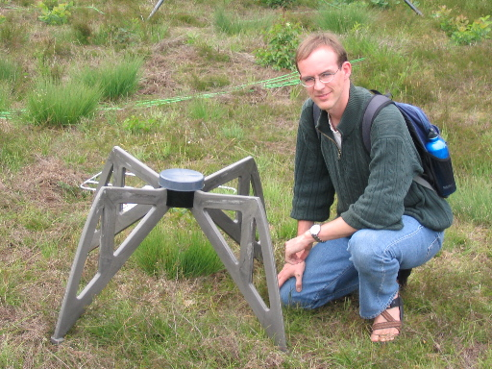

Experimental Efforts
Three main experiments:
PAST (NW China), LOFAR (NL)
and MWA (SW Australia)
Large radio arrays using
interferometry
Foregrounds!
(f_{21cm}=1.4 GHz)
MWA:
Freq: 80-300 MHz
Baselines: 10m-1.5km
LOFAR:
Freq: 30-240 MHz
Baselines: 100m-100km
~14000 antennae
The old: large dishes
The new: small dipoles
… & long baselines

Slide 24

Wouthysen-Field Effect
Hyperfine structure of HI
2₂P_{1/2}
2₁P_{1/2}
Effective for J_{α}>10⁻²¹erg/s/cm²/Hz/sr
T_{s}~T_{α}~T_{k}
2₁P_{1/2}
2₀P_{1/2}
W-F
recoils
Field 1959
n_{F}L_{J}
Lyman α
1₁S_{1/2}
Selection rules:
ΔF= 0,1 (Not F=0→F=0)
1₀S_{1/2}

Slide 25
Higher Lyman Series
Two possible contributions
  Direct pumping: Analogy of the W-F effect
  Cascade: Excited state decays through cascade to generate Lyα
Direct pumping is suppressed by the possibility of conversion into lower energy photons
  Ly α scatters ~10⁶ times before redshifting through resonance
  Ly n scatters ~1/P_{abs}~10 times before converting
  Direct pumping is not significant
Cascades end through generation of Ly α or through a two photon decay
  Use basic atomic physics to calculate fraction recycled into Ly α
  Discuss this process in the next few slides…
Hirata 2005
Notes:
Remember to smile

Slide 26
Lyman β
A_{3p,2s}=0.22×10⁸s⁻¹
A_{3p,1s}=1.64×10⁸s⁻¹
γγ
Optically thick to Lyman series
  Regenerate direct transitions to
  ground state
Two photon decay from 2S state
Decoupled from Lyman α
f_{recycle,β}=0
A_{γγ}=8.2s⁻¹

Slide 27
Lyman γ
γγ
Cascade via 3S and 3D levels
allows production of Lyman α
f_{recycle,γ}=0.26

Slide 28
Lyman δ
γγ
Going to higher n offers more
routes to the 2P level
f_{recycle,δ}=0.31
Following individual decay paths
gets complicated!

Slide 29

Calculating Recycling Fractions
γγ
Hirata 2005
Iterate from low to high n

Slide 30
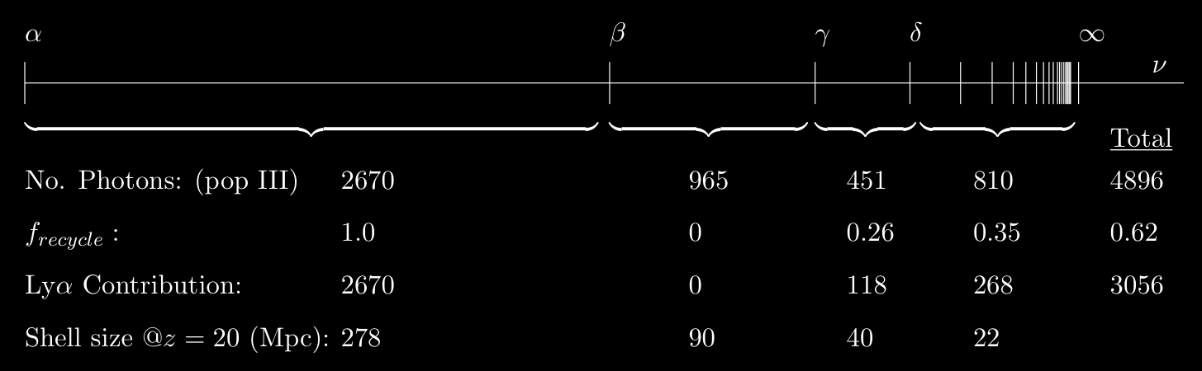

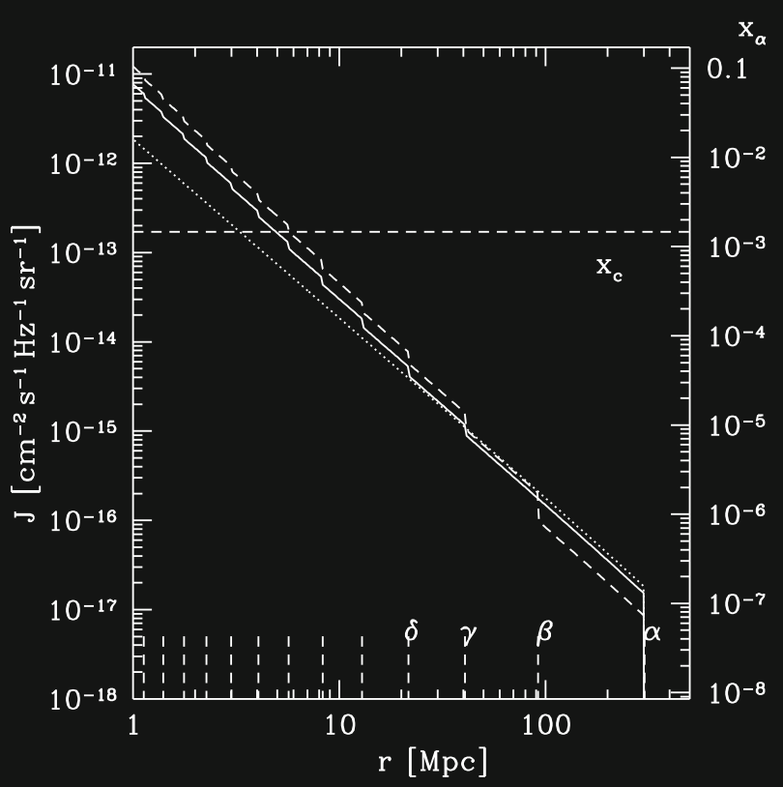
Lyman Series Cascades
0.26Mpc
~62% emitted
photons recycled
into Lyα
Lyα flux profile is steepened
HI
HII
278Mpc
n_{max}=23

Slide 31


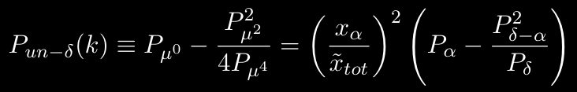
Fluctuations from the first stars
Density
Overdense region modifies observed flux
from region dV
Relate Ly α fluctuations to overdensities
δ
dV
Probe using separation of powers
Poisson
Fluctuations independent of density
perturbations
Small number statistics
Different regions see some of the same
sources though at different times in
their evolution
r_{A}
r_{B}
l
A
B
Barkana & Loeb 2004

Slide 32
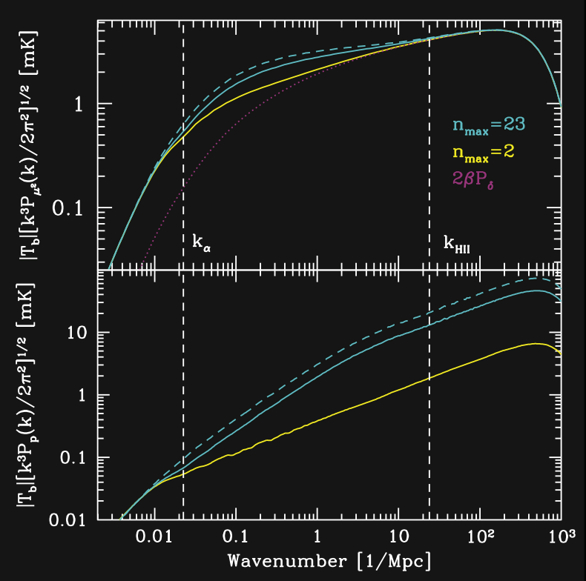
Fluctuation Power Spectra
Excess power probes star formation rate
Cutoffs from width of 21cm line and pressure support on small scales
Correct atomic physics reduces power by
~0.65 (density)
~0.42 (poisson)
Density
Poisson

Slide 33
Conclusions z=20
Including correct atomic physics is important for extracting astrophysical information from 21cm fluctuations
Cascade generated Lyman α photons increase the theoretical signal, but not as much as has previously been thought
~62% emitted Lyman series photons recycled into Lyman α
Recycling fractions are straightforward to calculate and should be included in future work on this topic
Basic atomic physics encoded in characteristic scales
21cm signal can, in principle, be used to probe early star formation

Slide 34
Imprints of reionization in the galaxy power spectrum
Jonathan Pritchard
Marc Kamionkowski
Steve Furlanetto
(Caltech)
Work in progress…

Slide 35
Overview
Formation of the first galaxies changes the IGM affecting the formation of further galaxies
The galaxy power spectrum may retain an imprint from the effect of ionized regions on galaxy formation
Use simple model in lieu of detailed physics
Use the Fisher Matrix formalism to probe this imprint
Consider effect on determination of cosmological and dark energy parameters

Slide 36
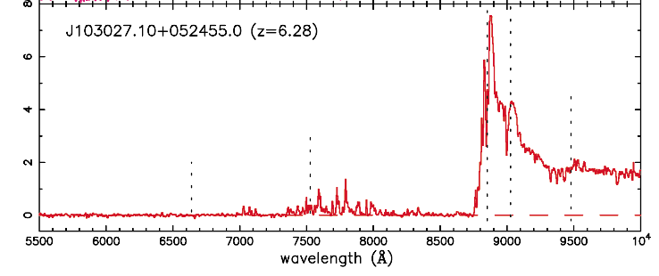
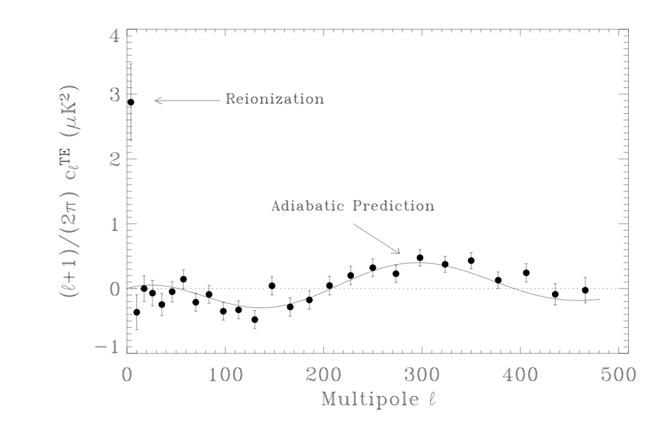
Evidence for Reionization
Gunn-Peterson Trough
Becker et al. 2005
Universe ionized below
z~6, approaching
neutral at higher z
WMAP measurement of τ~0.17
Kogut et al. 2003
Need early star formation
to match large optical depth
Integral constraint on
ionization history

Slide 37
Patchy Reionization
HI
HII
Ionizing flux from stars creates HII bubbles around galaxies
Eventually bubbles overlap and reionization completes

Slide 38

Galaxy formation and feedback
cooling
fragmentation
To get star formation need gas cloud to cool and fragment
t_{cool}<t_{dyn}<t_{hubble}
Feedback from first stars complicates matters:
-radiation, winds, metal pollution
Here ignore the details and parameterise our ignorance
bias
ionized
fraction

Slide 39

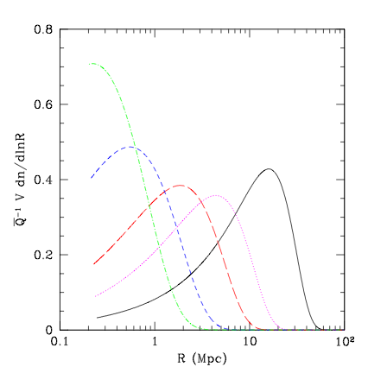
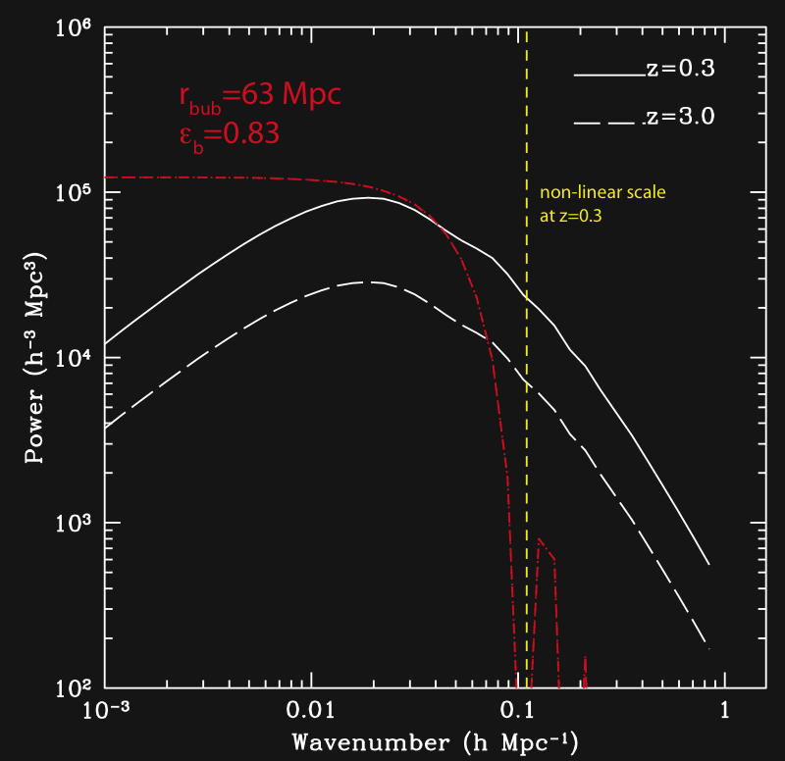
Bubble Model
Halo model approach to bubble
power spectrum + single bubble
size
Bubble sizes? - Unclear
R~10Mpc
Q=0.5
Furlanetto, Zaldarriaga,
Hernquist 2004
R~60Mpc
Wyithe and Loeb 2005

Slide 40
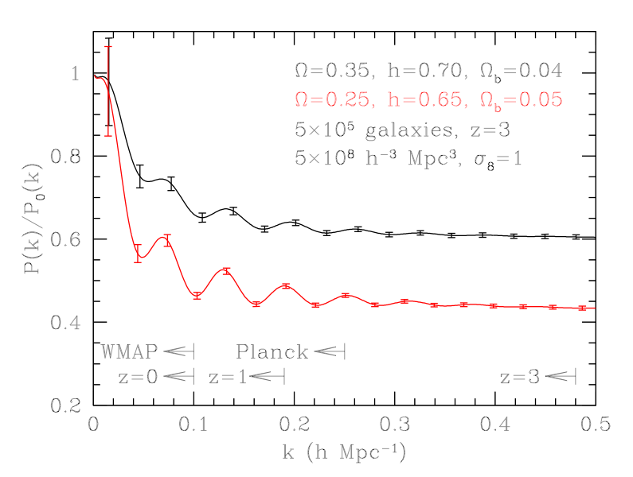

Probing Dark Energy
Baryon Oscillations
Alcock-Paczynski Effect
Observe
Infer
Wrong
cosmology
Right
cosmology
Using wrong cosmology to
reconstruct coordinate
distances breaks spatial
isotropy
Constrains HD_{A}
Same acoustic oscillations as
seen in the CMB
Constrains angular diameter
distance D_{A}
Seo & Eisenstein 2005
Alcock & Paczynski 1979

Slide 41
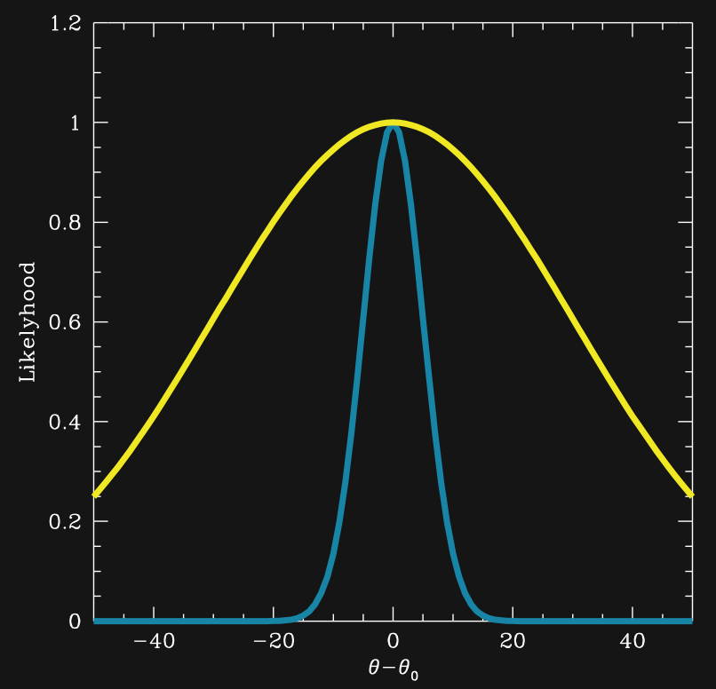
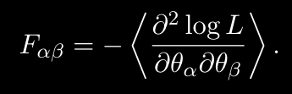

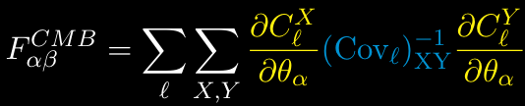
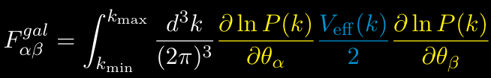
The Fisher Matrix
Estimate curvature of likelihood
Fisher 1935
Likelihood describes distribution of
model parameters
Cramer-Rao inequality:
Depends only on theoretical model and
experimental specifications
Tegmark 1997

Slide 42
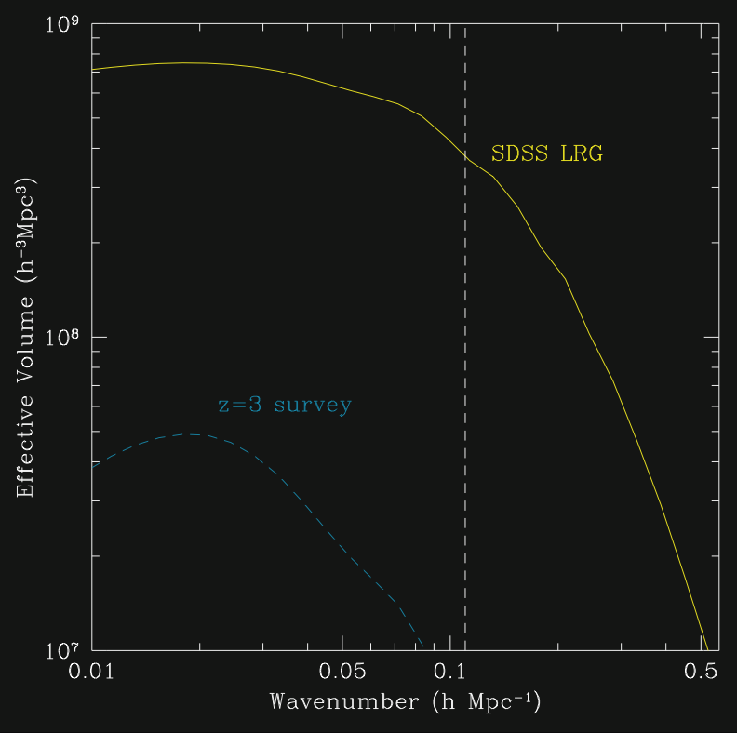
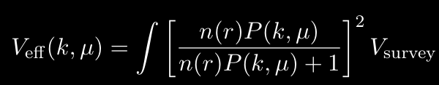
Galaxy Surveys
SDSS LRG
z~0.3
Luminous Red Galaxies
n~10⁻⁴ (h⁻¹Mpc)⁻³
V_{survey}=1.0 (h⁻¹Gpc)³
Survey 2
z~3.0
Lyman Break Galaxies
n~10⁻³ (h⁻¹Mpc)⁻³
V_{survey}=0.5 (h⁻¹Gpc)³

Slide 43
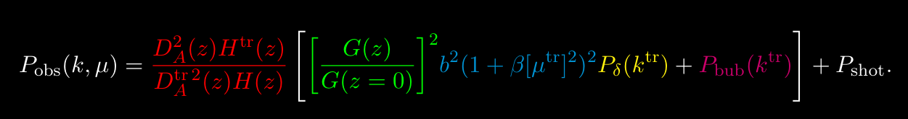
Approach Summary
Linear
Growth
Bias and
Redshift
distortion
Density
fluctuations
Bubbles
AP Effect
+
&
Galaxy + CMB experiment
specifications
->
Uncertainties on cosmological and bubble model parameters
Use these to probe effect of bubbles on galaxy power spectrum

Slide 44
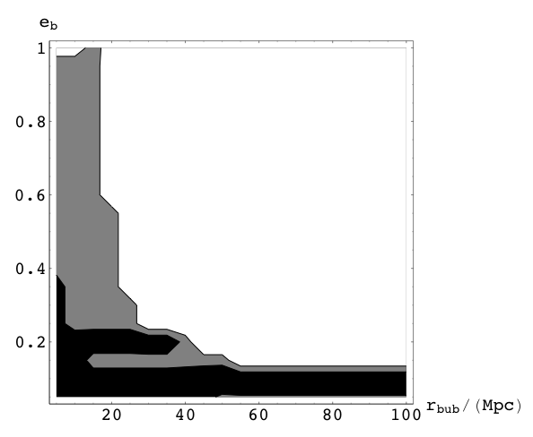
Possibilities for Detection
ε_{b}>2σ_{ε}
Current surveys barely
constrain most relevant
parameter region
Future surveys may
yield interesting
constraints
SDSS
SDSS
+S2
No detection

Slide 45
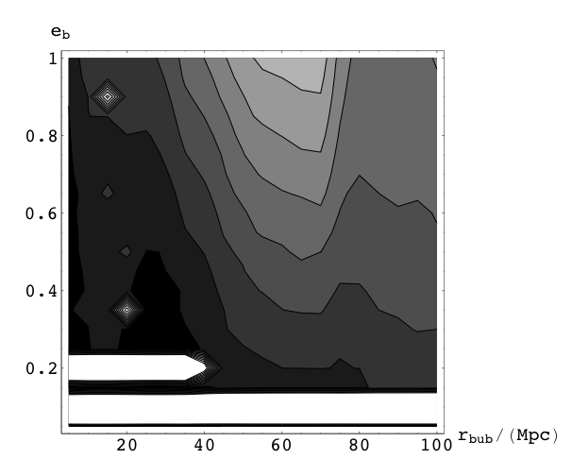
Dark Energy Uncertainties
σ_{w}
Highest
uncertainty
Uncertainties increased
for bubbles with
r_{bub}~65Mpc
-most degenerate with
matter power spectrum
Small effect ~30%
increase at most
Lowest
uncertainty

Slide 46
Conclusions z=3
Future galaxy surveys should be able to place interesting constraints on the effect of ionization regions on galaxy formation
Bubbles shouldn’t provide a major source of noise when attempting to constrain dark energy parameters
Some numerical issues need to be addressed
Need to explore different shapes for bubble power spectrum
Have explored statistical errors from including bubbles, but there will be a systematic change in maximum likelihood parameters as well. How can this be quantified?
Toy model used - would be nice to make a connection to the underlying physics e.g. Babich & Loeb 2005

Slide 47
Inhomogeneous X-ray Heating
Jonathan Pritchard
Steve Furlanetto
(Caltech)
Proposed work…

Slide 48
Inhomogeneous X-ray heating
X-rays are responsible
for heating the IGM above
the CMB temperature
Heating usually assumed
to be uniform
Simplistic, fluctuations
may lead to observable
21cm signal
Analogous to Lyα
fluctuations

Slide 49
Calculation
Model star formation to calculate X-ray flux variation
(Barkana & Loeb 2005)
Convert X-ray flux to temperature perturbations
(Shull & Van Steenberg 1985)
Calculate resulting 21cm T_{b} signal
Compare with temperature variation from overdense regions e.g. from photo-ionization equilibrium
(Nasser 2005)
Gas
Temperature
W-F
Coupling
neutral
fraction
Velocity
gradient
Density
Density
+ x-ray
IGM still
mostly
neutral
Lyα coupling
saturated

Slide 50
Future work z=0
Inhomogeneous X-ray heating as a source of 21 cm brightness temperature fluctuations
Graduate June 2007!

