Slide 1
Descending from on high: Lyman series cascades and spin-kinetic temperature coupling in the 21cm line
Jonathan Pritchard
Steve Furlanetto
Marc Kamionkowski
(Caltech)

Slide 2
Overview
21cm studies provide a way of probing the first galaxies (Barkana & Loeb 2004)
Fluctuations in the Lyman α flux lead to 21cm fluctuations via the Wouthysen-Field effect
Previous calculations have assumed all photons emitted between Lyman β and Lyman limit are converted into Lyman α photons
Quantum selection rules mean that some photons will be lost due to the 2S->1S two photon decay
Here consider atomic physics to calculate the details of the cascade process and illustrate the effect on the 21cm power spectra

Slide 3




21cm Basics
Observe difference of spin temperature against CMB
temperature
n₁
1₁S_{1/2}
n₁/n₀=3 exp(-hν₁₀/kT_{s})
1₀S_{1/2}
n₀
Spin temperature determined by radiative, collisional x_{c} and
Wouthysen-Field x_{α} coupling
Fluctuations: density, Lyman α flux, x_{HI}, velocity gradient
Bharadwaj & Ali 2004
Anisotropy of velocity gradient term allows angular separation
Barkana & Loeb 2004
Notes:
Comment on information the different P_mu contain

Slide 4

Wouthysen-Field Effect
Hyperfine structure of HI
2₂P_{1/2}
2₁P_{1/2}
Effective for J_{α}>10⁻²¹erg/s/cm²/Hz/sr
T_{s}~T_{α}~T_{k}
2₁P_{1/2}
2₀P_{1/2}
W-F
recoils
Field 1959
n_{F}L_{J}
Lyman α
1₁S_{1/2}
Selection rules:
ΔF= 0,1 (Not F=0→F=0)
1₀S_{1/2}

Slide 5
Higher Lyman Series
Two possible contributions
  Direct pumping: Analogy of the W-F effect
  Cascade: Excited state decays through cascade to generate Lyα
Direct pumping is suppressed by the possibility of conversion into lower energy photons
  Ly α scatters ~10⁶ times before redshifting through resonance
  Ly n scatters ~1/P_{abs}~10 times before converting
  Direct pumping is not significant
Cascades end through generation of Ly α or through a two photon decay
  Use basic atomic physics to calculate fraction recycled into Ly α
  Discuss this process in the next few slides…
Notes:
Remember to smile

Slide 6
Lyman β
A_{3p,2s}=0.22×10⁸s⁻¹
A_{3p,1s}=1.64×10⁸s⁻¹
γγ
Optically thick to Lyman series
  Regenerate direct transitions to
  ground state
Two photon decay from 2S state
Decoupled from Lyman α
f_{recycle,β}=0
A_{γγ}=8.2s⁻¹

Slide 7
Lyman γ
γγ
Cascade via 3S and 3D levels
allows production of Lyman α
f_{recycle,γ}=0.26

Slide 8
Lyman δ
γγ
Going to higher n offers more
routes to the 2P level
f_{recycle,δ}=0.31
Following individual decay paths
gets complicated!

Slide 9


Calculating Recycling Fractions
γγ
Iterate from low to high n

Slide 10
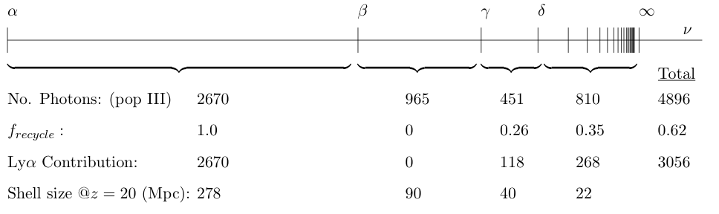

Lyman Series Cascades
Photons redshift until they hit Lyman series resonance
~62% emitted photons recycled into Lyman α
Contribution limited to scales within Lyman α range and outside HII region of galaxy ⇨ n_{max}=23
0.26Mpc
HI
HII
278Mpc

Slide 11
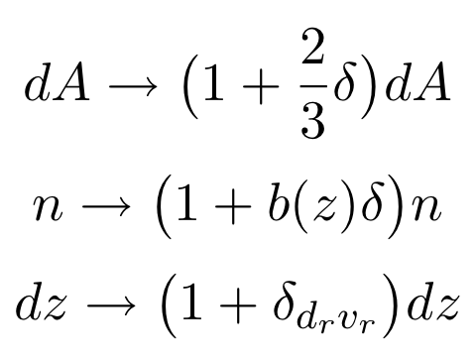


Origin of Density Fluctuations
Overdense region modifies
observed flux from region dV
δ
dV
Barkana & Loeb 2004
Relate Ly α fluctuations to overdensities
Extract power spectrum

Slide 12
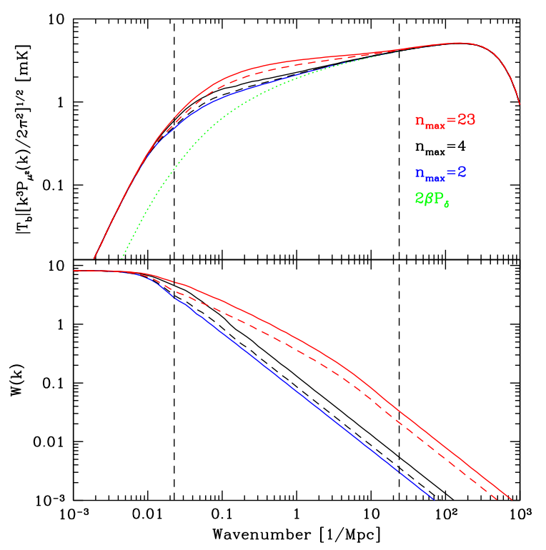
Density Fluctuations
Excess power on scales less than 24 Mpc⁻¹
Recover shape of matter power spectrum on small scales
Cutoffs from width of 21cm line and pressure support on small scales
Fluctuation ∝ flux
⇨Reduction ~ 0.65

Slide 13

Origin of Poisson Fluctuations
M
r_{A}
r_{B}
l
Barkana & Loeb 2004
A
B
Fluctuations independent of density perturbations
Small number statistics
Different regions see some of the same sources though at different times in their evolution

Slide 14
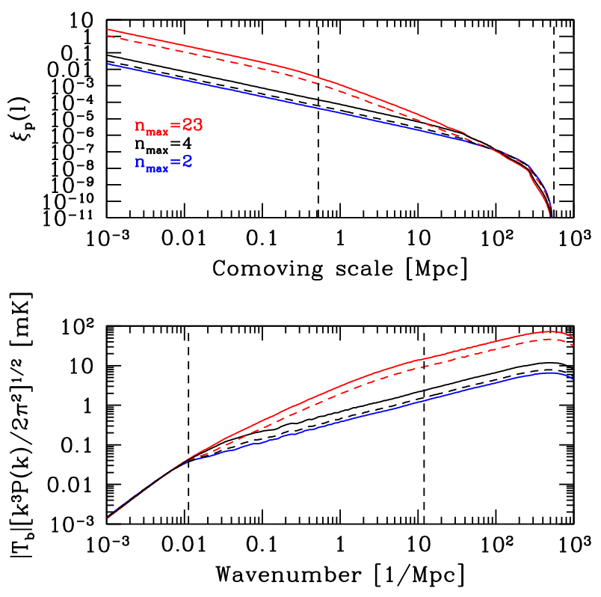
Poisson Fluctuations
Higher Lyman transitions increase correlation on small scales
No correlation on scales larger than twice Ly α range
Excess power in wavenumbers larger than 0.01 Mpc⁻¹
Fluctuation ∝ flux²
⇨Reduction ~ 0.4

Slide 15
Conclusions
Including correct atomic physics is important for extracting astrophysical information from 21cm fluctuations
Cascade generated Lyman α photons increase the theoretical signal, but not as much as has previously been thought
~62% emitted Lyman series photons recycled into Lyman α
Recycling fractions are straightforward to calculate and should be included in future work on this topic
Basic atomic physics encoded in characteristic scales

