Slide 1
Understanding the Tensor CMB Polarisation Power Spectrum
Jonathan Pritchard
with Marc Kamionkowski
Caltech

Slide 2
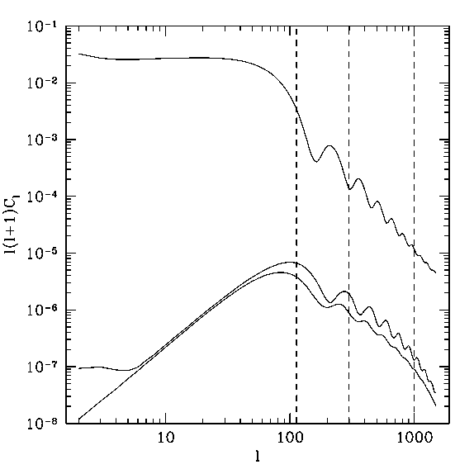

Overview
Have been attempting to develop analytic expressions for the tensor CMB power spectrum.
Analytic expressions aid intuition and give insight into results of numerical calculations.
Today will discuss only polarisation power spectrum.
B-mode polarisation current target of observational effort.
Tensor power spectra

Slide 3
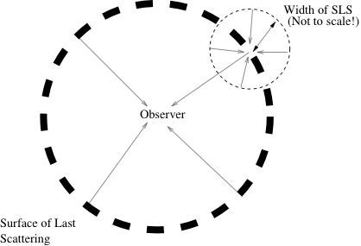
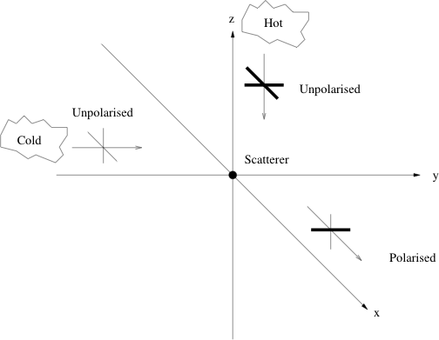
CMB Polarisation Introduction
Primordial plasma cools leading to recombination. e + p -> H
Photon mean free path increases.
CMB originates at the surface of last scattering (SLS).
Inflationary tensor perturbations to metric = stocastic gravitational wave background.
Time evolving gravitational potential generates temperature perturbations via Integrated Sachs-Wolfe (ISW) effect.
Thomson scattering of anisotropic temperature distribution generates polarisation.
Resulting polarisation spectrum decomposed into E (grad) and B (curl) modes.

Slide 4


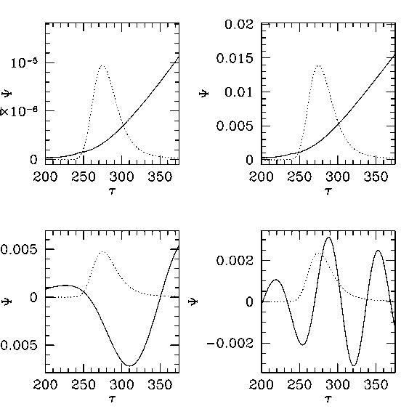
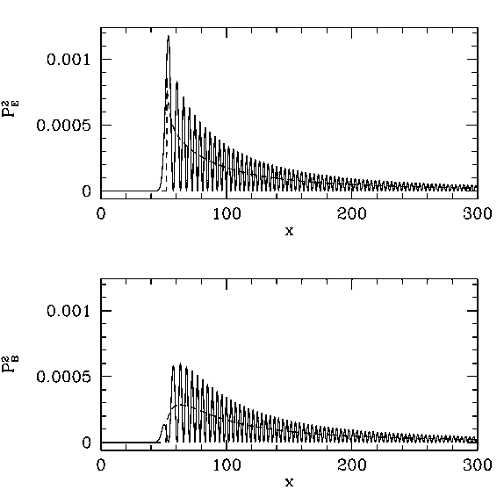
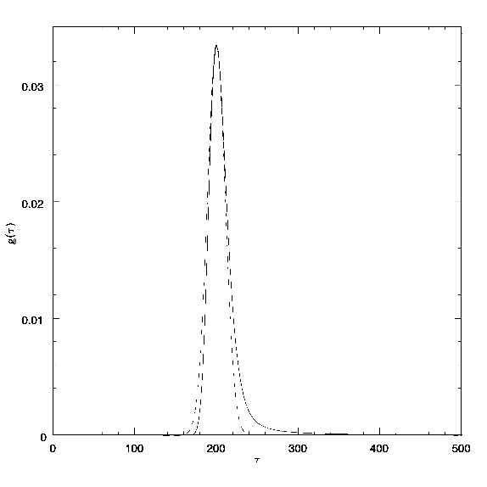
Structure of the problem
Decompose T and polarisation perturbations using Legendre polynomials,e.g.,
Solving equations for radiation transport then gives polarisation multipoles
Visibility Function
Source Evolution
Geometric Projection

Slide 5
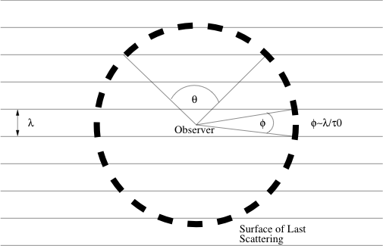
Geometric Projection
3D Fourier modes projected onto 2D angular scales.
Aliasing: Single Fourier mode contributes to many angles. Peak at
Projection terms involve spherical Bessel functions, oscillate and are messy to calculate.
Approximate Bessel functions using Debye’s asymptotic formula.
Average over oscillation to get polynomial envelope.

Slide 6
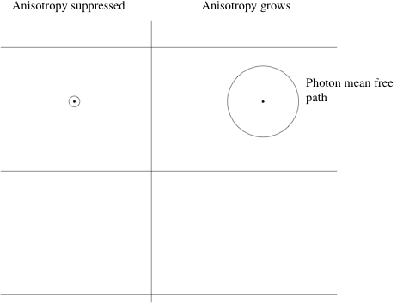
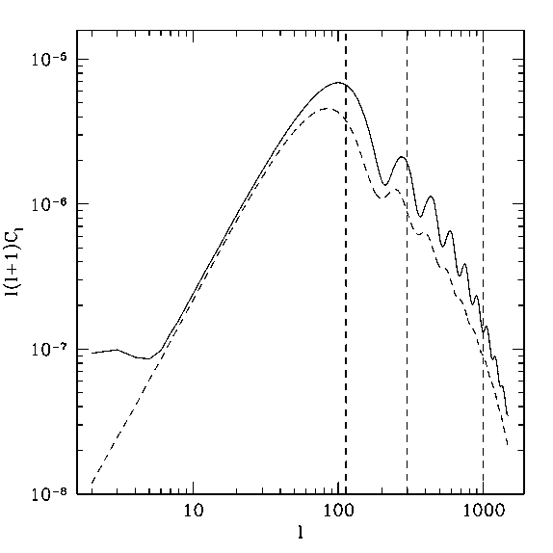
Growth of Anisotropy
Before recombination radiation and baryons are tightly coupled and the photon mean free path is small.
Increasing photon m.f.p. allows growth of anisotropy.
Resulting multipole depends on the strength of sourcing term and the time its had to grow.
Little power on large scales where gravitational wave varies little across width of SLS.

Slide 7
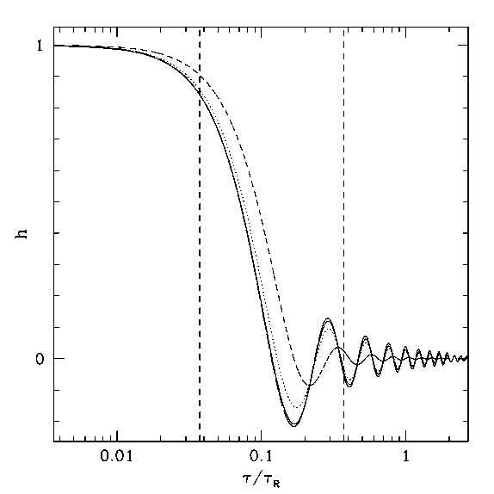


Gravitational Wave Evolution
Gravitational waves evolve according to damped wave equation
After horizon entry g.w. amplitude redshifts as
Expansion rate depends on radiation/matter content.
Scaling relation for amplitude
Use l=k (lookback) to get scaling for polarisation power spectrum .
Redshifting of g.w. leads to decrease in power on scales smaller than the horizon scale at recombination.

Slide 8
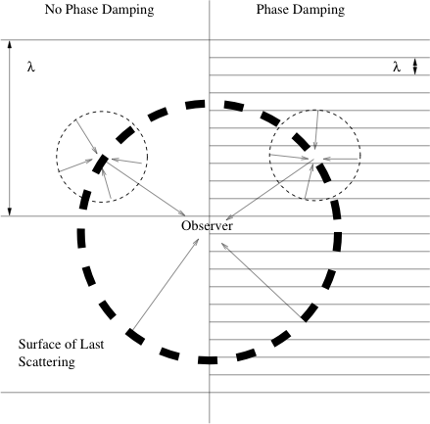
Phase damping
On small scales the tensor mode varies rapidly over the width of the SLS.
Coherent scattering of photons from regions of different phase leads to cancellation.
Exponential damping of multipoles
Suppression of power on small scales.

Slide 9
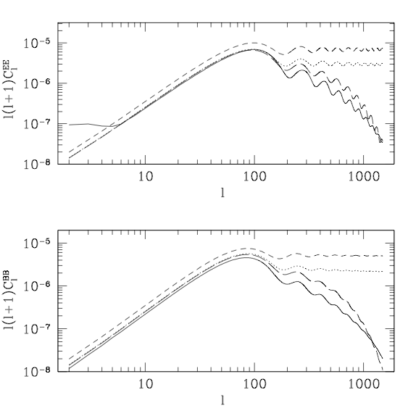
Conclusions
Combining all the physics mentioned can derive semi-analytic expressions for the power spectra.
Without phase damping recover appropriate scaling relations.
With phase damping see rapid drop in power on small scales.
Projection approximations only valid l<600.
Wiggles contain information about evolution of gravitational waves in the early universe.

