Slide 1
What to say when they tell you “Perl Sucks!!”
Debunking Perl Myths
Pritesh Ugrankar
Pritesh.ugrankar@gmail.com
@PriteshUgrankar

Slide 2
Who am I? Why this topic???
Worked in Storage domain as Admin/Tech Lead/Ops Manager/Design/Architect. Currently open to work. Intermittent Perl user. I love Perl!!
First used Perl in late 2012 - DWIM Perl (5.12) & later Strawberry Perl (5.14). I love Strawberry Perl, but more on that later.
First ever perl script – remove or add “:” in a list of WWNs. Recently - Used to email storage array health check and capacity (december 2020). Perl handled UTF 16 output far elegantly than any other language!!
First few scripts - ~20 lines, mostly regex, no modules, no subroutines, start small, gradually add functionality. Recent scripts - ~200 lines, some regex, used subroutines (DRY), lots of modules, start small, gradually add functionality, ALWAYS start with use strict, use warnings. Check script output every 4 to 5 lines, then add a few lines, check again, rinse, repeat!!

Slide 3
Who am I? Why this topic???
Online - A lot of articles/youtube videos were constantly dissing Perl, saying its a horrible language, is unreadable, made Perl look like full of issues/bugs, gave example code that should’ve generated warnings/errors but didn’t, used all sorts of expletives for Perl(Why do that??)
Offline – some of my friends wondered why I used Perl and not another programming languages which (they felt) are “better than” Perl for scripting.
Me – Ran the examples given in the aforementioned articles – But those did generate warnings/errors, Found that most Perl issues/bugs mentioned in the articles were either mitigated, removed or simply didn’t exist!! So I kept coming back to Perl and couldn’t understand all this negativity.

Slide 4
What to say when they tell you Perl Sucks!!
Ask them to give you specific examples or specific features of Perl they have issues with.
Most of them will not be able to give the specifics. It’s just mindless regurgitation of what they’ve read/seen online.
Some will give specific examples/reasons. The rest of this talk deals with a few of those.

Slide 5
But....Perl is old, no new versions!!
Perl version 5.34 was released May 20th 2021!!
The last time I heard this argument from a friend it was December 2020, and we had Perl 5.32 back then.
A new Perl version is released every year!!

Slide 6
But....Where do I go to ask questions???
PerlMonks is a fantastic forum!! I have myself used it so many times. It is quite unassuming in appearance but such a high quality resource!!.
The Monks (Forum members) are super useful, the answers are really high quality and at times, they’ve helped me with code snippets that I could use and expand. Not to mention the code snippets follow best practices and will be often interspersed with “lightbulb” moments.
Then, there’s stackoverflow and reddit!! Yeah, they’ve got folks who answer Perl questions there too!!

Slide 7
But...It’s a pain to install Perl on Windows!!
No it most certainly isnt!! There are TWO Windows-specific Perl distributions out there – ActivePerl and Strawberry Perl.
I have used Strawberry Perl myself and it comes loaded with all the Perl Modules and more!! You can use cpanm from windows command line just like you can use it on linux/unix to install more modules if you want.
Strawberry Perl Comes in 3 flavours!!
An exe you can install (just like any other exe)
A zipped version you can unzip and start using (NO ADMIN ACCESS needed!!) AND you can install multiple versions of Perl in the same system!!
A portable version that you can run off of a USB!!
A big shoutout and huge respect to the Strawberry Perl Developers. Strawberry Perl = life saver!! Thank you so much for creating, releasing and maintaining such a high quality distribution!!

Slide 8
But...Perl has all this cryptic syntax!!
This is more of a personal preference than anything else. For me, the $ used to denote a scalar, or the @ used to denote an array or the % used to denote a hash is far better and clearer than not having such a notation. For example, if I have my @nums = (1..10) , it tells me that I have an array called nums that is a container for a list which contains integers 1 to 10. The “..” is Perl’s way of saving me having to type 1 through 10. Then, if I say $nums[0], it means I want the value at index 0, whereas if I say @nums[0,1,8,9], it means I want the values at the indices mentioned in the square brackets (a slice).
Note, if I were to take a slice of a hash I’d still end up using the @sign for example @dict{‘key1’, ‘key2’, ‘key5’}. That’s because it is the type of brackets that indicate if I want a slice of an array or a hash. The @ in this case simply indicates that it is a slice. Slice of an array - @stuff[1,5,6] vs slice of a hash - @stuff{‘key1’, ‘key2’, ‘key5’} makes it pretty clear what the “stuff” is all about.
While some folks may find the “{“ for scopes, “;” for statement completion and white space ignorance distracting, some others (myself included) find it very useful. It helps write more legible scripts because one does not have to worry if a tab/space will change the scope, or if a statement spread over multiple lines will mess things up, or extra white space will generate an error.
Incidentally, the “strict” and “warnings” pragma have saved me from messing up more times than I can count. Their true power came to the fore when I was fixing existing scripts written by someone else who had not used these. A lot of errors/issues were revealed the moment these pragmas were added.
The way “my” and “our” keywords allow granular control of the variable scope is so practical. It also helps ensure I am not stepping over someone’s else’s variable that might have the same name.

Slide 9
But...Perl regex is so cryptic!!
In past few years, Perl has had a lot of useful features added to it. For example, one can use the /x or /xx modifier to write regular expressions so that it can be spread across multiple lines and # can be used for adding comments right inside the regex.
The qr function allows for the regex to be stored in a variable. This is powerful because it just has to be written once and thus easier to modify or maintain. Perl even allows you to customize regular expressions to suite your needs.
There’s also the “use re strict” pragma introduced in Perl version 5.22 which helps prevent regular expression gotchas.
While the regex101 is a good place to check/debug the PCRE (Perl Compatible Regular Expressions) , there's also Regexp::Debugger Perl Module that allows you to do it right into your script/code!! Note:- Just like many other useful modules, this one was recently updated.

Slide 10
But...Perl lacks function signatures!!
Wrong!! Function signatures were introduced way back in Perl 5.20
There’s a fantastic talk by Mark Gardner that speaks about it.
One can use anonymous hashes while calling the subroutine and get somewhat similar functionality. The next slide shows an example of the same.

Slide 11
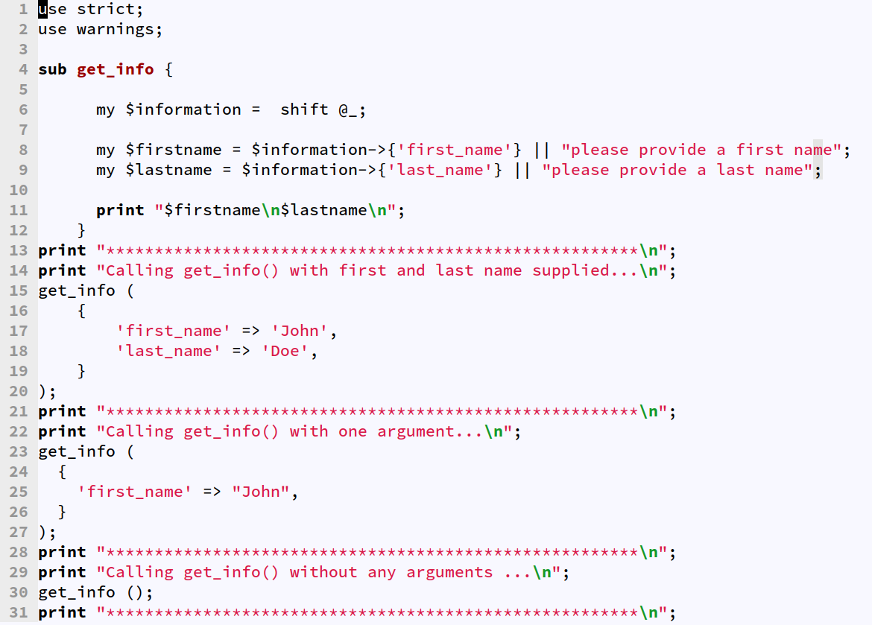
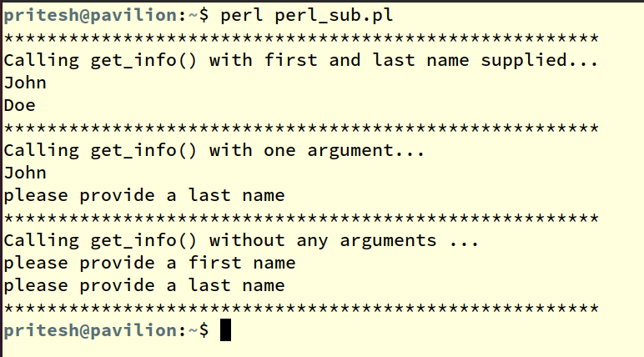
But...Perl lacks function signatures!!

Slide 12
But...Perl doesnt have these cool features/modules that I use in my language!!
My language has a module that lets me send out emails over SSL/TLS with ease – Perl has this fantastic module called Email::Sender::Transport::SMTP that lets you do the same.
My language has a module I can use to ssh to to devices over the network – Perl has Net::SSH2 and you can install it on Windows to ssh into devices to run commands, get outputs etc etc.. Comes pre installed with Strawberry Perl!!
My language has a module that lets me create Excel Reports with Charts, Graphs etc – Perl has Excel::Writer::XLSX. It’s got far more features than you’ll ever need!!
My language has this cool feature called list comprehensions that lets me do so much with just one line of code – Perl has had map and grep since forever...And yeah, Perl has MCE that lets you utilize all processor cores to do your stuff faster. Just check out MCE::Map, MCE::Grep
My language lets me write anonymous function in one line – Well Perl has had anonymous functions since a long time, and they can span across multiple lines if you want and are just far more powerful!!
My language has all these cool frameworks for web dev – Then you must check Dancer, Mojolicious and Catalyst. These are supercool web frameworks written in Perl.
My language let me write OOPS so easily!! - Well, while Perl’s native OOPS implementation might be tough for a new user to follow, it’s got Moose, Moo and few other modules that give fabulous OOPS power to Perl. Incidentally, there’s a new OOPS framework coming up for Perl!!

