Slide 1
CURRENCY EXCHANGE RATE FORECASTING

Slide 2
Group Members:
Mehal Rathod
Pritesh Sheth
Aishwarya Mathkar
Gauravi Tembulkar
Krutarth Patel
Notes:
aa

Slide 3

OBJECTIVE:
To forecast the INR in comparison to USD for approximately 780days (3 years).

Slide 4
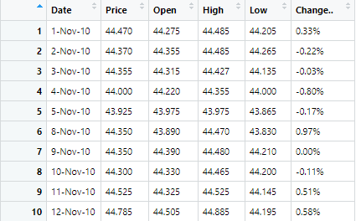
DATA DESCRIPTION:
This dataset contains the daily currency exchange rates as reported to Investing.com.
Included is Indian Rupee in comparison to USD over the period from 11-01-2010 to 11-29-2019.
Training data from Nov 1,2010 till Oct 20,2017 and test data from Oct 23,2017 till Nov 29,2019.
The rate of comparison to USD is always 1.

Slide 5
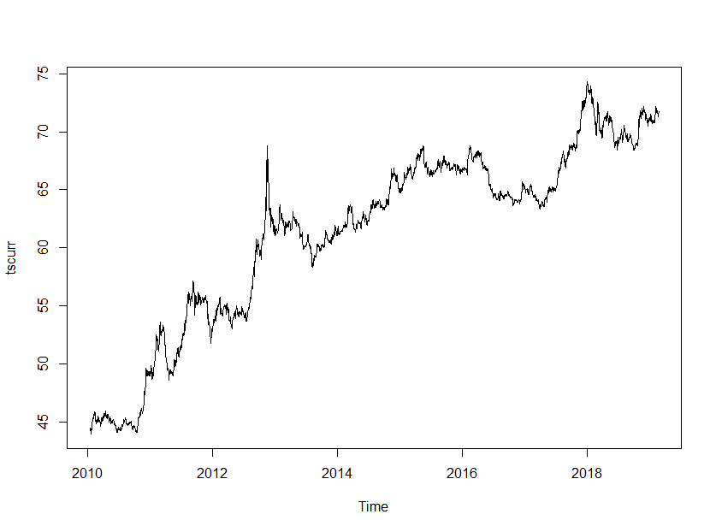
Time Plot of Original Data :

Slide 6

IMPLEMENTATION OF TIME SERIES TECHNIQUES

Slide 7
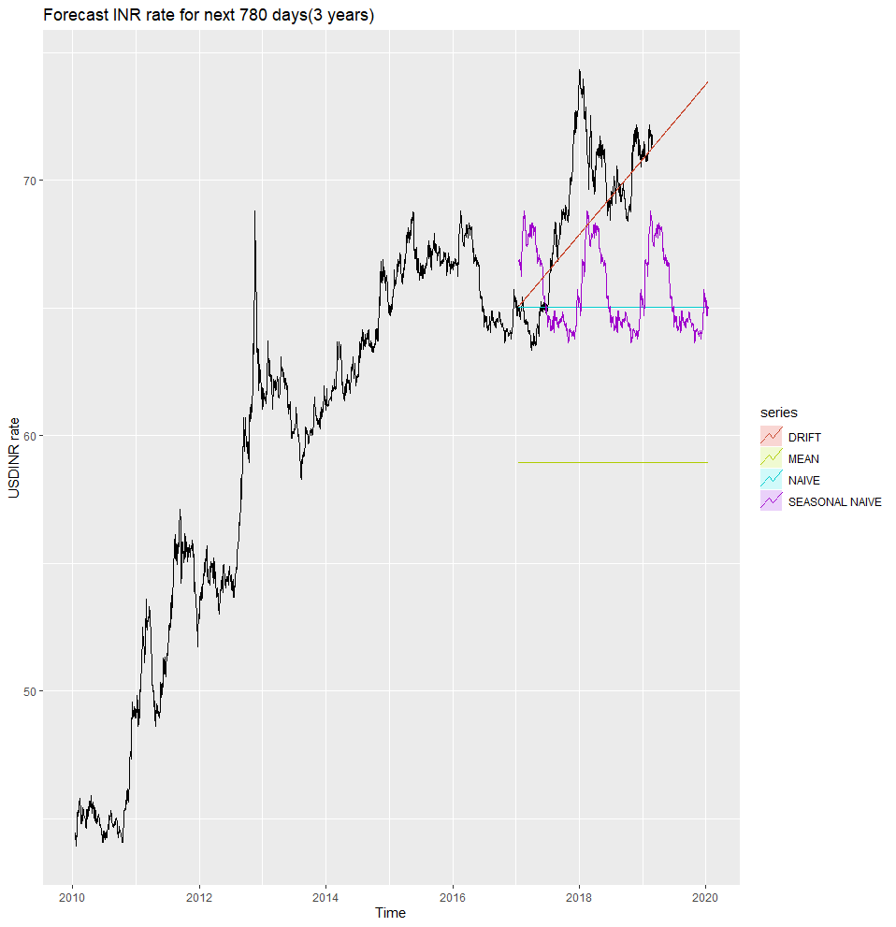
MEAN, NAÏVE, SEASONAL NAÏVE, DRIFT :

Slide 8
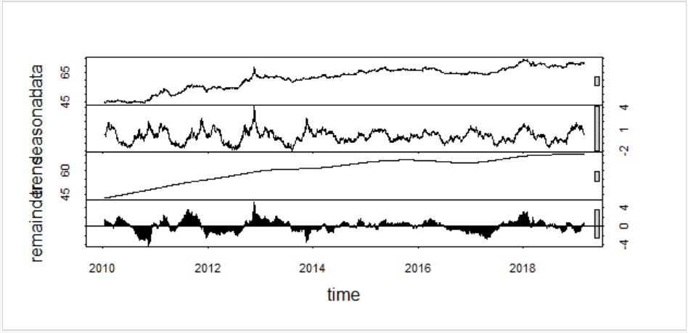
Decomposition of Additive time series

Slide 9
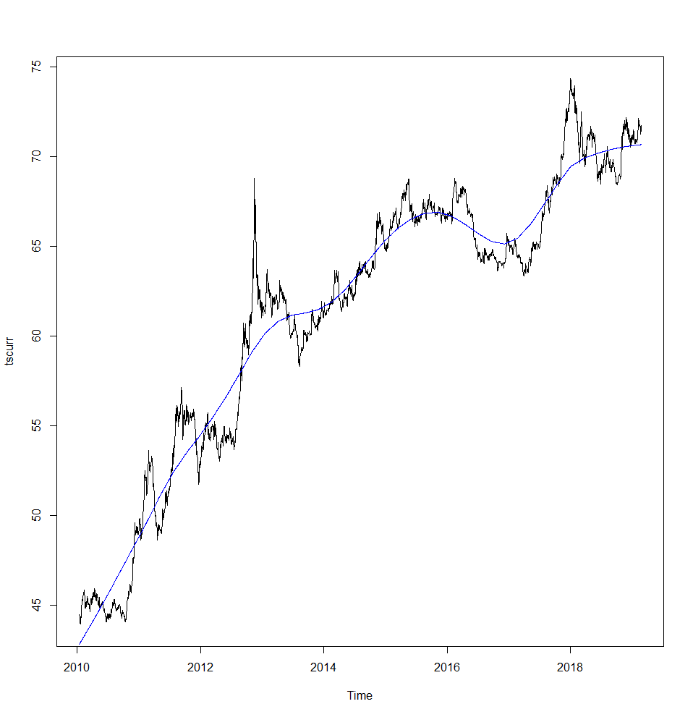
DECOMPOSITION using STL :
Blue line shows the trend cycle component over original data.

Slide 10
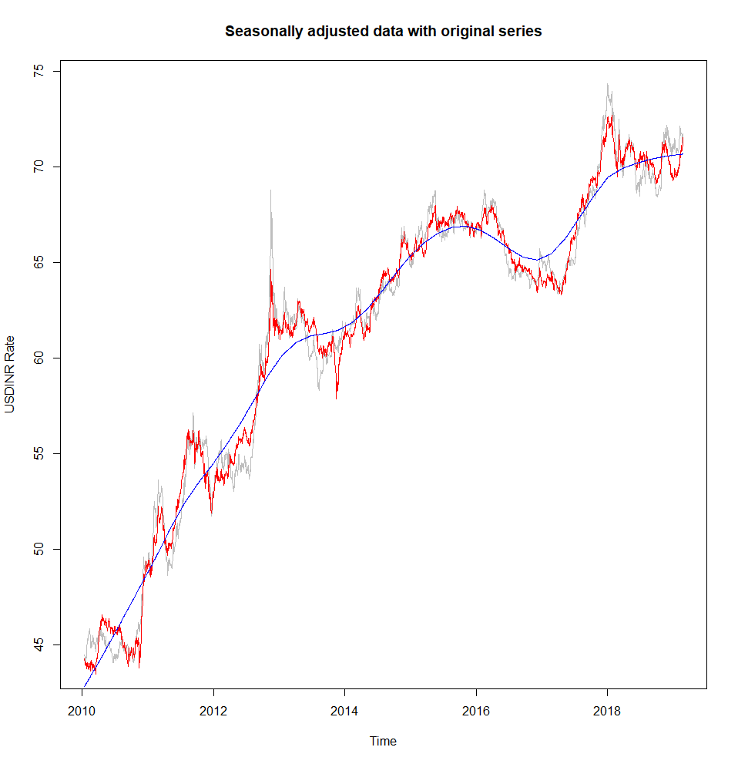
SEASONALLY ADJUSTED DATA
Here we have eliminated the seasonal component from the original data.
Red- trend + error
Blue – only trend

Slide 11
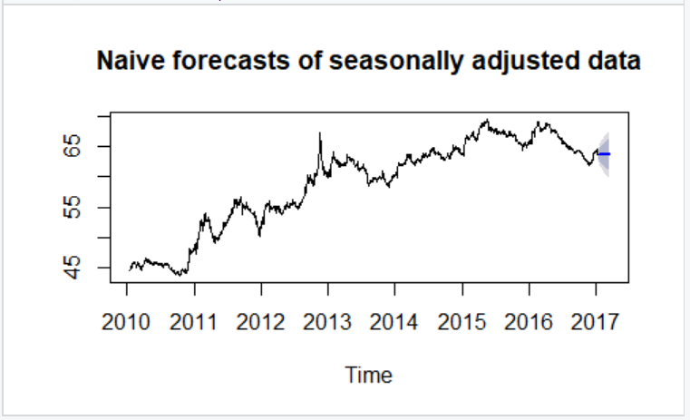
NAÏVE FORECAST OF SEASONALLY ADJUSTED DATA:

Slide 12
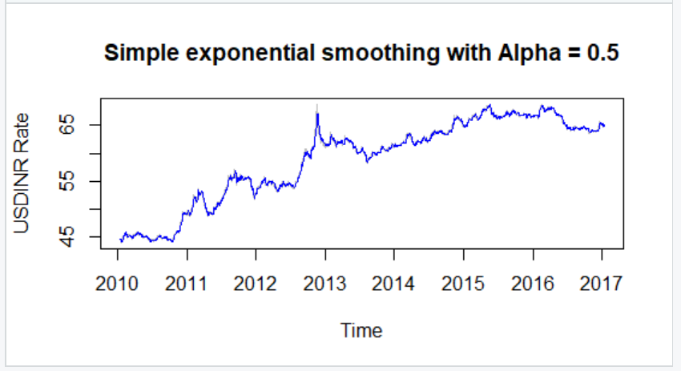
Simple exponential smoothing with Alpha as 0.5

Slide 13
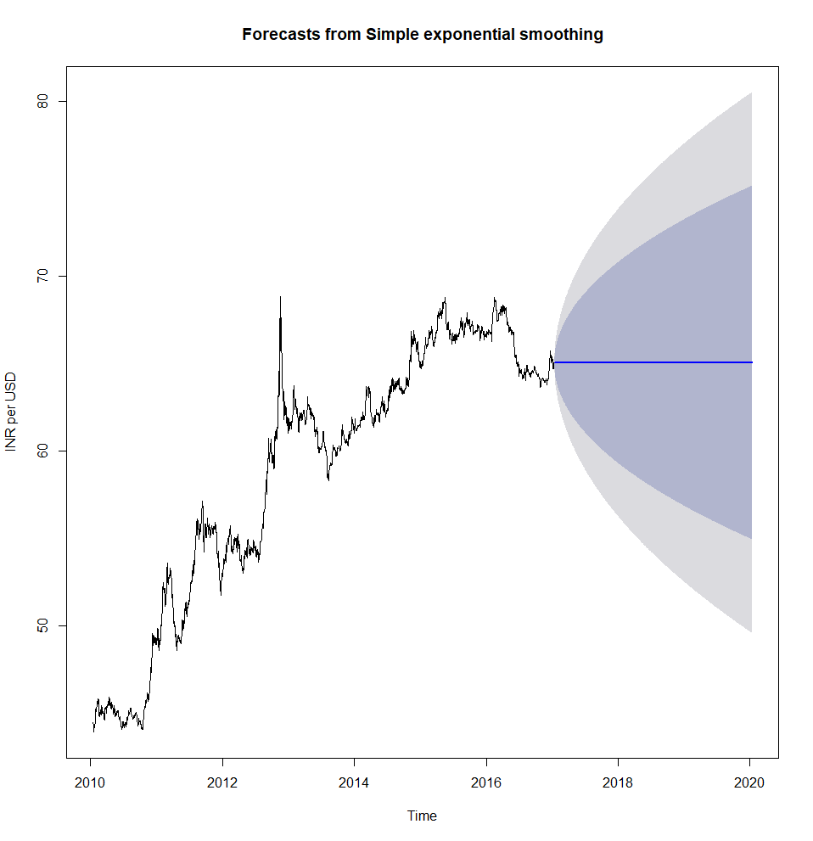
SIMPLE EXPONENTIAL SMOOTHING:
Notes:
Default – alpha (smoothing parameter for level) = 0.9999 and l0 = 44.4691

Slide 14
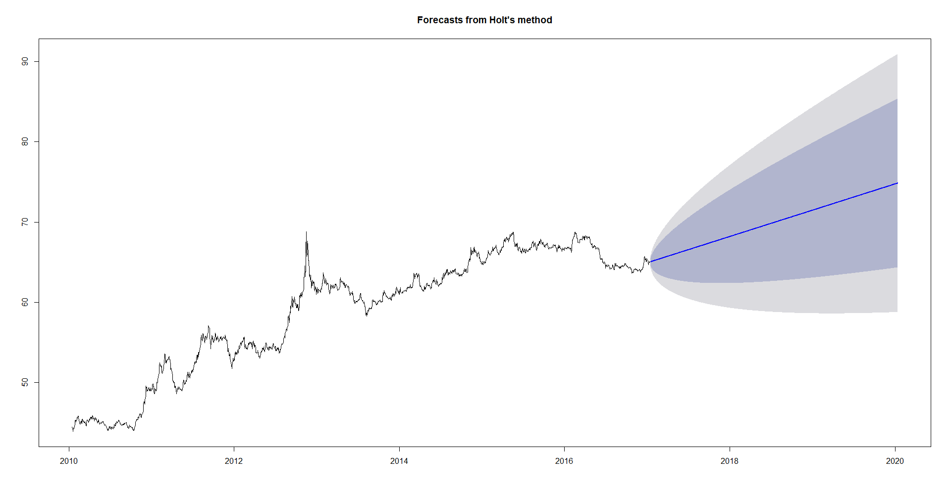
HOLT'S MODEL:
Notes:
Default – alpha(level) = 0.9999 and beta(smoothing) = 1e-04, l0 = 43.7788 and b0 = 0.0129
Dark gray is the 80% conﬁdence interval, the light gray is the 95% conﬁdence interval, and the blue line is the actual prediction.

Slide 15
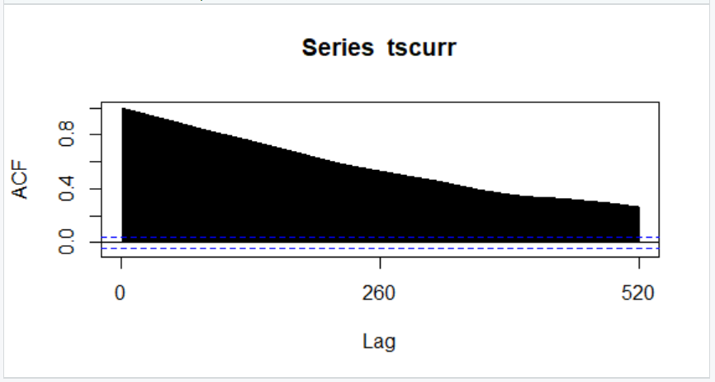
Acf Plot
Notes:
Acf plot, indicating significant correlation exists and decays very slowly which suggests that the time series is non-stationary

Slide 16
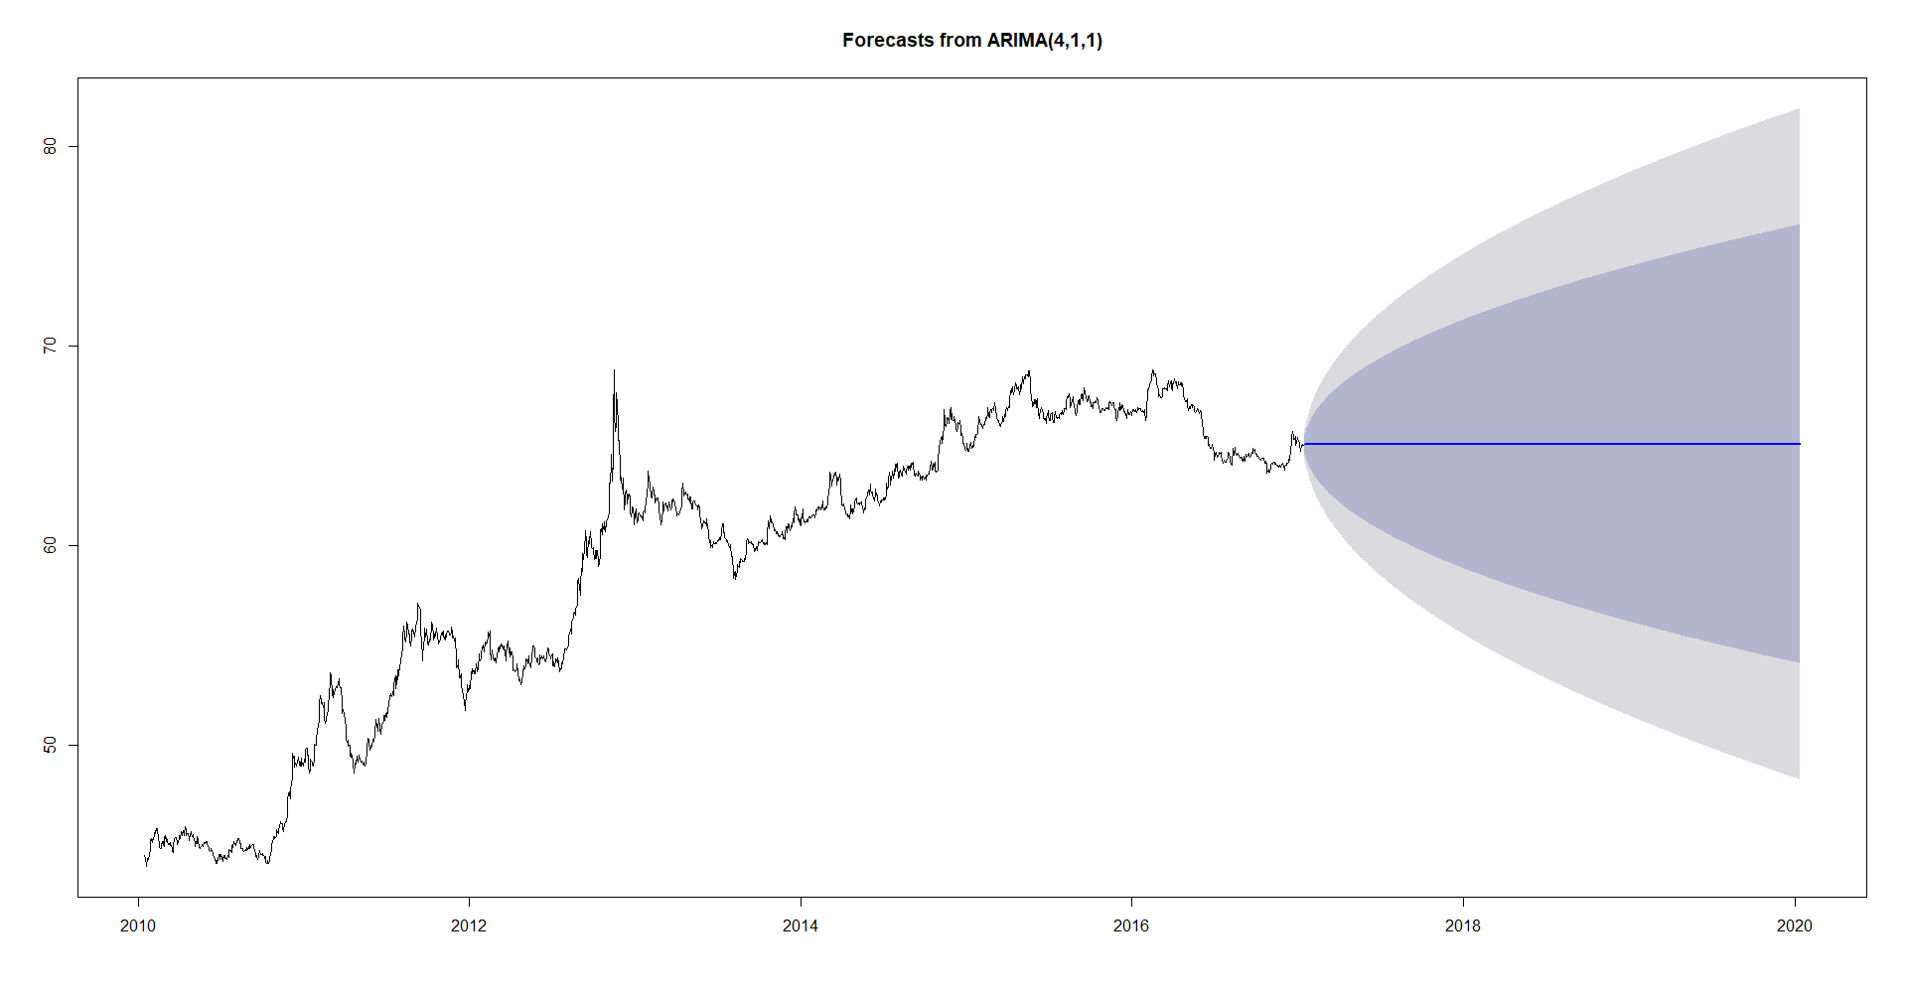
ARIMA MODEL :
Notes:
Coefficients: ar1 ar2 ar3 ar4 ma1 0.6437 -0.1286 0.0351 0.0986 -0.6123 with sigma^2 estimated as 0.0776: log likelihood = -256.24, aic = 524.48

Slide 17

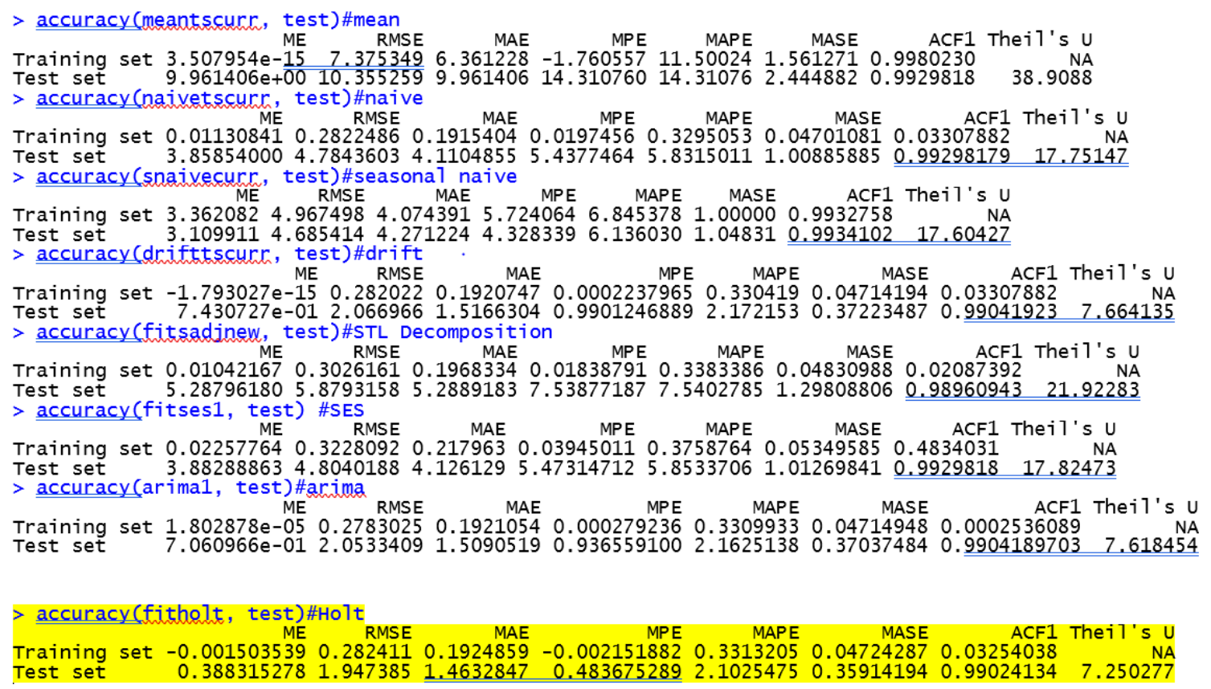
Results :

Slide 18
Conclusion
By comparing all the 7 types of errors in every model, we have concluded that Holt’s Model is the appropriate fit for our prediction.

Slide 19
THANK YOU

