Slide 1



Pillai HOC College of Engineering & Technology (Autonomous)
Mahatma Education Society's
Department of Computer Engineering
“Smart Sheild : AI enabeled helmet”
Date: 10/09/2026
Group members :
Vinit Patil
Siddhsesh Patil
Pritesh Patil
Under the guidance : Ms. Suchita Walke

Slide 2
Introduction
Road accidents caused by not wearing helmets, riding under the influence of alcohol, and rider fatigue remain major safety concerns. This project presents a Smart Helmet System using Arduino that enhances rider safety by integrating multiple sensors with wireless communication. The helmet is equipped with an IR sensor to detect whether the helmet is being worn, an MQ-3 alcohol sensor to detect alcohol consumption, and another IR sensor to monitor eye closure for drowsiness detection. The collected data is transmitted wirelessly to the motorcycle using RF communication. The bike's ignition is enabled only when the rider is wearing the helmet and no alcohol is detected. If signs of drowsiness are identified, the system alerts the rider using a buzzer. Additionally, the system includes a theft detection feature that activates an alarm when communication between the helmet and the motorcycle is interrupted. This low-cost, reliable, and user-friendly solution demonstrates how embedded systems and IoT concepts can be applied to improve road safety and reduce the risk of accidents.

Slide 3
Motivation
Increasing road accidents: Motorcycle riders face safety risks due to helmet non-compliance, alcohol consumption, drowsiness, and delayed emergency assistance.Lack of active safety monitoring: Traditional helmets mainly provide physical protection but cannot monitor the rider’s condition or riding behavior.Helmet non-compliance: Riders may start motorcycles without properly wearing a helmet, increasing the risk of serious injury.AI and IoT-based future scope: Intelligent monitoring can enable personalized safety alerts, accident detection, and real-time communication for improvedDrowsy riding: Rider fatigue and prolonged eye closure can reduce alertness and increase the possibility of accidents

Slide 4
LITERATURE SURVEY
Sr. No. | Paper Name | Year | Author Name | Methodology | Limitations of the paper
1. | Helmify: IoT-Based Smart Helmet System for Delivery Rider Safety | 2026 | Chembe Warren, Mainza Chilanga | Developed an IoT-based smart helmet using ESP32, MPU6050, FSR sensor, Bluetooth, Firebase, Android app, and Admin Dashboard. It detects helmet usage, monitors accidents, tracks GPS location, and sends emergency alerts in real time. | Depends on smartphone for GPS and internet. Bluetooth has limited range, and sudden movements may trigger false accident alerts.
2. | AI-Based Smart Helmet Detection System | 2024 | Rania H. Elabd, Maged M. Darwish, Hazem H. Alshamekh, Amr S. Moawad | Implemented an AI-based helmet detection system using YOLO, OpenCV, OCR, Python, and MongoDB. It detects riders without helmets from CCTV footage, recognizes vehicle number plates, and stores violation records automatically. | Detection accuracy depends on camera quality and lighting conditions. OCR accuracy may decrease with blurred or unclear number plates.
3. | Design and Development of a Smart Motorcycle and Bike Helmet for Enhanced Safety | 2024 | Talari Abhilash, Talluri Bhagya Sree, Terala Srikar Prasad, | Designed a smart helmet using Arduino Uno, Bluetooth, an accelerometer, a gyroscope, and a temperature sensor. It detects crashes, monitors the rider's lean angle, provides voice alerts, and sends emergency notifications via Bluetooth. | Bluetooth communication has limited range. The system does not support GPS tracking or cloud-based monitoring.

Slide 5
Limitations of existing work/Research Gap
Limited focus on rider safety: Existing systems mainly focus on basic helmet protection rather than actively monitoring multiple rider safety conditions.
Lack of proactive safety measures: Conventional helmets cannot automatically prevent riding when the helmet is not worn or alcohol is detected.
Limited drowsiness detection: Traditional safety systems provide limited support for detecting rider fatigue or prolonged eye closure.
Delayed emergency assistance: Existing systems may not provide automatic accident detection and real-time location sharing for faster emergency response.
Limited integration: Helmet detection, alcohol detection, drowsiness monitoring, accident detection, and emergency communication are often not combined into a single integrated system.

Slide 6
Problem Statement
Helmet non-compliance Many motorcycle riders do not wear helmets properly, increasing the risk of severe injuries during accidents. Drunk riding Riders may operate motorcycles under the influence of alcohol, increasing the possibility of accidents and unsafe riding. Drowsiness while riding Fatigue and prolonged eye closure can reduce rider alertness and increase the chances of accidents. Delayed accident response After an accident, emergency contacts may not be informed immediately, resulting in delays in receiving medical assistance. No automatic safety monitoring Conventional helmets provide physical protection but cannot monitor helmet usage, alcohol levels, rider alertness, or accidents.

Slide 7
Scope
Helmet Detection: Ensure that the motorcycle starts only when the rider is wearing the helmet properly.
Alcohol Detection: Detect alcohol consumption using an MQ-3 sensor and prevent the motorcycle from starting when the detected level exceeds the defined threshold.
Drowsiness Detection: Monitor the rider's eye blinking/closure using IR sensors and generate an alert when prolonged eye closure is detected.
Accident Detection: Continuously monitor sudden movements or impacts using an accelerometer/vibration sensor to automatically identify possible accidents.
Accident Detection: Continuously monitor sudden movements or impacts using an accelerometer/vibration sensor to automatically identify possible accidents.

Slide 8
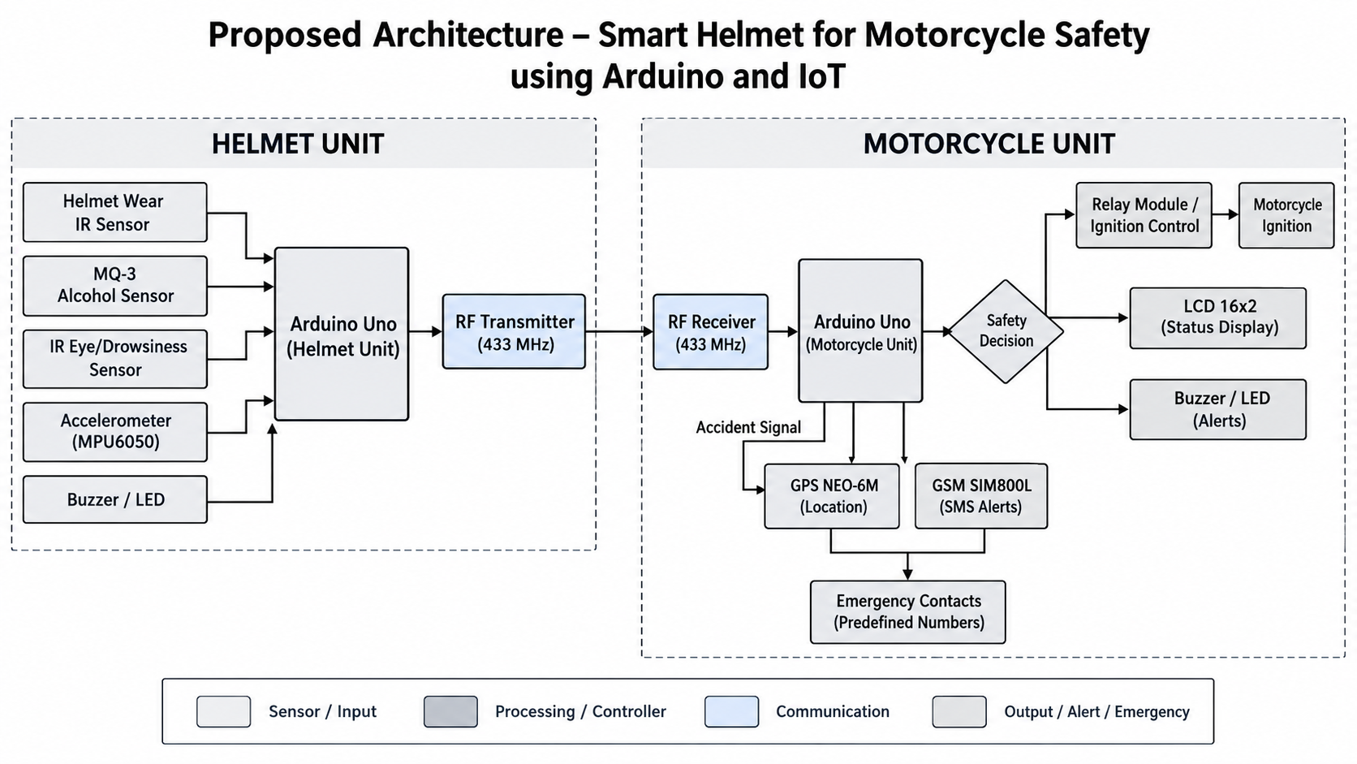
Proposed architecture

Slide 9
Methodology
Helmet Detection –Detect whether the rider is wearing the helmet properly using an IR sensor before allowing the motorcycle to start.
Alert & Status Display –Provide real-time safety information through an LCD 16×2, while buzzers and LEDs generate warnings for conditions such as alcohol detection, drowsiness, or system disconnection.
Wireless Data Transmission –
Transmit helmet sensor data from the helmet unit to the motorcycle unit using 433 MHz RF communication.
Drowsiness Detection –
Monitor the rider's eye blinking/closure using IR eye sensors and generate an alert when the eyes remain closed beyond a preset duration.
Alcohol Detection –
Measure alcohol levels from the rider's breath using the MQ-3 alcohol sensor and prevent ignition when the detected level exceeds the defined threshold.

Slide 10
Complexity
Sensor Integration Complexity: Integrating multiple sensors such as IR, MQ-3, accelerometer, GPS, and GSM with Arduino while ensuring reliable communication.
Helmet Detection Complexity: Accurately determining whether the helmet is properly worn and preventing false detection during different riding conditions.
Wireless Communication Complexity: Maintaining reliable 433 MHz RF communication between the helmet unit and motorcycle unit and detecting communication failure.
Real-Time Safety Control: Processing sensor data continuously to make timely decisions regarding ignition control, warnings, and emergency alerts.
System Integration Complexity: Combining sensing, wireless communication, ignition control, alerts, GPS, and GSM modules into one reliable safety system.

Slide 11
Expected Outcome
Automatic Helmet Detection using IR sensors to verify whether the rider is wearing the helmet before the motorcycle can start.
Alcohol Detection & Ignition Lock to prevent motorcycle operation when alcohol is detected above the defined threshold.
Drowsiness Detection through IR-based eye monitoring, with alerts generated when prolonged eye closure is detected.
Automatic Accident Detection using an accelerometer to identify sudden impacts and trigger the emergency response mechanism.
Real-Time Emergency Location Sharing using GPS to obtain accident coordinates and GSM to send the location through SMS to predefined contacts.
Automatic Motorcycle Ignition Control ensuring that the motorcycle starts only when the helmet is worn, alcohol is not detected, and wireless communication is active.

Slide 12
Relevance to the environment
Efficient Resource Usage: Automated monitoring of helmet status, alcohol, drowsiness, and accidents reduces repetitive manual safety checks.
Low Physical Resource Requirement: The project uses compact electronic components such as Arduino, sensors, RF, GPS, and GSM modules, requiring relatively little physical infrastructure.
Energy-Efficient Embedded System: The system is designed around low-power embedded components and a battery-powered helmet unit, making it suitable for portable operation.
Digital Safety Monitoring: Wireless communication and automatic SMS alerts reduce dependence on physical intervention during emergencies.
Sustainable Smart Transportation: The project supports the broader concept of smart and safer transportation by integrating embedded technology and IoT-based communication into motorcycles.

Slide 13
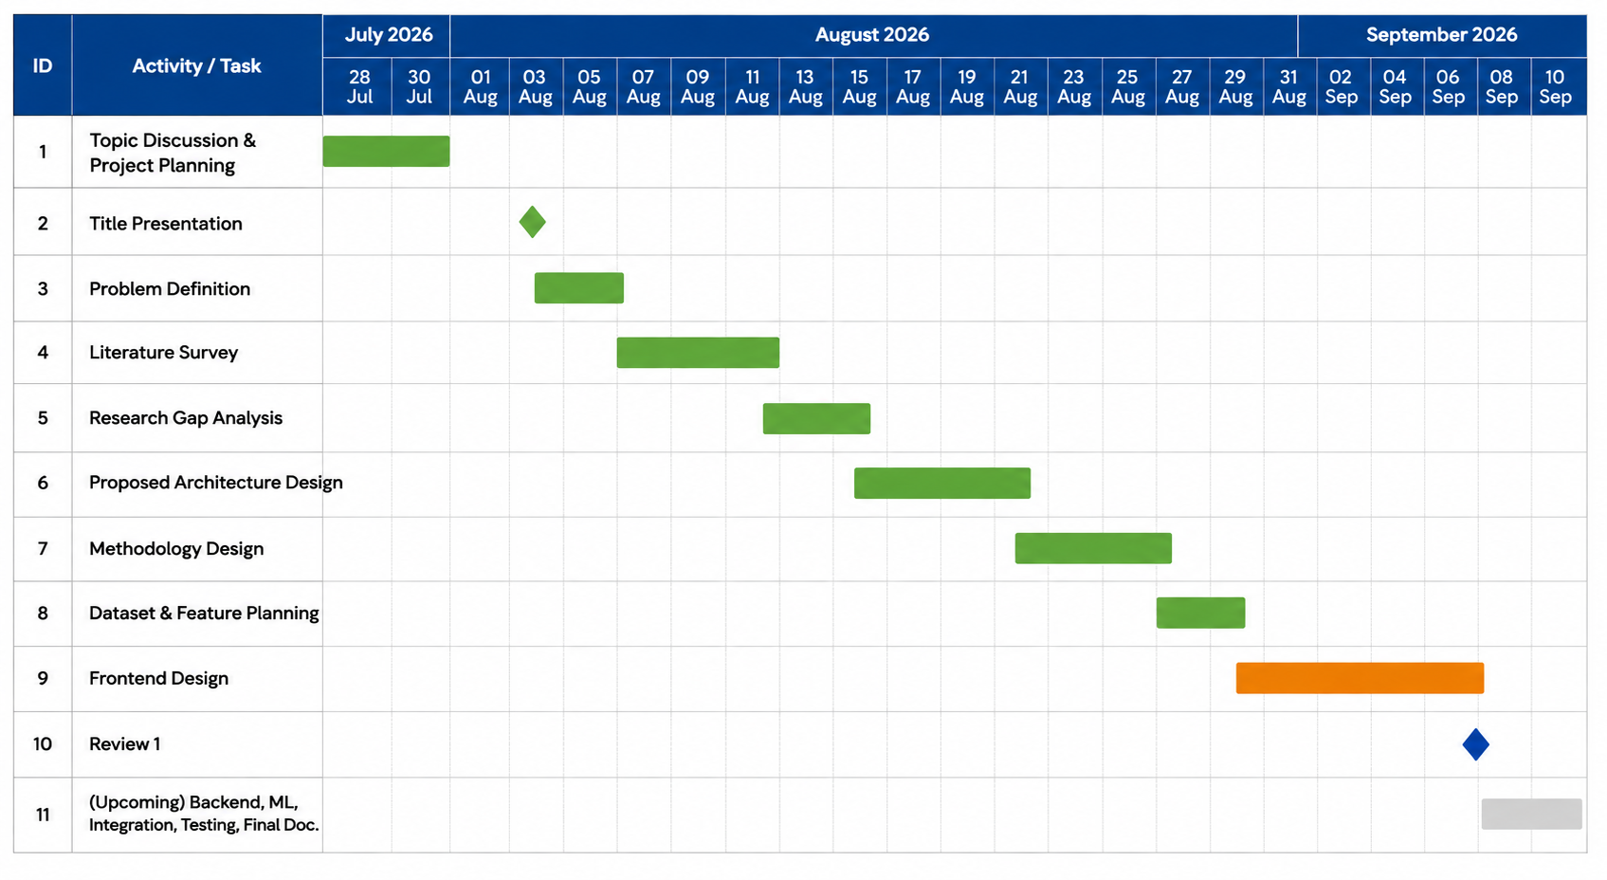
Gantt Chart
Task | Month 1 | Month 2 | Month 3 | Month 4
Literature Survey & Requirement Analysis | ███
Dataset Collection & Preprocessing | ███ | ⬛
NLP-Based Transaction Categorization |  | ███
Subscription Spike Detection |  | ███ | ⬛
Cash-Flow Prediction |  |  | ███
System Development & Integration |  |  | ███ | ⬛
Dashboard & Alert System |  |  |  | ███
Testing & Evaluation |  |  |  | ███

Slide 14
Sustainability
Long-Term Usability: The Smart Helmet can continuously monitor rider safety conditions during regular motorcycle usage.
Scalable Solution: The system can be extended with additional sensors, advanced communication technologies, and more safety-monitoring features.
Continuous Improvement: Accident detection, drowsiness detection, and safety monitoring can be improved with advanced AI and machine-learning techniques in future versions.
Reduced Manual Intervention: Automatic helmet verification, ignition control, accident detection, and emergency SMS reduce the need for manual safety checks and emergency communication.
Future Expansion: The project can be extended with mobile applications, cloud-based data logging, AI-based drowsiness detection, live GPS tracking, and automatic emergency calling

Slide 15
REFERENCES
[1] Chembe Warren, Mainza Chilanga’s Helmify: IoT-Based Smart Helmet System for Delivery Rider Safety June 2025
[2] Rania H. Elabd, Maged M. Darwish, Hazem H. Alshamekh, Amr S. Moawad’s AI-Based Smart Helmet Detection System February 2024
[3] Talari Abhilash, Talluri Bhagya Sree, Terala Srikar Prasad’s Design and Development of a Smart Motorcycle and Bike Helmet for Enhanced Safety January 2026
[4] Circuitdigest.com microcontroller-projects smart-helmet-using-arduino

