Slide 1

GlucoTwin
An India-aware digital twin for proactive type 2 diabetes management
Team ZIZ, Chandigarh University
Happiest Health Digital Twin Challenge 2026
Synthetic, open or anonymized data only
Decision support, not a medical device

Slide 2



Diabetes care is mostly reactive
Seen every few months
Spikes noticed afterwards
No continuous view
Patients meet the doctor only every few months.
A rise in glucose is usually seen after it happened.
Between visits the doctor sees nothing continuous.
Our goal: give the doctor a continuous view between visits, and warn about a likely excursion before it happens, not after.

Slide 3


What a digital twin is
A virtual copy of one patient, kept up to date with live data, that can monitor, predict and answer what-if questions.
A normal prediction model
GlucoTwin digital twin
Not personalized per patient
Personalized per patient
Not continuously updated
Continuously updated
No what-if testing
Supports what-if testing

Slide 4






GlucoTwin at a glance
Monitor
Predict
Alert
Explain
Live replay of the CGM stream
Glucose at +30, +60 and +120 min with a q10 to q90 band
Only events that pass a safety gate
Top features behind each forecast
Personalize
What-if
Doctor dashboard
Small per-patient adapters
Change a meal or activity and re-run
Five pages for the clinician

Slide 5
Data sources, roles and licenses
Source | Role | Size and notes | License
CGMacros (PhysioNet) | All training and evaluation | 45 participants (14 type 2 diabetes, 16 prediabetes, 15 healthy); 134,292 prediction windows | CC BY-NC-SA 4.0
HUPA-UCM (Mendeley Data) | Optional pretraining only, never used for evaluation | Type 1, 25 patients | CC BY 4.0
Synthetic AI-READI (ADVANCE Center) | Static patient table only | 10,518 synthetic static records | Terms not published
Indian meal library | What-if meals | 20 dishes; team estimates from IFCT 2017 raw ingredient values plus recipe assumptions; glycemic index values unverified | Team-made
No raw data redistributed
Record-to-wearable link is synthetic

Slide 6

















Architecture
Online inference
Offline training
1 Sources
2 Data layer
3 Twin core
4 Serving
5 Doctor dashboard
EHR static features
Validation
static
GRU fusion model with LightGBM fallback
FastAPI REST and WebSocket
Patients
CGM
Conformal calibration
Twin
5-minute grid
Alert gate
CGM and wearable stream via Kafka replay
offline training
LoRA adapters
What-if
Windows (72 steps)
Explanations
Rule-based low-glucose checks
Summary
Indian meal library
meals
What-if simulator
Patient-level splits
Doctor summary
Twin state in TimescaleDB
Evidence
Operations
Docker Compose
Prometheus and Grafana
MLflow
GitHub Actions

Slide 7
How the model fuses two streams
Static features
Outputs
Health record data, turned into a static embedding
Forecasts at +30, +60 and +120 min
Median plus q10 to q90 band
Conformal calibration, 80% target
GRU fusion
CGM sequence
static embedding plus CGM sequence
5-minute grid, 6-hour lookback (72 steps). Known-future inputs: hour of day, time since last meal, recent carbs.
80.2%
of observed values fell inside the GRU interval at +30 min (80% target). Static and time-varying features are kept separate.

Slide 8



Evaluation design: no patient leaks across folds
5-fold leave-patients-out cross-validation
Stratified by diabetes status
Scalers fit on training patients only
No patient in more than one role
Events we predict
Hyperglycemia: above 180 mg/dL
Severe: above 250 mg/dL
Hypoglycemia: below 70 mg/dL
Spike: rise of 40 mg/dL or more within 60 minutes
134,292 prediction windows from 45 participants were used for all training and evaluation.

Slide 9
Forecast error by horizon
32.86
mg/dL, GRU at +120 min, against 40.14 for persistence
A modest improvement over persistence. At +30 and +60 min the GRU, LightGBM and XGBoost are within one standard deviation of each other.

Slide 10
Paired comparison with persistence
Mean reduction in per-patient RMSE over 45 patients, with 95% bootstrap interval
Horizon | Model | Mean reduction (mg/dL) | 95% interval | Patients improved
+30 min | LightGBM | 2.39 | [1.92, 2.83] | 43 of 45
+30 min | XGBoost | 1.99 | [1.35, 2.54] | 41 of 45
+30 min | GRU | 1.41 | [0.83, 1.95] | 36 of 45
+60 min | GRU | 3.21 | [2.09, 4.26] | 36 of 45
+60 min | LightGBM | 2.85 | [1.85, 3.78] | 39 of 45
+60 min | XGBoost | 2.36 | [1.16, 3.47] | 37 of 45
The intervals exclude zero, but the reductions are modest, between 1.41 and 3.21 mg/dL, and not every patient improves.

Slide 11
Alerts only when a safety gate is passed
The alert gate
Hyperglycemia at +30 min
Held-out recall at least 40%
Precision at least 30%
Reliable: at least 10 events per fold
At most 1.0 false alerts per patient-day
65 ± 10%
61 ± 4%
recall
precision
0.8 ± 0.2
18 min
false alerts per patient-day
median lead time
Five events pass
Low glucose: rule-based, not predicted
Hyperglycemia +30 min. Severe hyperglycemia +30 and +60 min. Spike +30 and +60 min. All other events are shown only as a risk estimate, never an alert.
Predicted hypoglycemia did not pass (too few events). Checks on the observed reading: below 70, below 54, rapid fall.

Slide 12
Explanations and personalization
Explanations
Permutation importance for the GRU, SHAP for LightGBM.
39 of 45
patients improved with per-patient adapters. MARD 12.82% to 11.90%. RMSE 24.14 to 23.20 mg/dL at +60 min.
A small effect. A simple per-patient bias correction gives almost the same RMSE gain (0.91 vs 0.94 mg/dL). Adapters are promoted only if held-out error improves.

Slide 13
What-if simulator
Re-runs the model with a changed meal or activity. Default is the raw model output.
98.4%
of meals show a positive rise (direction is right)
0.3994 ± 0.1102
cross-fold Pearson r
72.5% to 100%
monotonic in carbohydrate: raw model, then physiological projection (100% by construction)
Meal rises are underestimated by about half. The walking effect is an assumption (0.38 mg/dL per net MET-minute, capped at 50 mg/dL), not validated.
model-based
assumption-based
approximate nutrient values

Slide 14
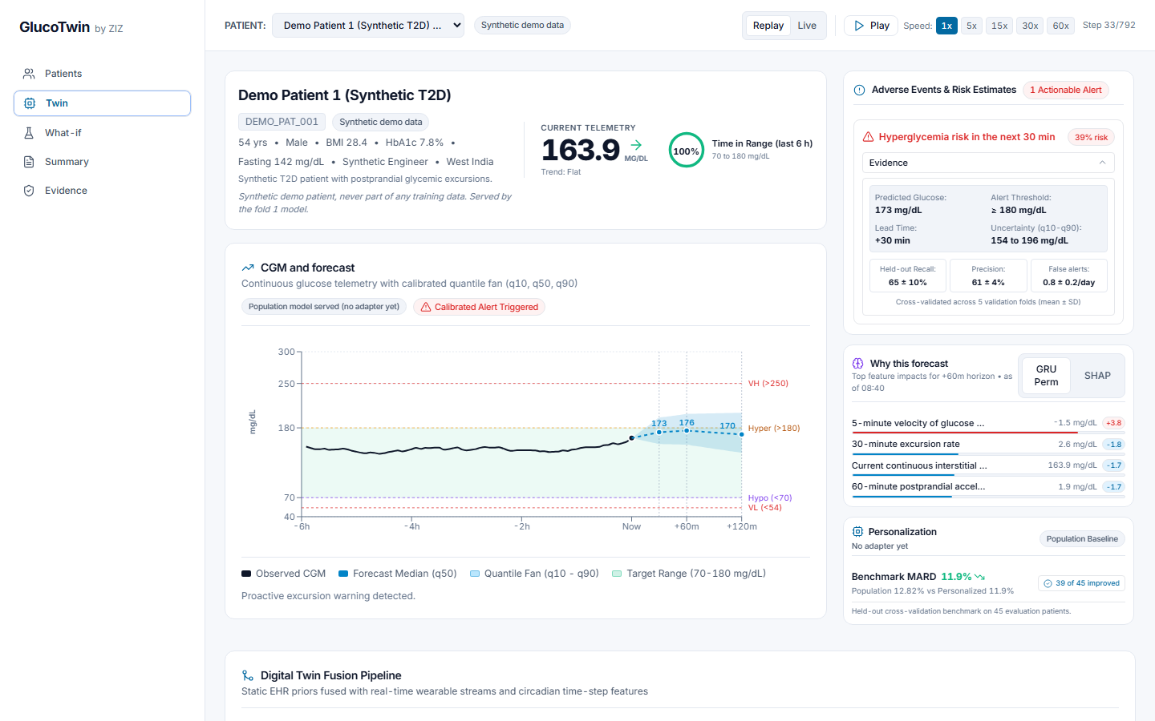
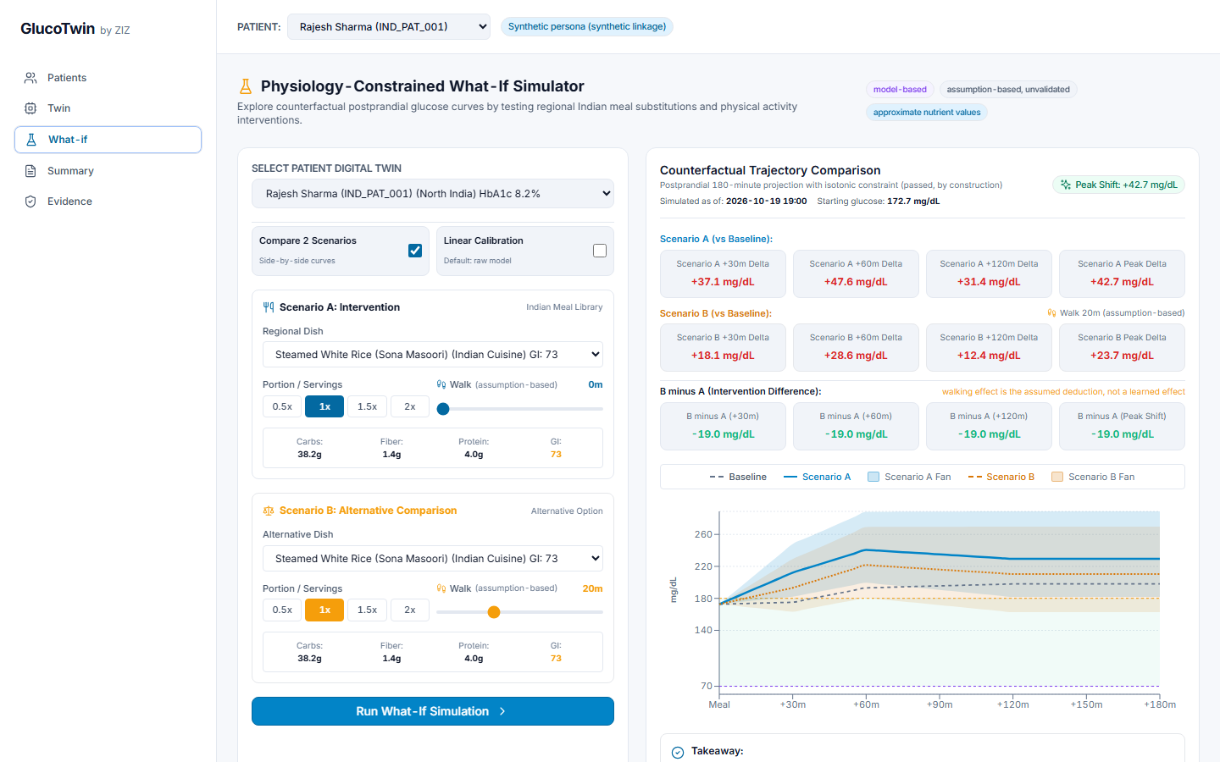
Doctor dashboard
Twin page: replay, forecast fan, alert, explanation, personalization
What-if page: two scenarios against a baseline, with provenance badges
Five pages: Patients, Twin, What-if, Summary, Evidence. The demo uses 3 synthetic demo patients and 4 synthetic personas.

Slide 15
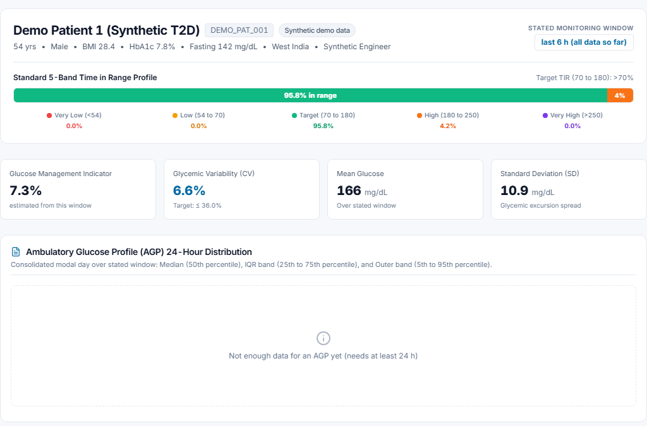
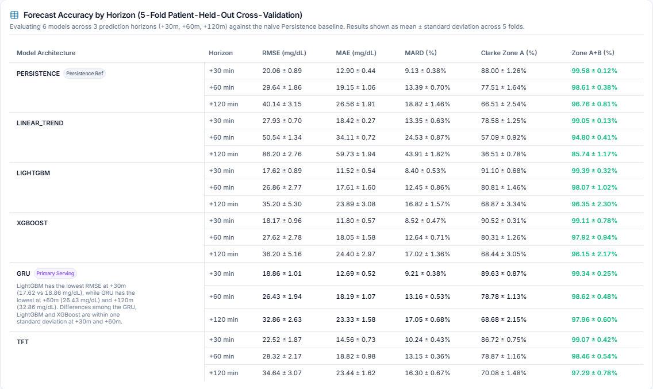
Summary and Evidence pages
Summary page: time in range, GMI and CV. The AGP appears when at least 24 h of data exist.
Evidence page: every number is read from the saved reports.
The Evidence page lets a reviewer check the claims in this deck against the saved reports.

Slide 16


Engineering and reproducibility
125
37
about 4.6 ms
about 34 to 44 ms
backend tests
frontend tests
median inference latency
median end-to-end stream latency, demo stack
FastAPI
Kafka
PostgreSQL
Prometheus and Grafana
REST and WebSocket
Replay of the wearable stream
with TimescaleDB
Monitoring
MLflow
Docker Compose
GitHub Actions
Licenses
Experiment tracking
One command starts everything; backend image 2.37 GB
4 jobs: lint and types, backend tests, frontend build, Docker build
Code MIT; models and reports CC BY-NC-SA 4.0
No raw data is included. Built with AI-assisted coding (Google Antigravity); the team specified, reviewed and tested everything.

Slide 17
Limitations and safety
Limitations
Safety design
Only 14 type 2 diabetes participants
Record-to-wearable link is synthetic
Hypoglycemia prediction is unreliable
Meal rises underestimated by about half
Meal nutrient values are estimates; glycemic index values unverified
Activity effect is an assumption
No prospective or clinical study
Decision support, not a medical device
No clinical validation, diagnosis or regulatory status is claimed
Only five events can raise an alert
Low-glucose checks are labeled rule-based, not predicted
Every input shows a provenance badge

Slide 18
Impact and roadmap
What it offers
Roadmap
A continuous view for the doctor between visits
Predicted warnings for five event types instead of noticing spikes afterwards
Indian meals for what-if questions, as estimates
Validate on larger Indian cohorts
Device and FHIR integration
Clinician feedback and usability testing
Better hypoglycemia detection
A prospective pilot
Guideline-grounded explanations with citations (future work, not built)
Photo-based meal logging (future work)

Slide 19
Thank you
GitHub repository
priteshkumarpandey/ZIZ_CHANDIGARH-UNIVERSITY
Team ZIZ, Chandigarh University
Happiest Health Digital Twin Challenge 2026
Demo video
Team Leader: Likhith Sai Seemakurthi
Member: Pritesh Kumar Pandey
[VIDEO LINK] placeholder

Slide 20
A1 Full RMSE table
Forecast RMSE in mg/dL, mean ± SD across 5 folds. Lowest in each column in blue.
Model | +30 min | +60 min | +120 min
Persistence | 20.06 ± 0.89 | 29.64 ± 1.86 | 40.14 ± 3.15
LightGBM | 17.62 ± 0.89 | 26.86 ± 2.77 | 35.20 ± 5.30
XGBoost | 18.17 ± 0.96 | 27.62 ± 2.78 | 36.20 ± 5.16
GRU (served primary) | 18.86 ± 1.01 | 26.43 ± 1.94 | 32.86 ± 2.63
TFT (experiment) | 22.52 ± 1.87 | 28.32 ± 2.17 | 34.64 ± 3.07
Clarke error grid zones A+B at +30 min: LightGBM 99.39 ± 0.32 percent, GRU 99.34 ± 0.25 percent.

Slide 21
A2 Alert operating table
Gate: recall at least 40%, precision at least 30%, reliable (at least 10 events per fold), at most 1.0 false alerts per patient-day.
Event | Status | Operating point
Hyperglycemia +30 min | Alert | Recall 65 ± 10%, precision 61 ± 4%, 0.8 ± 0.2 false alerts per patient-day, median lead time 18 min
Severe hyperglycemia +30 min | Alert | See Evidence page
Severe hyperglycemia +60 min | Alert | See Evidence page
Spike +30 min | Alert | See Evidence page
Spike +60 min | Alert | See Evidence page
All other events | Risk estimate only | Not shown as alerts
Predicted hypoglycemia | Did not pass (too few events) | Rule-based checks on observed reading: below 70, below 54, rapid fall

Slide 22
A3 Data and license table
Source or artifact | Role | License | Raw data redistributed
CGMacros (PhysioNet) | Training and evaluation | CC BY-NC-SA 4.0 | No
HUPA-UCM (Mendeley Data) | Optional pretraining only | CC BY 4.0 | No
Synthetic AI-READI (ADVANCE Center) | Static patient table only | Terms not published | No
Indian meal library | What-if meals (team estimates, IFCT 2017 based) | Team-made | No
Code | GlucoTwin software | MIT | Not applicable
Trained model files and reports | Served models and evidence | CC BY-NC-SA 4.0 (non-commercial, attribution, share-alike) | No raw data included

Slide 23
A4 Why not an LLM or RAG?
We did not build one. The task is numeric forecasting of a glucose time series with uncertainty, and our models can be tested on held-out patients. Our explanations come from permutation importance and SHAP, which point to model inputs. Guideline-grounded explanations with citations are future work and are not built.

Slide 24
A5 Why a GRU and not a transformer?
We tried a Temporal Fusion Transformer as an experiment. At +30 and +60 min it had the highest RMSE of the learned models (22.52 and 28.32 mg/dL), and at +120 min the GRU was lower (32.86 against 34.64). The GRU is lowest at +60 and +120 min and fuses the static embedding with the CGM sequence. LightGBM is lowest at +30 min, within one standard deviation, so it is the fallback.

Slide 25
A6 How do you know it generalizes?
We only know it partly. Evaluation uses 5-fold leave-patients-out cross-validation, stratified by diabetes status, with scalers fit on training patients only, and paired comparisons with bootstrap intervals over 45 patients. But there are only 45 participants, 14 with type 2 diabetes, the record-to-wearable link is synthetic, and there is no prospective or clinical study.

Slide 26
A7 Is hypoglycemia handled?
Not by prediction. Predicted hypoglycemia did not pass the alert gate because there were too few events, so it is shown only as a risk estimate. Low glucose is covered by rule-based checks on the observed reading (below 70, below 54, rapid fall), labeled rule-based, not predicted. Better hypoglycemia detection is on the roadmap.

Slide 27
A8 What are the main limits?
Only 14 type 2 diabetes participants; a synthetic link between record and wearable; unreliable hypoglycemia prediction; meal rises underestimated by about half; estimated meal nutrient values and unverified glycemic index values; an activity effect that is an assumption; and no prospective or clinical study.

