Slide 1
A Smart Safety App for Women's Protection
BATCH 12
TEAM MEMBERS:
JEEVESHWARAN.J-811721243020
PRITESH.S-811721243040
PRIYAGANTH.K-811721243041
SANTHOSH.H.S-811721243048
Project Guide: Mrs S.GEETHA M.E.,

Slide 2
OBJECTIVES
To provide a quick and easy way to alert trusted contacts or emergency services in case of danger or distress.
To enable location tracking and sharing with selected people for safety purposes.
To offer useful information and advice on how to deal with various situations that may compromise women’s safety.

Slide 3
EXISTING SYSTEM
All the existing systems must be connected to the GPRS service to work properly, hence cannot be used during emergency if there is no internet connectivity. Monitoring was tedious.
SCREAM ALARM:The generated scream is in a woman’s voice is severely helpful in discouraging the potential strong trouble makers.
POLICE NEARBY: The police nearby scanner android app is built with the aim to connect citizens & students to their nearest police stations city wise at one click and will permit the community to become more involved right from your Android Smart phones.
The disadvantages of using these applications are they only send the alert messages to the police not to the saved contacts.

Slide 4
PROPOSED SYSTEM
In this proposed system, the user writes the message content and also selects the contacts to which the message has to be sent and save it. So, when she is in some danger she just tilt the phone the warning is send to the contact list and the message stored will be sent to those numbers he has added in this application. So that he can receive the help in correct time.
The women safety laws and self defense laws will help in some troble.
Self defense method are provide with youtube links.
The message will sent in sms methods so there is no need of internet.

Slide 5
LITERATURE SURVEY
S.NO | TITLE | YEAR OF PUBLICATION | AUTHORS | ALGORITHMS USED | MERITS | DEMERITS
1. | The Role of IoT in Woman’s Safety: A Systematic Literature Review | 2023 | muhammadshoaib farooq s. a. m. gilaniayesha masoomauzma omerandzabihullah atal | logistic regression machine learning hidden Markov model | IoT devices provide real-time location tracking, enabling rapid assistance in emergencies. | Continuous tracking may risk personal data privacy. IoT devices may be expensive, limiting widespread accessibility
2. | FRNDY: A Women's Safety App | 2022 | P. Premi; K.S. Savita; N. Millatina | SOS Triggering Machine Learning and AI for Threat Prediction | One-touch panic button for quick emergency alerts, reducing response time. | Sending live location updates consumes battery power, limiting app use during long trips or emergencies.

Slide 6
LITERATURE SURVEY
S.NO | TITLE | YEAR OF PUBLICATION | AUTHORS | ALGORITHMS USED | MERITS | DEMERITS
3. | Android App for Women Safety | 2021 | DR. K Srinivas | Algorithms for secure data transmission AES or RSA | Some apps connect directly to local police or emergency services, reducing response time. | Offers SOS or panic buttons that send immediate alerts with location details.
4. | Smart Intelligent Security System for Women | 2016 | Vasantha Rama Ramya Sree Yadlapalli | Threat Prediction | The system can improve response times, prevent harm, and adapt to global settings, designated contacts during emergencies. | Hackers could potentially exploit weaknesses in the system to track or gather information, posing serious privacy and security risks.

Slide 7
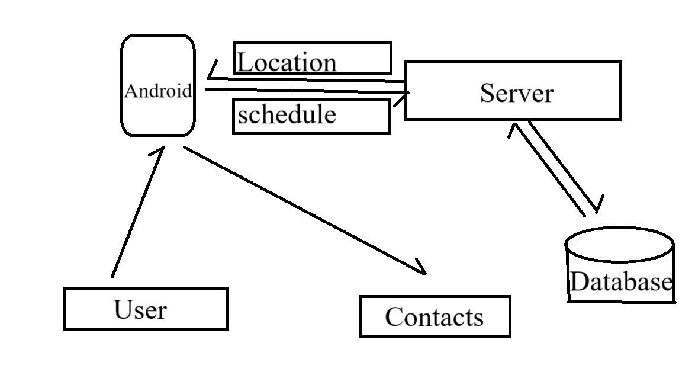
ARCHITECTURE DIAGRAM

Slide 8
SYSTEM SPECIFICATION
HARDWARE REQUIREMENTS
Below are the hardware requirements for the application development:
1. Operating System : windows
2. Processor : intel i3(min)
3. Ram : 8 GB(min)
4. Hard Disk : 256GB(min)
SOFTWARE REQUIREMENTS
Below are the software requirements for the application development:
1. The required language is java.
2. Editor for Android Studio ,lang-java and xml.
3. API-Application Programming Interface
4. Google Chrome, Firefox, Microsoft Edge or Brave Browser with Extension Support

Slide 9
MODULES
1. User Authentication
2. Emergency Alert System
3. Real-Time Location Sharing
4. Alerts and Notifications

Slide 10
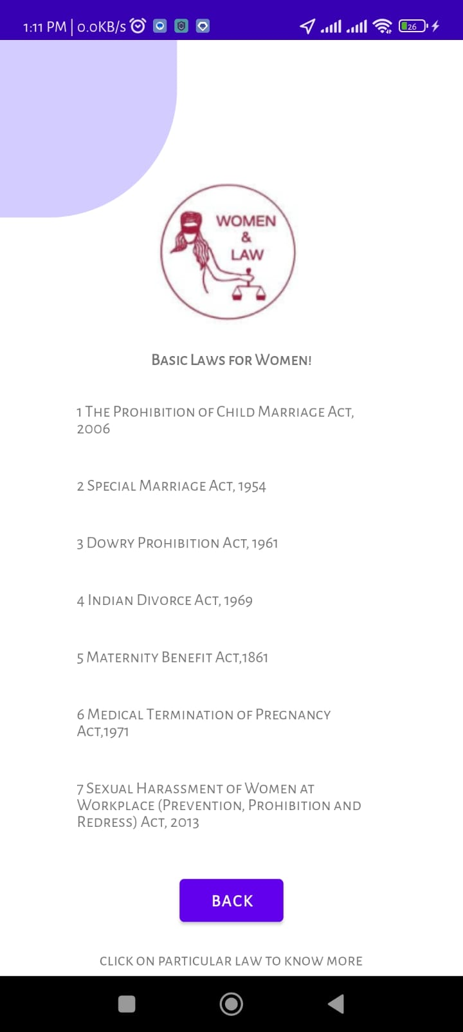
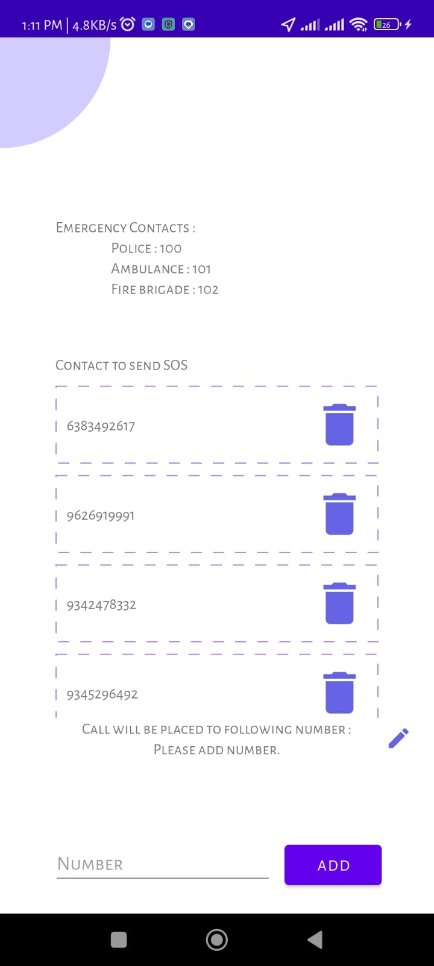
User Authentication
During registration, users can add up to 5 emergency contacts (phone numbers).
Contacts can be added manually or imported from the phone’s contact list.
Option to assign a priority level to each contact for sequential alerts.

Slide 11
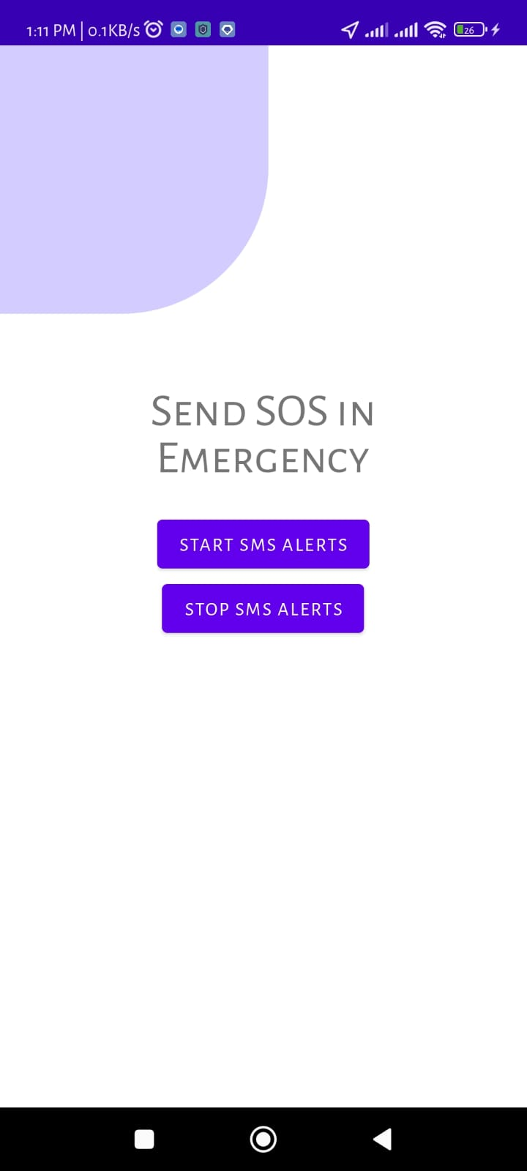
Emergency Alert System
SOS Button: A prominent button to send instant alerts during emergencies.
Emergency Message: Pre-configured alert messages with real-time location.
Voice Command Activation: Activate alerts via predefined voice commands .
Shake to Trigger: Initiate SOS by shaking the device.

Slide 12
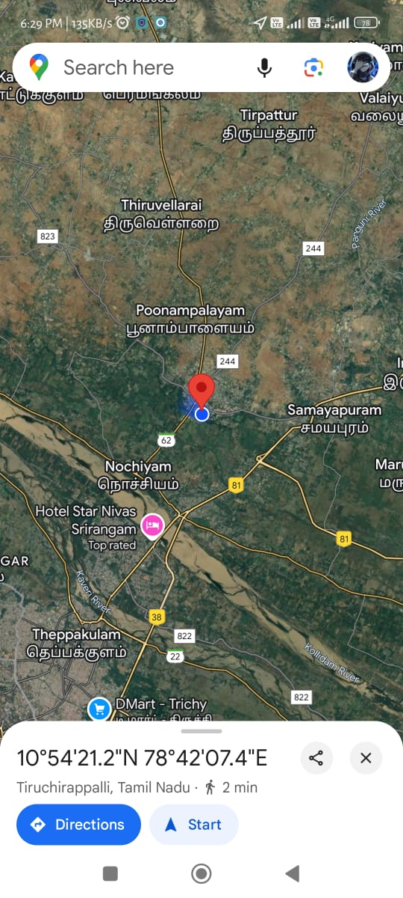
Real-Time Location Sharing
Share real-time GPS location updates with selected emergency contacts.
Automatic activation when an SOS alert is triggered.
Display the user’s current location on a map interface for contacts.
Include a link to view the location on Google Maps or similar platforms.

Slide 13
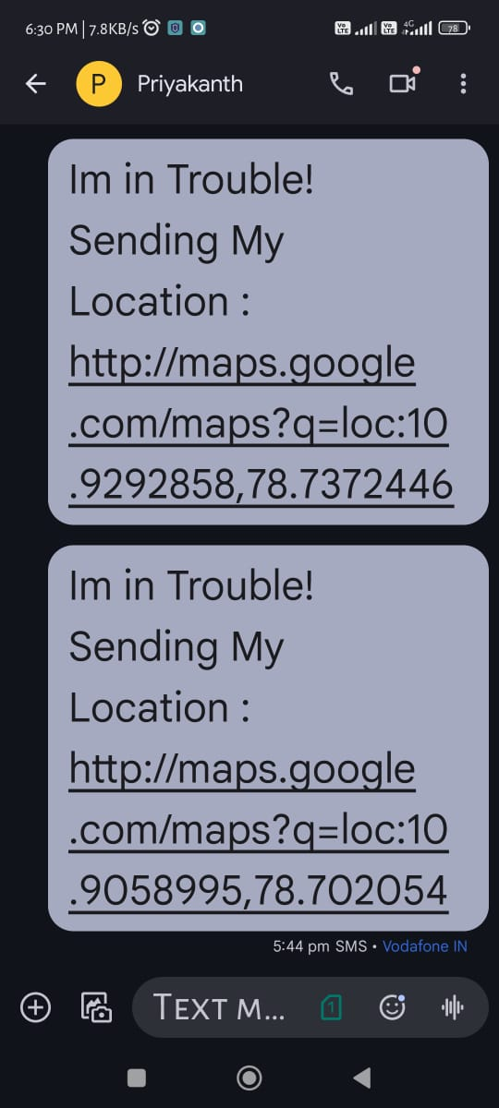
Alerts and Notifications
Sends pre-configured alert messages to emergency contacts with real-time location details.
Alerts are delivered via sms in app notifications
Alerts can be automatically sent to local police, ambulance, or fire services (if enabled).

Slide 14
CONCLUSION:
The Women's Safety App provides a practical and innovative solution to address critical safety concerns. With features like real-time location sharing, emergency alerts, and quick access to help, the app empowers women to feel secure in any situation.
This tool bridges technology and personal safety, offering reliability and ease of use.
It reflects a step toward ensuring that every woman can confidently embrace her freedom without fear.

Slide 15




