Slide 1

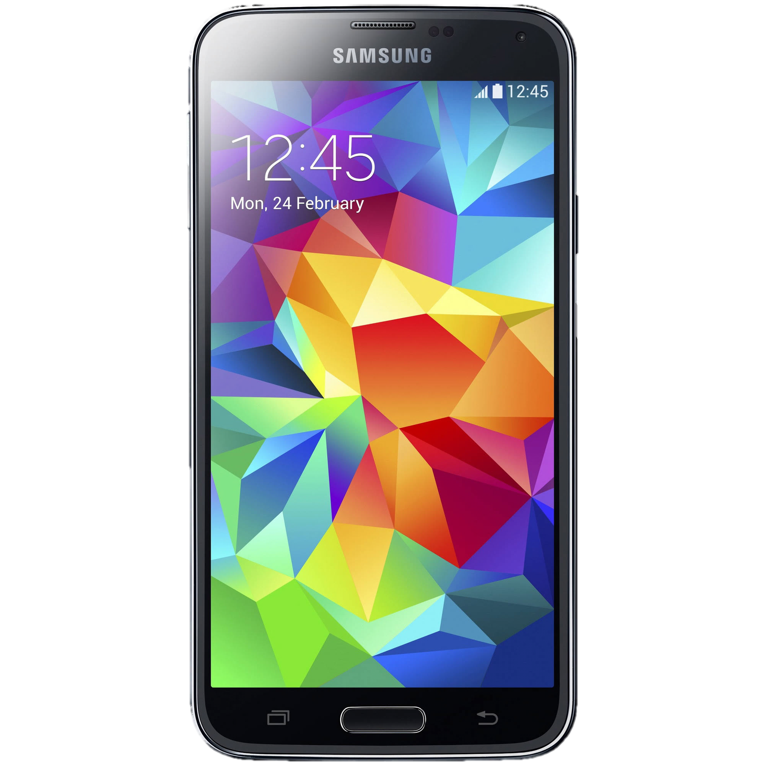

EasyEats
Group 11: Tejas Bhoir, Elizabeth Caronia, Mithulesh Kurale, Brett Lechner, Raj Patel, Kristen Wong, Prithvi Venkateswaran

Slide 2
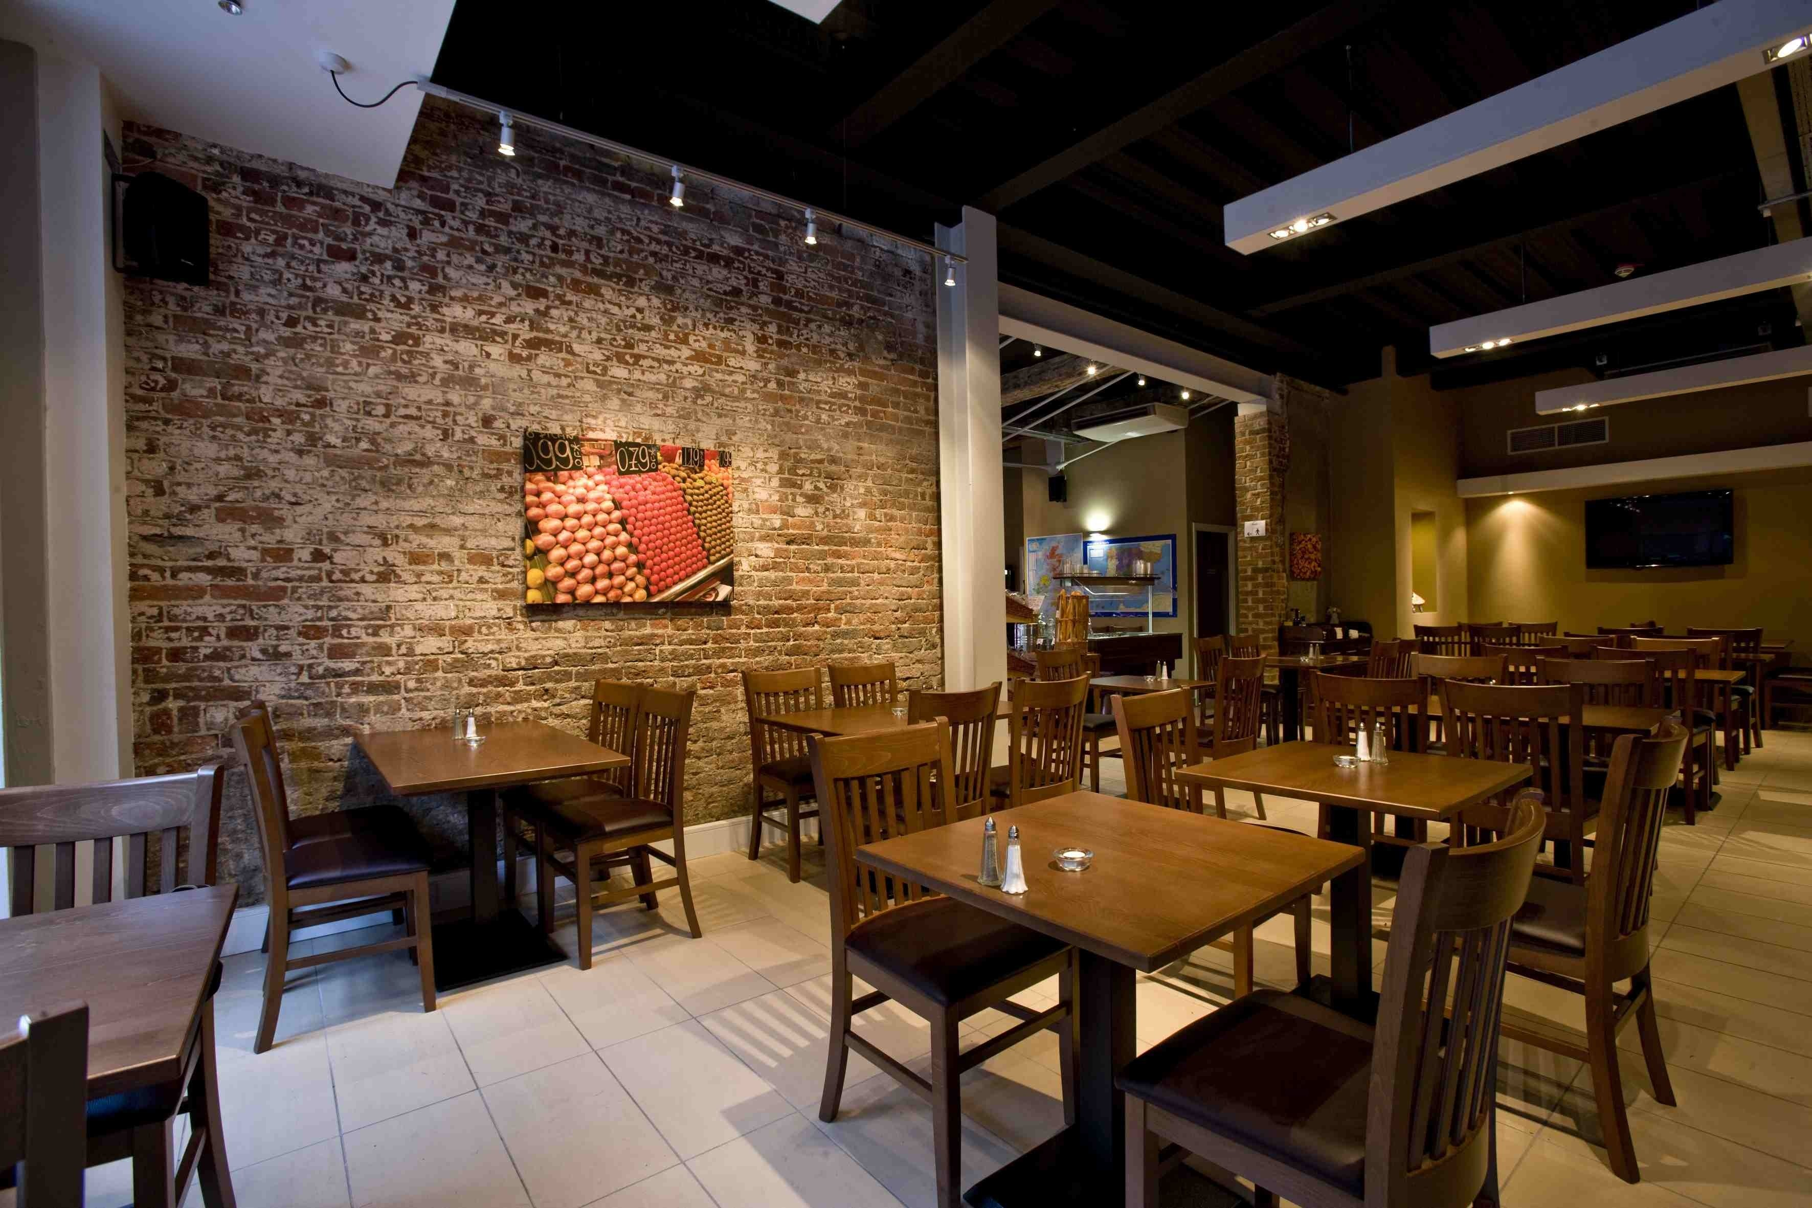
Problems We Address
Efficiency
Table seating
Food
Creation
Delivery
Ordering
Menu correction
Responsiveness to customers
Ordering
Paying
Reviews

Slide 3
Our Unique Solutions
Persistent data
More natural organization
More automized processes
Use of notifications
By diner
By chef/ bartender
Menu navigation
Quick links to categories
Customizable

Slide 4
Technical Challenges
Too many options
MEAN vs Java vs javascript vs php + sql +angularjs
Asynchronous development

Slide 5
Plans To Move Forward
Handle unexpected situations
If two users try to reserve the same table at same time
Managers:
Automate:
Stats/ profit page
Employee shifts
Login page => correct location
Server
Waitress
Waiter task queue
Customers
Create persistent data storage
Table reservations
Notes:
For instance I have literally never once remembered what the house special is, and as a result I have never ordered one. If the chef can put his specials on the menu, customers will be able to devote as much attention to them, and be able to order them

