Slide 1
HYPER ISLAND · DA27
Stockholm Transport
Analytics Pipeline
End-to-end data engineering: from scheduled ingestion to insight
Pritha Banerjee
Data Analytics · Hyper Island · 2026
Python
Azure
Snowflake
dbt
Power BI

Slide 2
Pipeline Architecture
Batch ingestion · Daily schedule
🔒 Azure Key Vault — Secures all credentials throughout the pipeline
1
2
3
4
5
6
7
📡
📄
💾
🏭
❄️
🔧
📊
→
→
→
→
⇆
→
Trafiklab
upload_stops.py
ADLS Gen2
ADF
Snowflake
dbt Cloud
Power BI
GTFS Static API
Python script
Bronze container
Daily trigger
Bronze→Silver→Gold
sync
Transform + tests
Dashboard
❄ ⇆ 📊 Power BI connects directly to Snowflake — reads Gold-layer tables for reporting
Why batch? — Static stop data updates once daily. Scheduled batch ingestion is efficient, cost-effective and aligned with Trafiklab's update frequency.
Architectural Decisions
🔒
Key Vault — all credentials stored centrally, never hardcoded in any script or pipeline
❄
Snowflake medallion — bronze → silver → gold ensures data gets cleaner and more valuable at each step
💾
ADLS Gen2 — raw data preserved in bronze layer; safe to reprocess if anything goes wrong downstream
🔧
dbt tests — not_null and unique constraints catch bad data before it ever reaches Power BI

Slide 3
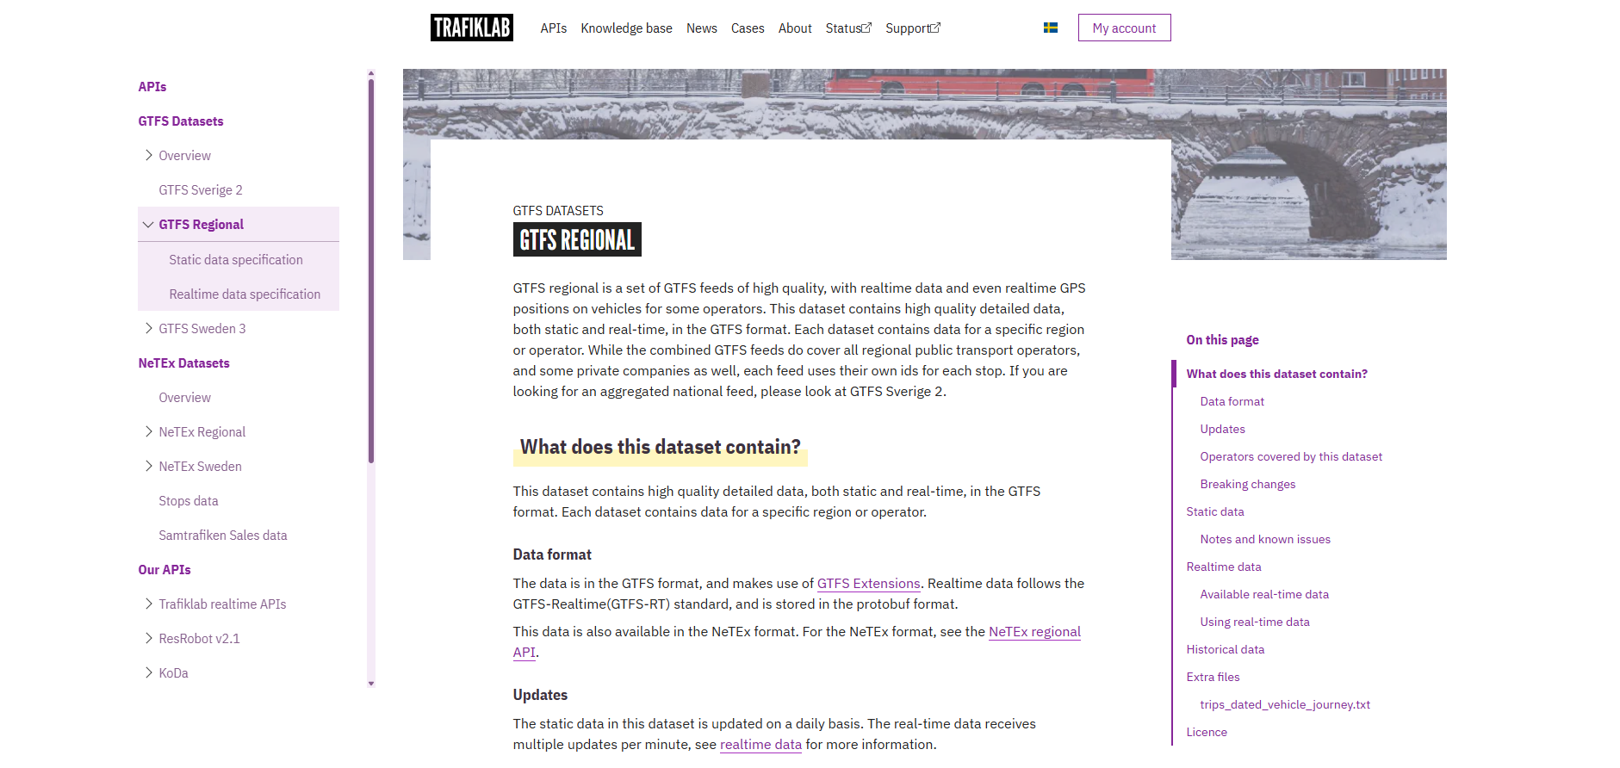


TRAFIKLAB API – Data Source

Slide 4
PROJECT OVERVIEW
What we built and why
Analytical Question: How is Stockholm's public transport network distributed across the city and which stops are busiest?
📍
🚌
🕐
🚇
21,829
614
2.78M
5
Transport Stops
Routes
Scheduled Departures
Transport Modes
Data Source: Trafiklab (GTFS Regional Static API) — Sweden's official public transport open data platform

Slide 5
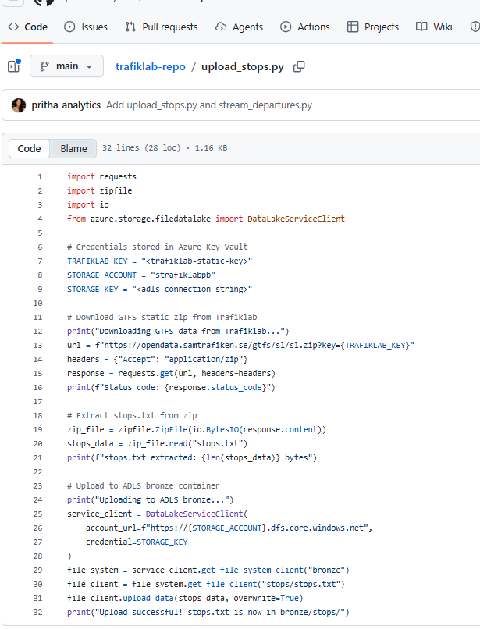
No credentials has been exposed
Extract API keys from TRAFIKLAB and connected to ADLS
Data comes from Trfiklab
Data going to ADLS bronze

Slide 6
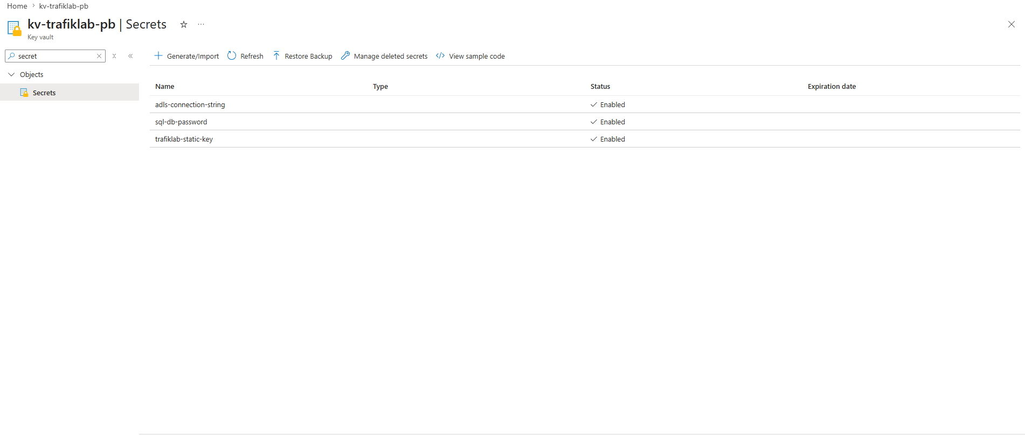
Azure Key Vault- Credential Management

Slide 7
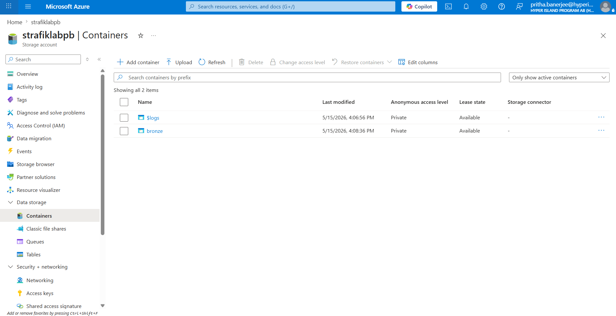
ADLS Gen 2- Bronze Layer

Slide 8
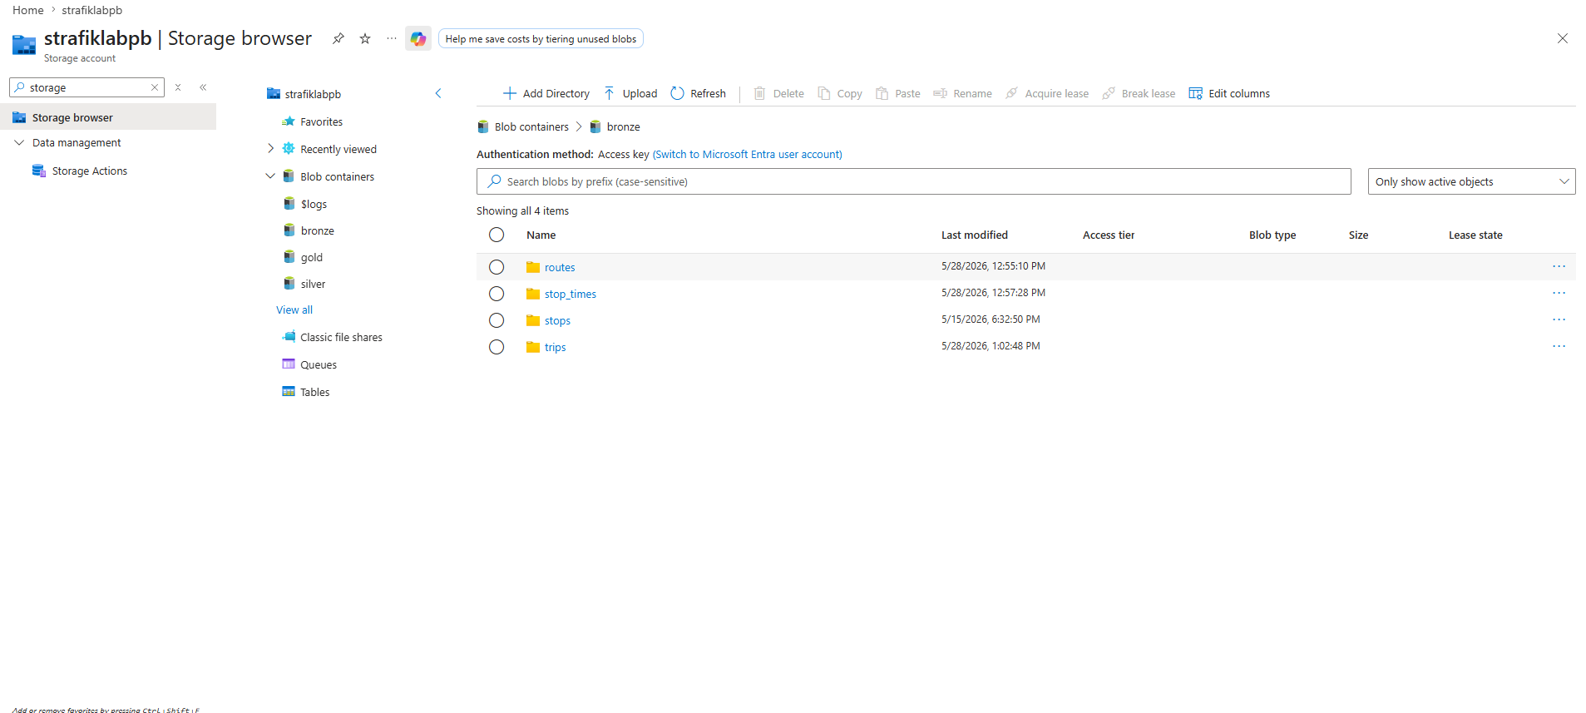
Bronze Container Folder Structure

Slide 9
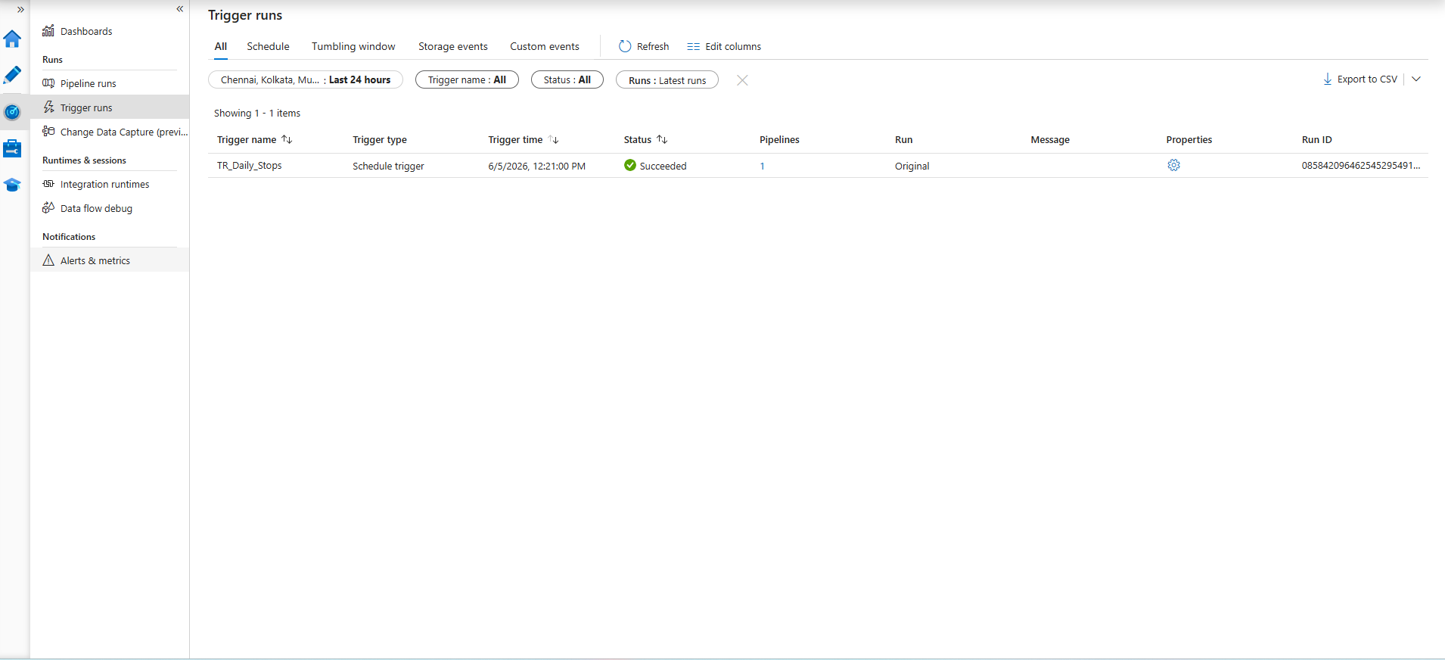
ADF Scheduled Trigger

Slide 10
SNOWFLAKE MEDALLION ARCHITECTURE
BRONZE
Raw data exactly as received
RAW_STOPS · RAW_ROUTES · RAW_TRIPS · RAW_STOP_TIMES
VARIANT type preserves original — safe to reprocess
21,829 stops · 614 routes · 138K trips · 2.78M stop times
SILVER
Cleaned, typed, validated
stg_stops · stg_routes · stg_stop_times
NULL filtering, type casting, transport mode mapping
Views built by dbt — always fresh from bronze
GOLD
Aggregated for consumption
fct_busiest_stops · fct_departures_by_hour · fct_routes_by_mode
Power BI reads only from here — no raw data exposure
11,809 stops ranked · 24hr pattern · 5 transport modes
COPY INTO from ADLS External Stage using SAS token stored in Key Vault — credentials never exposed in code

Slide 11


SNOWFLAKE MEDALLION ARCHITECTURE
BRONZE
Raw data exactly as received
RAW_STOPS · RAW_ROUTES · RAW_TRIPS · RAW_STOP_TIMES
VARIANT type preserves original — safe to reprocess
21,829 stops · 614 routes · 138K trips · 2.78M stop times
SILVER
Cleaned, typed, validated
stg_stops · stg_routes · stg_stop_times
NULL filtering, type casting, transport mode mapping
Views built by dbt — always fresh from bronze
GOLD
Aggregated for consumption
fct_busiest_stops · fct_departures_by_hour · fct_routes_by_mode
Power BI reads only from here — no raw data exposure
11,809 stops ranked · 24hr pattern · 5 transport modes
COPY INTO from ADLS External Stage using SAS token stored in Key Vault — credentials never exposed in code

Slide 12
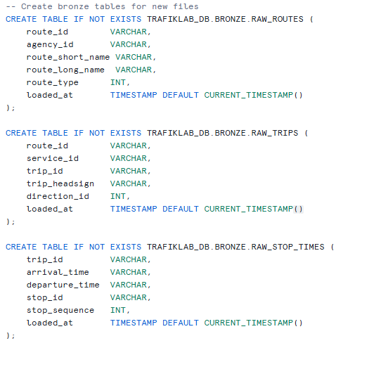
Snowflake Bronze Table Setup

Slide 13
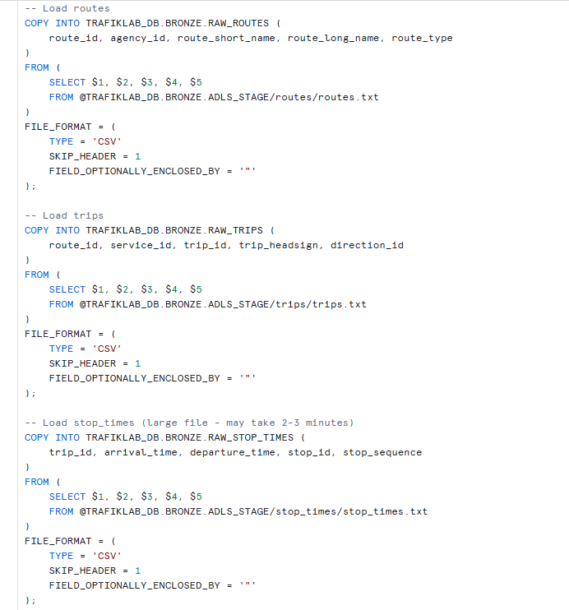
Snowflake COPY INTO Bronze

Slide 14
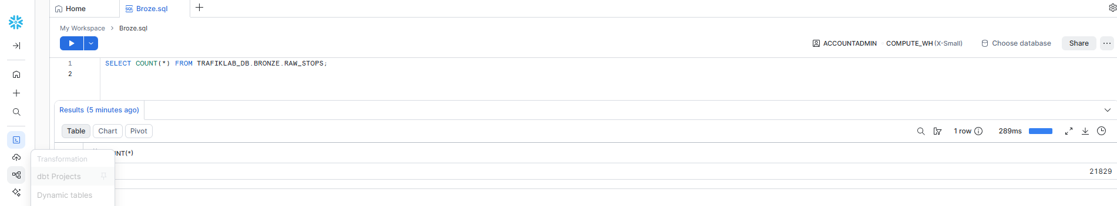
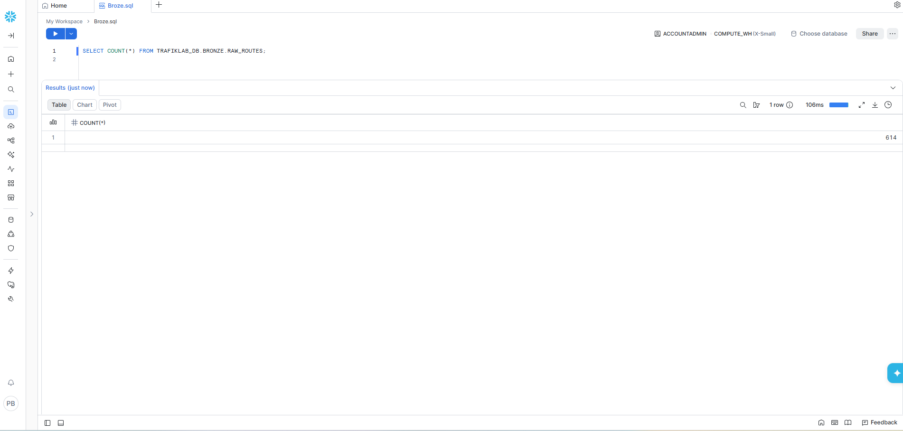
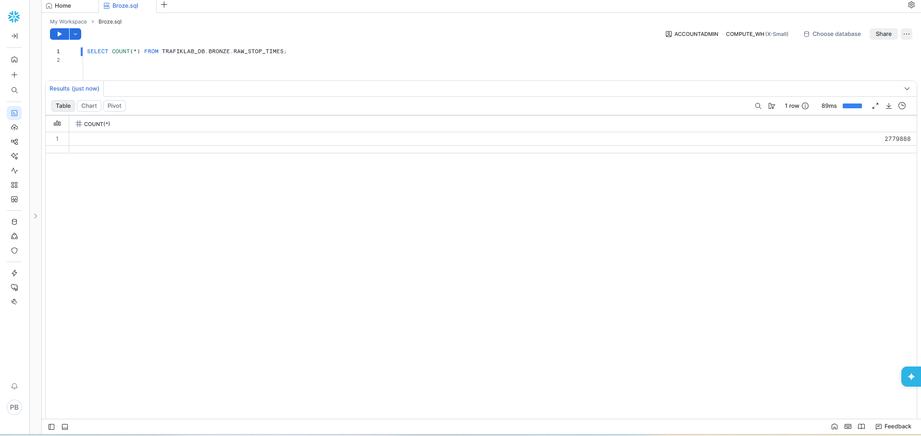

Slide 15

SNOWFLAKE MEDALLION ARCHITECTURE
BRONZE
Raw data exactly as received
RAW_STOPS · RAW_ROUTES · RAW_TRIPS · RAW_STOP_TIMES
VARIANT type preserves original — safe to reprocess
21,829 stops · 614 routes · 138K trips · 2.78M stop times
SILVER
Cleaned, typed, validated
stg_stops · stg_routes · stg_stop_times
NULL filtering, type casting, transport mode mapping
Views built by dbt — always fresh from bronze
GOLD
Aggregated for consumption
fct_busiest_stops · fct_departures_by_hour · fct_routes_by_mode
Power BI reads only from here — no raw data exposure
11,809 stops ranked · 24hr pattern · 5 transport modes
COPY INTO from ADLS External Stage using SAS token stored in Key Vault — credentials never exposed in code

Slide 16
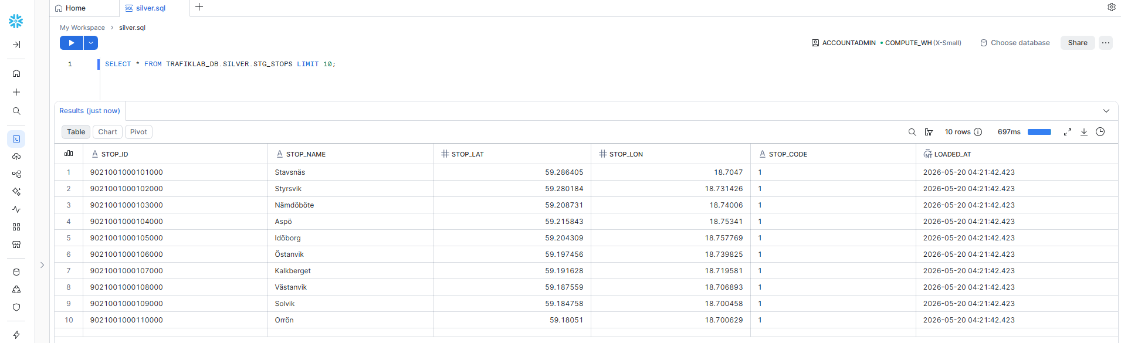
Snowflake Silver Layer (dbt)

Slide 17
SNOWFLAKE MEDALLION ARCHITECTURE
BRONZE
Raw data exactly as received
RAW_STOPS · RAW_ROUTES · RAW_TRIPS · RAW_STOP_TIMES
VARIANT type preserves original — safe to reprocess
21,829 stops · 614 routes · 138K trips · 2.78M stop times
SILVER
Cleaned, typed, validated
stg_stops · stg_routes · stg_stop_times
NULL filtering, type casting, transport mode mapping
Views built by dbt — always fresh from bronze
GOLD
Aggregated for consumption
fct_busiest_stops · fct_departures_by_hour · fct_routes_by_mode
Power BI reads only from here — no raw data exposure
11,809 stops ranked · 24hr pattern · 5 transport modes
COPY INTO from ADLS External Stage using SAS token stored in Key Vault — credentials never exposed in code

Slide 18
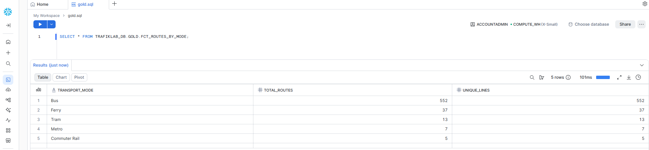
Snowflake Gold Layer (dbt)

Slide 19
DBT CLOUD — TRANSFORMATION LAYER
Data quality + lineage
Data Lineage Graph
bronze.RAW_STOPS
→
stg_stops (silver)
→
fct_busiest_stops (gold)
dbt Models
Data Quality Tests
stg_stops.sql
Silver · View
Cleans + filters raw stops
not_null on stop_id
PASS ✓
stg_routes.sql
Silver · View
Maps route types to modes
unique on stop_id
PASS ✓
stg_stop_times.sql
Silver · View
Extracts departure hours
fct_busiest_stops.sql
Gold · Table
Ranks stops by departures
not_null on stop_name
PASS ✓
fct_departures_by_hour.sql
Gold · Table
Hourly demand pattern
dbt build (all models)
6/6 PASS ✓
fct_routes_by_mode.sql
Gold · Table
Network by transport type

Slide 20
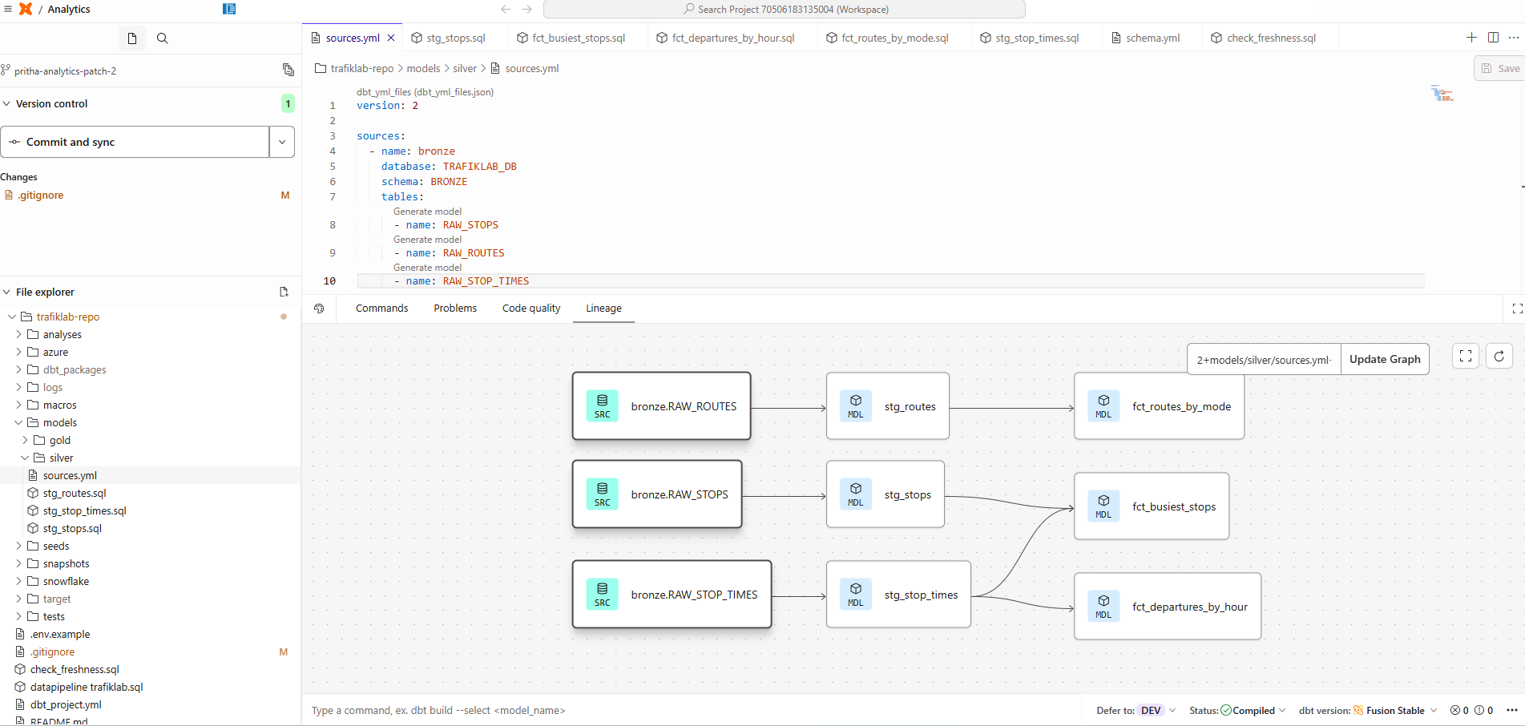
Dbt – Source & Models Configuration

Slide 21
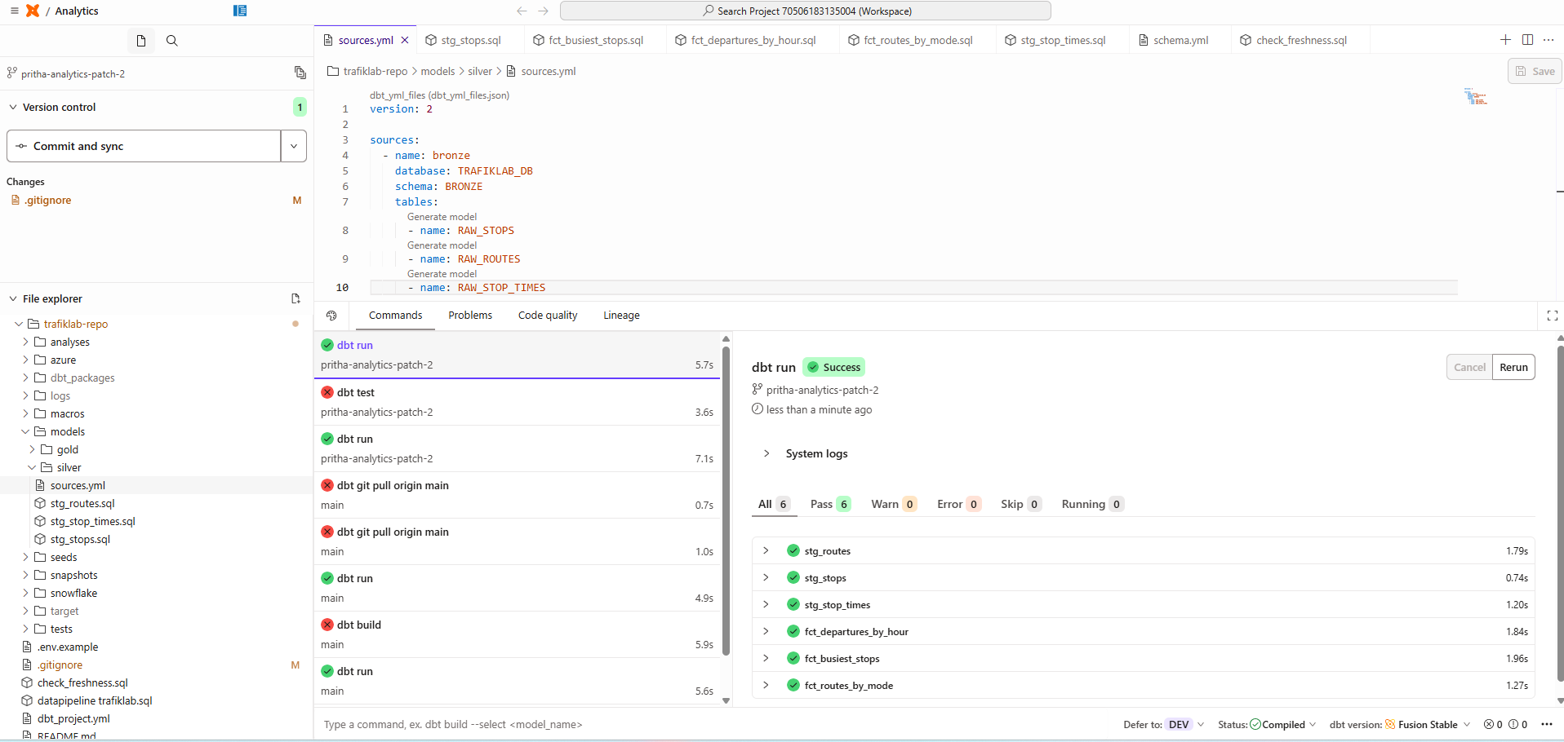
dbt Silver & Gold Model

Slide 22
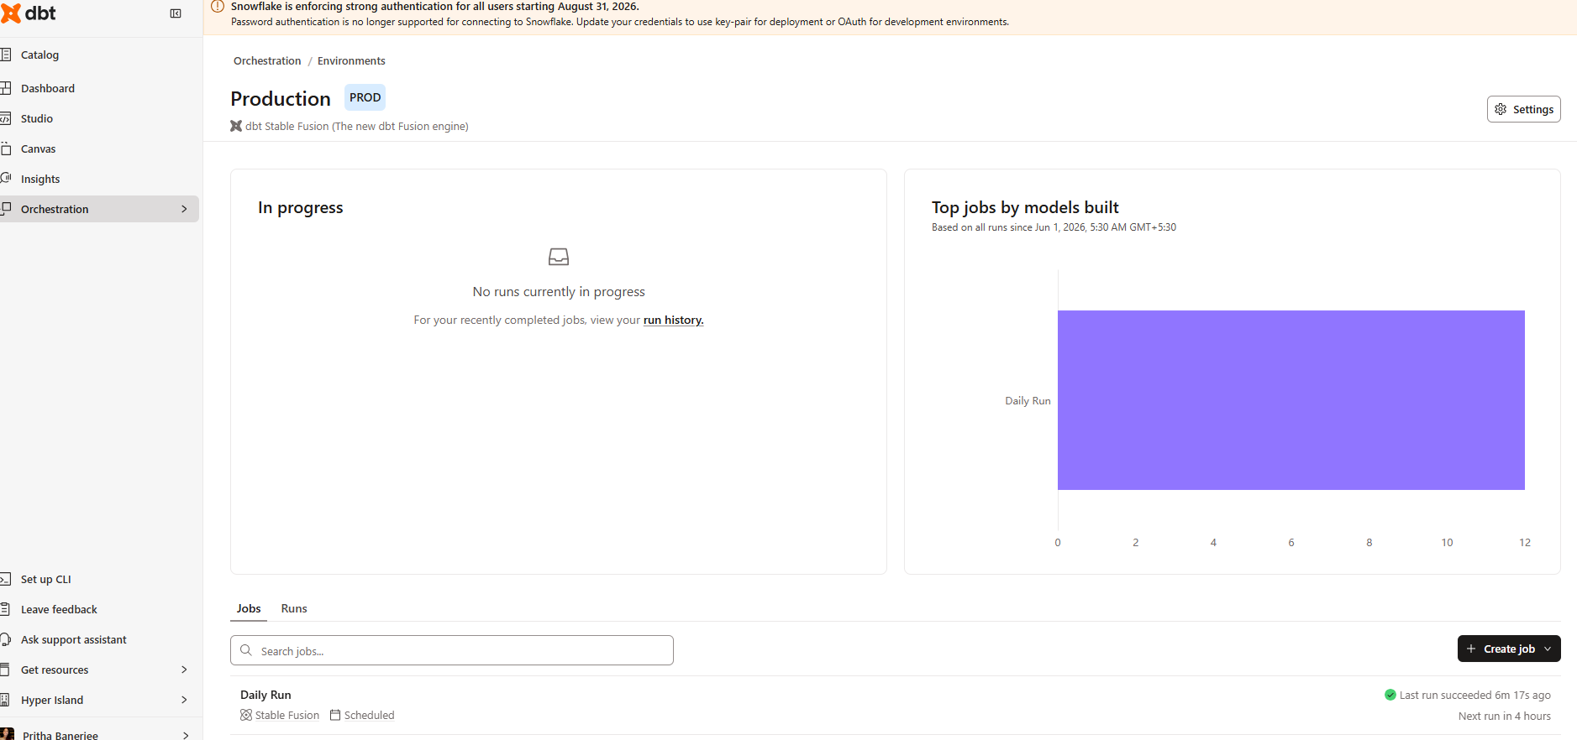
dbt Daily run on Production

Slide 23
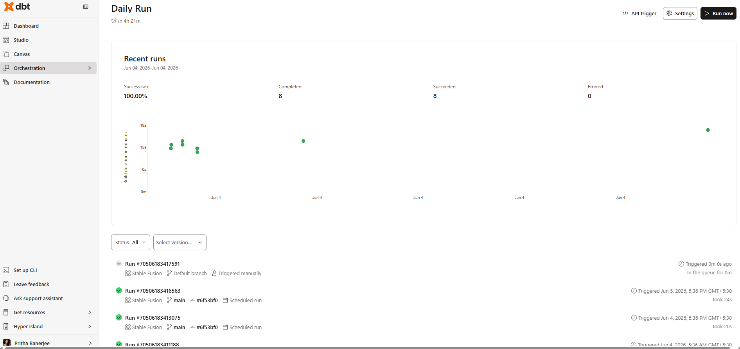
dbt Daily run on Production

Slide 24
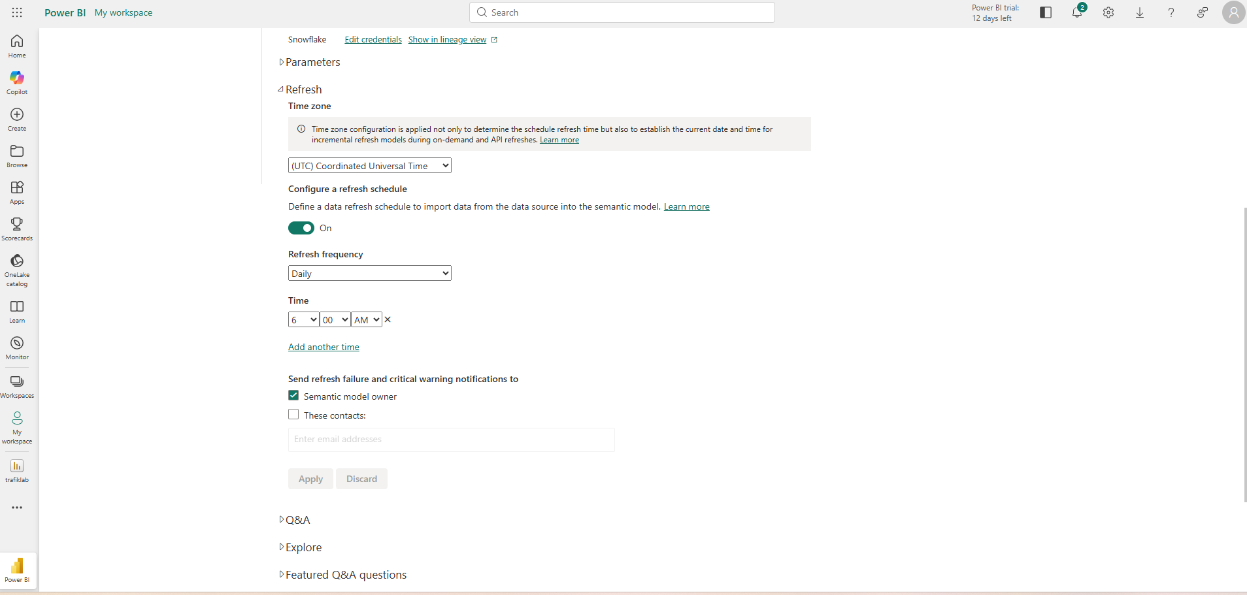
Power Bi Scheduled Refresh

Slide 25
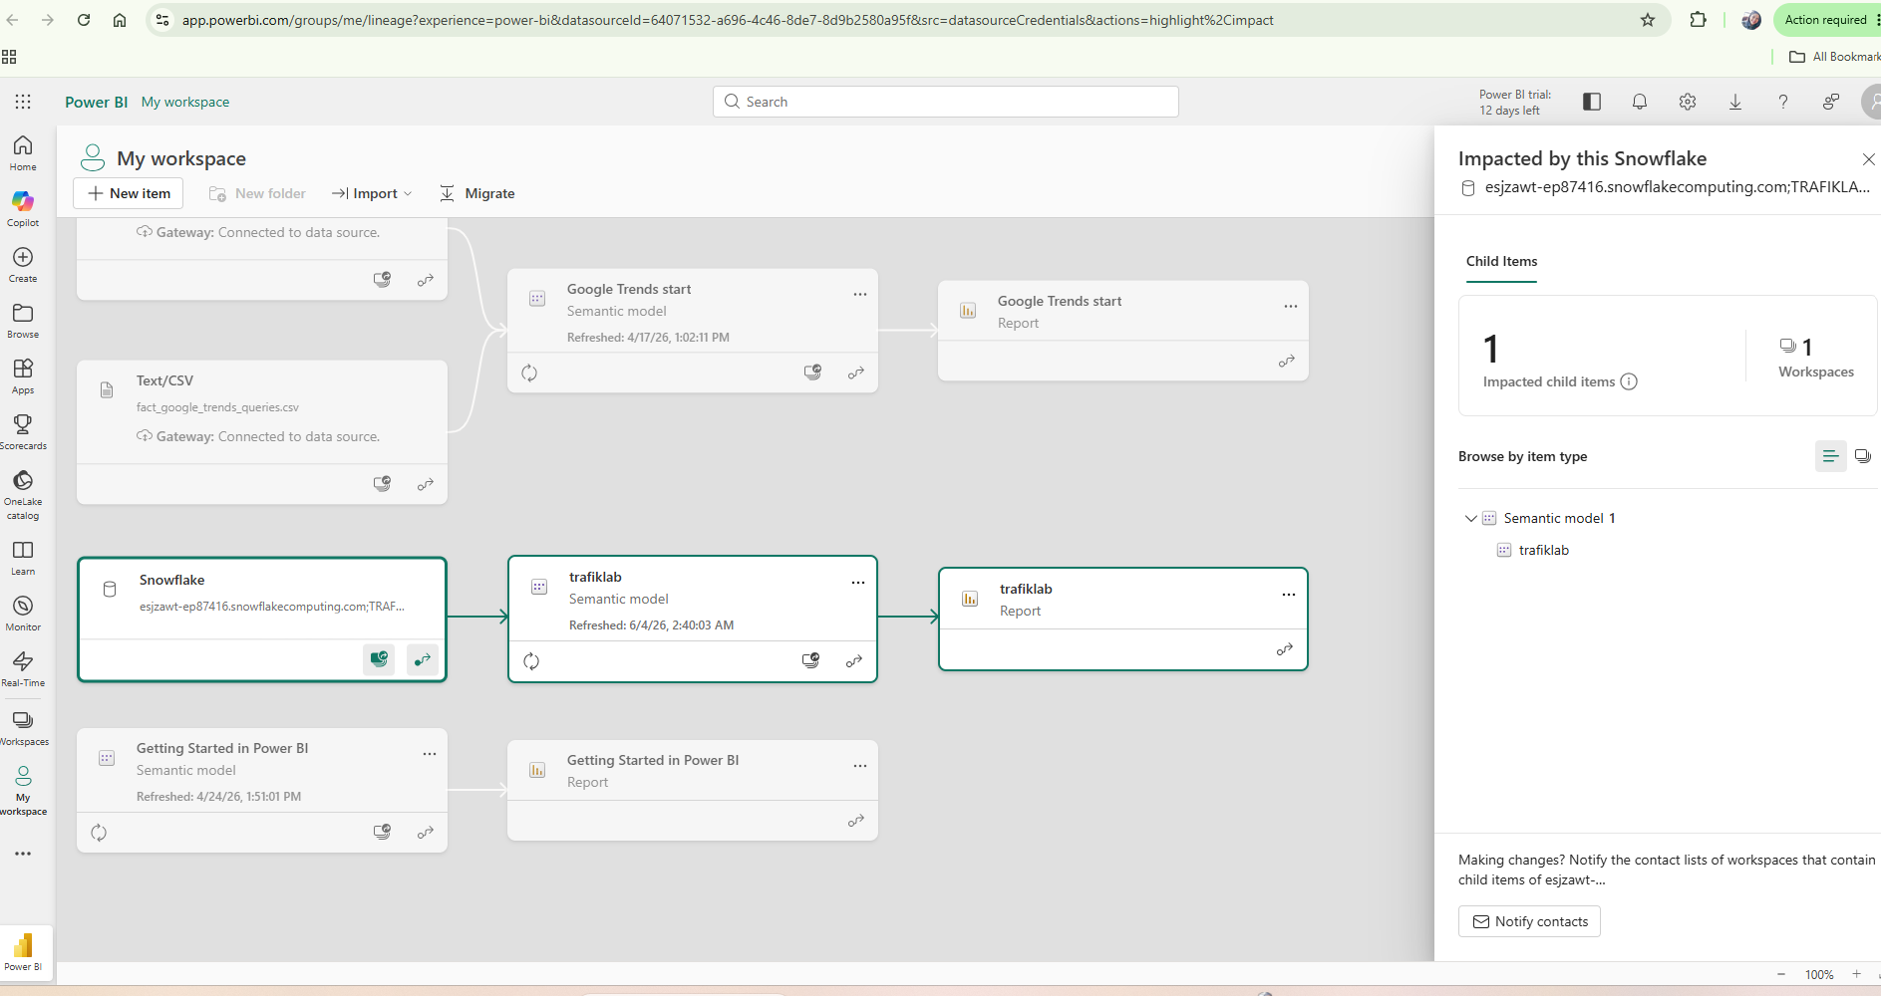
Power Bi Connected to Snowflake Gold Layer

Slide 26
KEY INSIGHTS
What the data tells us
🚌 Bus Dominates
89.9% of all routes are bus — Stockholm's network is overwhelmingly bus-dependent
⏰ Evening Peak at 17:00
🌙 24-Hour Service
Demand peaks at 16-17:00, not morning — suggesting asymmetric commuter patterns
Service runs from 05:00 to 23:00 — night service is minimal across all modes

Slide 27
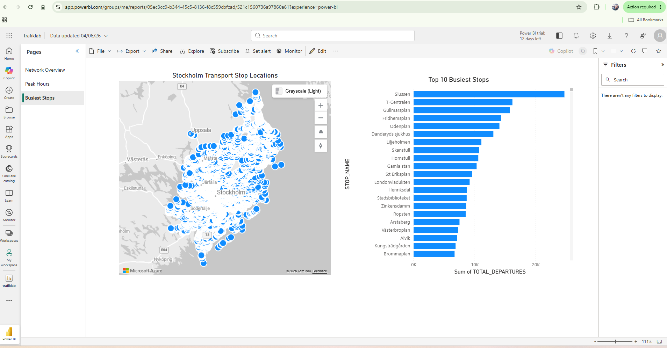
Key Insights
📍 Busiest Stop: Slussen
Slussen has ~20K daily departures — the single most connected interchange in Stockholm

Slide 28
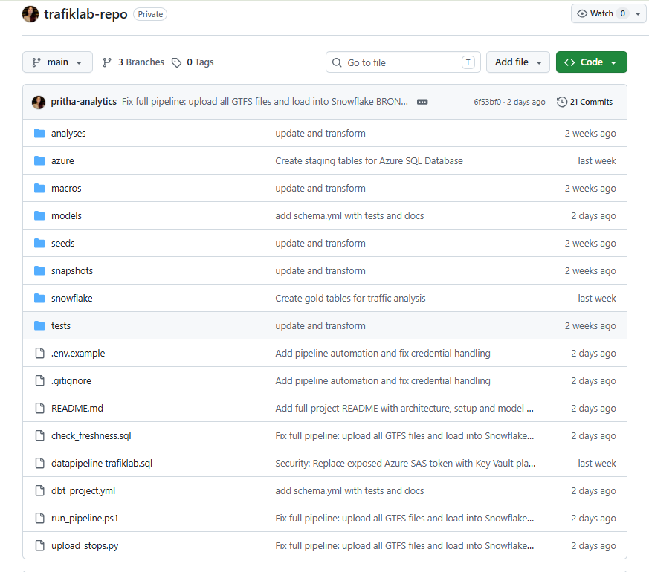
GitHub Repo

Slide 29
Thank You
Questions welcome
→ Real Trafiklab data — 21,829 stops, 614 routes, 2.78M scheduled departures
→ Full Azure cloud pipeline with security by design
→ Medallion architecture: bronze → silver → gold
→ dbt tests ensuring data quality at every layer
→ Live Power BI dashboard connected to Snowflake
Pritha Banerjee · DA27 · Hyper Island Stockholm · 2026

