Slide 1
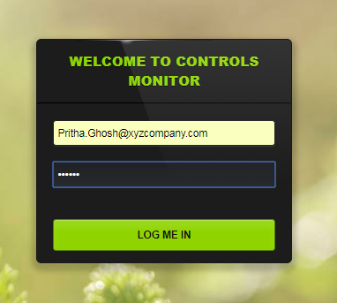
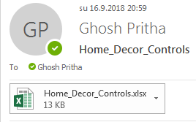

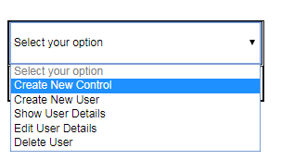
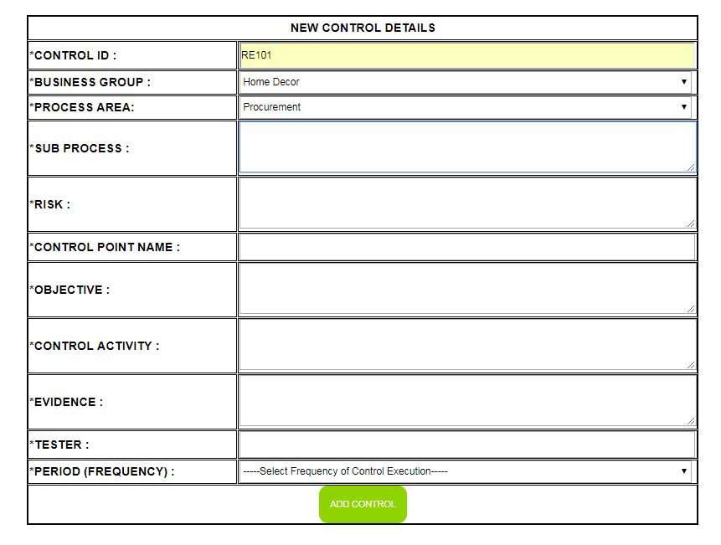
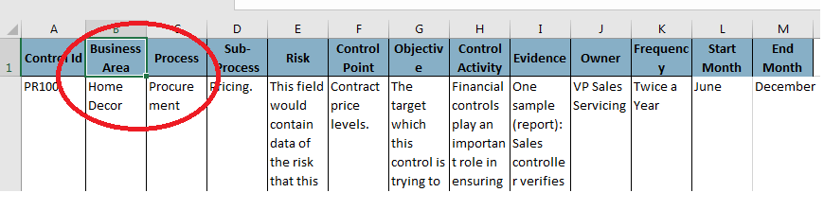
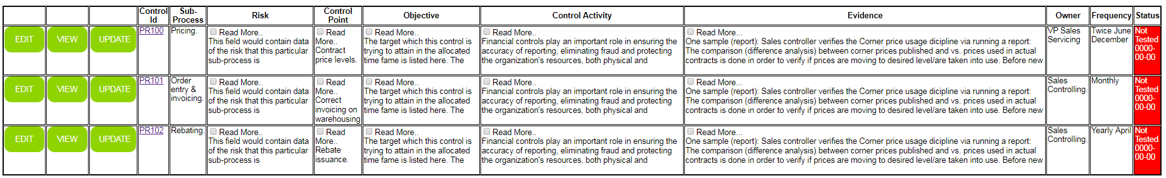
WORKFLOW OF INSERTING NEW CONTROLS IN TOOL
Robot Segregates excels based on BA and attaches name of month when the robot last performed the task, to the folder name
Robot selects ’Create new control’ from maintain page
Robot reads outlook to find control list of business areas
Robot Logs into Tool
Robot selects BA and Process area from the excel
The inserted controls can now be viewed in controls_view_dir.php page
Robot fills in data from the excel one row at a time

Slide 2
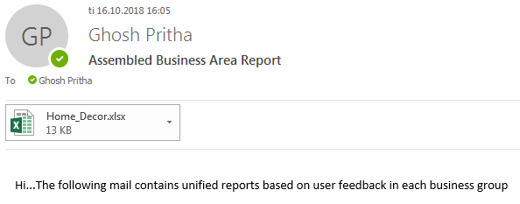
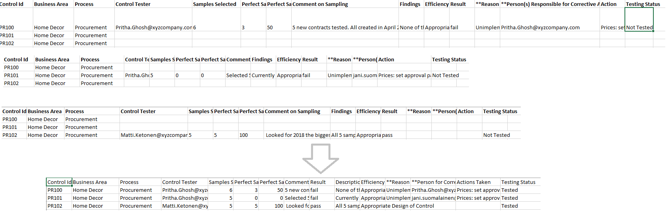
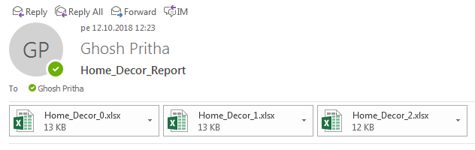

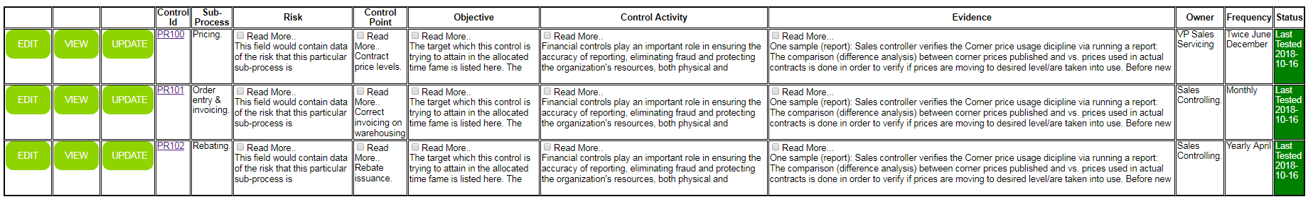
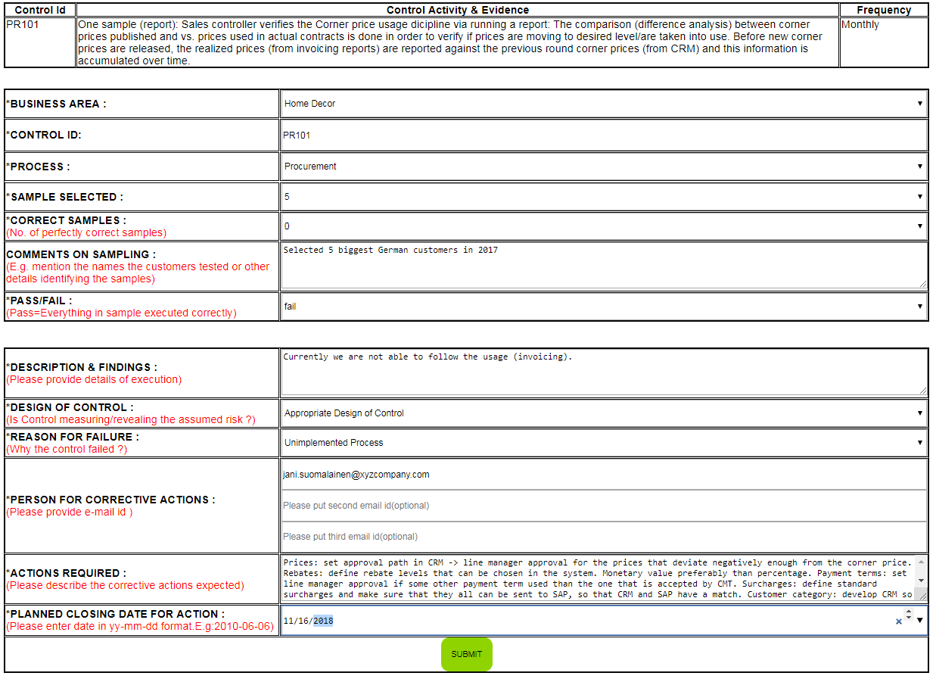
WORKFLOW OF TESTING CONTROLS IN TOOL
Robot stores the invidual feedbacks in a folder grouped by business area
Robot mails user the assembled report in outlook.
Robot finds user feedbacks from outlook
Robot assembles the invidual feedbacks in a single excel sheet and stores in a folder
Once a test is performed successfully the status field changes to green. The user may now see the feedbacks in the tool.
Robot fills in the user feedback data using the test form.
Robot selects the business area and process from the assembled file

