Slide 1


Spotify Tracks Data Analytics
“Discovering the Factors Behind Song Popularity Through Data Science”
Course: Data Science and Visualization (24ADI204)
Team Members:
Prithesa R(25BAD083) Saravanan A(25BAD102) Tejas T(25BAD124)
Viknesh T(25BAD128)
Faculty Name:
Dr.Rupashini

Slide 2


Introduction
What is Spotify?
Spotify is one of the world's leading digital music streaming platforms, providing access to millions of songs, podcasts, and audio tracks. It collects detailed audio features and user engagement metrics that help understand music listening patterns.
Why is Music Data Analysis important?
Helps understand listener preferences. Identify factors affecting song popularity.
Assist artists and producers in creating successful music. Improves Recommendation Systems.
Using data-driven insights.

Slide 3
Problem Statement
The global music industry releases thousands of songs every week. While streaming platforms provide numerous audio features for each song, identifying the characteristics that contribute to song popularity remains a challenge.
This project applies Data Science techniques to analyze Spotify tracks, clean the dataset, explore hidden patterns, and identify relationships between musical features and popularity.

Slide 4

Analyze a real-world Spotify dataset
Assess data quality and perform preprocessing
Identify missing values, duplicates, and outliers
Objectives
Perform Exploratory Data Analysis (EDA)
Discover relationships between audio features
Prepare the dataset for machine learning Generate meaningful business insights

Slide 5
Dataset Description
Dataset Name:Spotify Tracks Dataset(Updated Every Week)
Source: Kaggle
Dataset Type: Music Analytics
File Format: CSV FIle
Important Features:
Track ID Artist Name Track Name Album Name Popularity Danceability
Tempo Duration Language Energy Loudness Acousticness
Target Variable: Popularity(0-100)

Slide 6
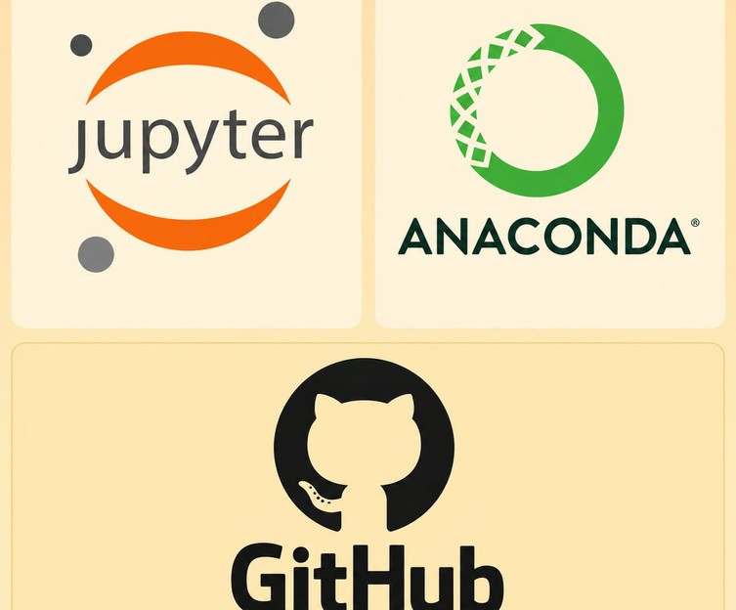
Technologies Used
Programming Language:Python Libraries:
Pandas NumPy Matplotlib Seaborn
Scikit-learn (Phase 2)
Development Environment: Jupyter Notebook Anaconda
GitHub

Slide 7


Methodology
Dataset Collection
↓
Data Understanding
↓
Data Cleaning
↓
Data Preprocessing
↓
Exploratory Data Analysis
↓ Visualization
↓ Insights
↓
Machine Learning (Future Phase)

Slide 8


Data Understanding & Data Quality Assessment
Data Understanding:
Loaded the dataset using Pandas.
Examined dataset dimensions (rows and columns). Reviewed column names and data types.
Generated descriptive statistics for numerical features.
Data Quality Assessment: Checked for missing values. Identified duplicate records. Examined data consistency.
Verified feature distributions before preprocessing
Some Key Functions:
df.info() df.describe()
df.isnull().sum()
df.duplicated().sum()
df.

Slide 9

Data Cleaning & Preprocessing
Data Cleaning:
Removed duplicate records. Handled missing values.
Corrected inconsistent data types. Detected outliers using box plots and IQR.
Data Preprocessing:
Selected relevant features.
Prepared data for Exploratory Data Analysis.
Organized the cleaned dataset for future machine learning
Some Key Functions:
fillna() – Handle Missing Values replace() – Replace Incorrect Values astype() – Convert Data Types

Slide 10
Analysis Pewrformed
Univariate Analysis: Popularity Distribution Danceability Distribution Energy Distribution Language Distribution
Bivariate Analysis: Popularity vs Danceability Popularity vs Energy Energy vs Loudness Language vs Popularity
Correlation Analysis:
Heatmap of numerical features
Exploratory Data Analysis (EDA)

Slide 11

Results and Insights
Most tracks have medium popularity.
Energy and loudness are strongly related. Danceability influences popularity to some extent. Outliers exist in tempo and duration.
The dataset is suitable for predictive modeling after preprocessing

Slide 12
Future Work
Next Phase
In the next phase, the project will include: Feature Engineering
Data Scaling Encoding
Train-Test Split
Machine Learning Models Linear Regression Random Forest Decision Tree
Model Evaluation
Interactive Dashboard (Streamlit/Plotly) Business Insights and Storytelling

