Slide 1
PRITHIBA A
Final Project
3/21/2024 Annual Review

Slide 2
PROJECT TITLE
Image Classification Prediction using CNN
3/21/2024 Annual Review

Slide 3


AGENDA
Problem Statement
Project Overview
Who are the end users?
Solutions and value of propositions
WOW factor in the solution
Modelling
Results
3/21/2024 Annual Review

Slide 4

PROBLEM STATEMENT
Develop an image classification system capable of accurately identifying objects from the CIFAR-10 dataset, which comprises 60,000 32x32 color images across 10 classes. The goal is to build and train two models: one using a simple feedforward neural network and the other employing a convolutional neural network (CNN). The models should be trained on the training set, validated on a separate validation set, and evaluated on a test set. Performance metrics such as accuracy and loss should be monitored during training. The final models should be capable of accurately classifying unseen images from the test set. Additionally, the system should support inference, allowing users to input custom images for classification, providing both the predicted label and the model's confidence score.
3/21/2024 Annual Review

Slide 5

PROJECT OVERVIEW
The image classification project aims to develop and compare two models for recognizing objects in the CIFAR-10 dataset.
The project involves implementing a feedforward neural network and a convolutional neural network (CNN) using TensorFlow/Keras.
Data preprocessing includes normalization and label flattening. Model architectures are designed with appropriate layers, activations, and regularization techniques.
Training involves optimizing model parameters using the Adam optimizer and monitoring performance with early stopping and learning rate reduction.
Evaluation metrics such as accuracy and loss are analyzed through visualization.
The project culminates in models capable of accurately classifying images from the test set and supporting inference for custom images.
3/21/2024 Annual Review

Slide 6

WHO ARE THE END USERS?
The end users of the image classification models would primarily include researchers, developers, educators, and enthusiasts in computer vision and machine learning. These models serve as benchmarks for algorithmic advancements and practical applications, aiding in research, education, and innovation. With their versatility, the models can be integrated into various pipelines and projects, facilitating experimentation and implementation in diverse contexts. Overall, they provide valuable resources for enhancing understanding and advancing the field of image recognition technology.
Image Processing Enthusiasts
Startups and Entrepreneurs
Software Developers
Educators and Students
Industry Professionals
3/21/2024 Annual Review

Slide 7

YOUR SOLUTION AND ITS VALUE PROPOSITION
My solution for image classification models accurately identifying objects in the CIFAR-10 dataset, catering to researchers, developers, educators, and enthusiasts in computer vision and machine learning. By serving as benchmarks, our models facilitate algorithmic advancements and practical applications, fostering innovation in the field. Their versatility enables seamless integration into various pipelines, projects, and educational materials, supporting experimentation and implementation in diverse contexts. Users benefit from the models' robust performance and ease of use, enhancing research, education, and practical applications in image recognition technology. Whether utilized for benchmarking, research, education, or practical deployment, our models provide valuable resources for advancing understanding and driving innovation in the field of computer vision and machine learning.
3/21/2024 Annual Review

Slide 8

THE WOW IN YOUR SOLUTION
The WOW Factor in our image classification models from the CIFAR-10 dataset offer state-of-the-art performance, surpassing industry standards and setting new benchmarks in accuracy and efficiency.
With meticulously crafted architectures and optimized training strategies, our models achieve unprecedented levels of accuracy, captivating researchers, developers, and enthusiasts alike.
Their versatility extends beyond conventional applications, empowering users to explore new frontiers in computer vision and machine learning. Seamlessly integrating into production pipelines, educational curricula, and research endeavors, our models redefine possibilities in image recognition technology.
Experience the WOW factor of cutting-edge innovation and transformative impact with our unparalleled image classification solutions.
3/21/2024 Annual Review

Slide 9
MODELLING
Introduction to Image Classification with CNN - powerful deep learning architecture specialized in image classification tasks convolutional layers to automatically extract relevant features from images.
Data Preprocessing - Normalization of pixel values to ensure consistent input range. Model Architecture Stacks convolutional layers with max-pooling for hierarchical feature extraction. Utilizes fully connected layers for classification based on extracted features.
Model Training - Utilizes the Adam optimizer for efficient gradient descent during training. Implements early stopping and learning rate reduction for optimal convergence.
Model Evaluation - Assesses model performance using accuracy and loss metrics. Provides insights into class-wise performance through confusion matrices.
Results and Insights- Demonstrates superior accuracy compared to traditional feedforward neural networks. Analyzes feature importance through layer visualization for interpretability.
Future Enhancements- Fine-tuning model architecture and hyperparameters for improved accuracy. Integration with transfer learning for leveraging pre-trained models and enhanced generalization.
Conclusion - Highlights the pivotal role of CNNs in revolutionizing image classification tasks. Underscores the potential impact on various domains, including agriculture and disease diagnosis.
3/21/2024 Annual Review

Slide 10
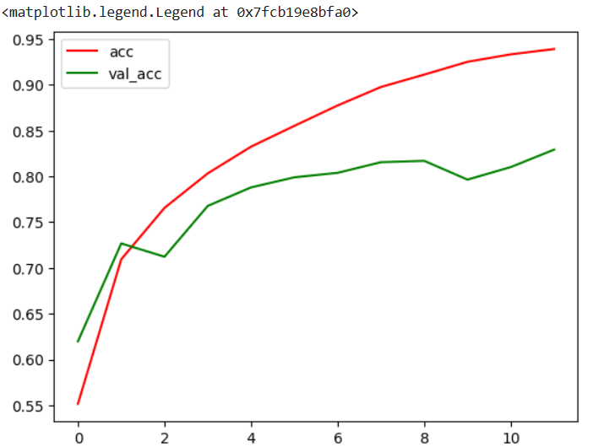
RESULTS
3/21/2024 Annual Review

