Slide 1



CO OP RPG GAME
Presented By,
KAVIN KIRTHIK RP (811722104071)
MUHUNDHAN S (811722104095)
PRITHICK ROSHAN (811722104113)
Guided By,
Mr. R .RAJAVARMAN , M.E.(Ph.D.,)
09/06/2025

Slide 2

ABSTRACT
This project presents a Co-op Competitive Game where players form teams and work together to compete against rival teams in dynamic, objective-based challenges. Combining the excitement of competition with the necessity of teamwork, the game encourages strategic coordination, shared resource management, and real-time decision-making. Success depends not just on individual performance but on how well players collaborate under pressure, making it both thrilling and socially engaging.
09/06/2025

Slide 3
OBJECTIVE
In this co-op RPG, players must work together to infiltrate enemy territory, facing a series of strategic challenges that require both tactical planning and teamwork. The journey begins with the players entering hostile zones, where they must carefully navigate through enemy defenses, avoiding or engaging patrols, and overcoming environmental obstacles. As they progress, they will encounter waves of enemies, from basic foot soldiers to powerful elites, each requiring different combat strategies.
09/06/2025

Slide 4
LITERATURE SURVEY
S.No. | Paper Title | Year | Remark
1 | Design Patterns for Cooperative MultiplayerGamesAuthors:ClaraFernández-Vara,MiguelSicart | 2012 | providing a structural lens for developers to create more engaging and organized cooperative systems. It’s valuable for those building gameplay architecture.
2 | Cooperative Game Design: Communication, Coordination, and Shared Goals | 2015 | This work emphasizes how shared goals and effective team dynamics enhance user experience and immersion.
3 | Enhancing Player Engagement in RPGs Through Multiplayer Dynamics | 2017 | narrative games boosts player connection and satisfaction.
09/06/2025

Slide 5
LITERATURE SURVEY
S.No. | Paper Title | Year | Remark
4 | Adaptive Dialogue and Narrative Systems in Cooperative Role-Playing Games | 2020 | Focuses on adaptive narratives and dialogue systems, showing how co-op experiences can be tailored based on player interactions.
5 | User Experience Evaluation in Online Co-op RPGs | 2021 | Provides a user experience evaluation framework for online co-op RPGs, using empirical data.
6 | Game Mechanics That Encourage Cooperation in RPGs | 2016 | Discusses specific game mechanics (like shared inventory, combo attacks, or cooperative quests) that drive teamwork in RPGs.
09/06/2025

Slide 6
LITERATURE SURVEY
S.No. | Paper Title | Year | Remark
7 | Multiplayer RPGs and Social Learning | 2019 | Links multiplayer RPGs with social learning, arguing that co-op games encourage collaboration, empathy, and peer-based learning.
8 | Game Mechanics That Encourage Cooperation in RPGs | 2016 | Builds on their earlier work by refining how mechanical incentives (e.g., bonus rewards for team effort) can be used to enhance cooperation
9 | The Impact of Class Systems on Co-op Gameplay in RPGs | 2022 | Analyzes the effect of class systems (e.g., tank, healer, damage dealer) on co-op gameplay, showing how diverse roles support better teamwork and game balance.
09/06/2025

Slide 7
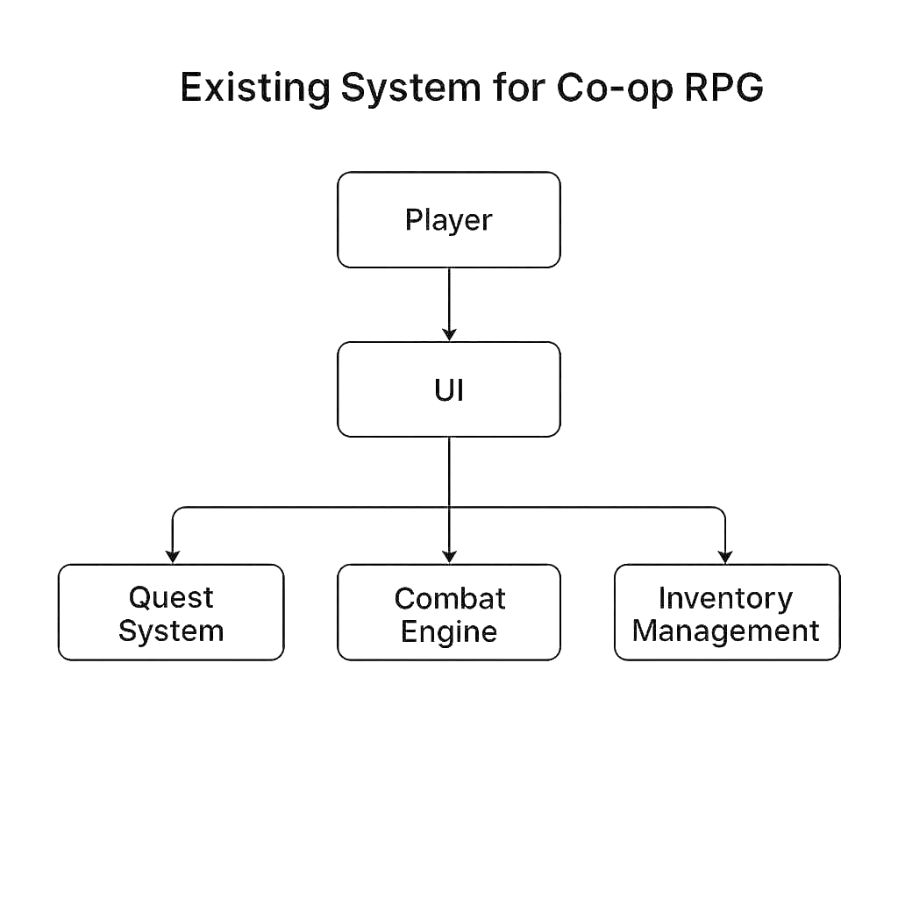
EXISTING SYSTEM
09/06/2025

Slide 8
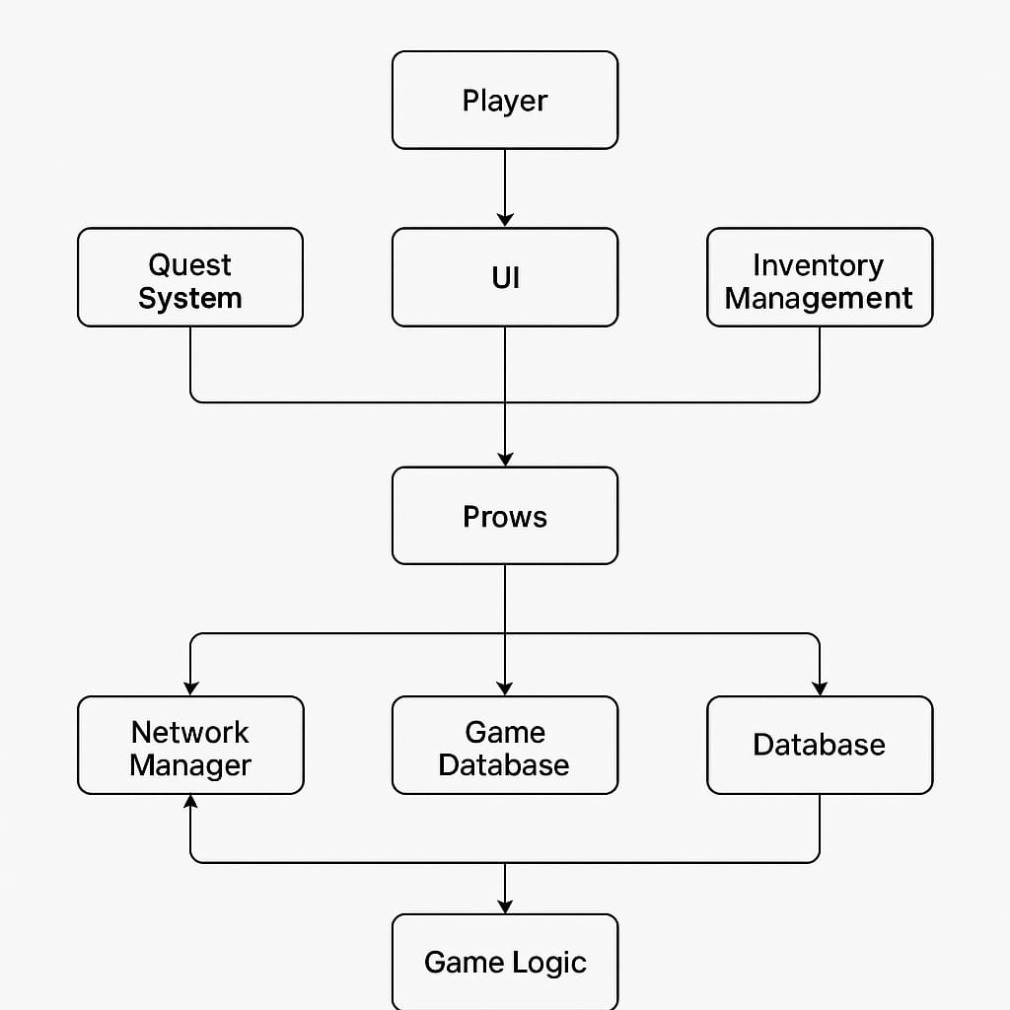
PROPOSED SYSTEM
Excel
Word
09/06/2025

Slide 9
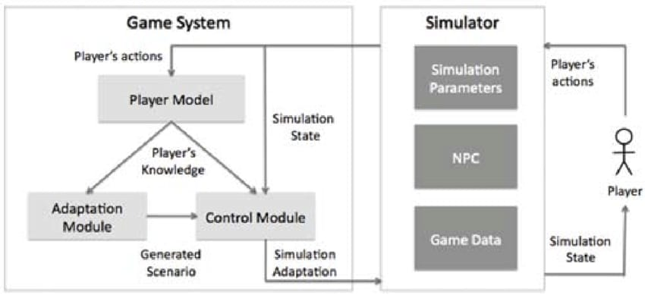
SYSTEM ARCHITECTURE
Rule based access control
09/06/2025

Slide 10
MODULE 1 : CHARACTER CREATION MODULE
Briefly explain the purpose of character creation (e.g., customize a unique hero for the game).
Follow the steps below to create your character. Choose carefully, as each choice will affect your abilities and role in the game.
Players can design their own character by choosing races, classes, appearance, and skills.
Includes a stat and skill selection menu that impacts the gameplay.
09/06/2025

Slide 11
MODULE 2 :COMBAT MODULES
Introduce the combat module to the players, explaining the overall structure and purpose of combat within the game.
In this game, combat is an essential part of progression. Players will face off against enemies, whether in small skirmishes or large-scale battles. Effective teamwork, strategy, and understanding your character's abilities will be key to victory.
Players can design their own character by choosing races, classes, appearance, and skills.
Includes a stat and skill selection menu that impacts the gameplay.
09/06/2025

Slide 12
MODULE 3 : QUEST MODULE
Explain the purpose of the quest system in the game and how it drives player progression.
Quests are the core of our RPG experience. They guide players through the game’s world, telling stories, presenting challenges, and rewarding players with items, experience, and new abilities. Quests come in various forms, from main story arcs to side adventures. Choose wisely, as each quest will shape your journey.
A system that allows the player to take on quests, track progress, and receive rewards.
Interactive dialogue and decision-making that influence the quest outcomes.
09/06/2025

Slide 13
MODULE 4 :NPC INTERACTION SYSTEM:
Provide an introduction to the role of NPCs in the game world, explaining their importance in the gameplay loop.
Non-Player Characters (NPCs) are the heart of your game’s world. They provide quests, offer information, sell items, and shape the narrative. Interacting with NPCs allows you to gain new objectives, unlock new storylines, and influence the world around you. Each NPC has a unique role, background, and personality.
Non-playable characters (NPCs) that the player can talk to, trade with, or engage in combat.
NPCs have schedules and can interact with the player based on their choices.
09/06/2025

Slide 14
MODULE 5 : OFFLINE CO OP MODULE
Detects and handles errors when speech recognition fails or misinterprets commands.
Provides text or voice feedback to notify users about unrecognized or incorrect commands.
Implements fallback mechanisms, such as re-prompting users or suggesting alternative commands.
Ensures smooth user experience by preventing unexpected crashes and handling Office automation errors.
09/06/2025

Slide 15
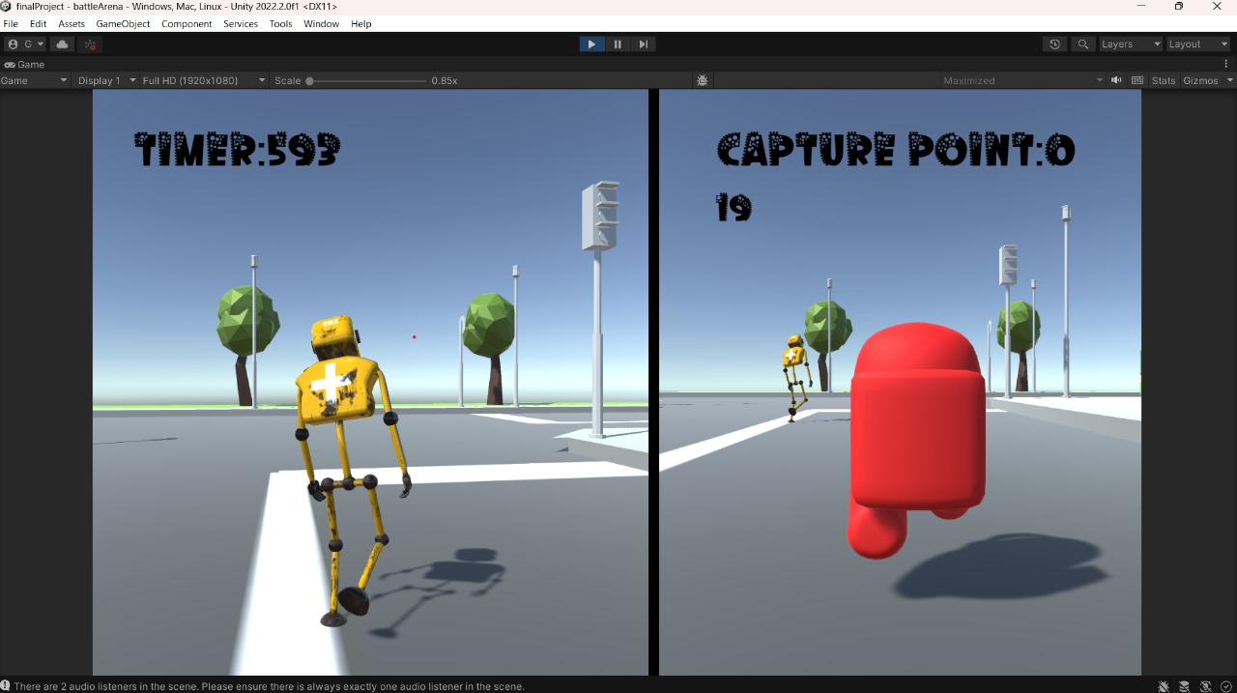
OUTPUT
09/06/2025

Slide 16
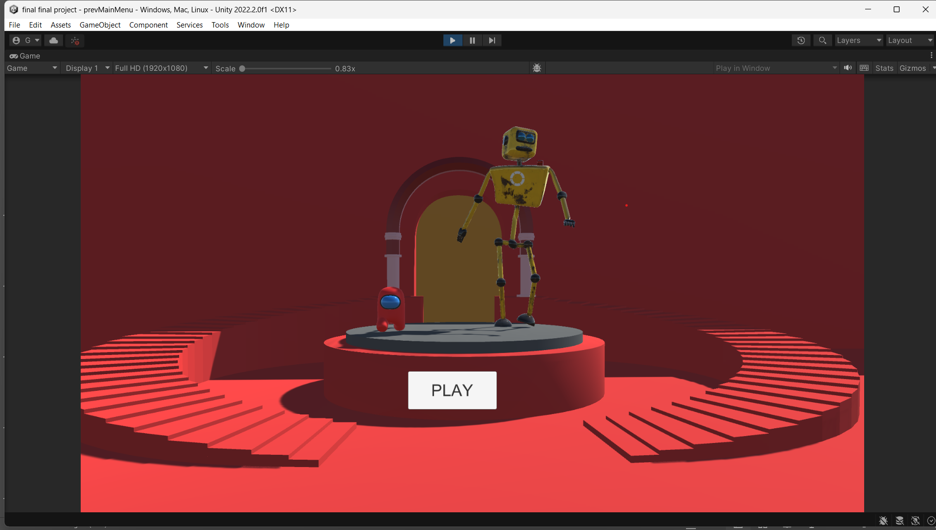
OUTPUT
09/06/2025

Slide 17
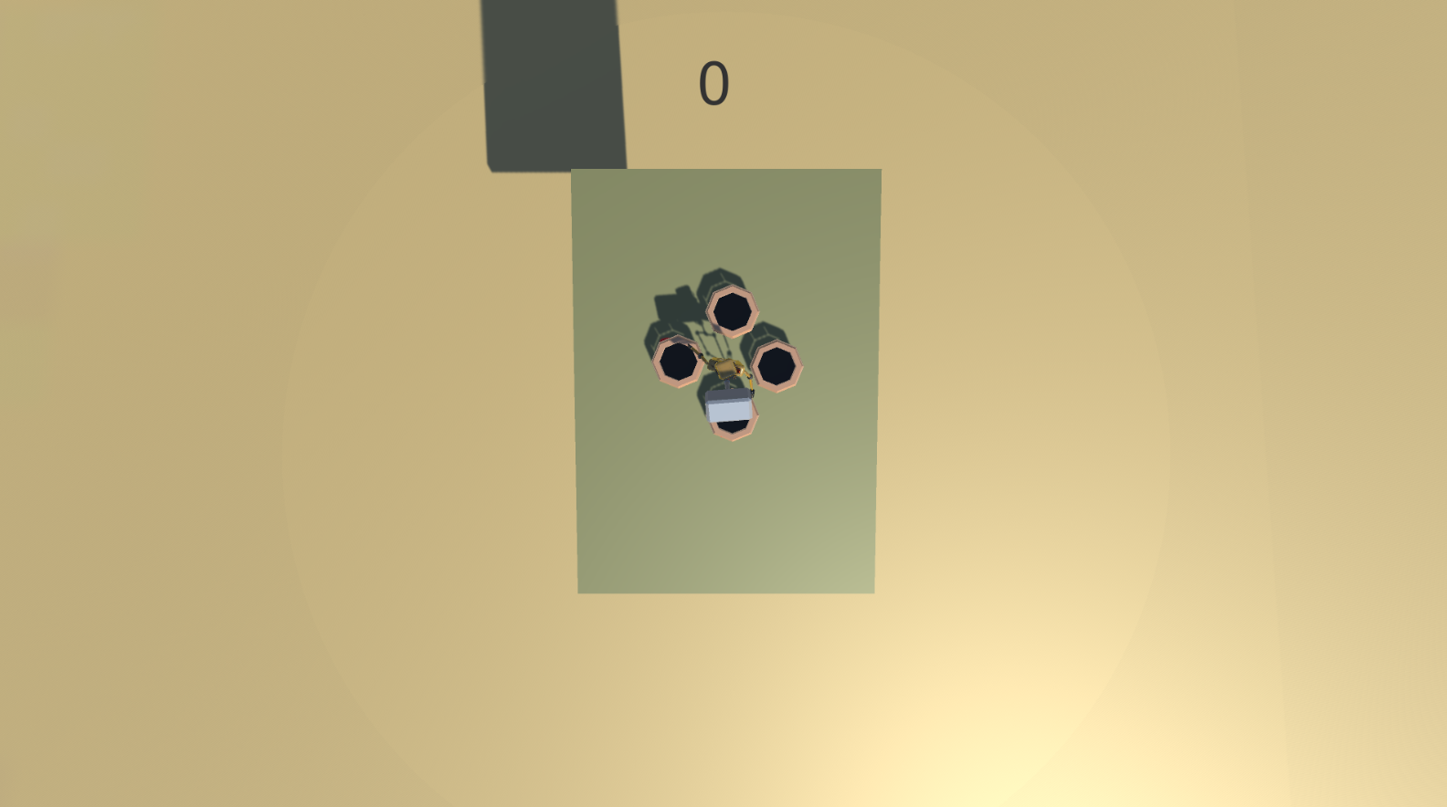
OUTPUT

Slide 18
CONCLUSION & FUTURE ENHANCEMENT
Immersive Co-op Experience:
The Offline Co-op system allows players to experience the game together without needing an internet connection. By supporting split-screen or shared-screen modes, the game fosters teamwork and collaboration in a rich, social gaming environment.
Future Enhancements:
Additional Co-op Modes:
Introduce new challenge modes, arena battles, or endgame content designed specifically for co-op gameplay. These could involve larger groups, special events, or specific player-versus-environment (PvE) activities.
09/06/2025

Slide 19
REFERENCES
Title:Design Patterns for Cooperative Multiplayer GamesAuthors:ClaraFernández-Vara,MiguelSicartYear: 2012
Title: Cooperative Game Design: Communication, Coordination, and Shared GoalsAuthors: Jonathan Steuer, Patrick M. FitzpatrickYear: 2015
Title: Enhancing Player Engagement in RPGs Through Multiplayer DynamicsAuthors: Emma Carlson, David ReedYear: 2017
Anderson, J., & Zhang, R.* (2020). Adaptive dialogue and narrative systems in cooperative role-playing games. International Journal of Interactive Media
Malik, S., & Bansal, R.* (2021). User experience evaluation in online co-op RPGs. International Journal of Human-Computer Interaction, 37(1), 35-52
09/06/2025

Slide 20

DD/MM/YYYY

