Slide 1



SMARTPHONE
DATASET ANALYSIS
BY:PRITHI KARRAHE

Slide 2

SMARTPHONE DATASET ANALYSIS:
This analysis explores the smartphone market trends in India, China, and the USA over the past three years(2023,2024,2025), focusing on launching prices and mobile phone models,brands and other features like storage,battery,RAM and camera quality. It will examine the competitive landscape..
OBJECTIVE:
-The primary objective of this Smartphone Dataset Analysis is to comprehensively understand the features, specifications, pricing, and trends of various mobile phone - --models across different companies in 3 different countries.
-This helps in making informed decisions for market analysis, product comparison, inventory planning, and consumer insights.
-The goal is to provide a comprehensive overview of the evolving smartphone landscape in these three significant markets.

Slide 3

What is this Dataset for?
This dataset is useful for:
Market research and competitor analysis.
Product development and feature benchmarking.
Pricing and marketing strategy formulation.
Analysis
The dataset covers diverse mobile brands and models with multiple specifications including weight, RAM, camera features, processor, battery capacity, screen size, launch pricing across different countries, and launch year. The dataset enables detailed examination of trends in mobile technology, pricing strategies, and feature distributions.

Slide 4
Current Industry Challenges Addressed by Data Analysis:
Difficulty in comparing vast number of models across brands.
Variability in features that impact user experience and buying decisions.
Price disparities across different markets (India, China, USA).
Identifying emerging technologies in processors and cameras.
Presenting this dataset using SQL
why using SQL?
Structured query language (SQL) is a powerfull programming language for storing and processing information in a relational database. A relational database stores information in tabular form, with rows and columns representing different data attributes and the various relationships between the data values.They serve as the primary means to manage, manipulate, and retrieve data stored in structured formats within databases.

Slide 5
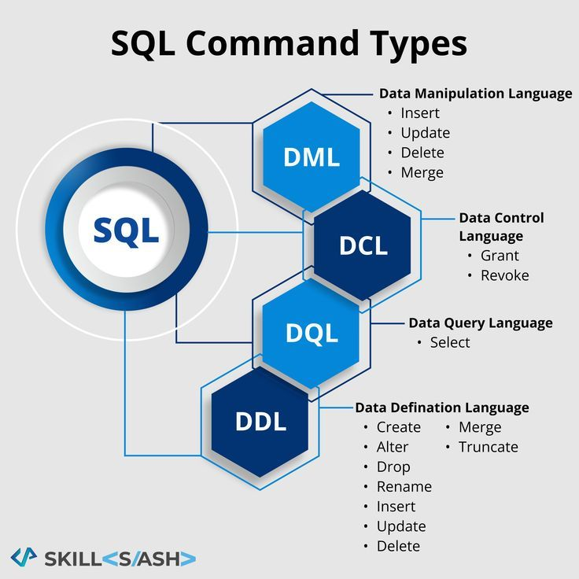
SQL COMMANDS:
SQL commands are used to manage access and permissions in a database. They control who can see, modify, or manage the data and database objects.the sql commands are given below:
Why we use SQL over excel?
SQL is preferred over Excel primarily due to its capabilities in handling large, complex, and relational datasets, as well as its robust features for -
data integrity and collaboration,
Scalability and Performance ,
Relational Data Management.

Slide 6
I have written my queries in mysql.
Frequently used commands in this project are:
Insert: Adds new rows of data into table .
Select :Retrieve data from one or more tables in a database.
Where : This clause is commonly used with SELECT, UPDATE, and DELETE statements.
Group By: Is used to group rows that have the same values in specified columns into summary rows.
Order By: the ORDER BY clause is used to sort the rows in the result set of a query based on one or more columns.
By default, it sorts the data in ascending order. To sort in descending order, the DESC keyword is used.
INNER JOIN: Returns only the rows where there is a match in both tables

Slide 7
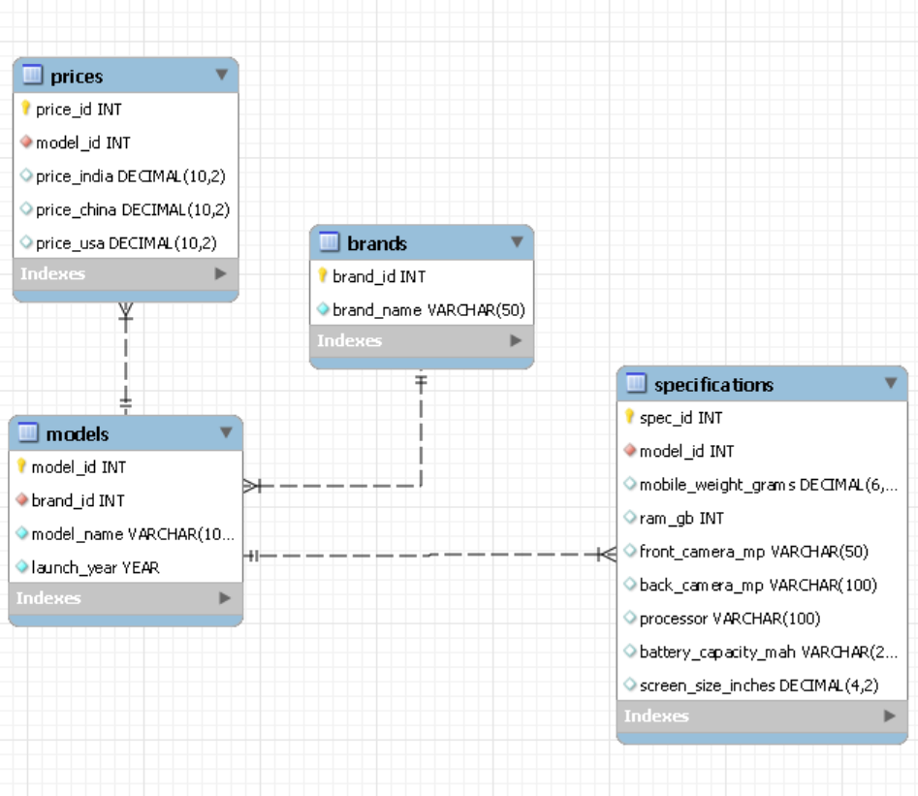
ER-DIAGRAM

Slide 8
Before creating any tables in mysql we need to specify a schema(database) or we can create it and then use that specific schema in which we want to create a table and perform operations.
for creating schema we use:
create schema schema_name;
Ex : create schema my_database;
for using this schema we can use:
use my_database;
Now lets begin with creating tables
1) Brands table — Stores company/brand names
CREATE TABLE Brands (
brand_id INT AUTO_INCREMENT PRIMARY KEY,
brand_name VARCHAR(50) NOT NULL UNIQUE
);

Slide 9
2) Models table — Stores model name, brand reference, and launch year
CREATE TABLE Models (
model_id INT AUTO_INCREMENT PRIMARY KEY,
brand_id INT NOT NULL,
model_name VARCHAR(100) NOT NULL,
launch_year YEAR NOT NULL,
FOREIGN KEY (brand_id) REFERENCES Brands(brand_id));
3) Specifications table — Stores the technical specifications of each model
CREATE TABLE Specifications (
spec_id INT AUTO_INCREMENT PRIMARY KEY,
model_id INT NOT NULL,
mobile_weight_grams DECIMAL(6,2),
ram_gb INT,
front_camera_mp VARCHAR(50),
back_camera_mp VARCHAR(100),
processor VARCHAR(100),
battery_capacity_mah VARCHAR(20),
screen_size_inches DECIMAL(4,2),
FOREIGN KEY (model_id) REFERENCES Models(model_id));

Slide 10
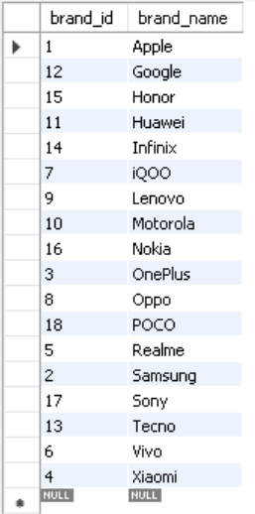
4) Prices table — Stores launch prices in different countries
CREATE TABLE Prices (
price_id INT AUTO_INCREMENT PRIMARY KEY,
model_id INT NOT NULL,
price_india DECIMAL(10,2),
price_china DECIMAL(10,2),
price_usa DECIMAL(10,2),
FOREIGN KEY (model_id) REFERENCES Models(model_id) );
INSERTING DATA INTO TABLES:
1-insert brands
INSERT INTO Brands (brand_name) VALUES
('Apple'),
('Samsung'),
('OnePlus'),
('Xiaomi'),
('Realme'),
('Vivo'),
('iQOO'),
('Oppo'),

Slide 11
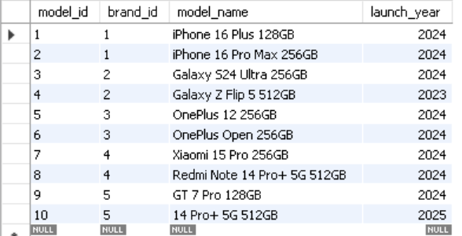
('Lenovo'),
('Motorola'),
('Huawei'),
('Google'),
('Tecno'),
('Infinix'),
('Honor'),
('Nokia'),
('Sony'),
('POCO');
select * from Brands;
2-Insert models
INSERT INTO Models (brand_id, model_name, launch_year) VALUES
(1, 'iPhone 16 Plus 128GB', 2024),
(1, 'iPhone 16 Pro Max 256GB', 2024),
(2, 'Galaxy S24 Ultra 256GB', 2024),
(2, 'Galaxy Z Flip 5 512GB', 2023),
(3, 'OnePlus 12 256GB', 2024),
(3, 'OnePlus Open 256GB', 2024),
(4, 'Xiaomi 15 Pro 256GB', 2024),
(4, 'Redmi Note 14 Pro+ 5G 512GB', 2024),
(5, 'GT 7 Pro 128GB', 2024),
(5, '14 Pro+ 5G 512GB', 2025);
select * from Models ;

Slide 12
3 – Insert Specifications
INSERT INTO Specifications (
model_id, mobile_weight_grams, ram_gb, front_camera_mp, back_camera_mp, processor, battery_capacity_mah, screen_size_inches
) VALUES
(1, 203, 6, '12MP', '48MP', 'A17 Bionic', 4200, 6.70),
(2, 221, 8, '12MP / 4K', '48MP + 12MP', 'A17 Pro', 4500, 6.70),
(3, 234, 12, '12MP', '200MP + 12MP', 'Exynos 2400', 5000, 6.80),
(4, 187, 8, '12MP', '12MP + 12MP', 'Snapdragon 8 Gen 2', 3700, 6.70),
(5, 205, 12, '32MP', '50MP + 48MP', 'Snapdragon 8 Gen 3', 5000, 6.70),
(6, 238, 16, '32MP', '48MP + 48MP', 'Snapdragon 8 Gen 2', 4800, 7.80),
(7, 210, 12, '32MP', '50MP + 50MP + 50MP', 'Snapdragon 8 Elite', 6100, 6.73),
(8, 205, 16, '16MP', '200MP + 8MP + 2MP', 'Snapdragon 7s Gen 3', 5110, 6.67),
(9, 222.8, 12, '16MP', '50MP + 50MP + 8MP', 'Snapdragon 8 Elite', 6500, 6.78),
(10, 184, 12, '16MP', '50MP + 8MP + 50MP', 'Snapdragon 7s Gen 3', 6000, 6.83);
select * from Specifications ;

Slide 13
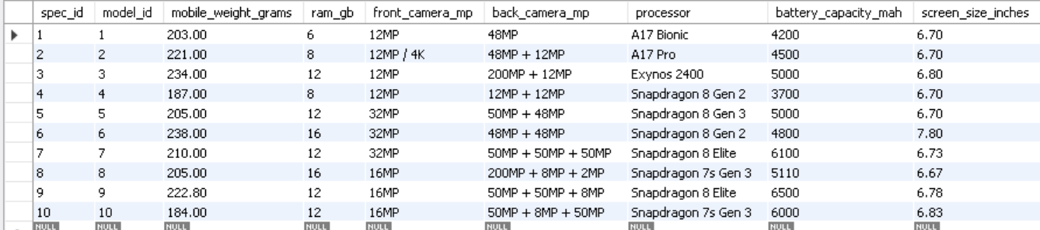
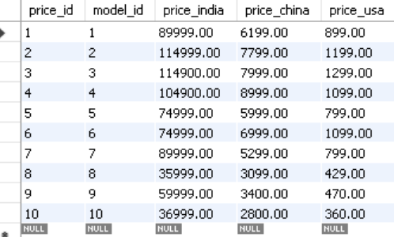
4 – Insert Prices
INSERT INTO Prices (model_id, price_india, price_china, price_usa) VALUES
(1, 89999, 6199, 899),
(2, 114999, 7799, 1199),
(3, 114900, 7999, 1299),
(4, 104900, 8999, 1099),
(5, 74999, 5999, 799),
(6, 74999, 6999, 1099),
(7, 89999, 5299, 799),
(8, 35999, 3099, 429),
(9, 59999, 3400, 470),
(10, 36999, 2800, 360);
select * from prices ;

Slide 14
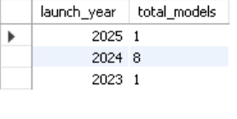
1.If I want to show number of models launched For all years (year-wise counts)
SELECT
launch_year,
COUNT(*) AS total_models
FROM
Models
GROUP BY
launch_year
ORDER BY
launch_year DESC;

Slide 15
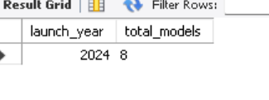
2 If I want to Show number of models launched in 2024
SELECT
launch_year,
COUNT(*) AS total_models
FROM
Models
WHERE
launch_year = 2024
GROUP BY
launch_year;

Slide 16
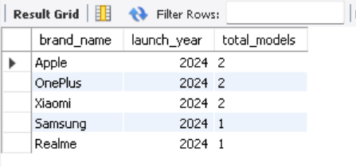
3.If I want brand-wise breakdown for a given year(lets say 2024):
SELECT
b.brand_name,
m.launch_year,
COUNT(*) AS total_models
FROM
Models m
JOIN
Brands b ON m.brand_id = b.brand_id
WHERE
m.launch_year = 2024
GROUP BY
b.brand_name, m.launch_year
ORDER BY
total_models DESC;

Slide 17
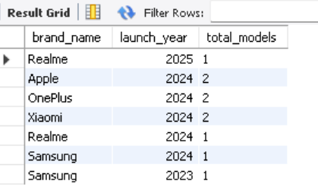
4.IF I want to show a market trend report according to both year-wise and brand-wise count of models launched
SELECT
b.brand_name,
m.launch_year,
COUNT(*) AS total_models
FROM
Models m
JOIN
Brands b ON m.brand_id = b.brand_id
GROUP BY
b.brand_name,
m.launch_year
ORDER BY
m.launch_year DESC,
total_models DESC,
b.brand_name;

Slide 18
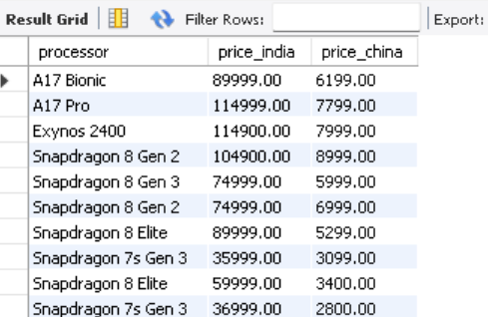
5.If I want to show all models with their processor, India price, and China price
SELECT
s.processor,
p.price_india,
p.price_china
FROM
Specifications s
JOIN
Prices p ON s.model_id = p.model_id;

Slide 19
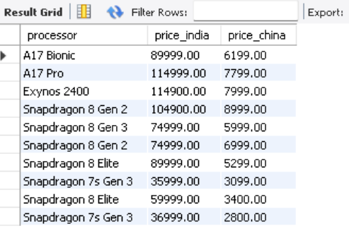
6.If I want to Show models where price in India is greater than China
SELECT
s.processor,
p.price_india,
p.price_china
FROM
Specifications s
JOIN
Prices p ON s.model_id = p.model_id
WHERE
p.price_india > p.price_china;

Slide 20
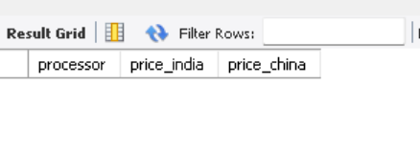
7.If I want to Show models where price in India is less than China
SELECT
s.processor,
p.price_india,
p.price_china
FROM
Specifications s
JOIN
Prices p ON s.model_id = p.model_id
WHERE
p.price_india <p.price_china;

Slide 21
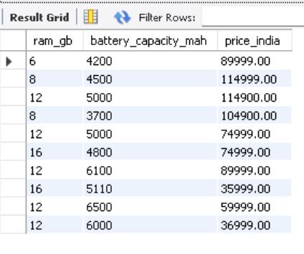
8.if I want to generate a report on mobile prices based on their ram and battery capacity
SELECT
s.ram_gb,
s.battery_capacity_mah,
p.price_india
FROM
Specifications s
JOIN
Prices p
ON s.model_id = p.model_id;

Slide 22
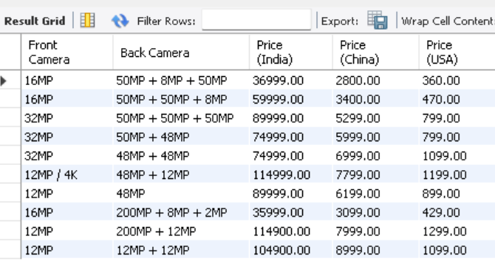
9.If I want a similar report as before but based on camera_mps and for all 3 countries launching prices from prices table
SELECT
s.front_camera_mp AS "Front Camera",
s.back_camera_mp AS "Back Camera",
p.price_india AS "Price (India)",
p.price_china AS "Price (China)",
p.price_usa AS "Price (USA)"
FROM
Specifications s
JOIN
Prices p
ON s.model_id = p.model_id
ORDER BY
s.back_camera_mp DESC,
s.front_camera_mp DESC;

Slide 23
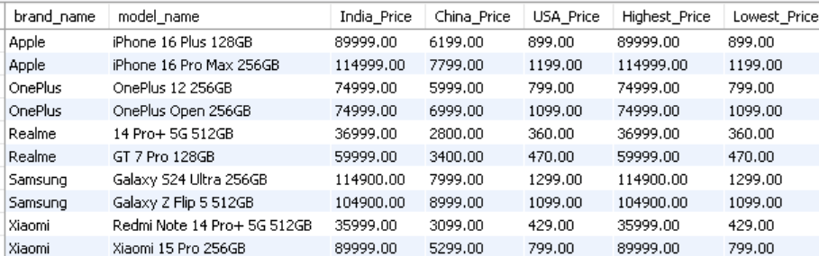
10.Now I wanted to generate a report which country launching prices are high or low
SELECT
b.brand_name,
m.model_name,
p.price_india AS India_Price,
p.price_china AS China_Price,
p.price_usa AS USA_Price,
GREATEST(p.price_india, p.price_china, p.price_usa) AS Highest_Price,
LEAST(p.price_india, p.price_china, p.price_usa) AS Lowest_Price
FROM
Models m
JOIN
Brands b ON m.brand_id = b.brand_id
JOIN
Prices p ON m.model_id = p.model_id
ORDER BY
b.brand_name,
m.model_name;

Slide 24
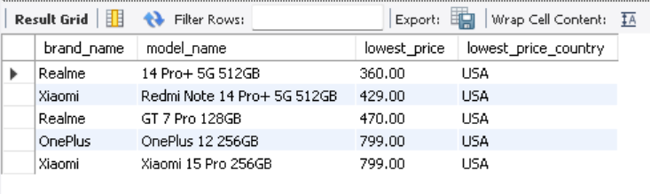
11. From the previous report I just want to show the top 5 lowest launching price with the country (USA)
SELECT
b.brand_name,
m.model_name,
p.price_usa AS lowest_price,
'USA' AS lowest_price_country
FROM
Models m
JOIN
Brands b ON m.brand_id = b.brand_id
JOIN
Prices p ON m.model_id = p.model_id
WHERE
p.price_usa < p.price_india
AND p.price_usa < p.price_china
ORDER BY
lowest_price ASC
LIMIT 5;

Slide 25

CONCLUSION :
The MySQL-based analysis of the smartphone dataset has provided valuable insights into the mobile phone market across three countries (INDIA,CHINA and USA), revealing trends in pricing, features(storage, ram, weight ,screen size ) and brand preferences. The structured data management capabilities of MySQL allowed for efficient storage, querying, and analysis of this complex dataset. This project demonstrates the power of relational databases in handling large, multifaceted datasets and offers a foundation for further exploration into mobile phone market dynamics.

Slide 26

THANK YOU

