Slide 1

Digital portfolio
Student name : Prithisha.S
Register no : 36324u18049
Department : BSC computer science
Collage : Sree abiraami art and science college for women
University : thiruvalluvar university
Email I’d : prithishasoundarrajan@gmail.com

Slide 2
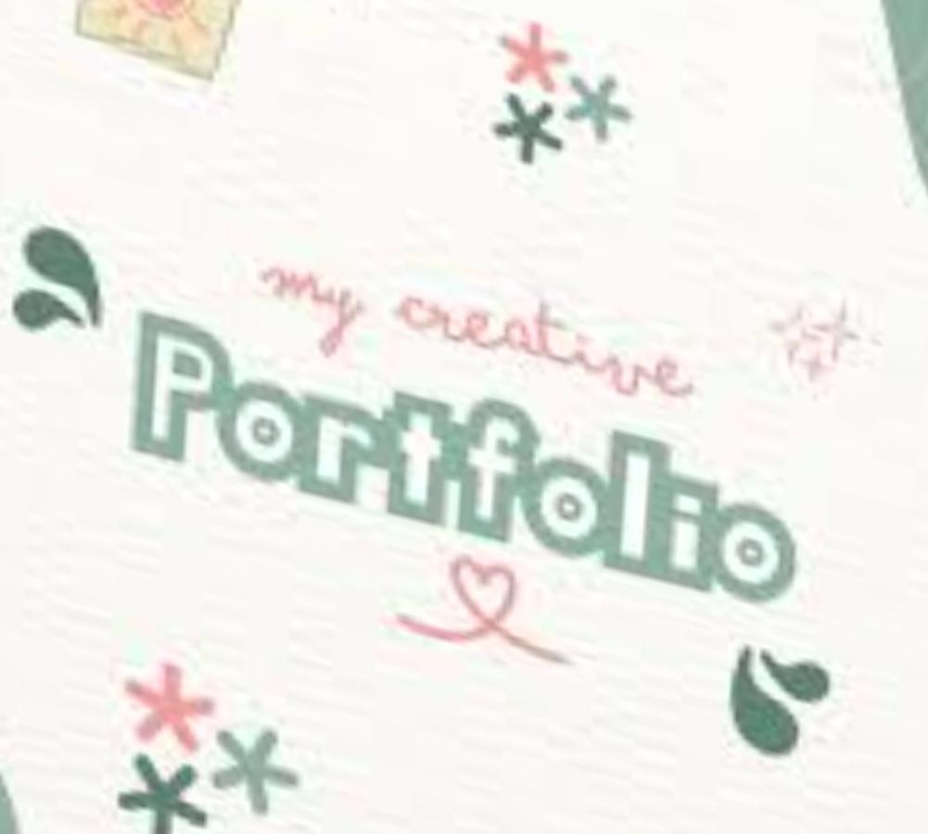
Project title
**Digital portfolio
For front end development**

Slide 3
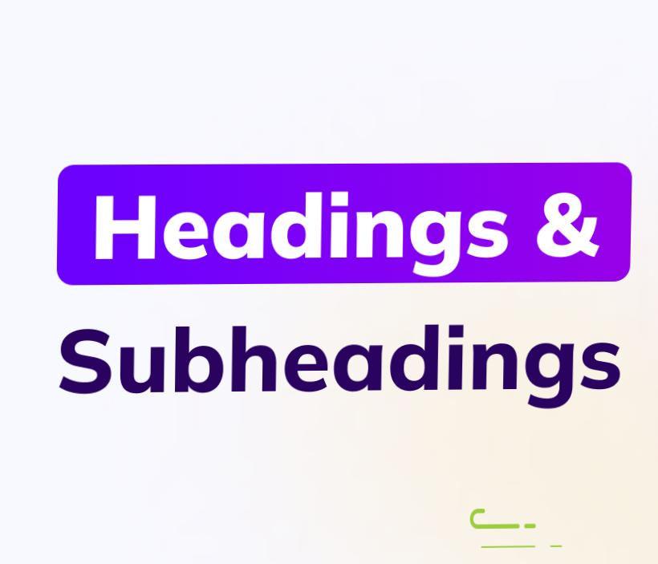
AGENDA:
1. Problem statement
2. Project Overview
3. End Users
4. Tools and Techniques
5. Portfolio design and Layout
6. Features and Functionality
7. Result and Screenshots
8. Conclusion
9. GitHub Link

Slide 4

Problem statement:
Here are a few **simple points** about a problem statement: 1. It explains what the problem is. 2. It shows why the problem is important. 3. It gives background or context. 4. It tells the impact if the problem is not solved. 5. It sets the goal for finding a solution.

Slide 5

Project Overview:
1. Project Title – Name of your project.
Introduction – A short description (2–3 lines) about the project.
2. Problem Statement – The issue or need your project addresses.
3. Objectives – The main goals your project aims to achieve.
4. Technologies Used – Tools, software, or programming languages applied.
5. Key Features – Important functions or highlights of the project.
6. Results – What the project achieved or how it is useful.

Slide 6

Who are the end users..?
End users are the people who actually use the project or product. They are the final audience who benefit from it. They may face the problem that the project is solving. They interact directly with the system or application. Examples: students, teachers, customers, employees, recruiters.

Slide 7

Tools and Techniques:
Tools HTML, CSS, JavaScript – to build the portfolio. Canva / Figma – to design visuals. GitHub – to store and share the portfolio online. ⚙️ Techniques Responsive design – works on mobile and desktop. Easy navigation – clear menu for sections. Interactive features – buttons, animations, hover effects.

Slide 8
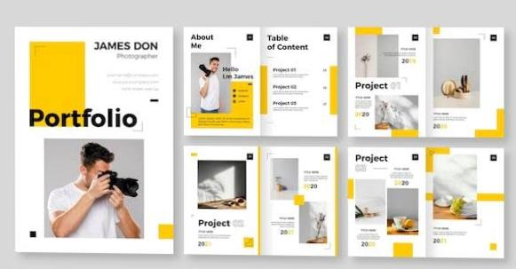
Portfolio design and Layout:
Clean and Simple – Use a neat design without clutter. Easy Navigation – Clear menu (Home, About, Projects, Contact). Responsive Layout – Works well on mobile, tablet, and desktop. Visual Balance – Use proper spacing, colors, and fonts. Highlight Sections – Showcase skills, projects, and achievements clearly.

Slide 9

Features of Functionality:
User-friendly interface – Easy to use and understand. Navigation User-friendly interface – Easy to use and understand.
Navigation – Smooth movement between sections/pages.
Responsive design – Works on all devices (mobile, tablet, desktop).
Interactive elements – Buttons, links, forms, and animations.
Content display – Show skills, projects, and achievements clearly.
– Smooth movement between sections/pages. Responsive design – Works on all devices (mobile, tablet, desktop). Interactive elements – Buttons, links, forms, and animations. Content display – Show skills, projects, and achievements clearly.

Slide 10
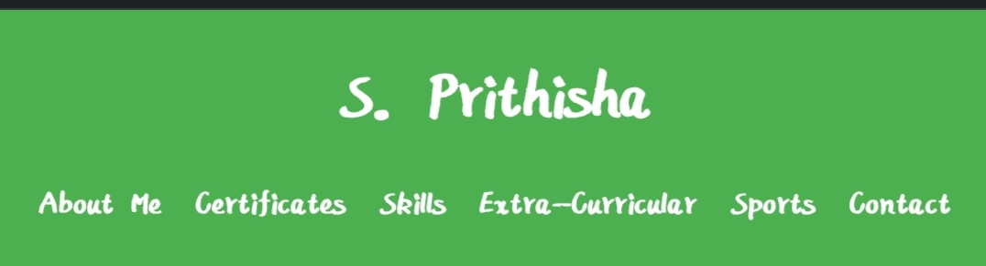
Result and Screenshots :

Slide 11
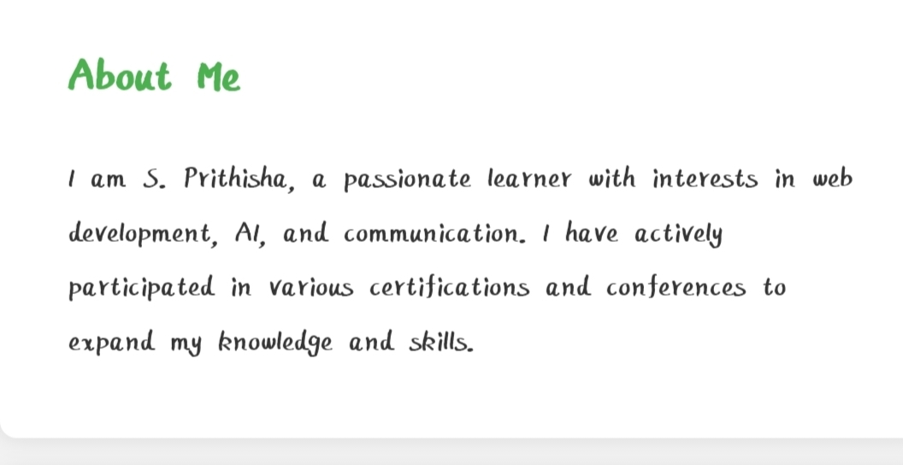

Slide 12
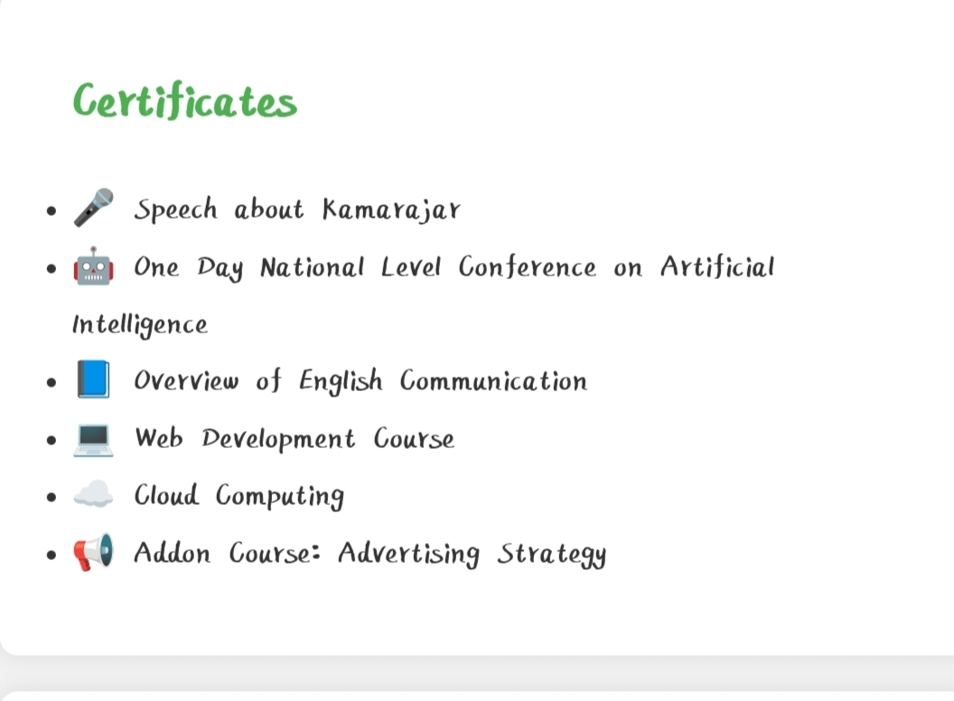

Slide 13
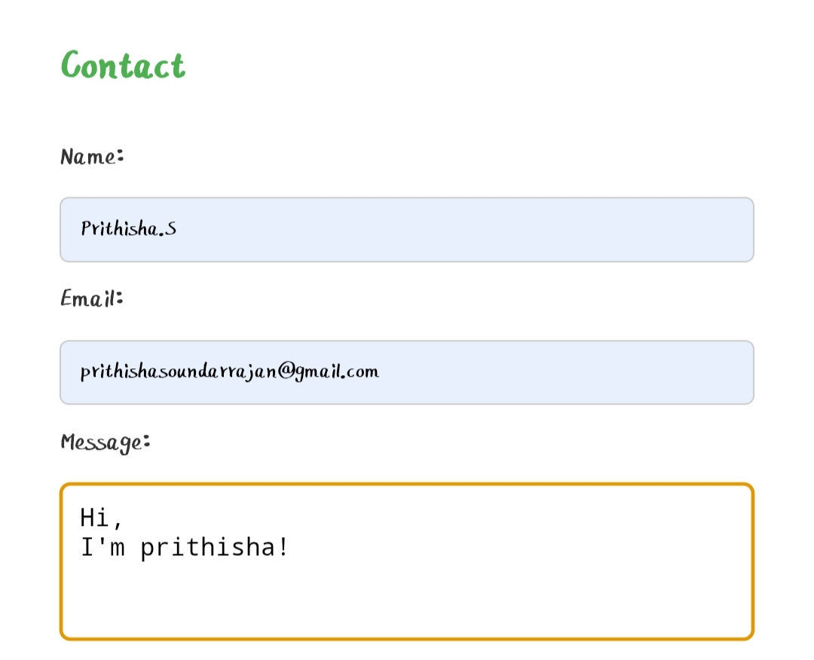
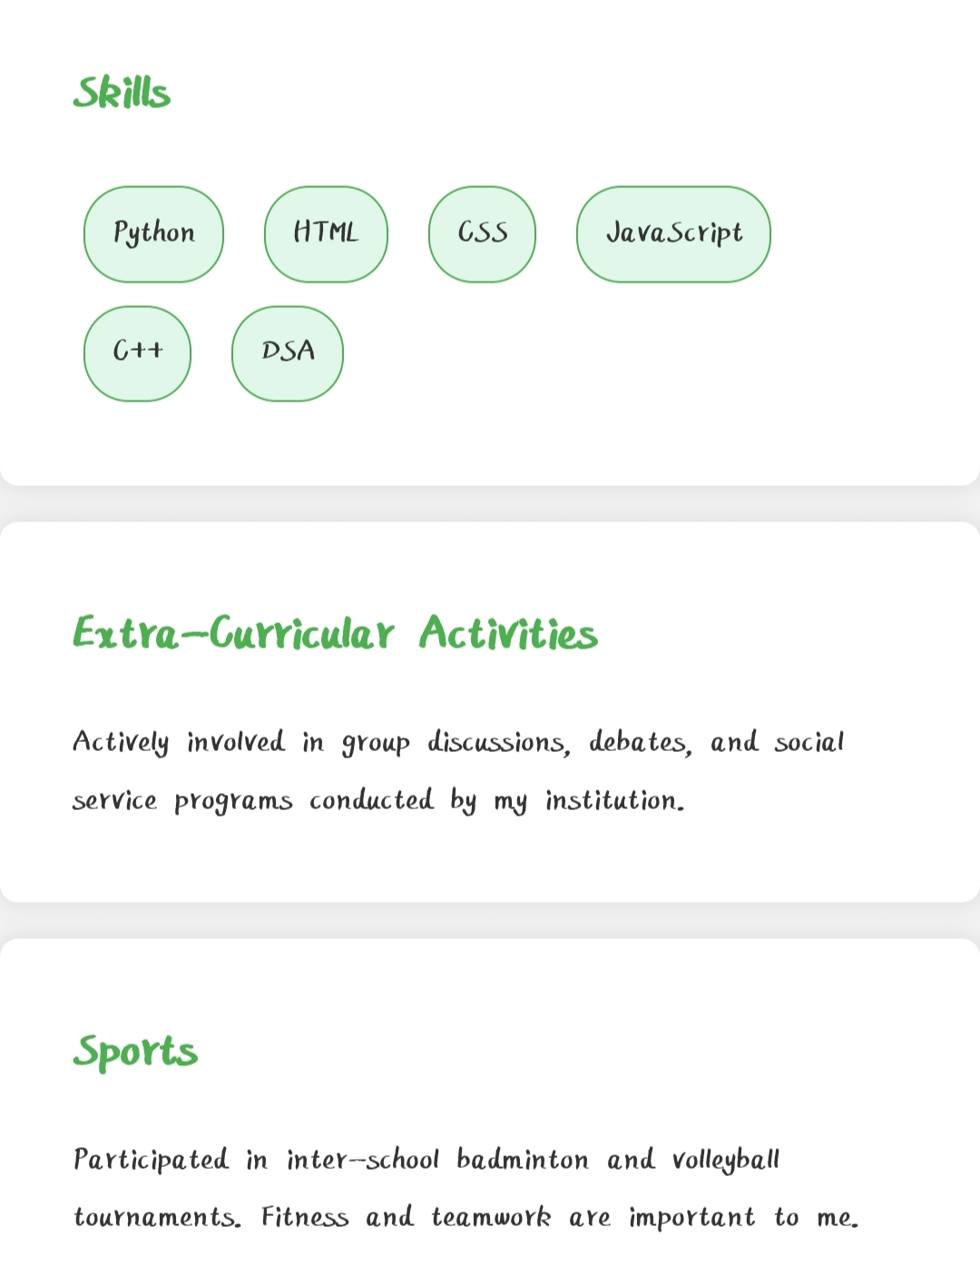

Slide 14
GitHub and project link:
This is the project and my digital portfolio link:
https://prithishasoundarrajan2006.github.io/.Prithishasoundrrajan-portfolio
My GitHub URL..
https://github.com/prithishasoundarrajan2006

Slide 15

Conclusion:
A digital portfolio helps to present skills, talents, and achievements clearly. Tools like Canva, Google Sites, WordPress, and PowerPoint make it easy to design and organize. Using these tools, the portfolio becomes more creative, professional, and easy to share. It supports learning, growth, and future opportunities.

Slide 16


