Slide 1
Digital Portfolio
STUDENT NAME:Akash Sanjay Raj
REGISTER NO AND NMID:24131050500121003
DEPARTMENT: BCA
COLLEGE: Periyar Arts college, cuddalore /Annamalai university

Slide 2
PROJECT TITLE

Slide 3
AGENDA
Problem Statement
Project Overview
End Users
Tools and Technologies
Portfolio design and Layout
Features and Functionality
Results and Screenshots
Conclusion
Github Link
3/21/2024 Annual Review

Slide 4
PROBLEM STATEMENT
In today's digital era, traditional resumes alone are not enough to showcase skills and projects effectively. Many students and professionals lack a structured online presence to highlight their work. A digital portfolio provides an interactive and accessible platform to present achievements, skills, and experiences.

Slide 5
PROJECT OVERVIEW
Brief summary of your project
What your portfolio contains (About Me, Projects, Skills, Contact).
Main idea: Showcase personal achievements, skills, and projects

Slide 6
WHO ARE THE END USERS?
Students (academic projects, resumes).
Job seekers (to share with recruiters). Freelancers (to show clients).
Professionals (to highlight experience and achievements).

Slide 7
TOOLS AND TECHNIQUES
HTML Structure (pages, sections).
CSS Styling (colors, layouts, responsiveness).
JavaScript Interactivity (navigation menu, animations, form validation).
Mention code editor (VS Code) or CODEPEN and hosting platform (GitHub Pages)

Slide 8
POTFOLIO DESIGN AND LAYOUT
Sections included:
Home/About Me Projects
Skills
Contact
Responsive layout (mobile + desktop view).

Slide 9
FEATURES AND FUNCTIONALITY
FEATURES AND FUNCTIONALITY
Navigation bar with smooth scrolling. Project showcase with images/details.
Interactive elements (hover effects, animations).
Contact form (with validation). Responsive design for all devices.

Slide 10
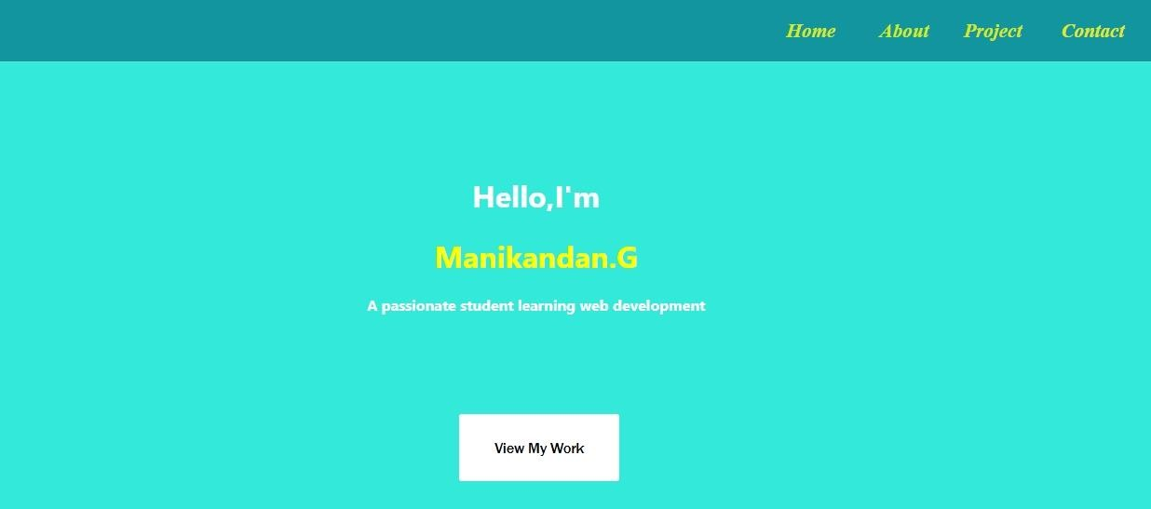
RESULTS AND SCREENSHOTS
Akash Sanjay Raj
3/21/2024 Annual Review
10

Slide 11
CONCLUSION
Highlights of your project
Final summary Benefits to society
11

