Slide 1
Memory Management
Chapter 3
Tanenbaum & Bo,Modern Operating Systems:4th ed., (c) 2013 Prentice-Hall, Inc. All rights reserved.

Slide 2
Topics
Memory Abstraction
Virtual Memory
Page Replacement Algorithms
10_MEMORY_MGMT

Slide 3
Memory
Paraphrase of Parkinson’s Law, ‘‘Programs expand to fill the memory available to hold them.’’
Average home computer nowadays has 10,000 times more memory than the IBM 7094, the largest computer in the world in the early 1960s
Tanenbaum & Bo,Modern Operating Systems:4th ed., (c) 2013 Prentice-Hall, Inc. All rights reserved.

Slide 4
Memory Management
  memory hierarchy:
    few MB of very fast, expensive, volatile cache memory
    few GB of medium speed and price volatile memory
    few TB of slow, cheap nonvolatile disk storage
    removable storage
  memory manager: keep track of which parts of memory are in use and allocate or deallocate memory to processes when necessary
10_MEMORY_MGMT

Slide 5
No Memory Abstraction
  physical memory
  set of addresses from 0 to max
  each address corresponds to cell with bits
10_MEMORY_MGMT

Slide 6
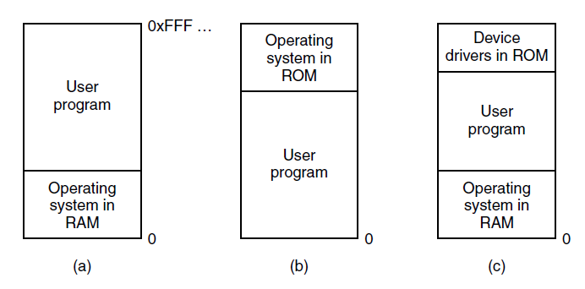
No Memory Abstraction
Figure 3-1. Three simple ways of organizing memory with an operating system and one user process. Other possibilities also exist
Tanenbaum & Bo,Modern Operating Systems:4th ed., (c) 2013 Prentice-Hall, Inc. All rights reserved.

Slide 7
No Memory Abstraction
  one process in memory at a time
  multiple processes
    entire contents of memory get saved to disk
    “swapping”
  or use special hardware
    memory divided into blocks
    key held in special registers
    PSW contained key (must match)
10_MEMORY_MGMT

Slide 8
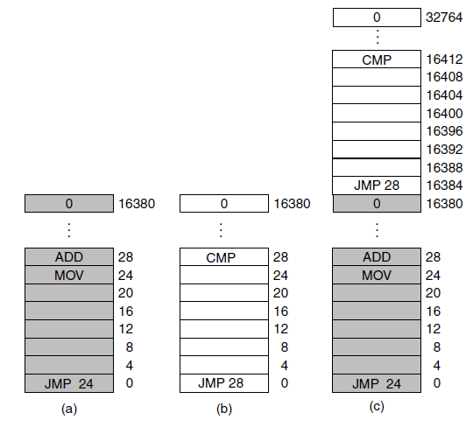
Running Multiple Programs Without a Memory Abstraction
Figure 3-2. Illustration of the relocation problem. (a) A 16-KB program. (b) Another 16-KB program. (c) The two programs loaded consecutively into memory.
Tanenbaum & Bo,Modern Operating Systems:4th ed., (c) 2013 Prentice-Hall, Inc. All rights reserved.

Slide 9
Address Spaces
  set of addresses that process can use to access memory
  each process has its own space
  two problems to solve: protection and relocation
10_MEMORY_MGMT

Slide 10
Base and Limit Registers
  dynamic relocation
  programs are loaded into consecutive memory locations wherever there is room
  no relocation during loading
  CPU adds base to addresses generated by process (and checks limit)
10_MEMORY_MGMT

Slide 11
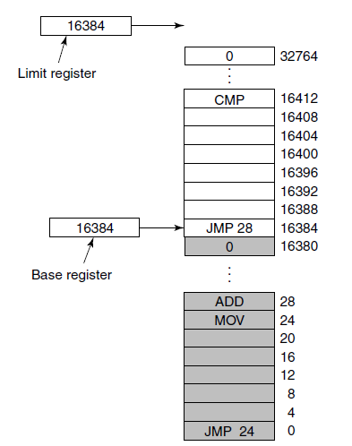
Base and Limit Registers
Figure 3-3. Base and limit registers can be used to give each process a separate address space.
Tanenbaum & Bo,Modern Operating Systems:4th ed., (c) 2013 Prentice-Hall, Inc. All rights reserved.

Slide 12
Swapping
  generally, more RAM is needed than is available
  bringing in each entire process for a while, then putting it back on disk
10_MEMORY_MGMT

Slide 13
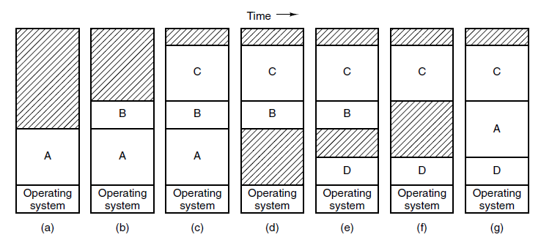
Swapping (1)
Figure 3-4. Memory allocation changes as processes come into memory and leave it. The shaded regions are unused memory
Tanenbaum & Bo,Modern Operating Systems:4th ed., (c) 2013 Prentice-Hall, Inc. All rights reserved.

Slide 14
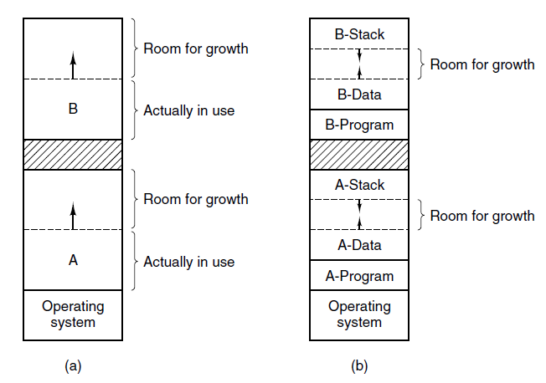
Swapping (2)
Figure 3-5. (a) Allocating space for a growing data segment.
(b) Allocating space for a growing stack and a growing data segment.
Tanenbaum & Bo,Modern Operating Systems:4th ed., (c) 2013 Prentice-Hall, Inc. All rights reserved.

Slide 15
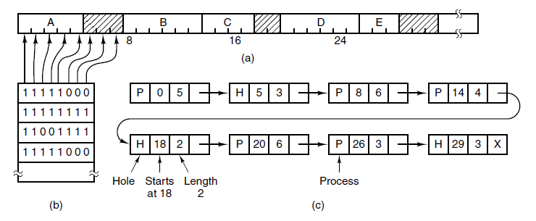
Memory Management with Bitmaps
Figure 3-6. (a) A part of memory with five processes and three holes. The tickmarks show the memory allocation units. The shaded regions (0 in the bitmap) are free. (b) The corresponding bitmap. (c) The same information as a list.
Tanenbaum & Bo,Modern Operating Systems:4th ed., (c) 2013 Prentice-Hall, Inc. All rights reserved.

Slide 16
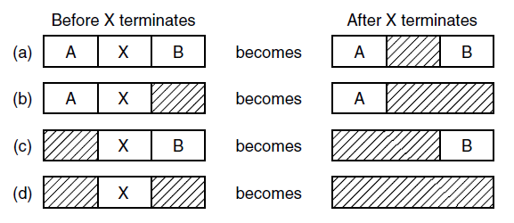
Memory Management with Linked Lists
Figure 3-7. Four neighbor combinations for the
terminating process, X.
Tanenbaum & Bo,Modern Operating Systems:4th ed., (c) 2013 Prentice-Hall, Inc. All rights reserved.

Slide 17
Memory Management Algorithms
First fit
  first hole that’s big enough
Next fit
  saves most recent hole location
Best fit
  smallest hole
Worst fit
  largest hole
Quick fit
  list of locations for common hole sizes
Tanenbaum & Bo,Modern Operating Systems:4th ed., (c) 2013 Prentice-Hall, Inc. All rights reserved.

Slide 18
Virtual Memory
There is a need to run programs that are too large to fit in memory
Solution adopted in the 1960s, split programs into little pieces, called overlays
  Kept on the disk, swapped in and out of memory
Virtual memory : each program has its own address space, broken up into chunks called pages
Tanenbaum & Bo,Modern Operating Systems:4th ed., (c) 2013 Prentice-Hall, Inc. All rights reserved.

Slide 19
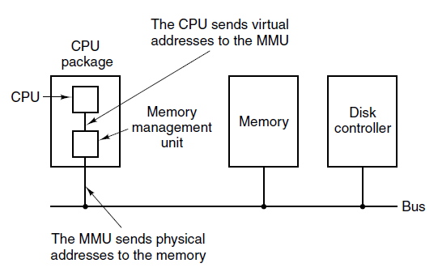
Paging (1)
Figure 3-8. The position and function of the MMU. Here the
MMU is shown as being a part of the CPU chip because
it commonly is nowadays. However, logically it
could be a separate chip and was years ago.
Tanenbaum & Bo,Modern Operating Systems:4th ed., (c) 2013 Prentice-Hall, Inc. All rights reserved.

Slide 20
Paging
  page: contiguous range of addresses, mapped onto physical memory
  paging:
    upon instruction execution, address is generated
    goes through the Memory Management Unit to map onto physical memory addresses
    (as opposed to generated address being put directly into the memory bus)
10_MEMORY_MGMT

Slide 21
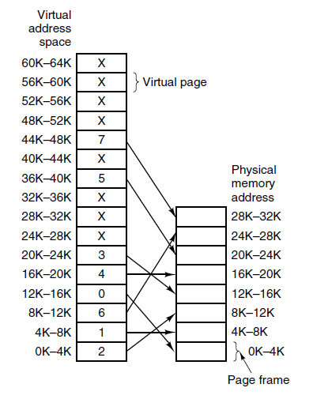
Paging (2)
Figure 3-9. The relation between virtual addresses and physical memory addresses is given by the page table. Every page begins on a multiple of 4096 and ends 4095 addresses higher, so 4K–8K really means 4096–8191 and 8K to 12K means 8192–12287
Tanenbaum & Bo,Modern Operating Systems:4th ed., (c) 2013 Prentice-Hall, Inc. All rights reserved.

Slide 22
Paging
  page fault: when page is needed but not in physical memory
    OS chooses page to put back to disk and overwrite with new page
  page table:
    page number is index to yield page frame number
10_MEMORY_MGMT

Slide 23
Paging
  virtual address contains virtual page number and offset
  virtual page number is index in page table to find page frame number
  page frame number replaces virtual page number and offset stays in place to create the physical address
10_MEMORY_MGMT

Slide 24
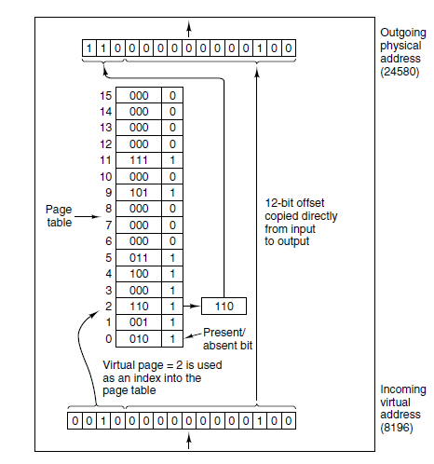
Paging (3)
Figure 3-10. The internal
operation of the MMU
with 16 4-KB pages.
Tanenbaum & Bo,Modern Operating Systems:4th ed., (c) 2013 Prentice-Hall, Inc. All rights reserved.

Slide 25
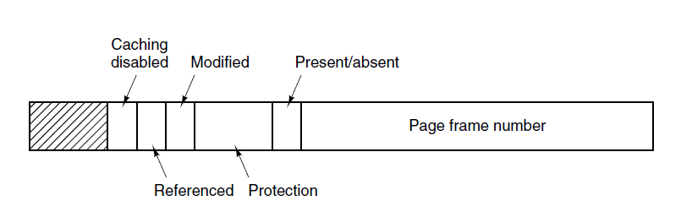
Structure of a Page Table Entry
Figure 3-11. A typical page table entry.
Tanenbaum & Bo,Modern Operating Systems:4th ed., (c) 2013 Prentice-Hall, Inc. All rights reserved.

Slide 26
Paging
  Protection: what kind(s) of access are permitted
  Modified: has page been written to
  Referenced: helps decide which page to replace
10_MEMORY_MGMT

Slide 27
Speeding Up Paging
Major issues faced:
The mapping from virtual address to physical address must be fast.
If the virtual address space is large, the page table will be large.
Tanenbaum & Bo,Modern Operating Systems:4th ed., (c) 2013 Prentice-Hall, Inc. All rights reserved.

Slide 28
Translation Lookaside Buffer
  Large number of references to a small number of pages.
  Create small hardware device for mapping virtual address to physical addresses (without going through page table)
  Useful for loop that spans multiple virtual pages
10_MEMORY_MGMT

Slide 29
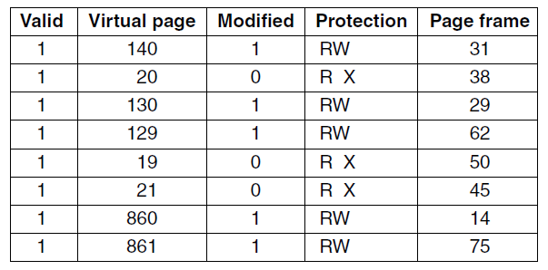
Translation Lookaside Buffers
Figure 3-12. A TLB to speed up paging.
Tanenbaum & Bo,Modern Operating Systems:4th ed., (c) 2013 Prentice-Hall, Inc. All rights reserved.

Slide 30
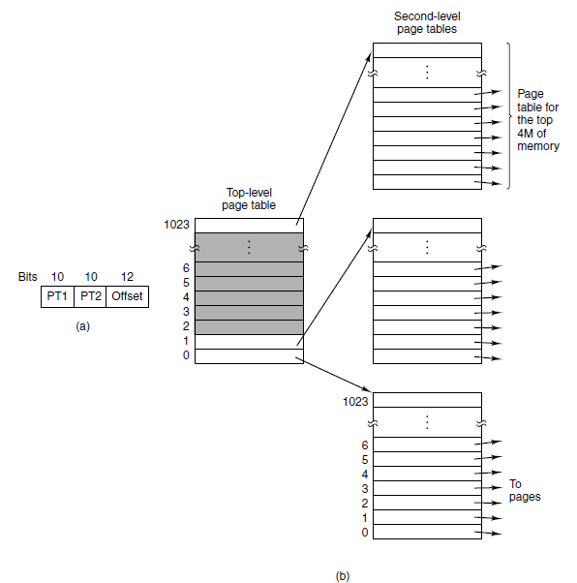
Multilevel Page Tables
Figure 3-13. (a) A 32-bit address with two page table fields. (b) Two-level page tables.
Tanenbaum & Bo,Modern Operating Systems:4th ed., (c) 2013 Prentice-Hall, Inc. All rights reserved.

Slide 31
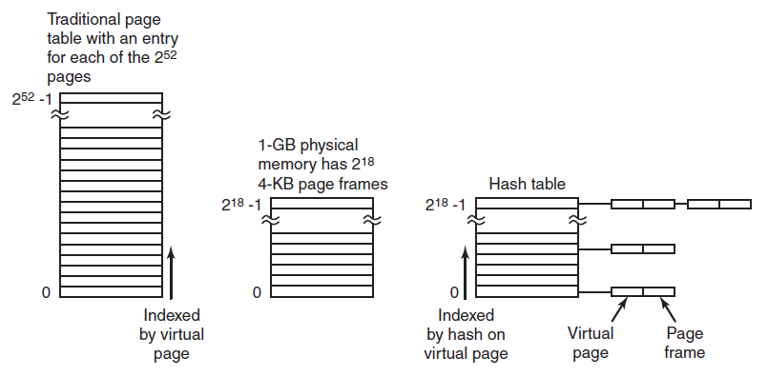
Inverted Page Tables
Figure 3-14. Comparison of a traditional page table
with an inverted page table.
Tanenbaum & Bo,Modern Operating Systems:4th ed., (c) 2013 Prentice-Hall, Inc. All rights reserved.

Slide 32

Next Class
Memory Management
Modern Operating Systems:
Chapter 3
  Abstractions
  Address Spaces
  Virtual Memory
10_MEMORY_MGMT

