Slide 1
Memory Management
Chapter 3
Tanenbaum & Bo,Modern Operating Systems:4th ed., (c) 2013 Prentice-Hall, Inc. All rights reserved.

Slide 2
Topics
Page Replacement Algorithms
Design Issues
10_MEMORY_MGMT

Slide 3
Page Replacement Algorithms
Optimal algorithm
Not recently used algorithm
First-in, first-out (FIFO) algorithm
Second-chance algorithm
Clock algorithm
Least recently used (LRU) algorithm
Working set algorithm
WSClock algorithm
Tanenbaum & Bo,Modern Operating Systems:4th ed., (c) 2013 Prentice-Hall, Inc. All rights reserved.

Slide 4
Optimal Algorithm
Optimal page replacement algorithm:
  A page fault occurs with pages in memory
  The very next instruction references one of those pages
  Each is page labeled with the number of instructions to be executed before that page is first referenced
  Page with highest label should be removed
Not possible
  OS cannot know when page will be referenced next
  But! if we run a process once, we can make predictions for next time
11_MEMORY_MGMT

Slide 5
Not Recently Used
  R: referenced (read or write)
  M: modified (written to)
  Periodically (e.g., on each clock interrupt), the R bit is cleared (to indicate pages that have not been referenced recently)
11_MEMORY_MGMT

Slide 6
Not Recently Used Algorithm
At page fault, system inspects pages
Categories of pages based on the current values of their R and M bits:
Class 0: not referenced, not modified.
Class 1: not referenced, modified.
Class 2: referenced, not modified.
Class 3: referenced, modified.
Tanenbaum & Bo,Modern Operating Systems:4th ed., (c) 2013 Prentice-Hall, Inc. All rights reserved.

Slide 7
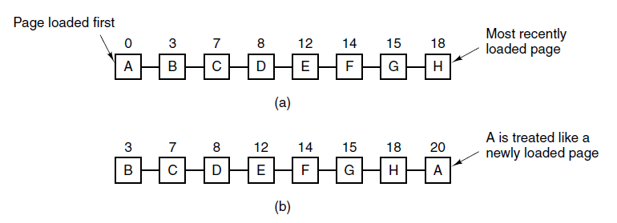
Second-Chance Algorithm
Figure 3-15. Operation of second chance. (a) Pages sorted in FIFO order. (b) Page list if a page fault occurs at time 20 and A has its R bit set. The numbers above the pages are their load times.
Tanenbaum & Bo,Modern Operating Systems:4th ed., (c) 2013 Prentice-Hall, Inc. All rights reserved.

Slide 8
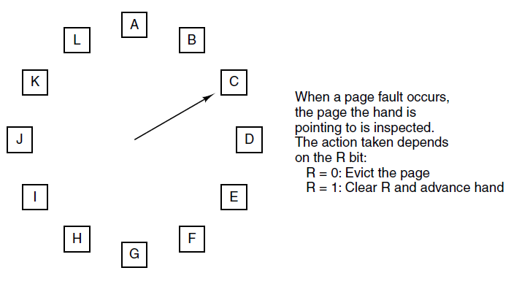
Clock Page Replacement Algorithm
Figure 3-16. The clock page replacement algorithm.
Tanenbaum & Bo,Modern Operating Systems:4th ed., (c) 2013 Prentice-Hall, Inc. All rights reserved.

Slide 9
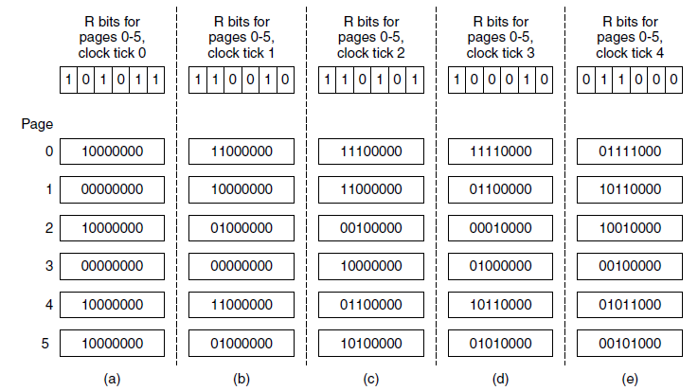
Simulating LRU in Software
Figure 3-17. The aging algorithm simulates LRU in software. Shown are six pages for five clock ticks. The five clock ticks are represented by (a) to (e).
Tanenbaum & Bo,Modern Operating Systems:4th ed., (c) 2013 Prentice-Hall, Inc. All rights reserved.

Slide 10
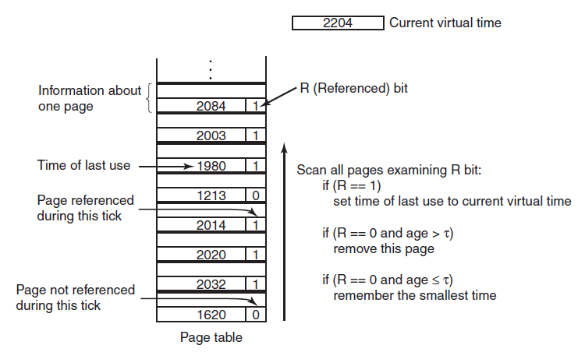
Working Set Algorithm
Figure 3-19. The working set algorithm.
Tanenbaum & Bo,Modern Operating Systems:4th ed., (c) 2013 Prentice-Hall, Inc. All rights reserved.

Slide 11
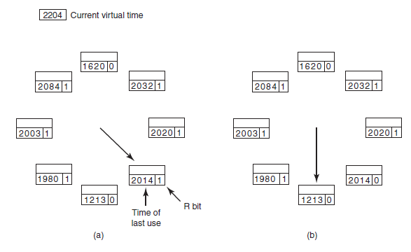
WSClock Algorithm (1)
Figure 3-20. Operation of the WSClock algorithm. (a) and (b) give an example of what happens when R = 1.
Tanenbaum & Bo,Modern Operating Systems:4th ed., (c) 2013 Prentice-Hall, Inc. All rights reserved.

Slide 12
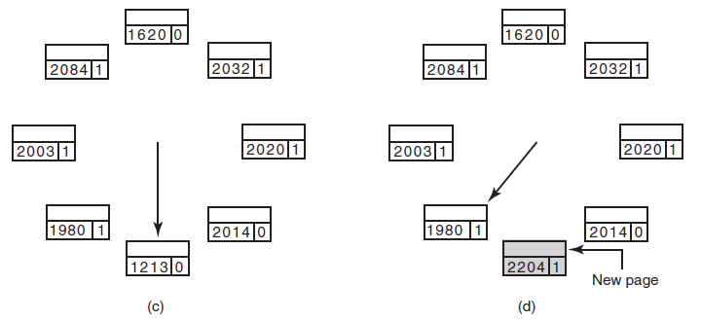
WSClock Algorithm (2)
Figure 3-20. Operation of the WSClock algorithm.
(c) and (d) give an example of R = 0.
Tanenbaum & Bo,Modern Operating Systems:4th ed., (c) 2013 Prentice-Hall, Inc. All rights reserved.

Slide 13
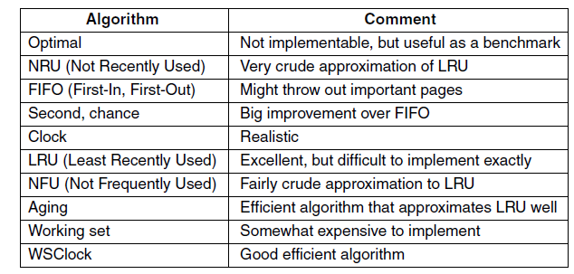
Summary of Page Replacement Algorithms
Figure 3-21. Page replacement algorithms discussed in the text.
Tanenbaum & Bo,Modern Operating Systems:4th ed., (c) 2013 Prentice-Hall, Inc. All rights reserved.

Slide 14
Local vs Global Allocation
How to allocate among competing runnable processes
  Use page replacement within process or across running processes?
  thrashing: program causing page faults every few instructions
11_MEMORY_MGMT

Slide 15
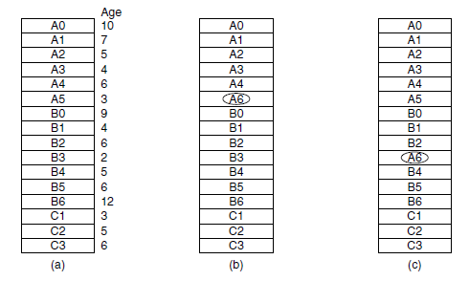
Local versus Global Allocation Policies (1)
Figure 3-22. Local versus global page replacement.
(a) Original configuration. (b) Local page replacement.
(c) Global page replacement.
Tanenbaum & Bo,Modern Operating Systems:4th ed., (c) 2013 Prentice-Hall, Inc. All rights reserved.

Slide 16
Local vs Global Allocation
LOCAL
GLOBAL
  if working set grows, then thrashing
  if shrinks, then memory wasted
  generally better
  must decide how many page frames for each process
11_MEMORY_MGMT

Slide 17
Local vs Global Allocation
Global allocation
  Evenly
  Minimum
  Dynamically
11_MEMORY_MGMT

Slide 18
Local vs Global Allocation
Global allocation
  Evenly: equal shares to small and large processes?
  Minimum: instruction needs more pages than allocated?
  Dynamically: updated as process runs
11_MEMORY_MGMT

Slide 19
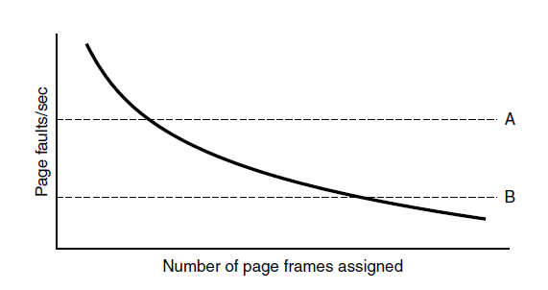
Local versus Global Allocation Policies (2)
Figure 3-23. Page fault rate as a function of the number of page frames assigned.
Tanenbaum & Bo,Modern Operating Systems:4th ed., (c) 2013 Prentice-Hall, Inc. All rights reserved.

Slide 20
Load Control
Even with best page replacement and optimal global allocation, there can be thrashing
  Some processes need more memory, but no processes need less memory
  Fall back to swapping
    But! If CPU bound process is swapped out, it will be idle
11_MEMORY_MGMT

Slide 21
Page Size
SMALL
LARGE
  avoid wasting space
  smaller page table
    shorter load time
  longer to transfer equivalent sizes
  less space in TLB
11_MEMORY_MGMT

Slide 22
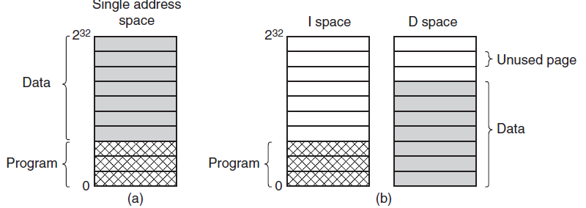
Separate Instruction and Data Spaces
Figure 3-24. (a) One address space.
(b) Separate I and D spaces.
Tanenbaum & Bo,Modern Operating Systems:4th ed., (c) 2013 Prentice-Hall, Inc. All rights reserved.

Slide 23
Shared Pages
  Several users running same program
  Single user running several programs which use the same library
  Generally, just read only pages are sharable
11_MEMORY_MGMT

Slide 24
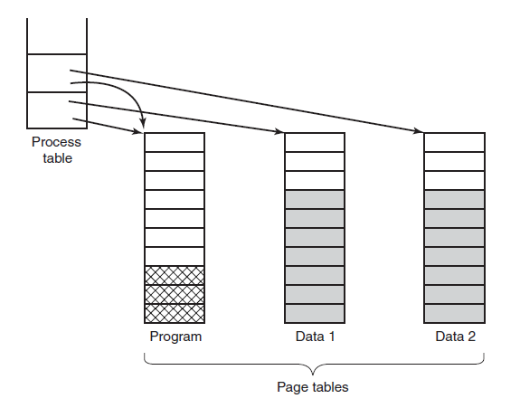
Shared Pages
Figure 3-25. Two processes sharing the same
program sharing its page table.
Tanenbaum & Bo,Modern Operating Systems:4th ed., (c) 2013 Prentice-Hall, Inc. All rights reserved.

Slide 25
Static Libraries
  When a program is linked, one or more object files and possibly some libraries are named in the command to the linker
  All .o files in the current directory are linked, then any libraries are scanned.
    Any function called in the object files but not present there are called undefined externals and looked for
      If found, they’re included in the executable
11_MEMORY_MGMT

Slide 26
Shared Libraries
  Linker includes stub function instead of actual one
  Either loaded with program or has already been loaded
11_MEMORY_MGMT

Slide 27
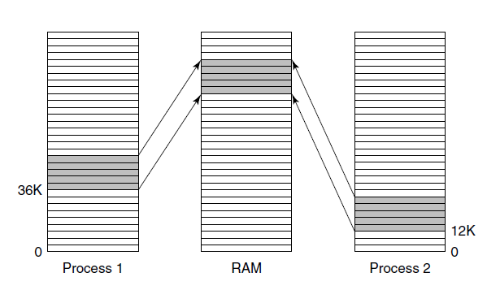
Shared Libraries
Figure 3-26. A shared library being used by two processes.
Tanenbaum & Bo,Modern Operating Systems:4th ed., (c) 2013 Prentice-Hall, Inc. All rights reserved.

Slide 28
Cleaning Policy
  paging daemon: background process responsible for ensuring a plentiful supply of free page frames is available
  mostly sleeping, wakes to inspect memory
    if too few page frames are free, it selects pages to evict
      writes to disk, if necessary
    could add an additional hand to the WSClock
      sweeps ahead increasing the probability that the page replacement hand finds a free page
11_MEMORY_MGMT

Slide 29

Next Class
Memory Management
Modern Operating Systems:
Chapter 3
  Implementation Issues
  Segmentation
10_MEMORY_MGMT

