Slide 1
Memory Management
Chapter 3
Tanenbaum & Bo,Modern Operating Systems:4th ed., (c) 2013 Prentice-Hall, Inc. All rights reserved.

Slide 2
Topics
Implementation Issues
Segmentation
12_MEMORY_MGMT

Slide 3
OS Involvement with Paging
Process creation
Process execution
Page fault
Process termination
12_MEMORY_MGMT

Slide 4
Process Creation
Determine how large the program and data will be (initially)
Create page table
  Space allocated
  Initialized
swap area
  Space allocated in anticipation of pages being swapped
  Program text and data are initialized so pages can be brought in from here
Info about page table and swap area saved to process table
12_MEMORY_MGMT

Slide 5
Process Execution
MMU reset for new process
TLB flushed to get rid of traces of previously executed process
New process’ page table made current
  copy it or pointer to hardware register(s)
All (or some) pages brought into memory to reduce page faults
12_MEMORY_MGMT

Slide 6
Page Fault Handling (1)
The hardware traps to kernel, saving program counter on stack.
Assembly code routine started to save general registers and other volatile info
system discovers page fault has occurred, tries to discover which virtual page needed
Once virtual address caused fault is known, system checks to see if address valid and the protection consistent with access
Tanenbaum & Bo,Modern Operating Systems:4th ed., (c) 2013 Prentice-Hall, Inc. All rights reserved.

Slide 7
Page Fault Handling (2)
If frame selected dirty, page is scheduled for transfer to disk, context switch takes place, suspending faulting process
As soon as frame clean, operating system looks up disk address where needed page is, schedules disk operation to bring it in.
When disk interrupt indicates page has arrived, tables updated to reflect position, and frame marked as being in normal state.
Tanenbaum & Bo,Modern Operating Systems:4th ed., (c) 2013 Prentice-Hall, Inc. All rights reserved.

Slide 8
Page Fault Handling (3)
Faulting instruction backed up to state it had when it began and program counter is reset
Faulting process is scheduled, operating system returns to routine that called it.
Routine reloads registers and other state information, returns to user space to continue execution
Tanenbaum & Bo,Modern Operating Systems:4th ed., (c) 2013 Prentice-Hall, Inc. All rights reserved.

Slide 9
Process Termination
Release page table, pages, and disk space the pages occupy (when they’re on disk)
  If shared with other process(es), released after those terminate
12_MEMORY_MGMT

Slide 10
Instruction Backup
  When an instruction causing a fault is stopped partway and a trap to the OS occurs
    After OS fetches page, the instruction must be restarted
12_MEMORY_MGMT

Slide 11
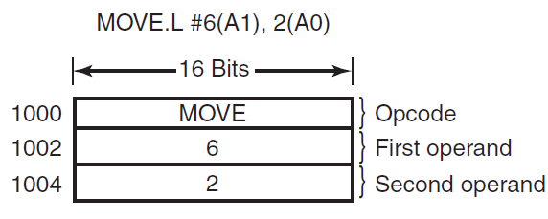
Instruction Backup
Figure 3-27. An instruction causing a page fault.
Tanenbaum & Bo,Modern Operating Systems:4th ed., (c) 2013 Prentice-Hall, Inc. All rights reserved.

Slide 12
Instruction Backup
  The program counter depends on which of the three memory references caused the page fault
    If we restarting in the middle, the OS doesn’t know if the word is a memory address associated with an instruction (at 1000) or an opcode
Solution: hidden internal register into which the program counter is copied just before each instruction is executed.
12_MEMORY_MGMT

Slide 13
Locking Pages
  A process issues a system call to I/O device
  It’s suspended and another process runs
  This other process gets a page fault
  If paging is global, the page containing the I/O buffer might get removed
Solution: pinning pages engaged in I/O in memory
12_MEMORY_MGMT

Slide 14
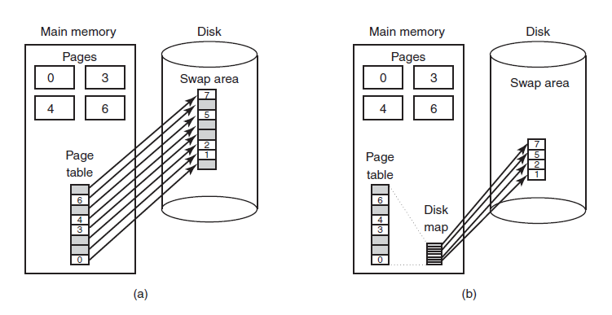
Backing Store
Figure 3-28. (a) Paging to a static swap area.
(b) Backing up pages dynamically.
Tanenbaum & Bo,Modern Operating Systems:4th ed., (c) 2013 Prentice-Hall, Inc. All rights reserved.

Slide 15
Separation of Policy and Mechanism (1)
Memory management system is divided into three parts
A low-level MMU handler.
A page fault handler that is part of the kernel.
An external pager running in user space.
Tanenbaum & Bo,Modern Operating Systems:4th ed., (c) 2013 Prentice-Hall, Inc. All rights reserved.

Slide 16
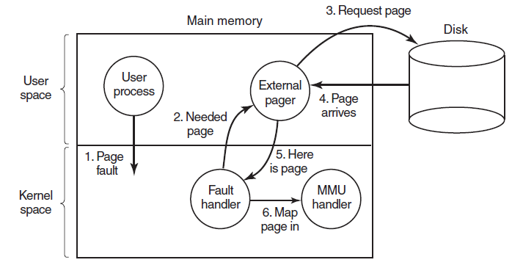
Separation of Policy and Mechanism (2)
Figure 3-29. Page fault handling with an external pager.
Tanenbaum & Bo,Modern Operating Systems:4th ed., (c) 2013 Prentice-Hall, Inc. All rights reserved.

Slide 17
Segmentation
  Memory management approach where the process is divided into the variable size segments and loaded to the logical memory address space
  The logical address space is the collection of variable size segments. Each segment has its name and length.
  For the execution, the segments from logical memory space are loaded to the physical memory space.
12_MEMORY_MGMT

Slide 18
Segmentation (1)
Examples of tables generated by compiler:
The source text being saved for the printed listing
The symbol table, names and attributes of variables.
The table containing integer and floating-point constants used.
The parse tree, syntactic analysis of the program.
The stack used for procedure calls within compiler.
Tanenbaum & Bo,Modern Operating Systems:4th ed., (c) 2013 Prentice-Hall, Inc. All rights reserved.

Slide 19
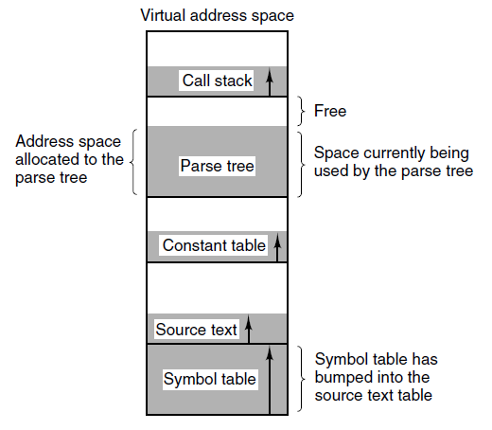
Segmentation (2)
Figure 3-30. In a one-dimensional address space with growing tables, one table may bump into another.
Tanenbaum & Bo,Modern Operating Systems:4th ed., (c) 2013 Prentice-Hall, Inc. All rights reserved.

Slide 20
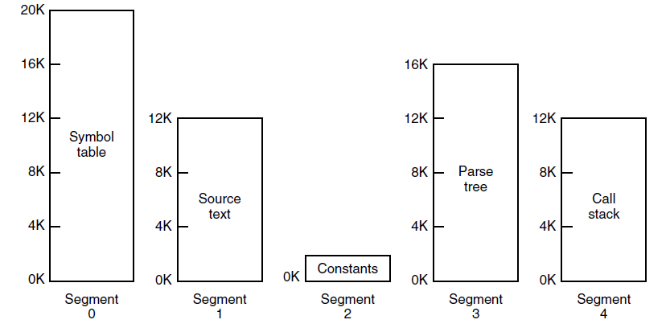
Segmentation (3)
Figure 3-31. A segmented memory allows each table to grow or shrink independently of the other tables.
Tanenbaum & Bo,Modern Operating Systems:4th ed., (c) 2013 Prentice-Hall, Inc. All rights reserved.

Slide 21
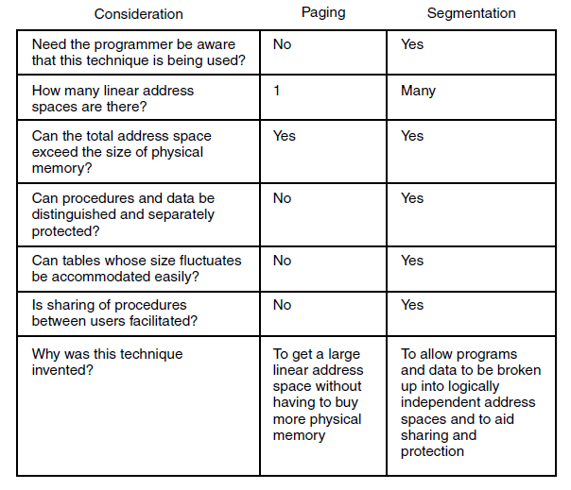
Segmentation (4)
Figure 3-32. Comparison of paging and segmentation
Tanenbaum & Bo,Modern Operating Systems:4th ed., (c) 2013 Prentice-Hall, Inc. All rights reserved.

Slide 22
Paging vs Segmentation
PAGING
SEGMENTATION
  A page is of fixed block size
  Paging may lead to internal fragmentation
  The user specified address is divided by CPU into a page number and offset
  A segment is of variable size
  Segmentation may lead to external fragmentation
  The user specifies each address by two quantities a segment number and the offset (Segment limit)
12_MEMORY_MGMT

Slide 23
Paging vs Segmentation
PAGING
SEGMENTATION
  The hardware decides the page size
  Paging involves a page table that contains base address of each page
  The segment size is specified by the user
  Segmentation involves the segment table that contains segment number and offset (segment length)
https://techdifferences.com/difference-between-paging-and-segmentation-in-os.html
12_MEMORY_MGMT

Slide 24
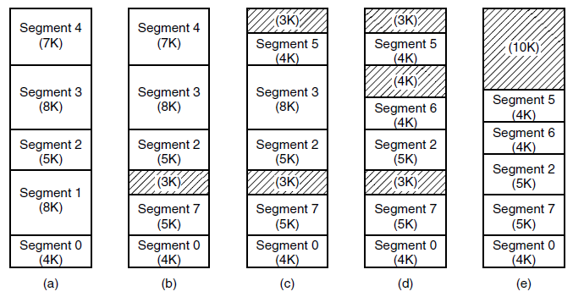
Implementation of Pure Segmentation
Figure 3-33. (a)-(d) Development of checkerboarding.
(e) Removal of the checkerboarding by compaction.
Tanenbaum & Bo,Modern Operating Systems:4th ed., (c) 2013 Prentice-Hall, Inc. All rights reserved.

Slide 25
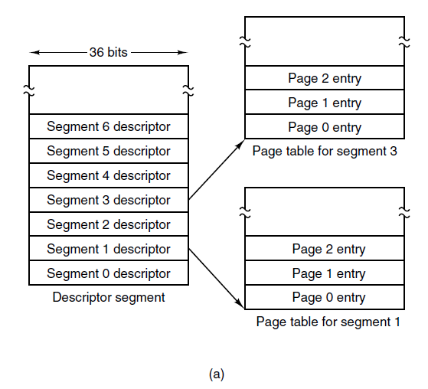
Segmentation with Paging: MULTICS (1)
Figure 3-34. The MULTICS virtual memory. (a) The descriptor segment pointed to the page tables.
Tanenbaum & Bo,Modern Operating Systems:4th ed., (c) 2013 Prentice-Hall, Inc. All rights reserved.

Slide 26
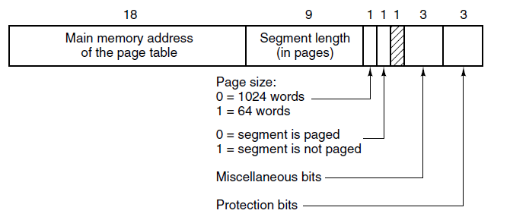
Segmentation with Paging: MULTICS (2)
Figure 3-34. The MULTICS virtual memory. (b) A segment descriptor. The numbers are the field lengths.
Tanenbaum & Bo,Modern Operating Systems:4th ed., (c) 2013 Prentice-Hall, Inc. All rights reserved.

Slide 27
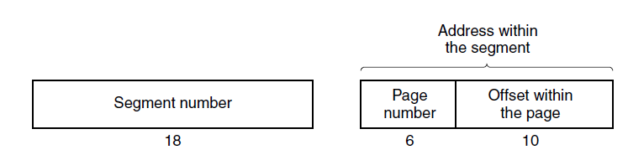
Segmentation with Paging: MULTICS (3)
Figure 3-35. A 34-bit MULTICS virtual address.
Tanenbaum & Bo,Modern Operating Systems:4th ed., (c) 2013 Prentice-Hall, Inc. All rights reserved.

Slide 28
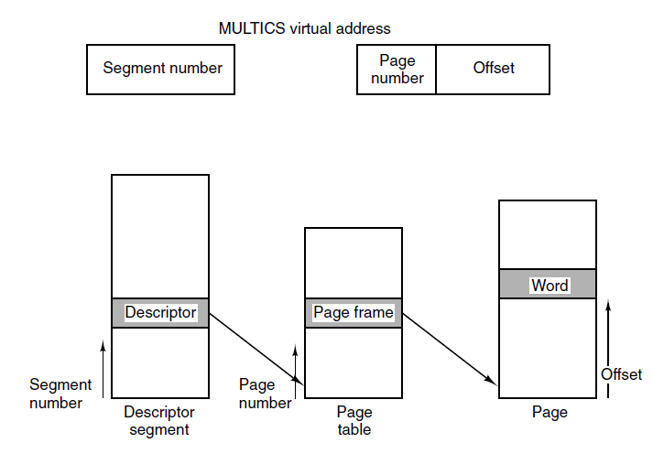
Segmentation with Paging: MULTICS (4)
Figure 3-36. Conversion of a two-part MULTICS address into a main memory address.
Tanenbaum & Bo,Modern Operating Systems:4th ed., (c) 2013 Prentice-Hall, Inc. All rights reserved.

Slide 29
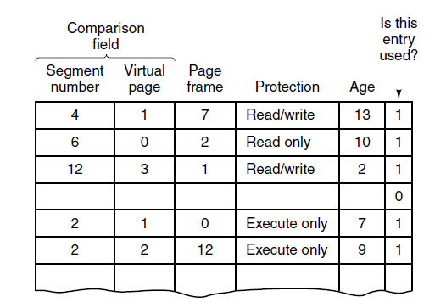
Segmentation with Paging: MULTICS (5)
Figure 3-37. A simplified version of the MULTICS TLB. The existence of two page sizes made the actual TLB more complicated.
Tanenbaum & Bo,Modern Operating Systems:4th ed., (c) 2013 Prentice-Hall, Inc. All rights reserved.

Slide 30

Next Class
Midterm Review
Modern Operating Systems:
Chapters 1 - 4
10_MEMORY_MGMT

