Slide 1
CS 446
Erin Keith

Slide 2
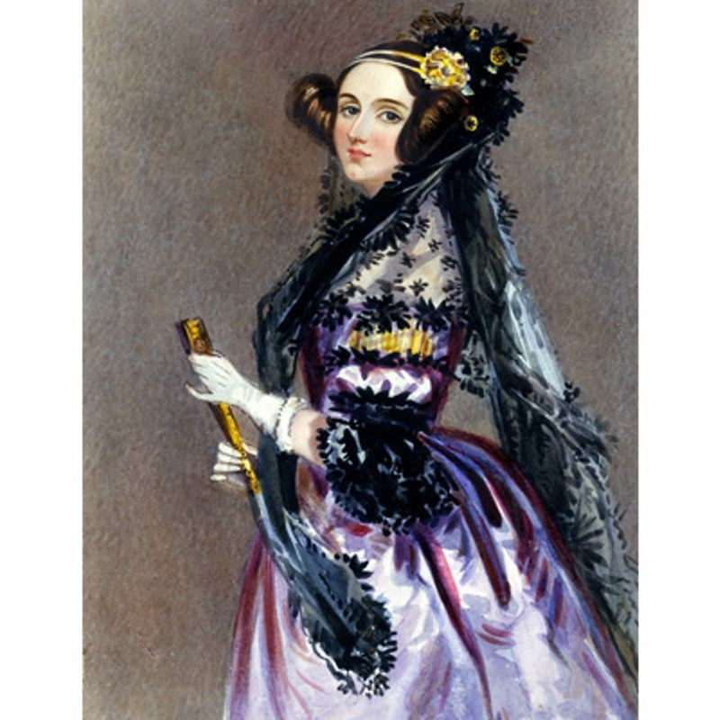
Who’s this?
Erin Keith

Slide 3
Ada Lovelace
First programmer
The programming language Ada is named after her
Daughter of British poet Lord Byron
Helped Charles Babbage in his quest to build the first digital computer

Slide 4
MODERN OPERATING SYSTEMS Third Edition ANDREW S. TANENBAUM Chapter 1 Introduction
Tanenbaum, Modern Operating Systems 3 e, (c) 2008 Prentice-Hall, Inc. All rights reserved. 0-13-6006639
Notes:
4

Slide 5
Topics
What is an operating system?
History of operating systems
Hardware review

Slide 6
What Is An Operating System (1)
A modern computer consists of:
One or more processors
Main memory
Disks
Printers
Various input/output devices
Managing all these components requires a layer of software – the operating system
Tanenbaum, Modern Operating Systems 3 e, (c) 2008 Prentice-Hall, Inc. All rights reserved. 0-13-6006639

Slide 7
What is an Operating System
kernel mode
user mode
privileged mode where the process has unrestricted access to system resources like hardware, memory, etc.
when the system boots, hardware starts in kernel mode
any crash in kernel mode brings down the whole system
normal mode where the process has limited access
when the system is run by user applications like creating a text document or using any application program, then the system is in user mode
any crash in user mode brings down the faulty process only

Slide 8
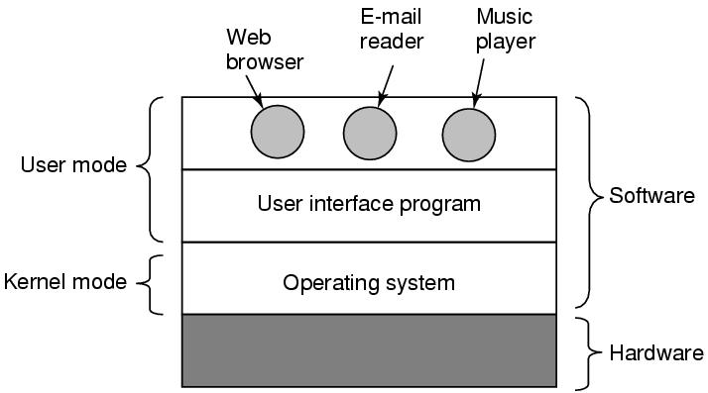
What Is An Operating System (2)
Figure 1-1. Where the operating system fits in.
Tanenbaum, Modern Operating Systems 3 e, (c) 2008 Prentice-Hall, Inc. All rights reserved. 0-13-6006639

Slide 9
What is an Operating System
Software that runs in kernel mode (generally)
Provides a layer of abstraction for application programs (and programmers) to interact with the hardware
The GUI and command line are applications (in user mode) on top of the OS (kernel mode)

Slide 10
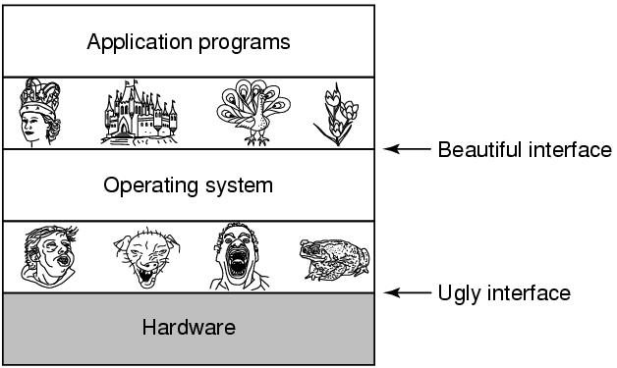
The Operating System as an Extended Machine
Figure 1-2. Operating systems turn ugly hardware into beautiful abstractions.
Tanenbaum, Modern Operating Systems 3 e, (c) 2008 Prentice-Hall, Inc. All rights reserved. 0-13-6006639

Slide 11
The Operating System as a Resource Manager
Allow multiple programs to run at the same time
Manage and protect memory, I/O devices, and other resources
Includes multiplexing (sharing) resources in two different ways:
In time
In space
Tanenbaum, Modern Operating Systems 3 e, (c) 2008 Prentice-Hall, Inc. All rights reserved. 0-13-6006639

Slide 12
History of Operating Systems
Generations:
(1945–55) Vacuum Tubes
(1955–65) Transistors and Batch Systems
(1965–1980) ICs and Multiprogramming
(1980–Present) Personal Computers
(1990–Present) Mobile Computers
Tanenbaum, Modern Operating Systems 3 e, (c) 2008 Prentice-Hall, Inc. All rights reserved. 0-13-6006639

Slide 13
History of Operating Systems
Vacuum tubes
All programming done in absolute machine language
OR sometimes by wiring up electrical circuits (like a switchboard)

Slide 14
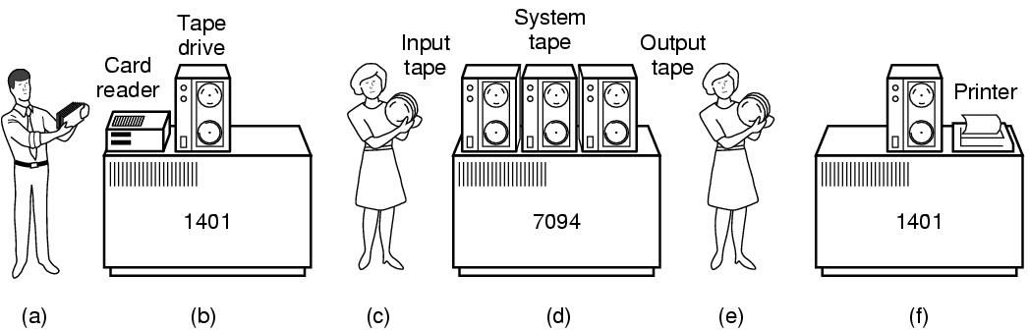
Transistors and Batch Systems (1)
Figure 1-3. An early batch system. (a) Programmers bring cards to 1401. (b)1401 reads batch of jobs onto tape.
Tanenbaum, Modern Operating Systems 3 e, (c) 2008 Prentice-Hall, Inc. All rights reserved. 0-13-6006639

Slide 15
Transistors and Batch Systems (2)
Figure 1-3. (c) Operator carries input tape to 7094. (d) 7094 does computing. (e) Operator carries output tape to 1401. (f) 1401 prints output.
Tanenbaum, Modern Operating Systems 3 e, (c) 2008 Prentice-Hall, Inc. All rights reserved. 0-13-6006639

Slide 16
History of Operating Systems
Transistors and Batch Systems
Write program on paper (in FORTRAN or assembly)
Punch it on cards
Hand to input operators in input room
Tear off output for programmer in output room
*if the FORTRAN compiler was needed, those cards would have to be fed in, too
Eventually became trays full of jobs

Slide 17
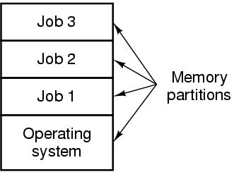
ICs and Multiprogramming
Figure 1-5. A multiprogramming system with three jobs in memory.
Tanenbaum, Modern Operating Systems 3 e, (c) 2008 Prentice-Hall, Inc. All rights reserved. 0-13-6006639

Slide 18
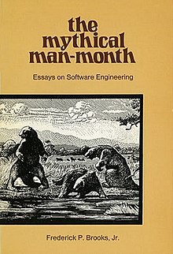
History of Operating Systems
Integrated Circuits and Multiprogramming
science vs commercial products
IBM: series of software compatible machines which could run different programs
Different companies had different families of compatible computers
Enormous, buggy OS built in assembly
multiprogramming – running several programs on one processor
UNIX started with Ken Thompson at Bell Labs

Slide 19
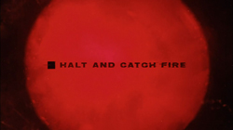
History of Operating Systems
Personal Computers
Chips with thousands of transistors
General purpose CPUs
Comedy of errors:
Intel, Kildall and CP/M
IBM, Bill Gates and MS-DOS
Xerox, Steve Jobs and GUIs

Slide 20
History of Operating Systems
Mobile Computers
Personal Digital Assistant was the precursor
Nokia first to combine phone with PDA
running Symbian OS
became Windows phone
Blackberry was a strong contender
iPhone changed it all
Android (Linux based) from Google now dominant

Slide 21
Battle Royale
OSx/iOS vs Windows vs Linux/Android

Slide 22
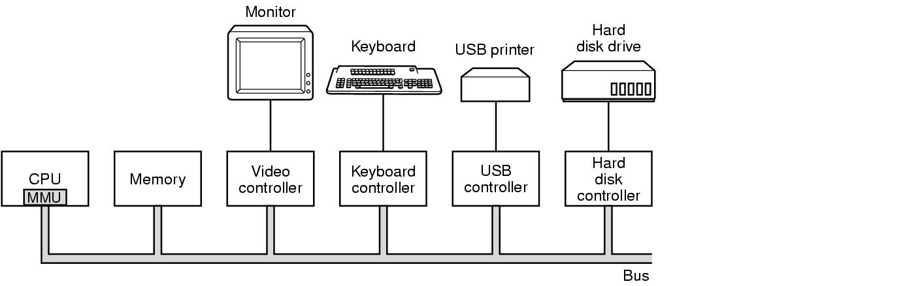
Computer Hardware Review
Figure 1-6. Some of the components of a simple personal computer.
Tanenbaum, Modern Operating Systems 3 e, (c) 2008 Prentice-Hall, Inc. All rights reserved. 0-13-6006639

Slide 23
CPU
“Brain” of the computer
Fetch, decode, execute instructions until program is done
Each CPU has its own instruction set
x86 vs ARM
Registers
general data/instructions
program counter (next instruction)
stack pointer (top of current stack which contains frames for each procedure)
Program Status Work (condition code bits for system calls and I/O)

Slide 24
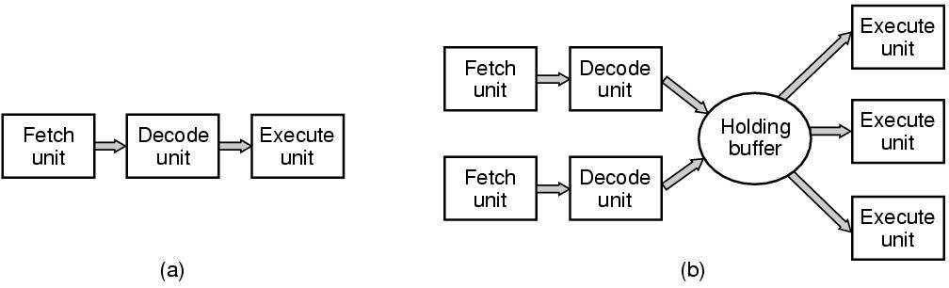
CPU Pipelining
Figure 1-7. (a) A three-stage pipeline. (b) A superscalar CPU.
Tanenbaum, Modern Operating Systems 3 e, (c) 2008 Prentice-Hall, Inc. All rights reserved. 0-13-6006639

Slide 25
Multithreaded and Multicore Chips
Pipeline -> Superscalar -> bigger caches -> multithreading
allows the CPU to hold the state of two different threads, then switch back and forth
thread: a kind of lightweight process which is running a program
Ex: one process needs to read from memory, CPU switches to another thread
*Not true “parallelism”, just thread-switching

Slide 26
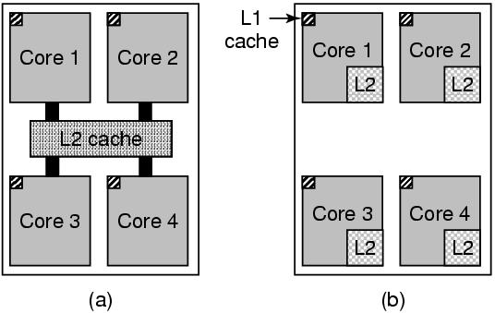
Multithreaded and Multicore Chips
Figure 1-8. (a) A quad-core chip with a shared L2 cache. (b) A quad-core chip with separate L2 caches.
Tanenbaum, Modern Operating Systems 3 e, (c) 2008 Prentice-Hall, Inc. All rights reserved. 0-13-6006639

Slide 27
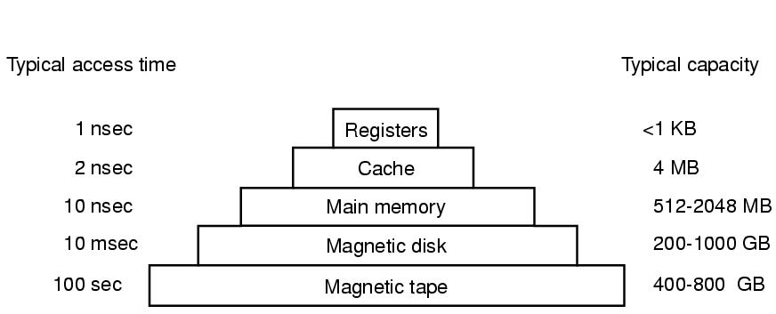
Memory (1)
Figure 1-9. A typical memory hierarchy. The numbers are very rough approximations.
Tanenbaum, Modern Operating Systems 3 e, (c) 2008 Prentice-Hall, Inc. All rights reserved. 0-13-6006639

Slide 28
Memory (2)
Questions when dealing with cache:
When to put a new item into the cache.
Which cache line to put the new item in.
Which item to remove from the cache when a slot is needed.
Where to put a newly evicted item in the larger memory.
Tanenbaum, Modern Operating Systems 3 e, (c) 2008 Prentice-Hall, Inc. All rights reserved. 0-13-6006639

Slide 29
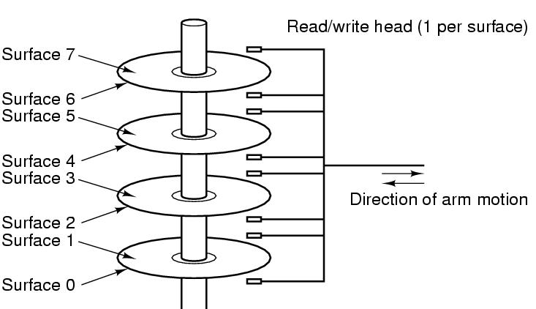
Disks
Figure 1-10. Structure of a disk drive.
Tanenbaum, Modern Operating Systems 3 e, (c) 2008 Prentice-Hall, Inc. All rights reserved. 0-13-6006639

Slide 30
Disks
“magnetic” disk consists of platters
Track: ring-shaped region where info is written
Sectors: divisions on a track
Sloooooooow
*SSDs (Flash memory)

Slide 31
I/O Devices
controller + device
driver: software which talks to a controller
needs to be put into the operating system so it can be run in kernel mode.
busy waiting
program issues system call -> kernel sends procedure to driver -> driver starts I/O -> polls device -> driver puts data then returns
interrupt
driver starts device -> receives interrupt -> driver returns

Slide 32
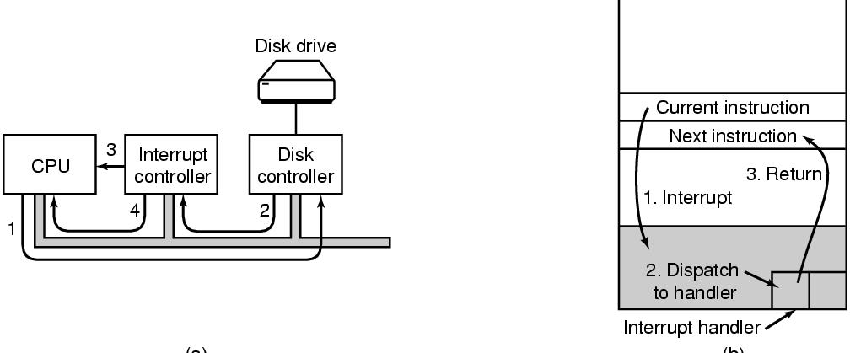
I/O Devices
Figure 1-11. (a) The steps in starting an I/O device and getting an interrupt.
Tanenbaum, Modern Operating Systems 3 e, (c) 2008 Prentice-Hall, Inc. All rights reserved. 0-13-6006639

Slide 33
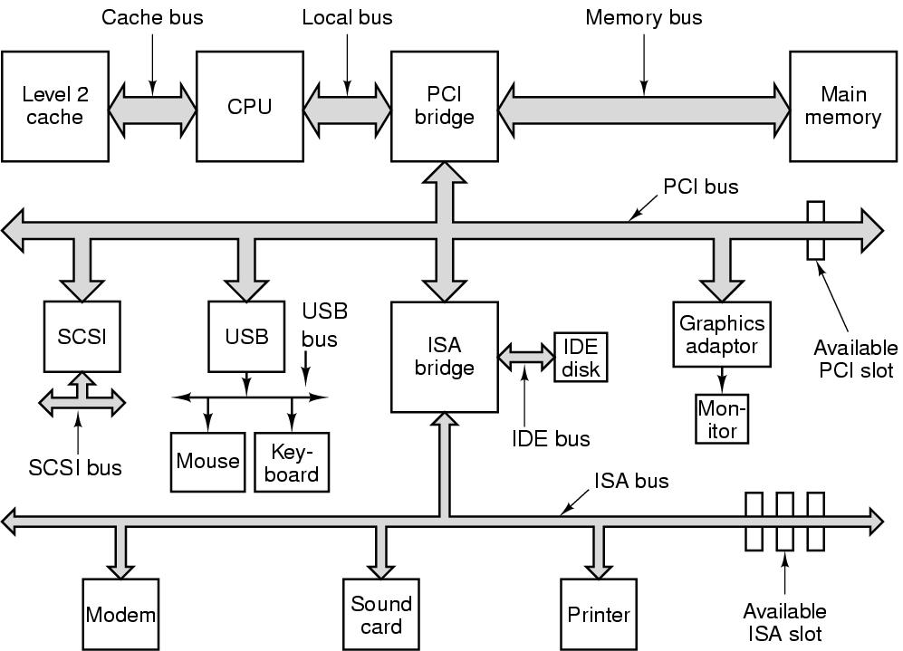
Buses
Figure 1-12. The structure of a large Pentium system
Tanenbaum, Modern Operating Systems 3 e, (c) 2008 Prentice-Hall, Inc. All rights reserved. 0-13-6006639

Slide 34
Next Class
Intro
Modern Operating Systems:
Chapter 1

