Slide 1
CS 446
Erin Keith

Slide 2
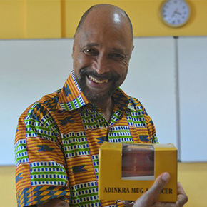
Who’s this?
Erin Keith

Slide 3
Clarence “Skip” Ellis
Professor and Computer Scientist
University of Colorado, Boulder; MIT; Stanford; Ashesi University
Bell Labs, Xerox, ARPANET
Started as graveyard shift computer operator
At Xerox, worked on icon-based GUI
later used in Apple’s Lisa and MS-DOS
Operational Transformation pioneer
collaboration functionalities between collaborative systems
Ex: concurrency control in collaborative editing of text documents

Slide 4
MODERN OPERATING SYSTEMS Third Edition ANDREW S. TANENBAUM Chapter 1 Introduction
Tanenbaum, Modern Operating Systems 3 e, (c) 2008 Prentice-Hall, Inc. All rights reserved. 0-13-6006639
Notes:
4

Slide 5
Topics
Types of Operating Systems
OS Concepts
System Calls

Slide 6
The Operating System Zoo
Mainframe operating systems
Server operating systems
Multiprocessor operating systems
Personal computer operating systems
Handheld operating systems
Embedded operating systems
Sensor node operating systems
Real-time operating systems
Smart card operating systems
Tanenbaum, Modern Operating Systems 3 e, (c) 2008 Prentice-Hall, Inc. All rights reserved. 0-13-6006639

Slide 7
Mainframe
High end, still room sized in major corporate data centers with huge I/O capacity
1000 disks, millions of GB of data
Batch: automatic, routine jobs without user interaction
Transaction processing: large numbers of small requests
Timesharing: querying big data base (multiple remote users)
OS/390

Slide 8
Server
Usually very large PCs (occasionally mainframes)
Often serving web pages for websites
Handle many incoming requests
Linux, Windows Server

Slide 9
Multiprocessor
Parallel systems which combine multiple CPUs as a single system
Linux, Windows + libraries such as MPI or PVM

Slide 10
Personal Computers
Support multiprogramming (running several programs on one processor)
Linux, Windows, OSx

Slide 11
Handheld
PDAs
Lots of hardware (sensors, cameras, etc.)
Lots of apps
Android, iOS

Slide 12
Embedded
devices not considered to be “computers”
microwaves, cars, etc.
software in ROM
Embedded Linus, QNX

Slide 13
Sensor-Node
networks of tiny sensor nodes
communicate with each other and a base station
detect fires, guard systems, weather
generally event driven
TinyOS

Slide 14
Real Time
time is key parameter
process-control systems
hard vs soft real-time systems -> deadlines
eCos, FreeRTOS

Slide 15
Smart Card
smallest OS
severe resource constraints
power issues
COS, TrustSec

Slide 16
Operating System Concepts
Processes
Files
Input/Output
Protection
The shell
Tanenbaum, Modern Operating Systems 3 e, (c) 2008 Prentice-Hall, Inc. All rights reserved. 0-13-6006639

Slide 17
Processes
Process: program in execution
registers, list of open files, alarms, related process
address space: list of memory locations where process can read and write
contains executable program, data, stack
Container that holds all the information needed to run a program

Slide 18
Processes
Multiple processes (programs) running
OS decides to stop one
Later, must be restarted in the exact same state
Process table: an array of structures, one for each process that’s “alive” where info about the process is stored

Slide 19
Processes
Consider: we start a CLI then use it start open another program. We’ve used a process to start a process (child process).

Slide 20
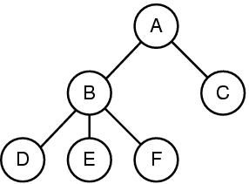
Processes
Figure 1-13. A process tree. Process A created two child processes, B and C. Process B created three child processes, D, E, and F.
Tanenbaum, Modern Operating Systems 3 e, (c) 2008 Prentice-Hall, Inc. All rights reserved. 0-13-6006639
Notes:
20

Slide 21
File System
Abstracts out the particulars of the disks and other I/O devices.
Directory: way of grouping files together which leads to a hierarchy
Path name: sequence of directories leading to location from root directory

Slide 22
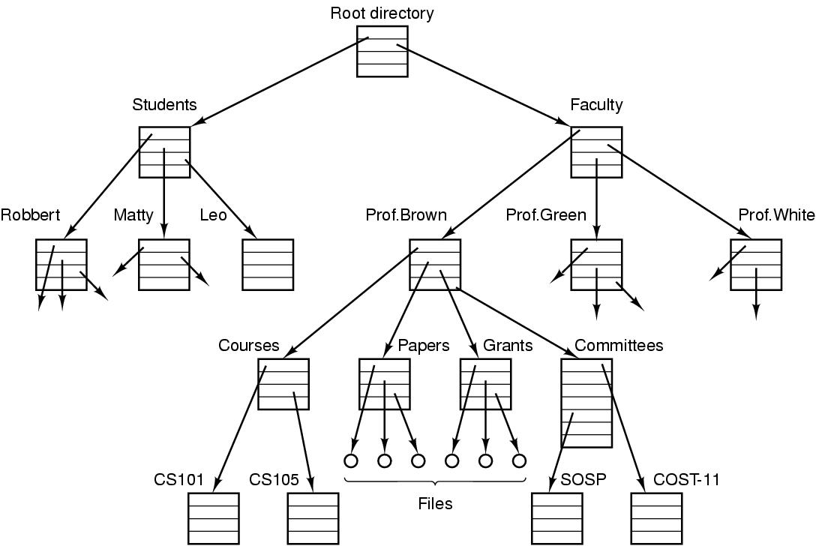
Files (1)
Figure 1-14. A file system for a university department.
Tanenbaum, Modern Operating Systems 3 e, (c) 2008 Prentice-Hall, Inc. All rights reserved. 0-13-6006639

Slide 23
File System
UNIX mounted file system: data storage in addition to the disk drive(s) gets mounted to the tree so a path can be created

Slide 24
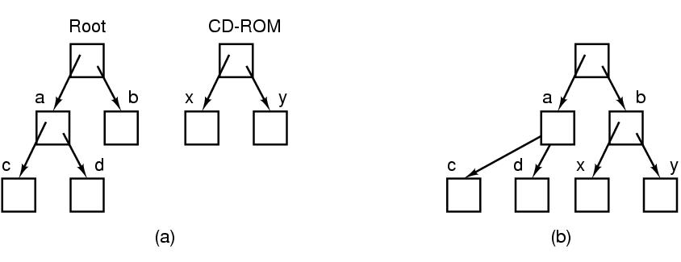
Files (2)
Figure 1-15. (a) Before mounting, the files on the CD-ROM are not accessible. (b) After mounting, they are part of the file hierarchy.
Tanenbaum, Modern Operating Systems 3 e, (c) 2008 Prentice-Hall, Inc. All rights reserved. 0-13-6006639

Slide 25
File System
When processes need to talk to each other, a pseudofile, called a pipe, is created that can be used to connect them.
Reading and writing occur from and to the pipe as if it were a file.

Slide 26
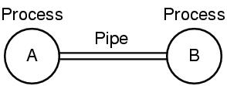
Files (3)
Figure 1-16. Two processes connected by a pipe.
Tanenbaum, Modern Operating Systems 3 e, (c) 2008 Prentice-Hall, Inc. All rights reserved. 0-13-6006639

Slide 27
Protection
Each person authorized to use the system is assigned a UID (User IDentification). Each process started has the UID of the person who started it.
Users can be members of groups, each of which has a GID (Group Identification).
Files (in UNIX) are protected by a 9-bit binary code
(rwx bits). The code consists of three 3-bit fields (owner, owner’s group, everyone else)
rwxr-x--x

Slide 28
The Shell
the shell: The UNIX command interpreter
not part of the OS but uses the OS features
prompt: where the commands are typed
shell script: program which can be run by the command interpreter

Slide 29
System Calls
Interface between user programs and the operating system
Machine dependent, expressed in assembly, vary from OS to OS
POSIX (basis for UNIX, Linux, etc.) examples

Slide 30
System Calls
If a process is running a user program in user mode and needs a system service, it must execute a “trap instruction” to transfer control to the operating system.
trap: software generated interrupt
OS inspects parameters to determine what the calling process wants, carries out the call, then returns control to the instruction following the system call.

Slide 31
System Calls
Example: read system call
3 parameters
file, buffer, number of bytes to read
pushes parameters onto stack
call to the procedure
initiate trap instruction
switch from user to kernel mode
dispatches to correct system-call handler, which runs
return to user mode
cleans up stack

Slide 32
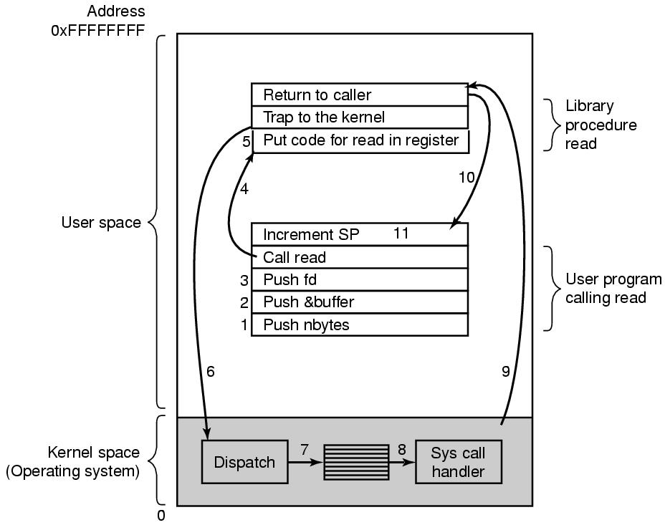
System Calls
Figure 1-17. The 11 steps in making the system call read(fd, buffer, nbytes).
Tanenbaum, Modern Operating Systems 3 e, (c) 2008 Prentice-Hall, Inc. All rights reserved. 0-13-6006639

Slide 33
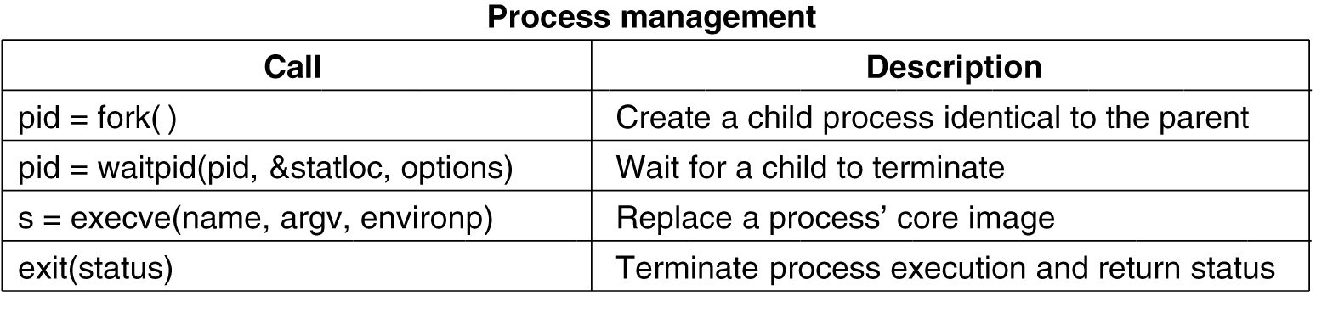
System Calls for Process Management
Figure 1-18. Some of the major POSIX system calls.
Tanenbaum, Modern Operating Systems 3 e, (c) 2008 Prentice-Hall, Inc. All rights reserved. 0-13-6006639

Slide 34
System Calls for File Management (1)
Figure 1-18. Some of the major POSIX system calls.
Tanenbaum, Modern Operating Systems 3 e, (c) 2008 Prentice-Hall, Inc. All rights reserved. 0-13-6006639

Slide 35
System Calls for File Management (2)
Figure 1-18. Some of the major POSIX system calls.
Tanenbaum, Modern Operating Systems 3 e, (c) 2008 Prentice-Hall, Inc. All rights reserved. 0-13-6006639

Slide 36
Miscellaneous System Calls
Figure 1-18. Some of the major POSIX system calls.
Tanenbaum, Modern Operating Systems 3 e, (c) 2008 Prentice-Hall, Inc. All rights reserved. 0-13-6006639

Slide 37
A Simple Shell
Figure 1-19. A stripped-down shell.
Tanenbaum, Modern Operating Systems 3 e, (c) 2008 Prentice-Hall, Inc. All rights reserved. 0-13-6006639

Slide 38
Next Class
Introduction
Modern Operating Systems:
Chapter 1

