Slide 1
CS 446
Erin Keith

Slide 2
MODERN OPERATING SYSTEMS Third Edition ANDREW S. TANENBAUM Chapter 1 Introduction
Tanenbaum, Modern Operating Systems 3 e, (c) 2008 Prentice-Hall, Inc. All rights reserved. 0-13-6006639
Notes:
2

Slide 3
Topics
The world according to C
Operating System Structure

Slide 4
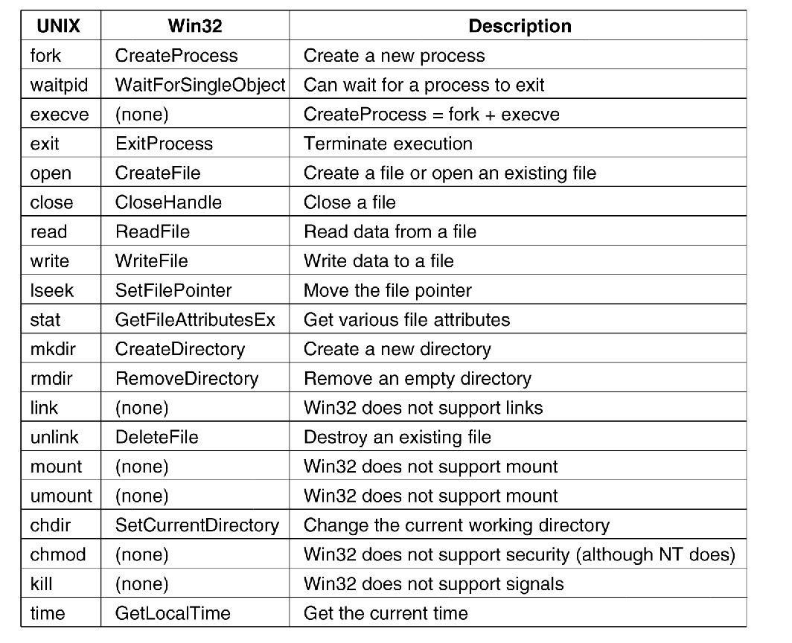
Windows Win32 API
Figure 1-23. The Win32 API calls that roughly correspond to the UNIX calls of Fig. 1-18.
Tanenbaum, Modern Operating Systems 3 e, (c) 2008 Prentice-Hall, Inc. All rights reserved. 0-13-6006639

Slide 5
A Simple Shell
Figure 1-19. A stripped-down shell.
Tanenbaum, Modern Operating Systems 3 e, (c) 2008 Prentice-Hall, Inc. All rights reserved. 0-13-6006639

Slide 6
The World According to C
The C language
Header files
Large programming projects
Tanenbaum, Modern Operating Systems 3 e, (c) 2008 Prentice-Hall, Inc. All rights reserved. 0-13-6006639

Slide 7
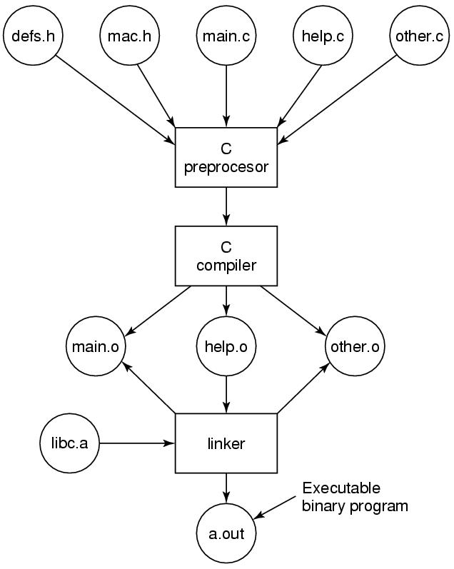
The Model of Run Time
Figure 1-30. The process of compiling C and header files to make an executable.
Tanenbaum, Modern Operating Systems 3 e, (c) 2008 Prentice-Hall, Inc. All rights reserved. 0-13-6006639

Slide 8
Monolithic Systems (1)
Basic structure of OS
A main program that invokes the requested service procedure.
A set of service procedures that carry out the system calls.
A set of utility procedures that help the service procedures.

Slide 9
Monolithic Systems
Pro
con
Flexible (procedures call other procedures)
Modular (1 to 1 service procedure to system call)
Fragile (if a procedure breaks)
No encapsulation (information hiding)
Huge! (thousands of procedures)

Slide 10
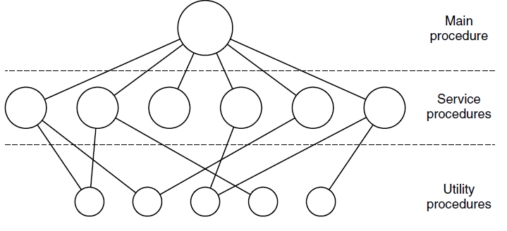
Monolithic Systems (2)
Figure 1-24. A simple structuring model for a monolithic system.

Slide 11
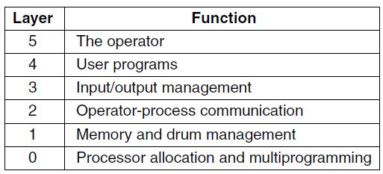
Layered Systems
Figure 1-25. Structure of the THE operating system.

Slide 12
Layered Systems
Pro
con
Flexible (procedures call other procedures)
Modular (1 to 1 service procedure to system call)
Robust (protect layers)
No encapsulation (information hiding)
Huge! (thousands of procedures)

Slide 13
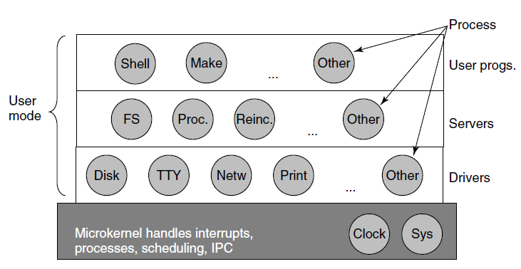
Microkernels
Figure 1-26. Simplified structure of the
MINIX 3 system.

Slide 14
Microkernels
Pro
con
Increased modularity (run as different processes)
Reliability (bugs in different modules don’t break entire system)
Inter-process communication is slower

Slide 15
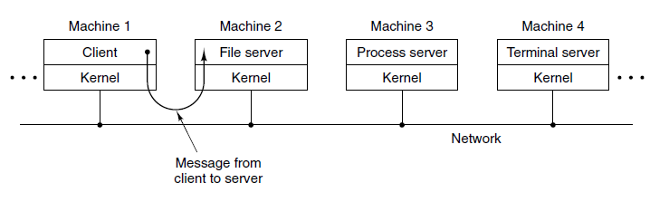
Client-Server Model
Figure 1-27. The client-server model over a network.

Slide 16
Client-Server
Pro
con
Can be used for single or networked machines
Inter-process communication is slower

Slide 17
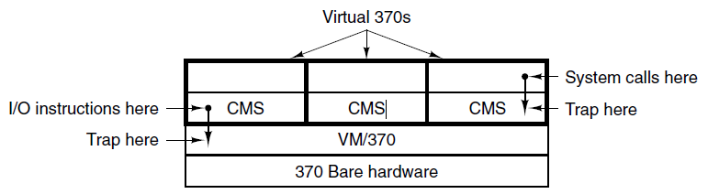
Virtual Machines
Figure 1-28. The structure of VM/370 with CMS.

Slide 18
Virtual Machines
Pro
con
Can run different servers on same machine
Can run different OS on same machine
Web hosting
CPU must be virtualizable

Slide 19
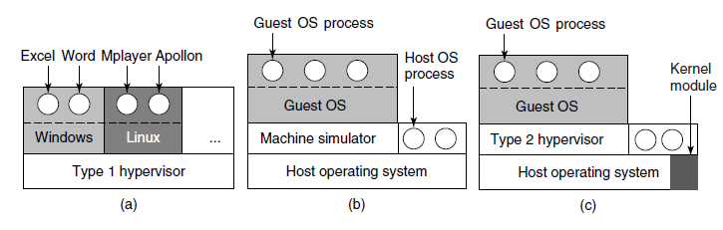
Virtual Machines Rediscovered
Figure 1-29. (a) A type 1 hypervisor. (b) A pure type 2 hypervisor. (c) A practical type 2 hypervisor.

Slide 20
Discussion
There are several design goals in building an operating system, for example, resource utilization, timeliness, robustness, etc.
Give an example of two design goals that may contradict one another.

Slide 21
Next Class
Processes and Threads
Modern Operating Systems:
Chapter 2

