Slide 1
CS 446
Erin Keith

Slide 2
Processes and Threads
Chapter 2

Slide 3
Topics
Processes
Threads

Slide 4
Process
An abstraction of a running program
An instance of an executing program, including the current values of the program counter, registers, and variables

Slide 5
Multiprogramming
CPU switches back and forth from process to process
(so fast that it’s easier to think of them running in parallel)
The rate at which a process performs its computation will not be uniform and probably not even reproducible if the same processes run again.

Slide 6
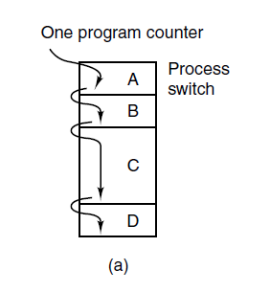
The Process Model (1)
Figure 2-1. (a) Multiprogramming of four programs.

Slide 7
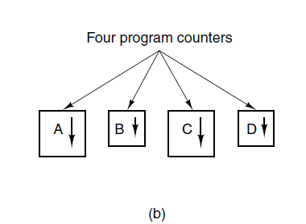
The Process Model (2)
Figure 2-1. (b) Conceptual model of
four independent, sequential processes.

Slide 8
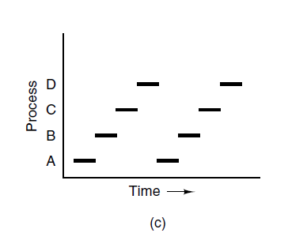
The Process Model (3)
Figure 2-1. (c) Only one program is active at once.

Slide 9
Process Creation
Four principal events that cause processes to be created:
System initialization.
Execution of a process creation system call by a running process.
A user request to create a new process.
Initiation of a batch job.

Slide 10
Process Creation
daemons: processes that stay in the background to handle some activity
email
Web pages
printing

Slide 11
Process Creation
fork: system call to create new process. Creates an exact clone of the calling process (same memory image, same environment strings, same open files)
Example:
User types sort into shell
Shell forks child process
Child process uses execve to change its memory image
Execute the sort system call

Slide 12
Process Termination
Typical conditions which terminate a process:
Normal exit (voluntary).
Error exit (voluntary).
Fatal error (involuntary).
Killed by another process (involuntary).

Slide 13
Process Hierarchy
In Unix a process and all its children (and further descendants) form a process group.
Example:
Special process, called init, starts after booting
Forks new processes for each necessary terminal
If successful login, login process executes a shell
And so on creating a tree with init process at the root

Slide 14
Process States (1)
Three states a process may be in:
Running (actually using the CPU at that instant).
Ready (runnable; temporarily stopped to let another process run).
Blocked (unable to run until some external event happens).

Slide 15
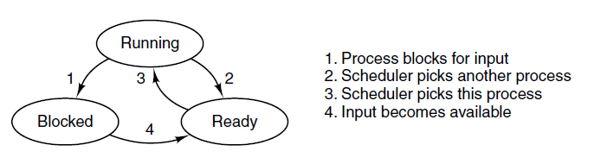
Process States (2)
Figure 2-2. A process can be in running, blocked, or ready state. Transitions between these states are as shown.

Slide 16
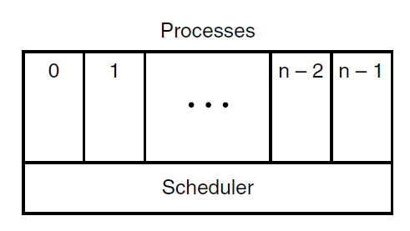
Process States (3)
Figure 2-3. The lowest layer of a process-structured operating system handles interrupts and scheduling. Above that layer are sequential processes.

Slide 17
Process Table
An array of structs comprising a table with one entry per process containing
program counter
stack pointer
memory allocation
status of open files
accounting and scheduling info
anything else

Slide 18
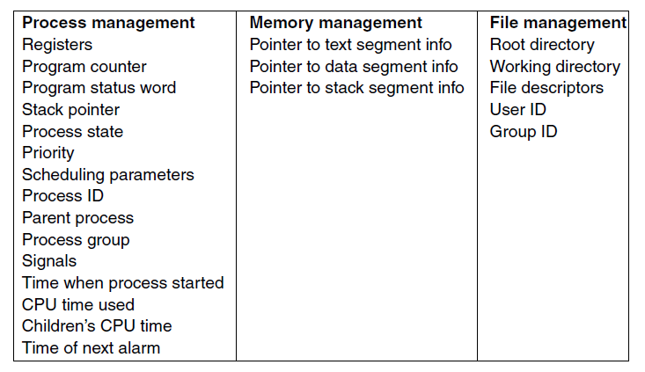
Implementation of Processes (1)
Figure 2-4. Some of the fields of a typical process table entry.

Slide 19
Interrupts
Interrupt vector: each I/O class has a location (usually near the bottom of memory) containing the address of the interrupt service procedure

Slide 20
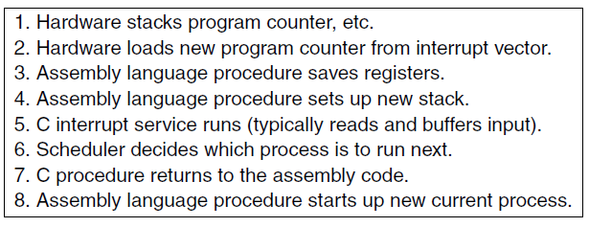
Implementation of Processes (2)
Figure 2-5. Skeleton of what the lowest level of the operating system does when an interrupt occurs.

Slide 21
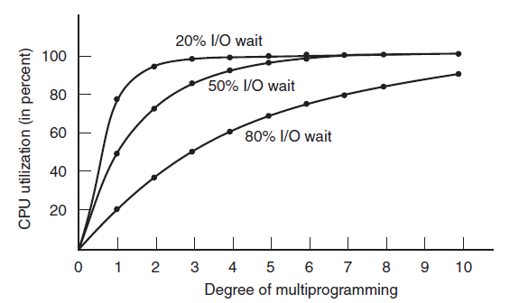

Modeling Multiprogramming
Figure 2-6. CPU utilization as a function of the number of processes in memory.

Slide 22
Thread
Each process has an address space and a single thread of control.
Sometimes it is desirable to have multiple threads (miniprocesses) of control running in quasi-parallel as if they were separate processes sharing the same address space.

Slide 23
Thread
Benefits:
Abstraction
Easier/faster to create and destroy
Performance gain when much I/O
Multiple CPUs

Slide 24
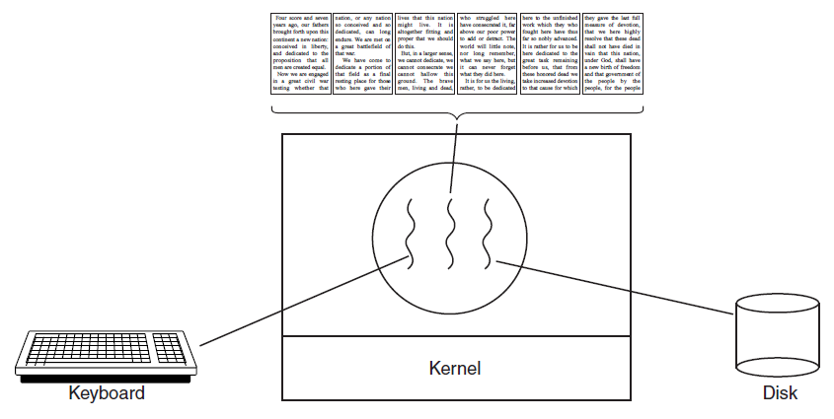
Thread Usage (1)
Figure 2-7. A word processor with three threads.

Slide 25
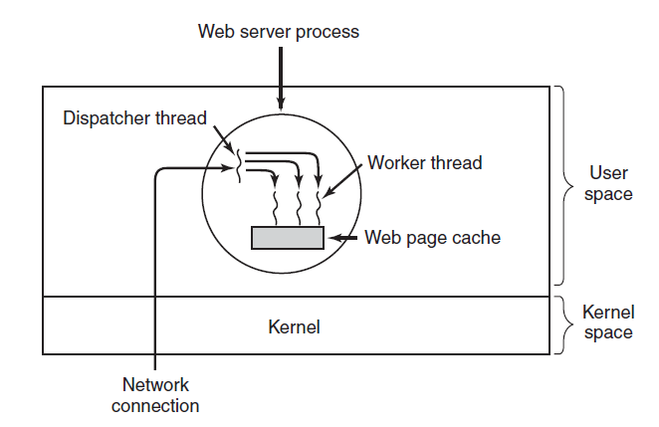
Thread Usage (2)
Figure 2-8. A multithreaded Web server.

Slide 26
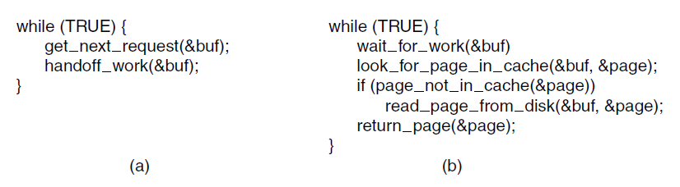
Thread Usage (3)
Figure 2-9. A rough outline of the code for Fig. 2-8. (a) Dispatcher thread. (b) Worker thread.

Slide 27
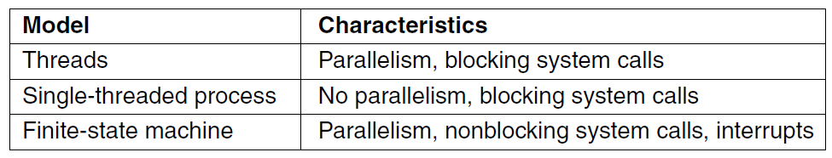
Thread Usage (4)
Figure 2-10. Three ways to construct a server.

Slide 28
The Classical Thread Model
group related resources together in a process
address space
open files
child processes
thread of execution
program counter
registers
stack

Slide 29
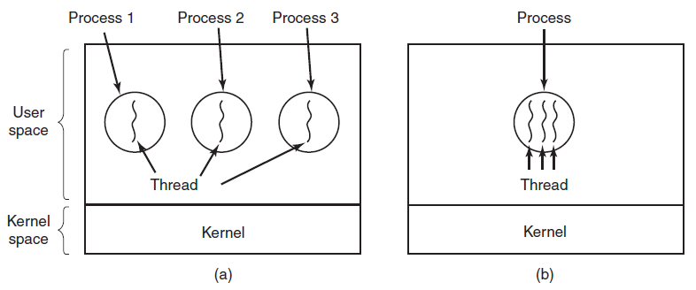
The Classical Thread Model (1)
Figure 2-11. (a) Three processes each with one thread. (b) One process with three threads.

Slide 30
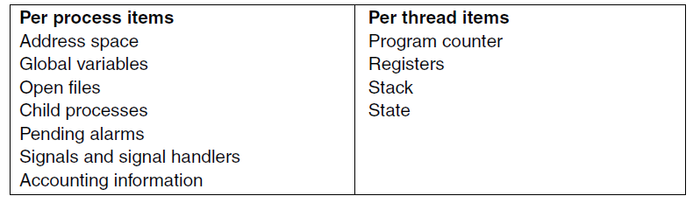
The Classical Thread Model (2)
Figure 2-12. The first column lists some items shared by all threads in a process. The second one lists some items private to each thread.

Slide 31
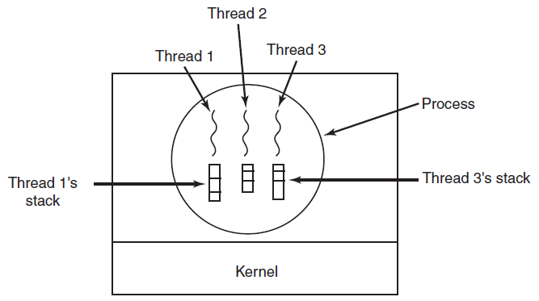
The Classical Thread Model (3)
Figure 2-13. Each thread has its own stack.

Slide 32
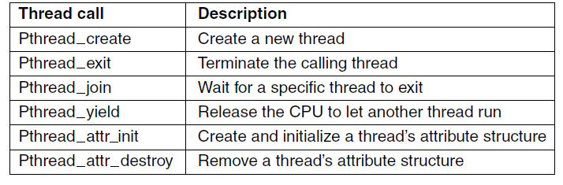
POSIX Threads (1)
Figure 2-14. Some of the Pthreads function calls.

Slide 33
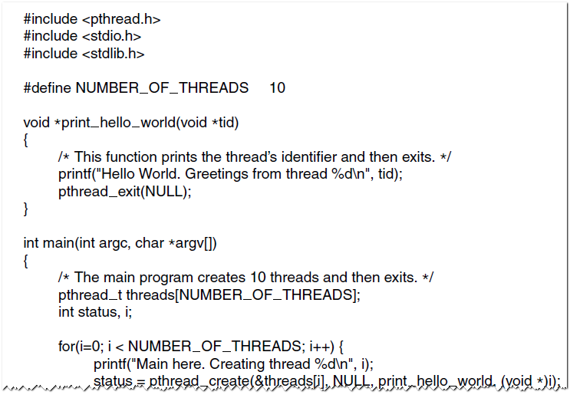
POSIX Threads (2)
Figure 2-15. An example program using threads.

Slide 34
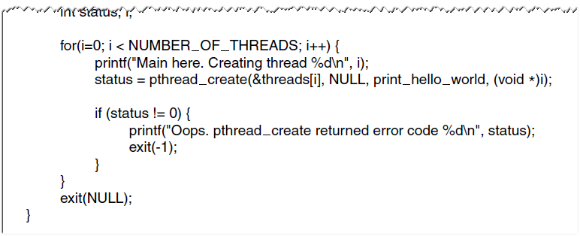
POSIX Threads (3)
Figure 2-15. An example program using threads.

Slide 35
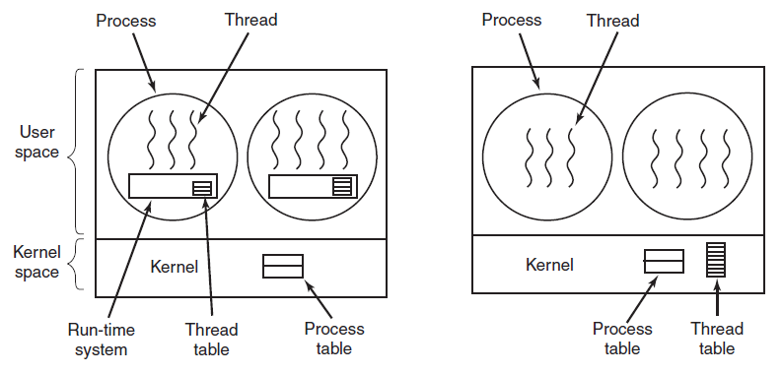
Implementing Threads in User Space
(a)
(b)
Figure 2-16. (a) A user-level threads package. (b) A threads package managed by the kernel.

Slide 36
Thread Implementation
User space
kernel space
No need for kernel call when thread_yield
No trap needed
Scale better
Blocking system calls
Scheduling
More flexible scheduling
Greater cost -> recycling

Slide 37
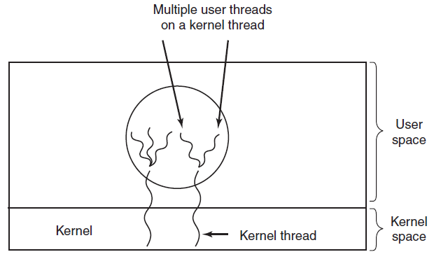
Hybrid Implementations
Figure 2-17. Multiplexing user-level threads onto kernel-level threads.

Slide 38
Next Class
Processes and Threads
Modern Operating Systems:
Chapter 2

