Slide 1
CS 446
Erin Keith

Slide 2
Processes and Threads
Chapter 2

Slide 3
Topics
Interprocess Communication

Slide 4
Interprocess Communication
Processes need to share information with each other.
Processes (or threads) should not compete with each other.
Processes (or threads) may be dependent on a certain sequence.

Slide 5
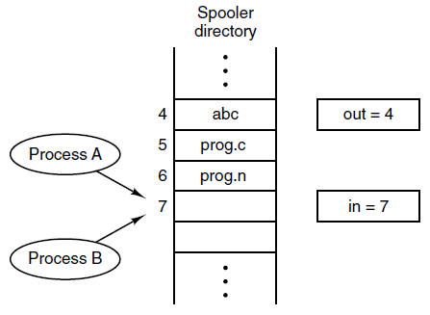
Race Conditions
Figure 2-21. Two processes want to access shared memory at the same time.

Slide 6
Critical Region
That part of the program where the shared files or memory is accessed.

Slide 7
Critical Regions (1)
Requirements to avoid race conditions:
No two processes may be simultaneously inside their critical regions.
No assumptions may be made about speeds or the number of CPUs.
No process running outside its critical region may block other processes.
No process should have to wait forever to enter its critical region.

Slide 8
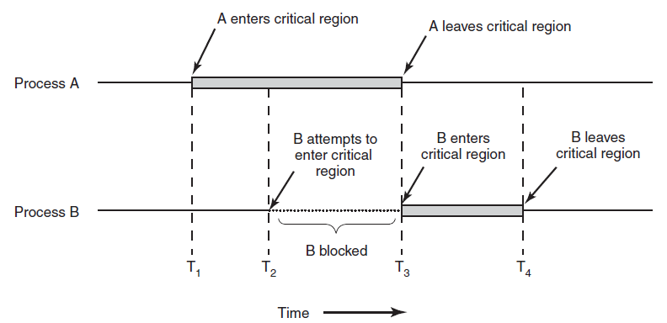
Critical Regions (2)
Figure 2-22. Mutual exclusion using critical regions.

Slide 9
Mutual Exclusion with Busy Waiting
Disabling Interrupts
User: with great power comes great responsibility
Kernel: can do on a few
Lock Variables
process switch variable between 1 and 0
same problem!

Slide 10
Mutual Exclusion with Busy Waiting
Strict Alternation
taking turns
what if one is faster?
Busy waiting – continuously testing a variable until some value appears

Slide 11
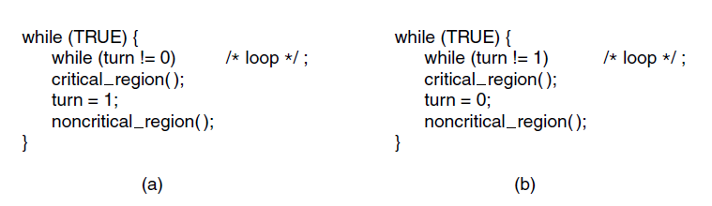
Mutual Exclusion with Busy Waiting: Strict Alternation
Figure 2-23. A proposed solution to the critical region problem. (a) Process 0. (b) Process 1. In both cases, be sure to note the semicolons terminating the while statements.

Slide 12
Mutual Exclusion with Busy Waiting
Peterson’s solution
create a “waiting room”

Slide 13
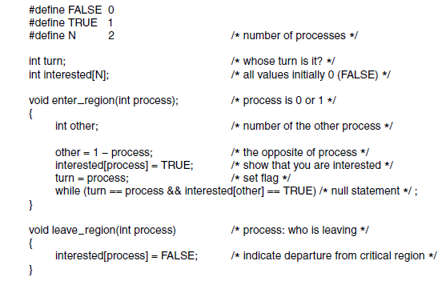
Mutual Exclusion with Busy Waiting: Peterson’s Solution
Figure 2-24. Peterson’s solution for achieving mutual exclusion.

Slide 14
Mutual Exclusion with Busy Waiting
The TSL Instruction
hardware help
“test and set lock”
read lock register, then store in it
indivisible
memory bus lock

Slide 15
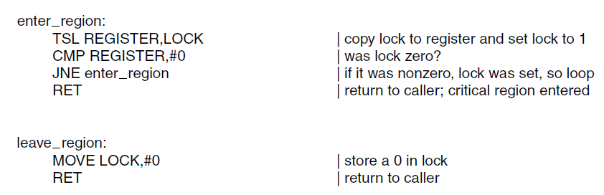
Mutual Exclusion with Busy Waiting: The TSL Instruction (1)
Figure 2-25. Entering and leaving a critical region using the TSL instruction.

Slide 16
Mutual Exclusion with Busy Waiting
Wastes CPU cycles
Process priority can cause unexpected behavior

Slide 17
Mutual Exclusion with Sleep and Wakeup
Producer-Consumer Problem
processes share buffer
producer puts info into buffer
consumer(s) take info out
producer sleeps if buffer full
consumer sleeps if buffer empty
each wakes the other appropriately
could get lost

Slide 18
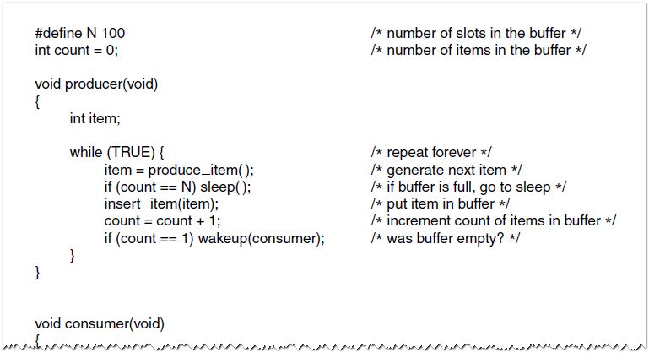
Sleep and Wakeup The Producer-Consumer Problem (1)
Figure 2-27. The producer-consumer problem with a fatal race condition.

Slide 19
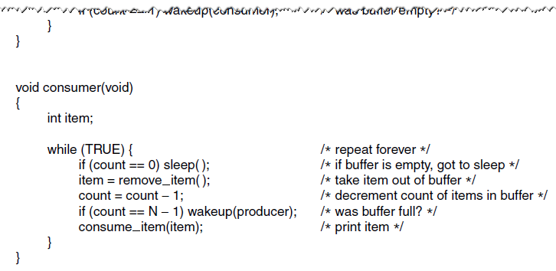
Sleep and Wakeup The Producer-Consumer Problem (2)
Figure 2-27. The producer-consumer problem with a fatal race condition.

Slide 20
Mutual Exclusion with Semaphores
shared variable to count the number of wakeups saved for future use
up and down operations
check, change, (maybe) sleep
atomic actions
group of actions performed together or not at all
system calls

Slide 21
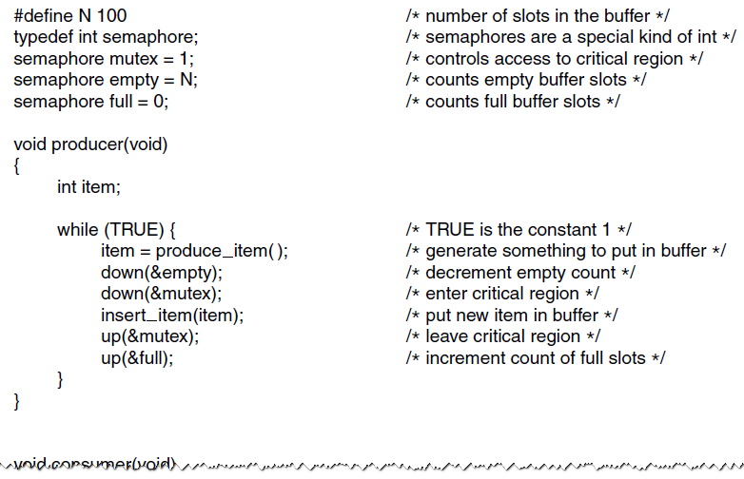
Semaphores (1)
Figure 2-28. The producer-consumer problem using semaphores.

Slide 22
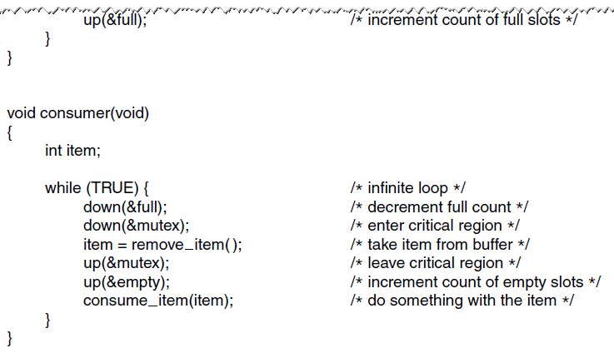
Semaphores (2)
Figure 2-28. The producer-consumer problem using semaphores.

Slide 23
Mutual Exclusion with Mutexes
shared variable for unlocked vs locked
Futexes
fast user space mutex
not in kernel space
Pthreads
mutexes
condition variables
allow threads to block due to some condition not being met

Slide 24
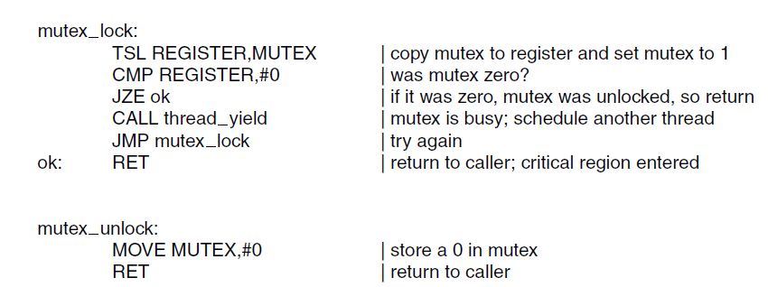
Mutexes
Figure 2-29. Implementation of mutex_lock and mutex_unlock.

Slide 25
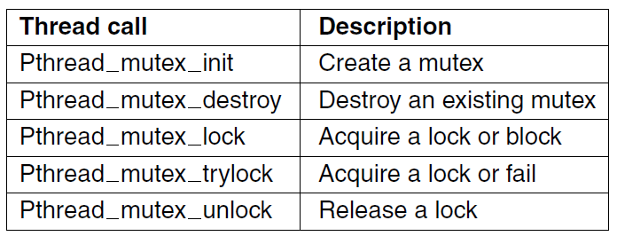
Mutexes in Pthreads (1)
Figure 2-30. Some of the Pthreads calls relating to mutexes.

Slide 26
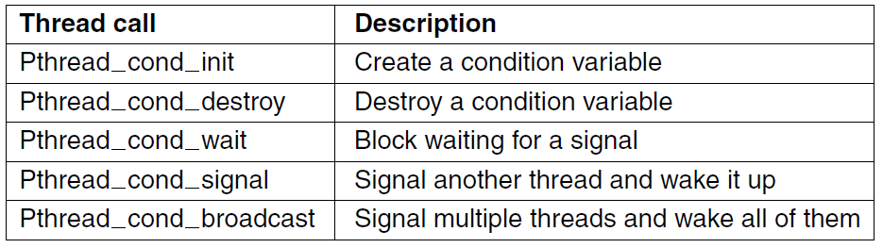
Mutexes in Pthreads (2)
Figure 2-31. Some of the Pthreads calls relating to condition variables.

Slide 27
Mutual Exclusion with Monitors
Mutexes and Semaphores: order matters
collection of procedures, variables, and data structures that are all grouped together in a special kind of module or package
processes may call procedures but not access internal data structures
programming language constructs
compiler arranges for mutual exclusion

Slide 28
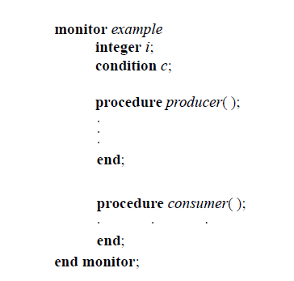
Monitors (1)
Figure 2-33. A monitor.

Slide 29
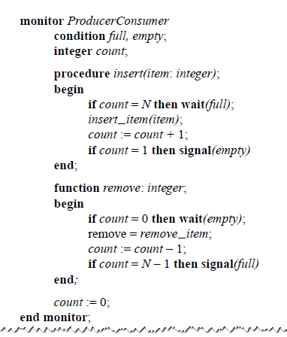
Monitors (2)
Figure 2-34. An outline of the producer-consumer problem with monitors. Only one monitor procedure at a time is active. The buffer has N slots.

Slide 30
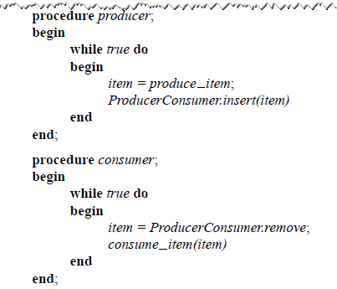
Monitors (3)
Figure 2-34. An outline of the producer-consumer problem with monitors. Only one monitor procedure at a time is active. The buffer has N slots.

Slide 31
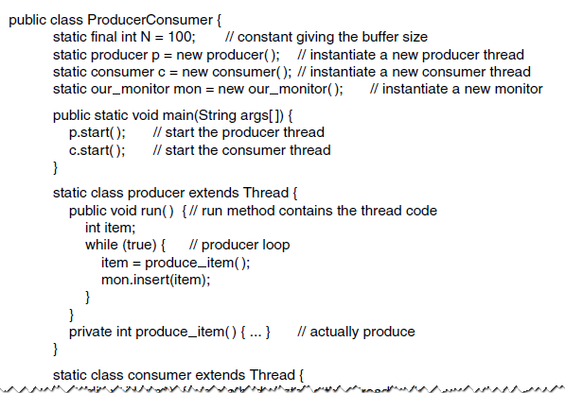
Monitors (4)
Figure 2-35. A solution to the producer-consumer problem in Java.

Slide 32
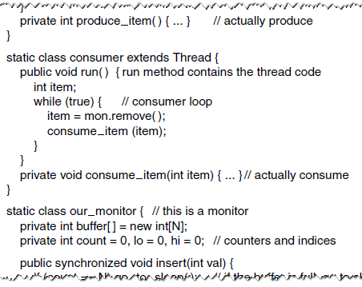
Monitors (5)
Figure 2-35. A solution to the producer-consumer problem in Java.

Slide 33
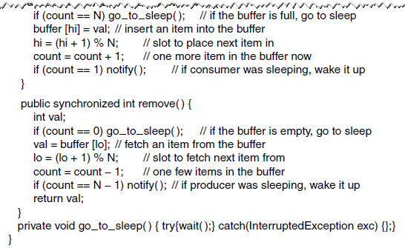
Monitors (6)
Figure 2-35. A solution to the producer-consumer problem in Java.

Slide 34
Mutual Exclusion with Message Passing
send and receive are system calls
network loss
authentication

Slide 35
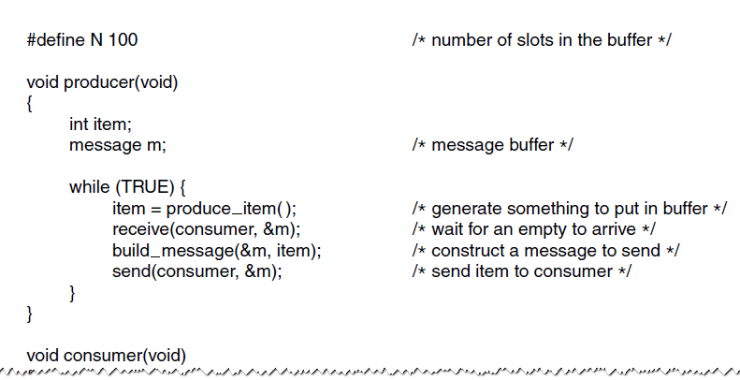
The Producer-Consumer Problem with Message Passing (1)
Figure 2-36. The producer-consumer problem with N messages.

Slide 36
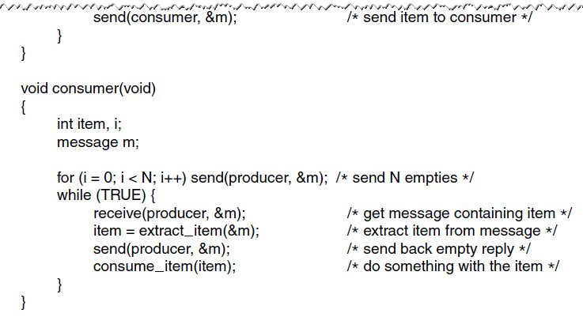
The Producer-Consumer Problem with Message Passing (2)
Figure 2-36. The producer-consumer problem with N messages.

Slide 37
Mutual Exclusion with Barriers
groups of processes
blocks finished processes until all processes finish

Slide 38
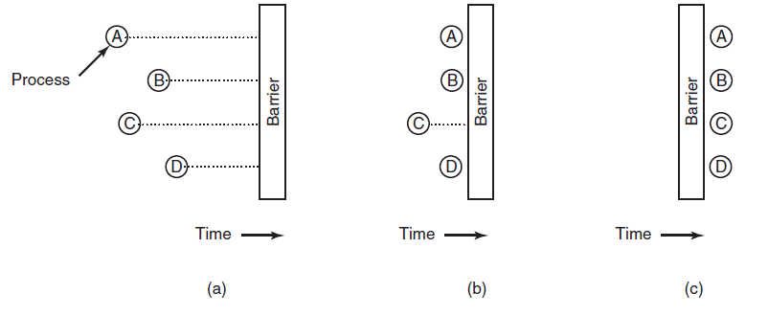
Barriers
Figure 2-37. Use of a barrier. (a) Processes approaching a barrier. (b) All processes but one blocked at the barrier. (c) When the last process arrives at the barrier, all of them are let through.

Slide 39
Mutual Exclusion with Avoiding Locks
minimize control to old or new data, just nothing in between
read, copy, update

Slide 40
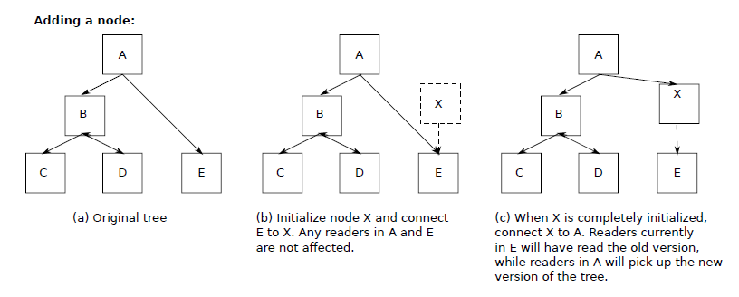
Avoiding Locks: Read-Copy-Update (1)
Figure 2-38. Read-Copy-Update: inserting a node in the tree and then removing a branch—all without locks

Slide 41
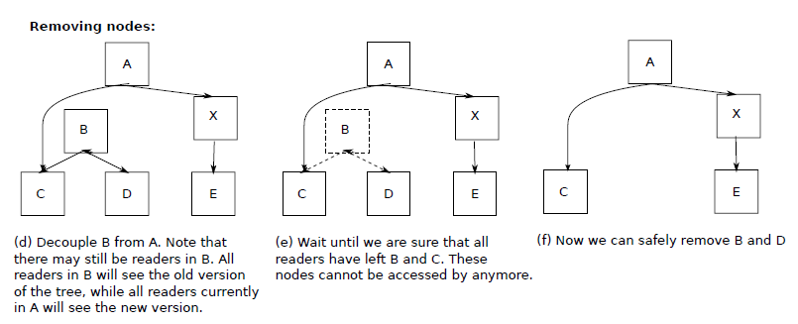
Avoiding Locks: Read-Copy-Update (2)
Figure 2-38. Read-Copy-Update: inserting a node in the tree and then removing a branch—all without locks

Slide 42
Next Class
Processes and Threads
Modern Operating Systems:
Chapter 2
Scheduling

